Slide 1

Team 13
Control a Relay Module and a 7-Segment Display using ESP32 with Micropython
Code
Hardware
Components
Video
Project
Installation
Microprocessor Final Project

Slide 2
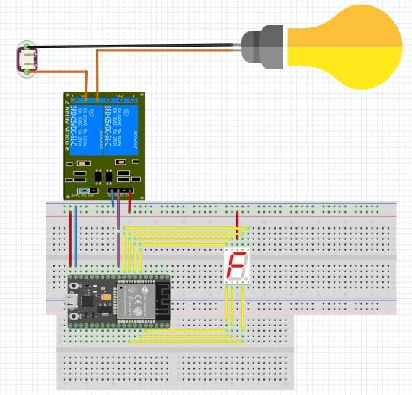
The Project Concept
Using a relay Module to control AC household loads remotely. The relay itself will be controlled by an ESP32 Chip which will be controlled using a micropython code. The relay will control a lightbulb. We also use the esp-32 to control a seven-segment display. All by using a web server html will enable us to control this entire circuit remotely. Using a smart phone or a laptop with the application on it. We will be able to turn the light on and off. The seven-segment display will be decremented and incremented.
Code
Hardware
Installation
Components
Video
Project

Slide 3
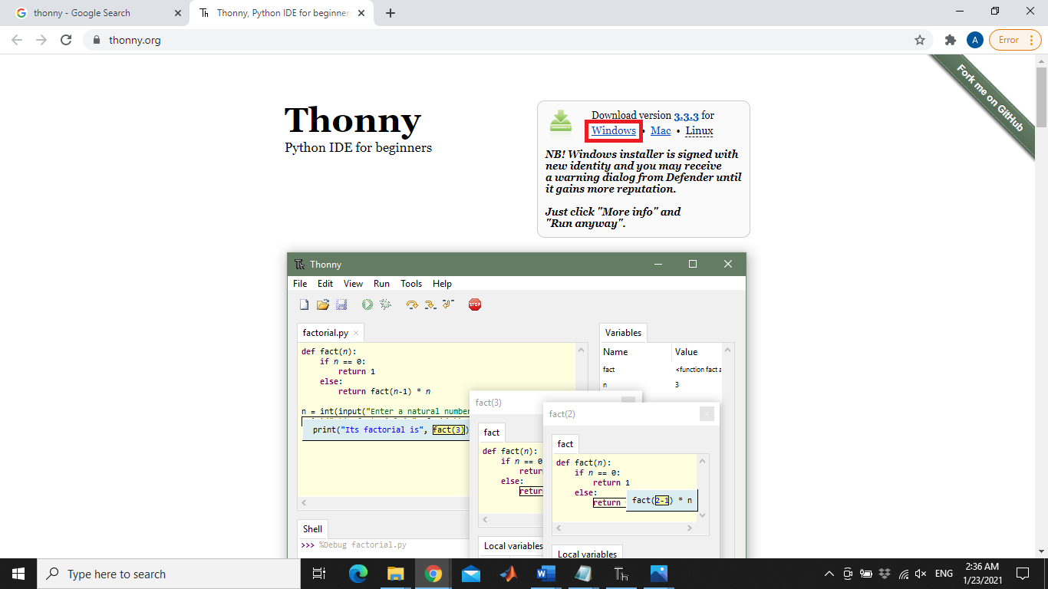
Install Thonny
Code
Project
Hardware
Components
Video
Installation

Slide 4
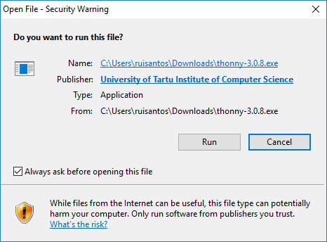
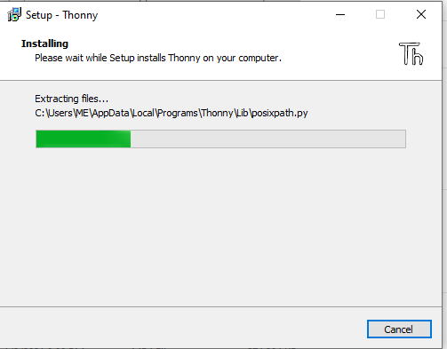
Install Thonny
Code
Project
Hardware
Components
Video
Installation

Slide 5
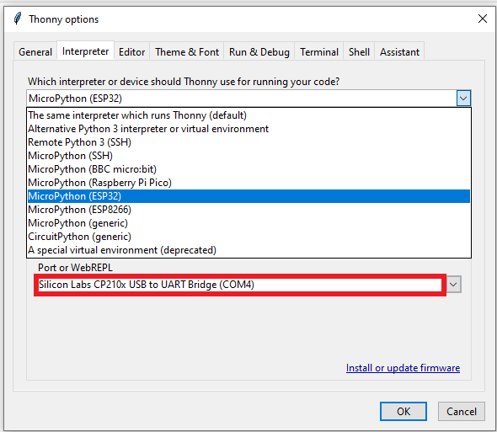
Install Thonny
Code
Project
Hardware
Components
Video
Installation
Installation

Slide 6
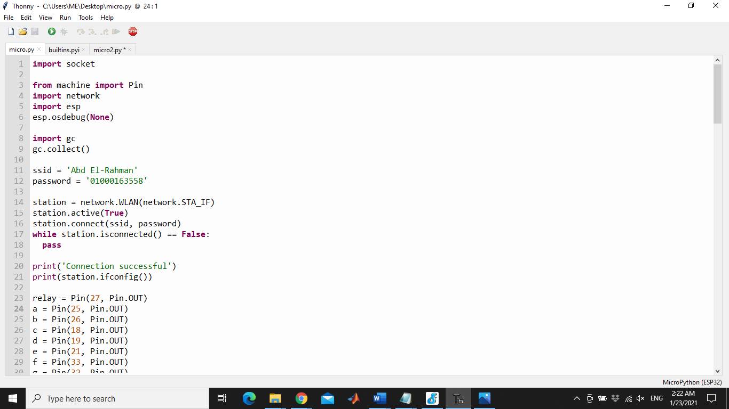
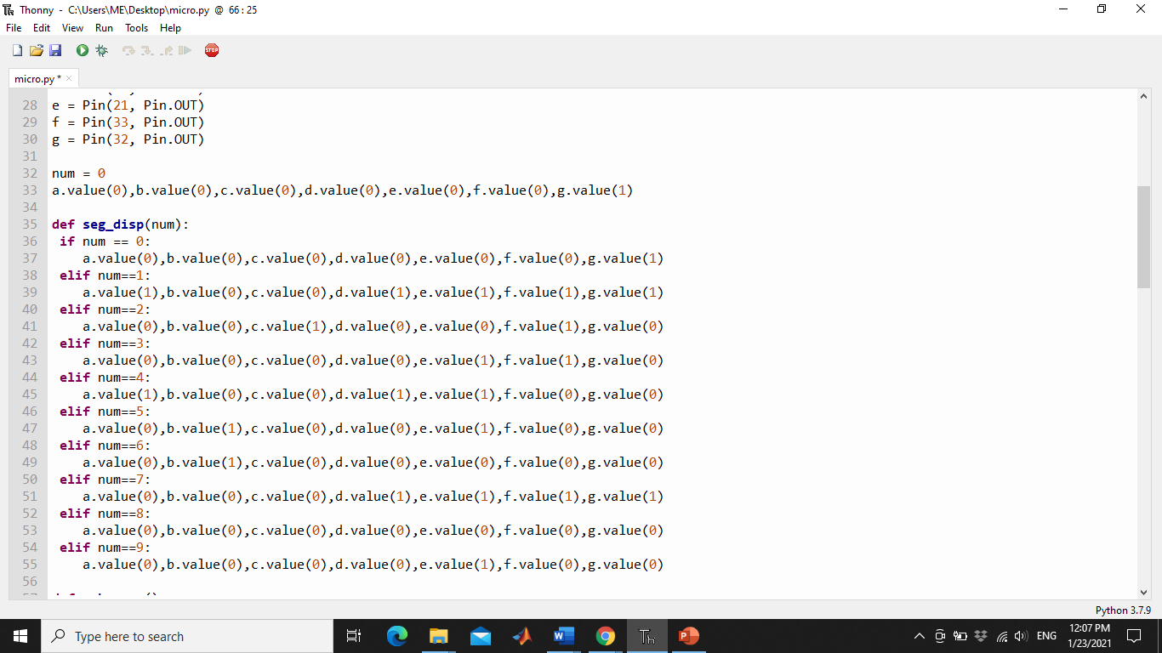
Micropython code
Components
Project
Hardware
Installation
Video
Code

Slide 7
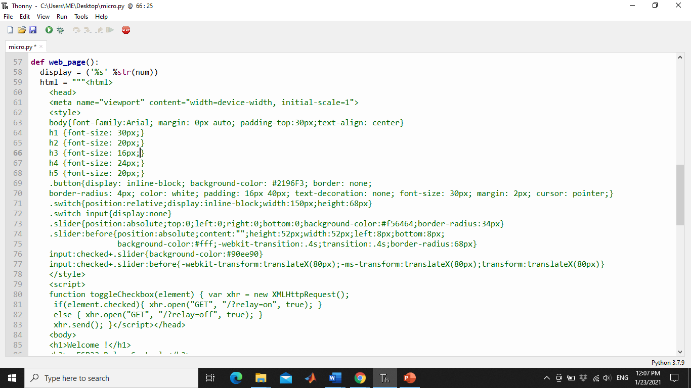
Micropython code
Project
Installation
Hardware
Code
Components
Video

Slide 8
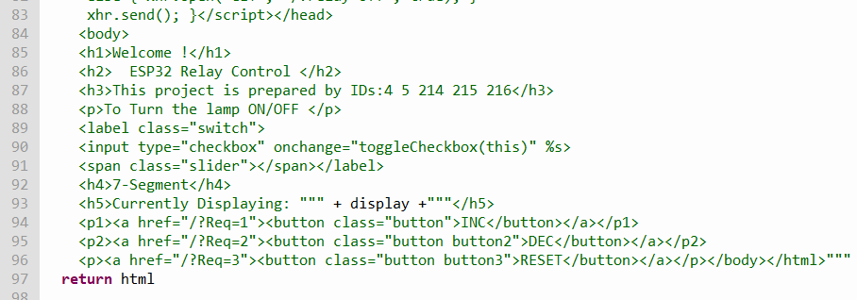
Micropython code
Hardware
Code
Components
Video
Project
Installation

Slide 9
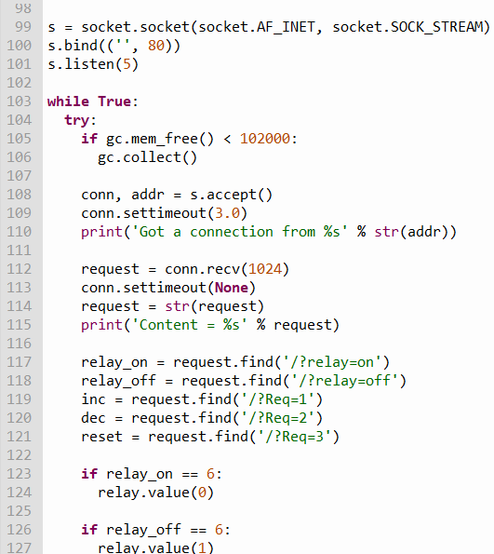
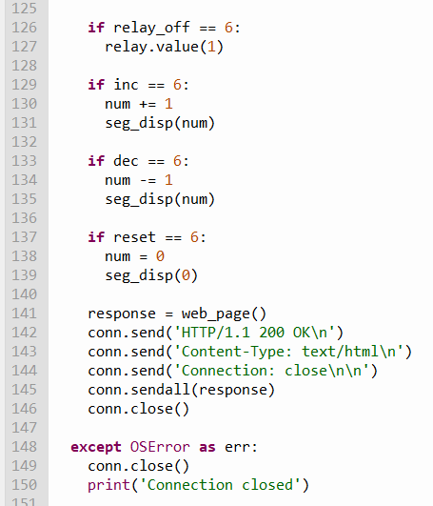
Micropython code
Hardware
Code
Components
Video
Project
Installation

Slide 10
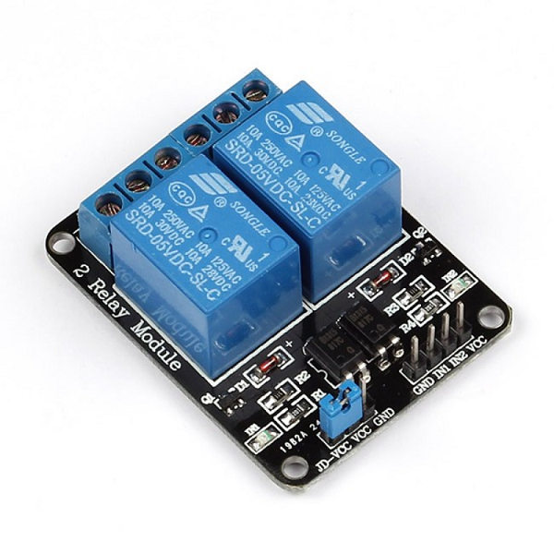
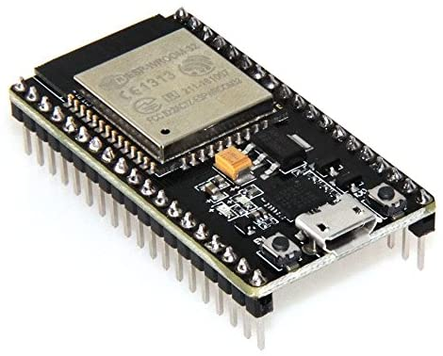
Components
A Two channel relay module
a Lightbulb
seven-segment display.
ESP32 Chip that is controls the relay through a micropython code and a web server application.
Jumper wires
Hardware
Code
Video
Project
Installation

Slide 11
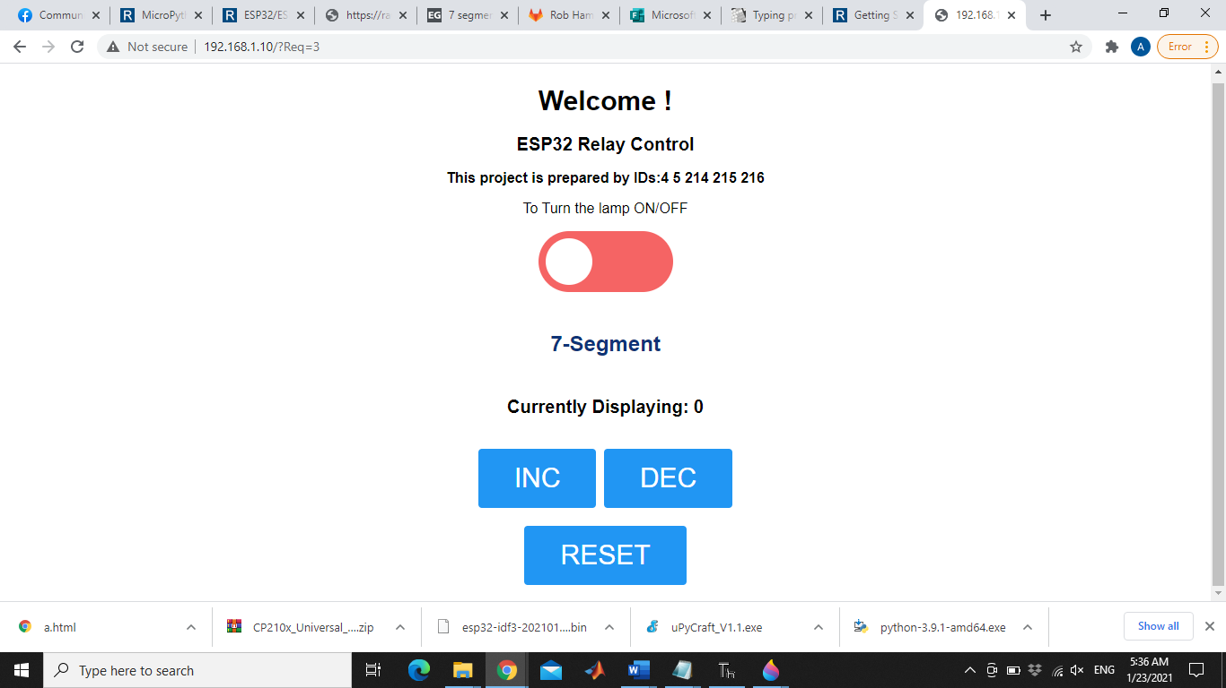
Hardware Workings of the project
The ESP32 is controlled through a Micropython code and a HTML code. The chip is programmed to output a 3.3V on the 26th pin. This pin is connected to a relay module that switches between the lamp and the Seven segment display. Using the web application, we get the following figure displayed on a laptop or a mobile screen. The first switch turns the lamp on or off. The seven-segment display starts at zero. The inc button increments it and the dec button decrements. The reset button resets back to display zero.
Code
Hardware
Video
Components
Project
Installation

Slide 12
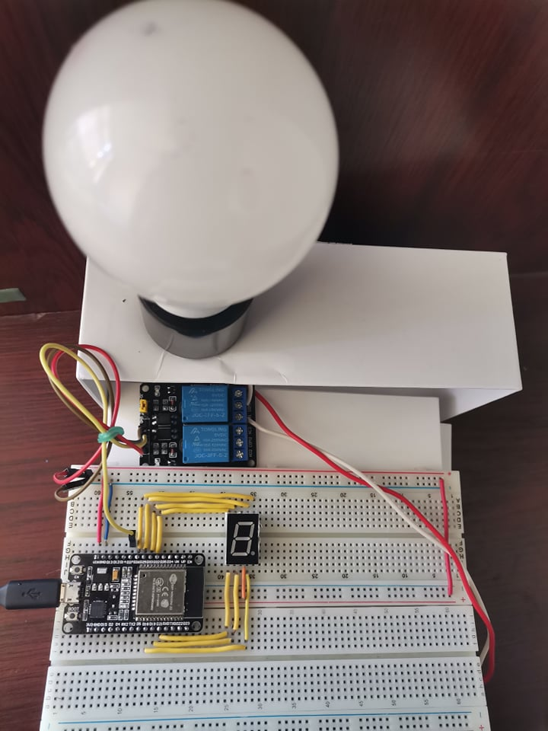
Code
Hardware
Video
Components
Project
Installation

Slide 13
Thank You
Name | ID
Alaa Mohammed Morsy | 4
Alaa Hisham Mostafa | 5
Mariam Said Gaber Ibrahim | 214
Mariam Sayed Abdelhakem | 215
Mariam Amr Abdelhamied Bakr | 216

