Slide 2
CDC Diabetes Health Indicators Data
Introduce the data set and its covariates (predictors). Use the following link for more info:https://archive.ics.uci.edu/dataset/891/cdc+diabetes+health+indicators

Slide 3
Exploratory Data Analyses (EDA)
The data set contains 21 covariates and 253680 cases
3 numeric covariates
18 categorical covariates
There is no missing, duplicated, or extreme values
Binary outcome (Diabetes/No diabetes), Classification
Number of those with diabetes = 35,346 , Proportion (Diabetes) = 14 %
Imbalanced class -> Down sampling was applied and now (35,346 each)

Slide 4
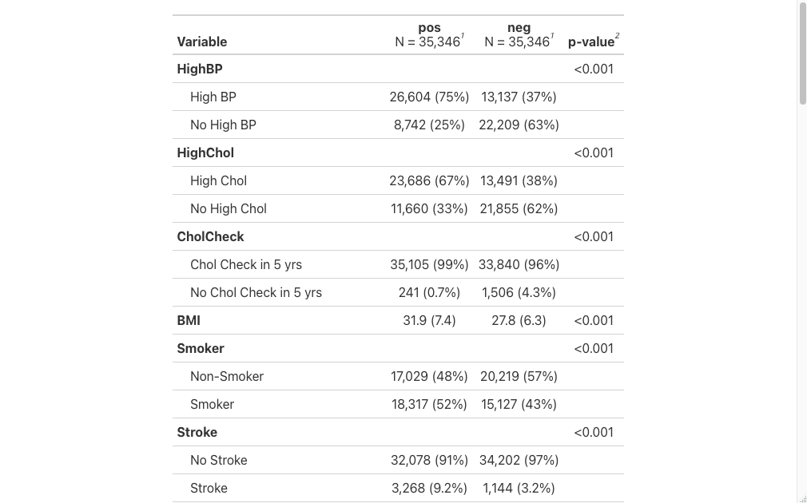
Summary Table and Variable Selection

Slide 5
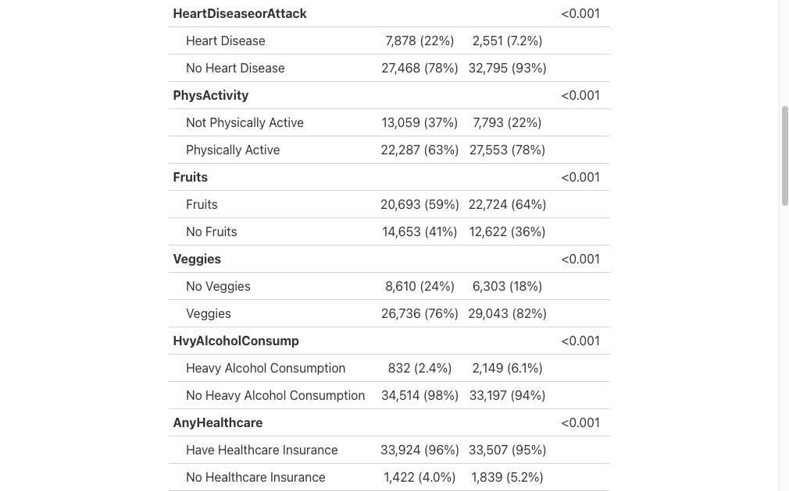

Slide 6
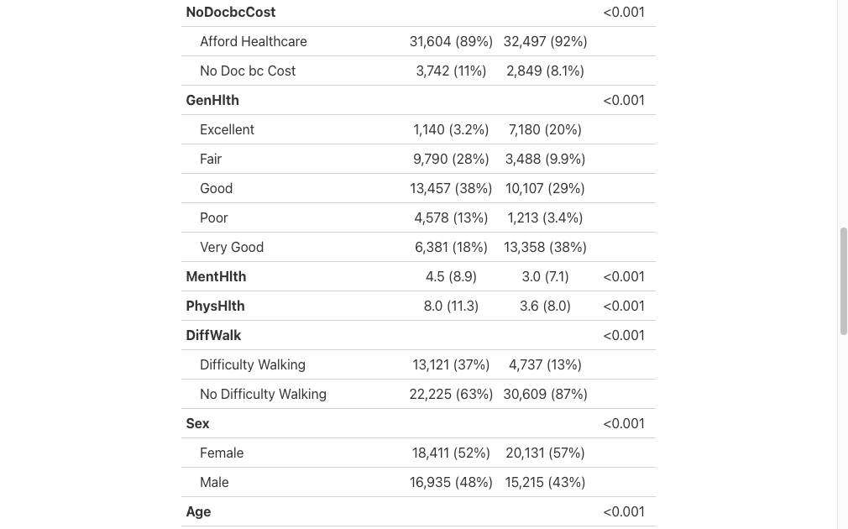

Slide 7
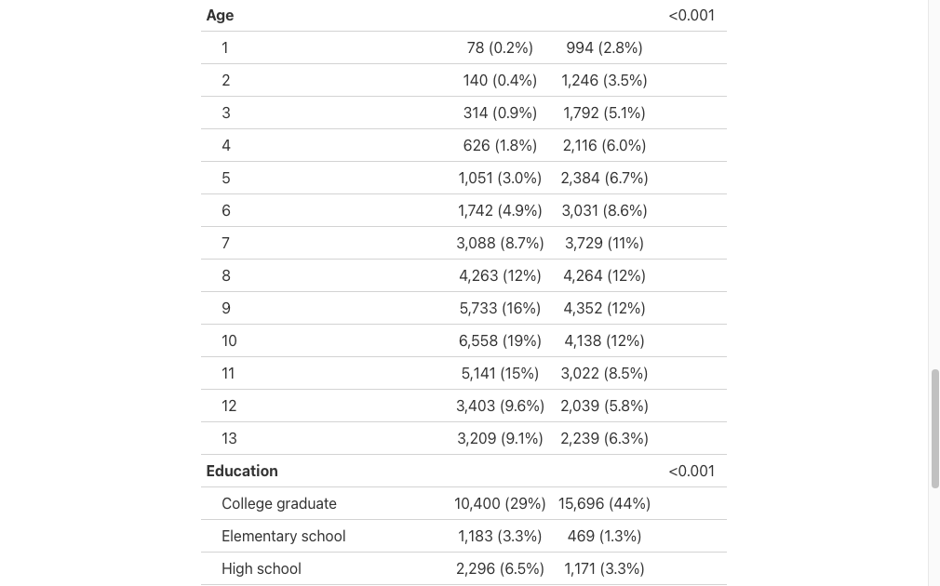

Slide 8
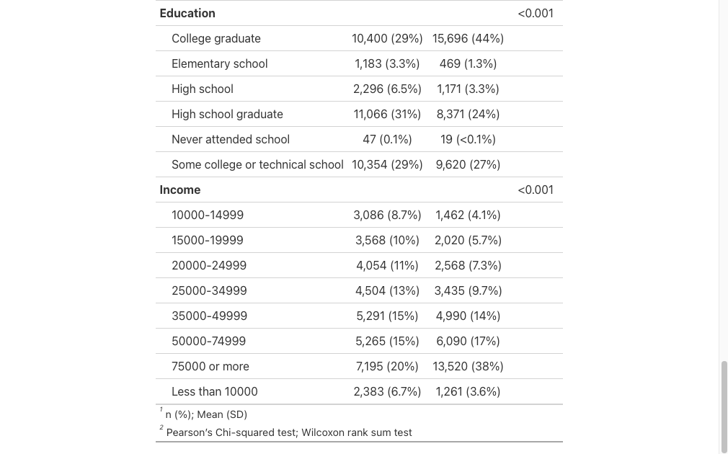

Slide 9
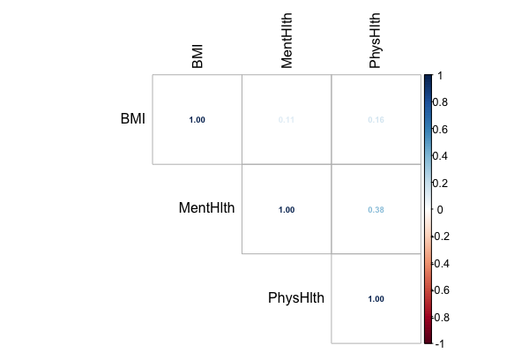
Correlation between numerical covariates

Slide 10
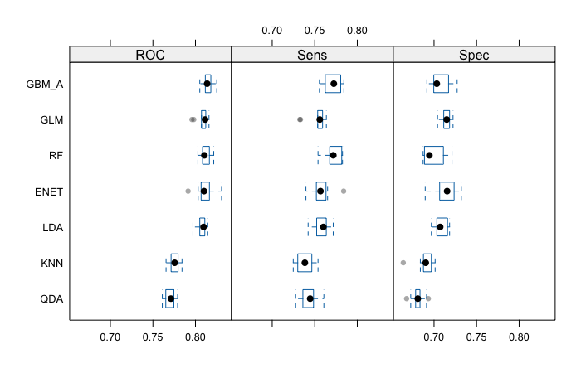
Cross-validation results

Slide 11
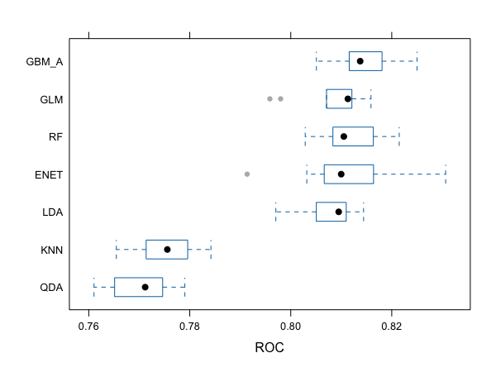

Slide 12
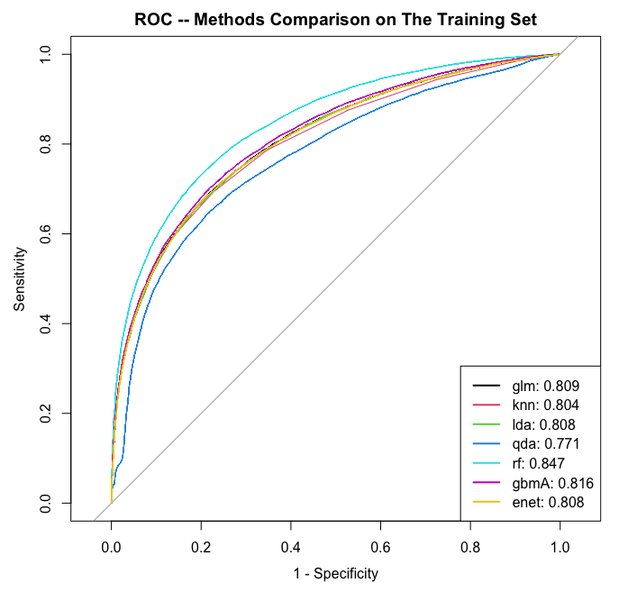
AUROC

Slide 13
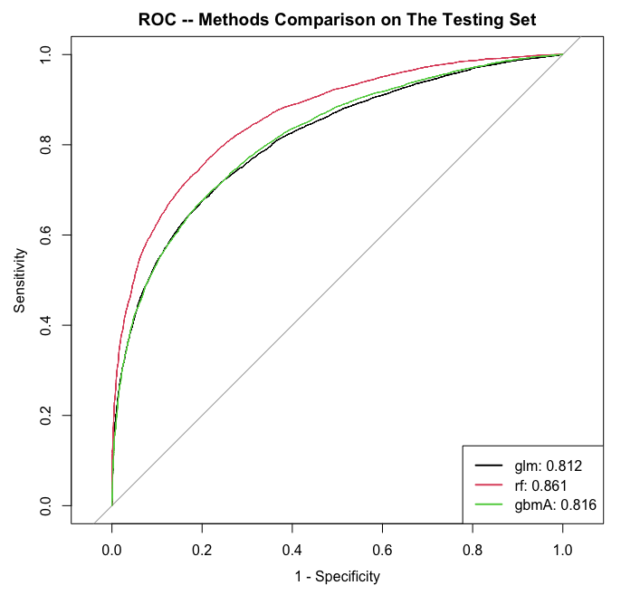

Slide 14
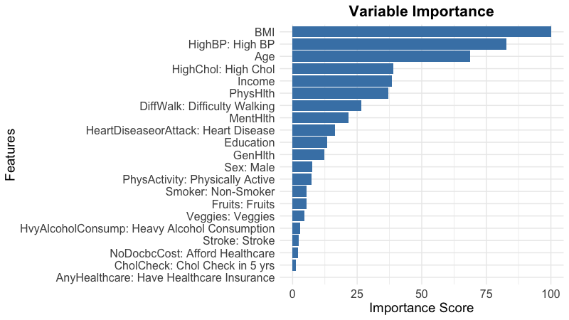

Slide 15
