Slide 2
CDC Diabetes Health Indicators Data
Introduce the data set and its covariates (predictors). Use the following link for more info:https://archive.ics.uci.edu/dataset/891/cdc+diabetes+health+indicators

Slide 3
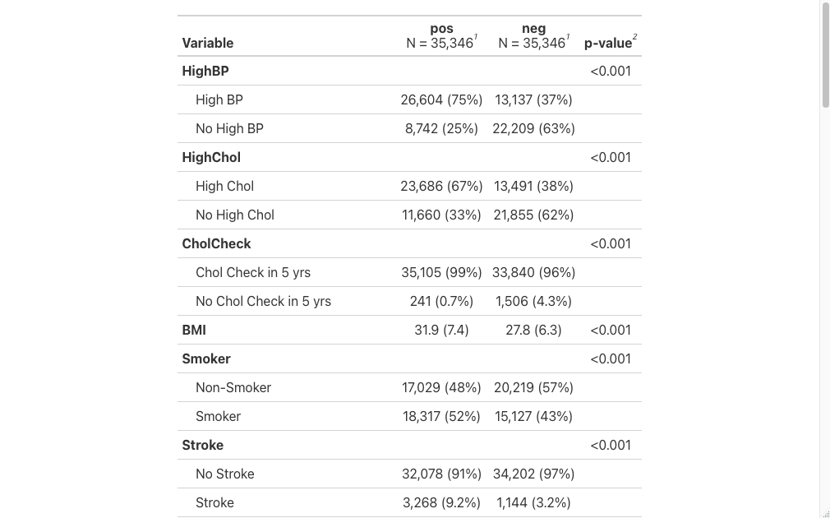
Summary Table

Slide 4
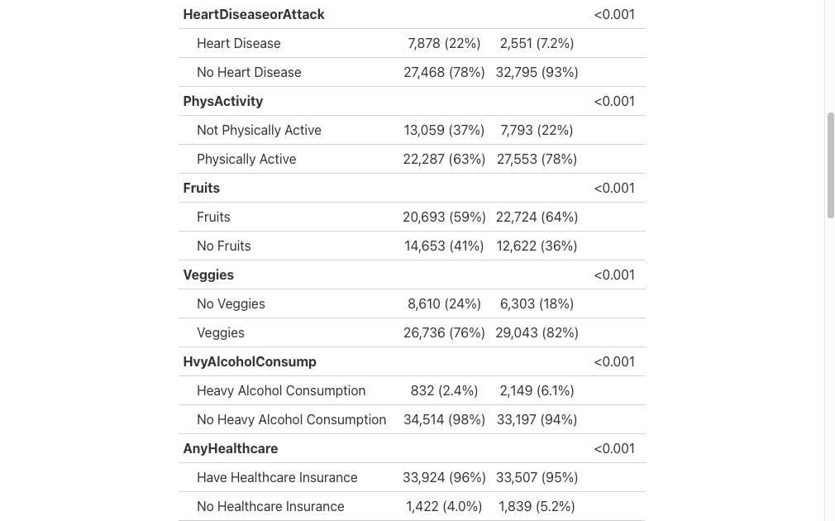

Slide 5
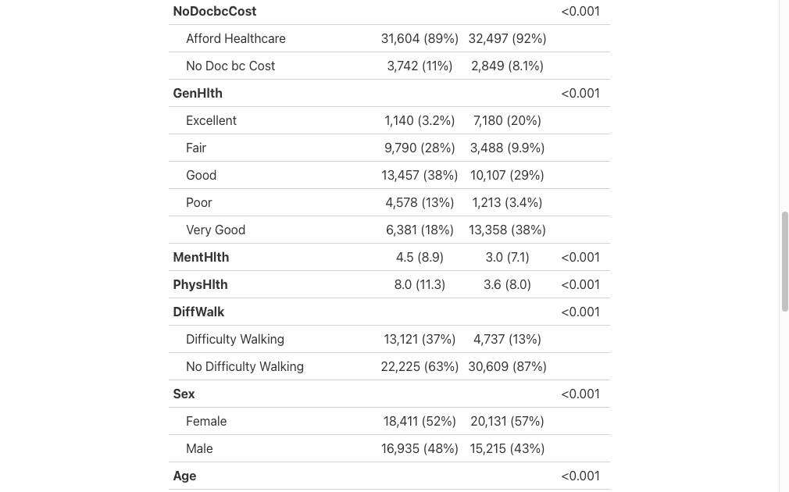

Slide 6
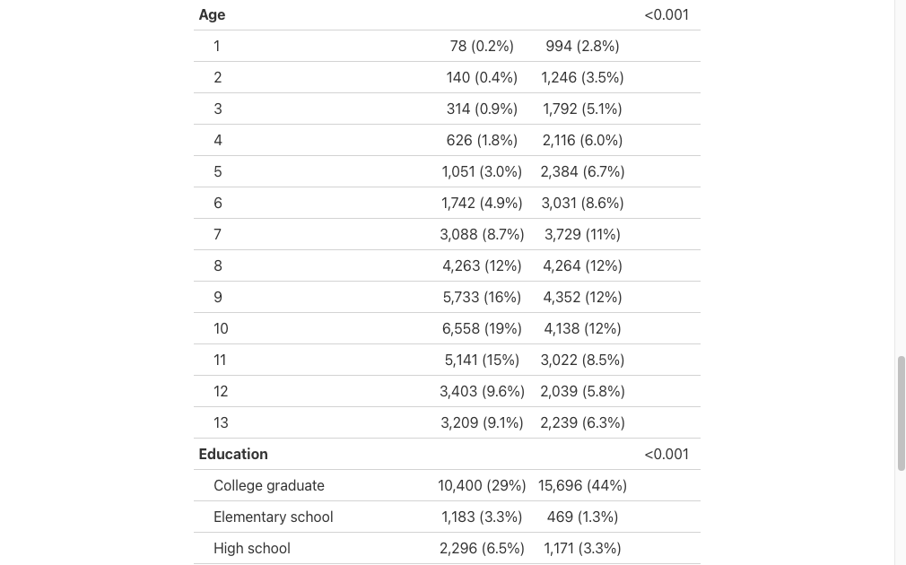

Slide 7
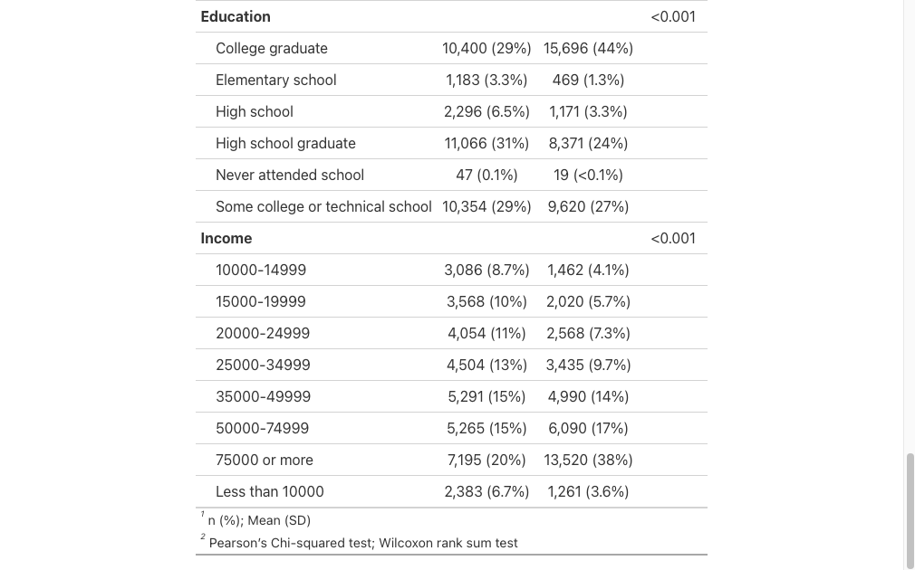

Slide 8
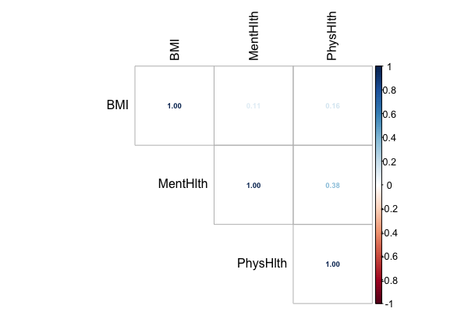
Correlation between numerical covariates

Slide 9
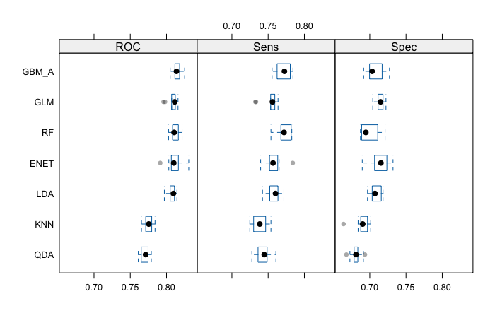
Cross-validation results

Slide 10
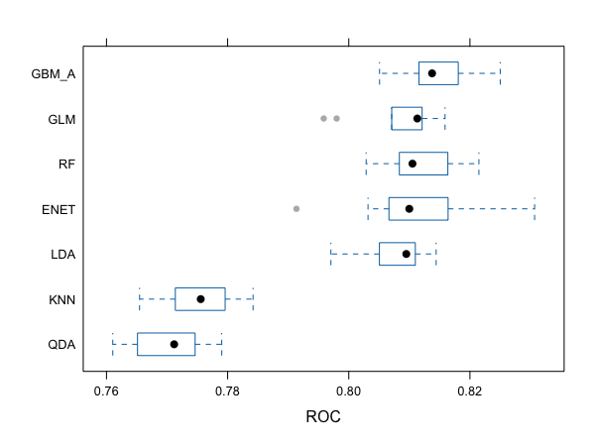

Slide 11
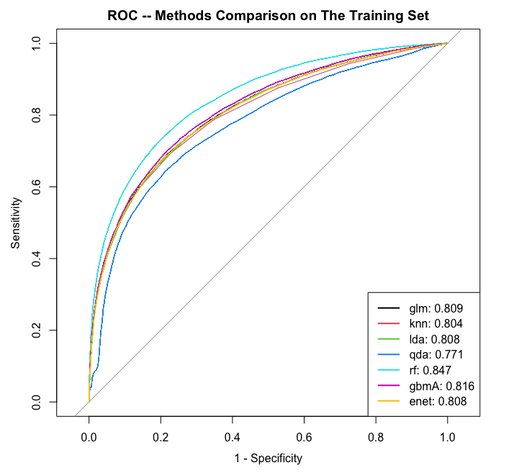
AUROC

Slide 12
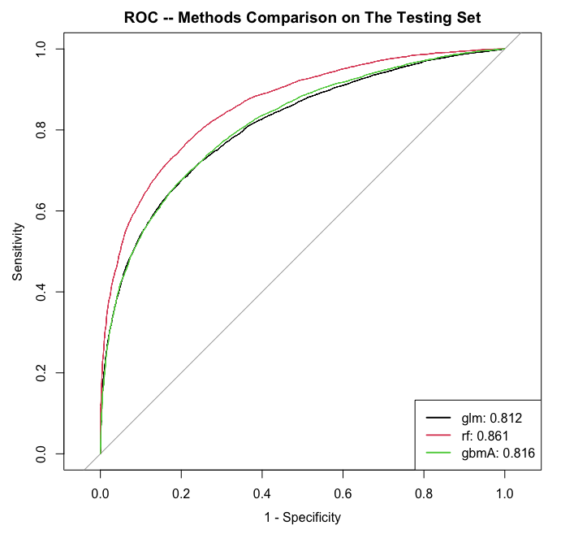

Slide 13
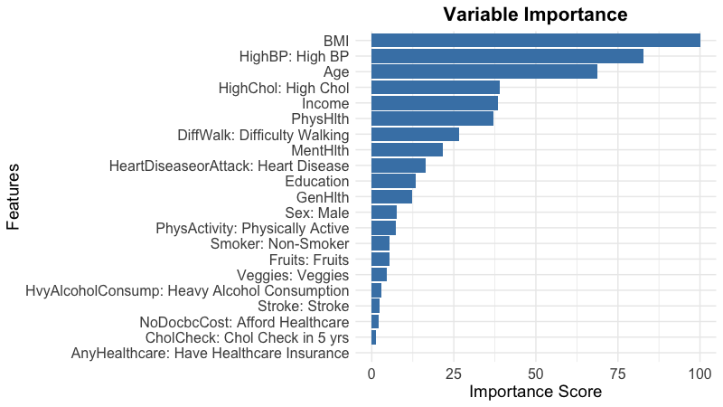

Slide 14
