Slide 1
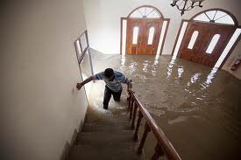
It takes one minute to save alive !

Slide 2
House Flooding Early Detection
Prepared by
Abrar Al-Taj - 20120175038
Alaa Abu-Hantash - 20120175015

Slide 3
Outline
Motivation
Objectives
Introduction
Problem statement
Approach
Results
Conclusion

Slide 4
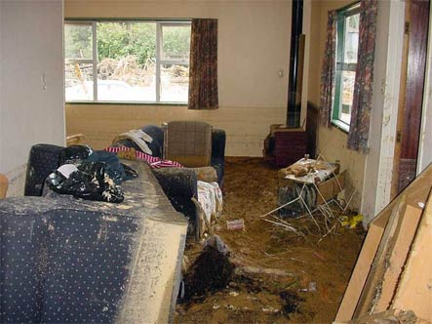
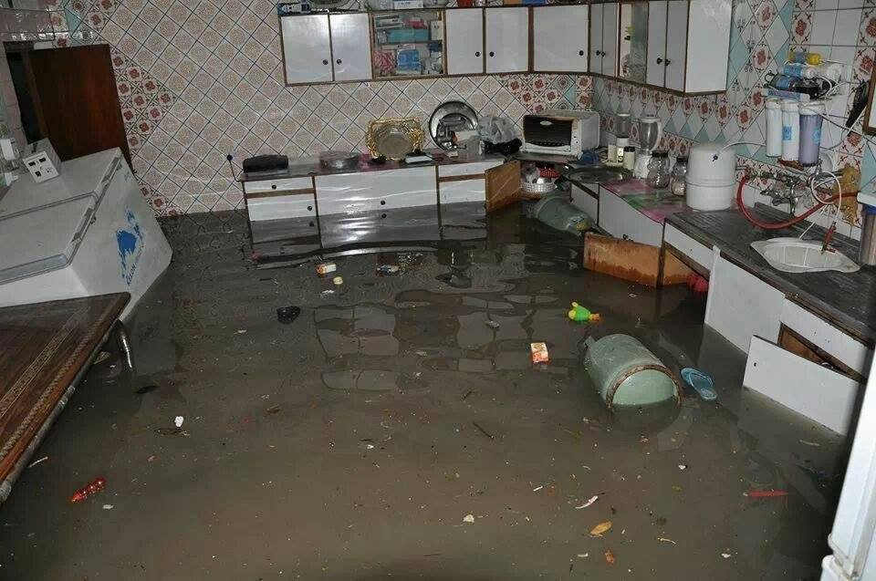
Motivation
There are many people who are affected due to flood damage which causes material losses, financial losses, and even humans death!

Slide 5
Objectives
This will lead to:
Reduce the number of houses that are fully flooded.
Reduce rate of the damage and the number of houses that are fully flooded.
Increase the number of people that will be saved.
Predict the flood before it occurs completely (especially at night).

Slide 6
Introduction
The idea of this project is to help people through warning them before the occurrence of the flood disaster and keep a constantly updated about the house state even when the homeowner is outside.
Help them to take the appropriate action.

Slide 7
Problem statement
Upon the occurrence of the flood, the water flowing is very fast and cannot control it.
Flood causes a big damage to the house; walls falling down, furniture getting destroyed and Electric Machineries get crashed.
Also it is possible to loess some important files, For example like passport and textbooks.
People might lose their lives.

Slide 8
Approach
Block diagram

Slide 9
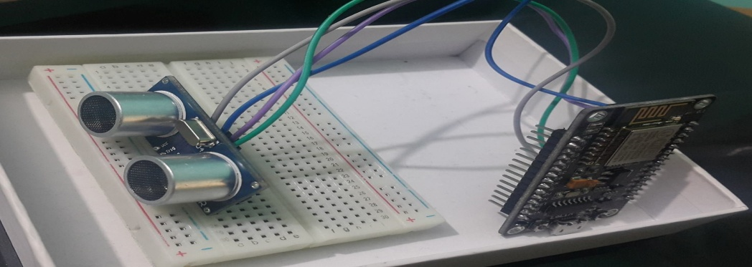
Approach(cont’d)
The Hardware

Slide 10
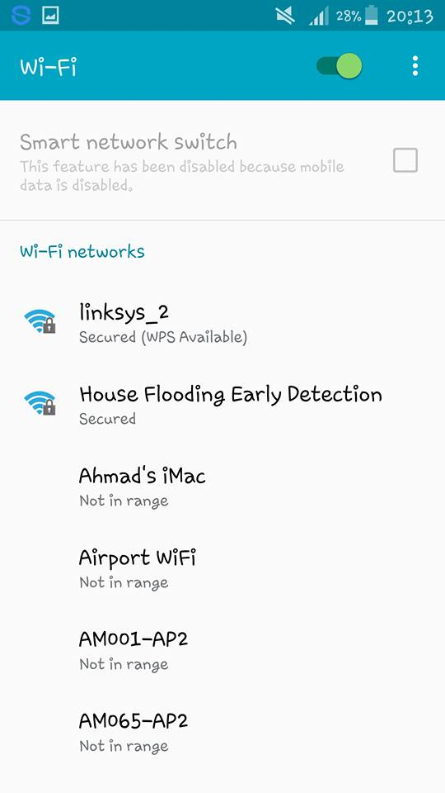
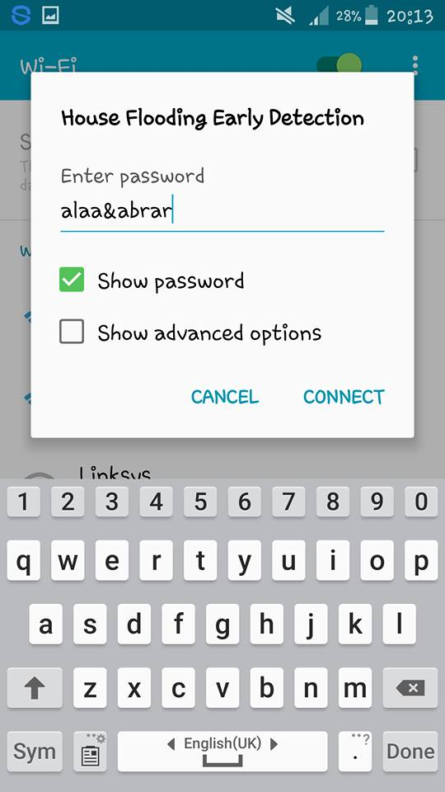
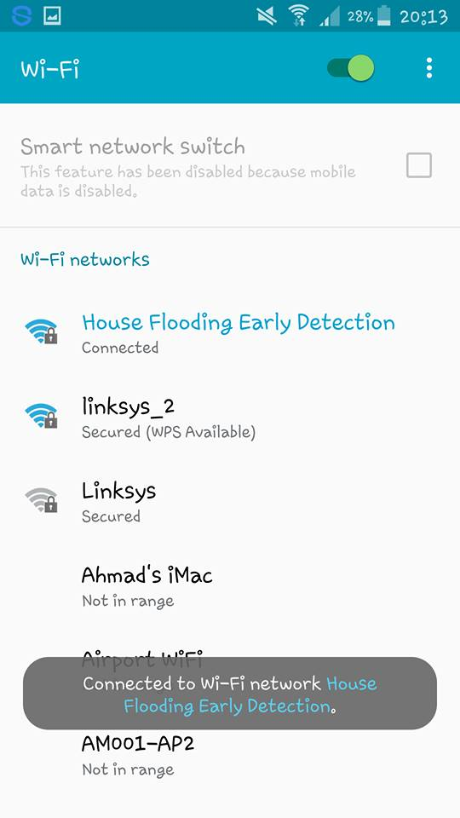
Approach(cont’d)

Slide 11
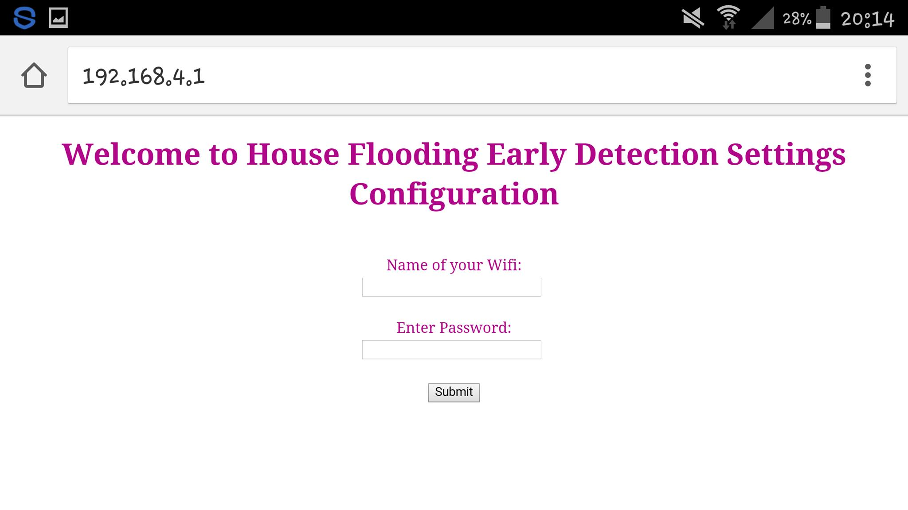
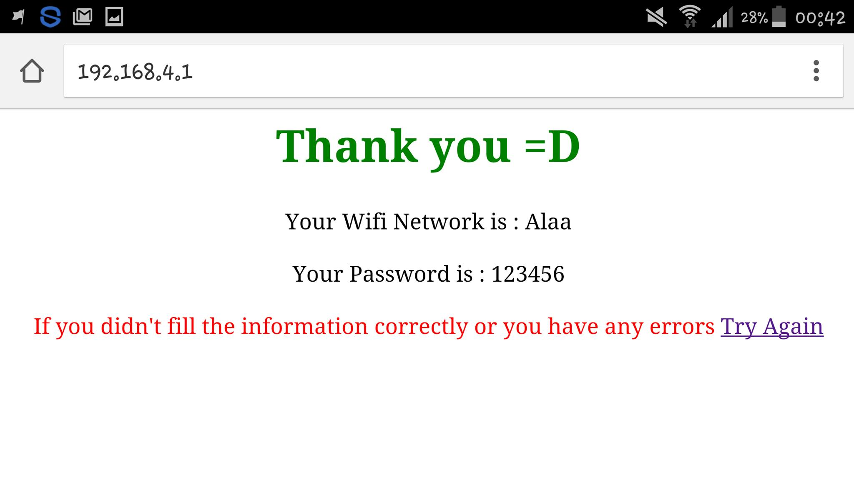
Approach(cont’d)

Slide 12

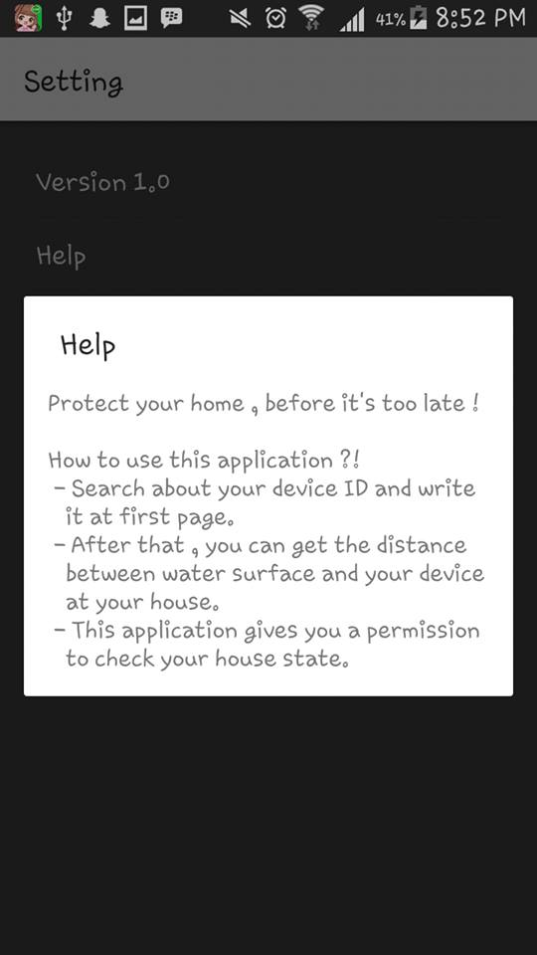
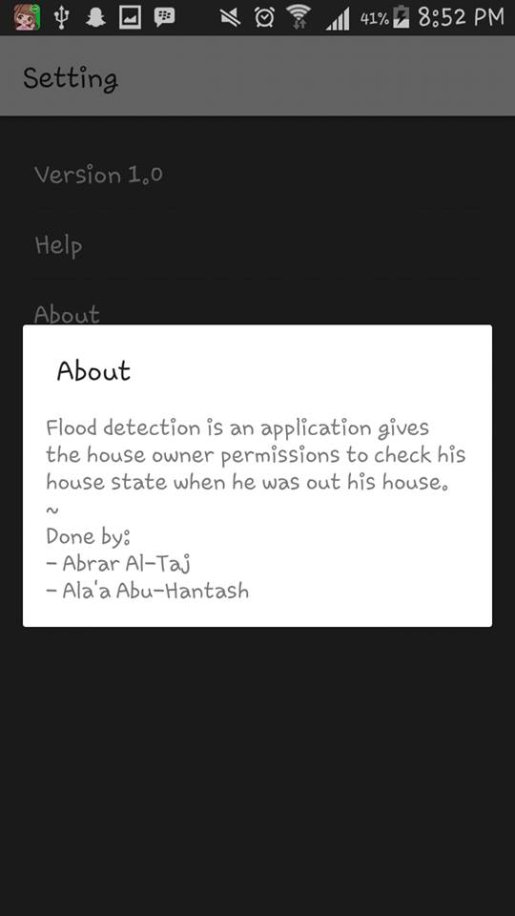
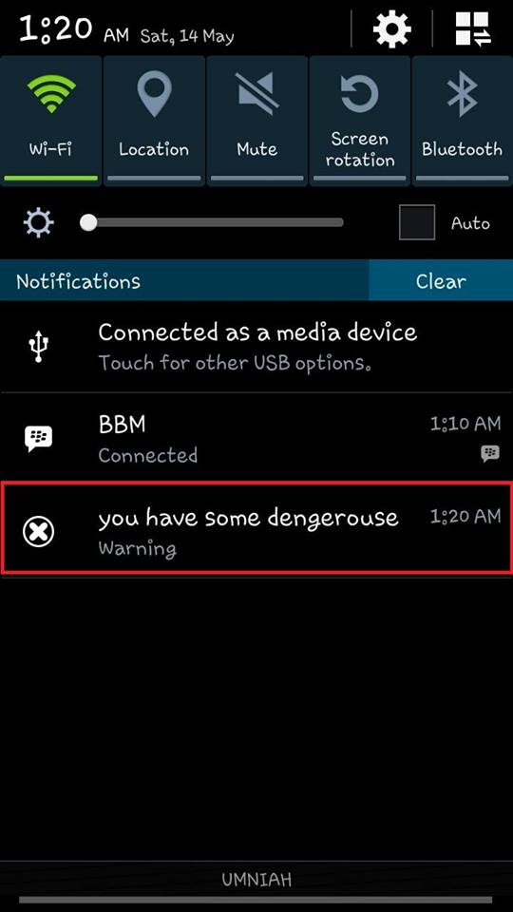
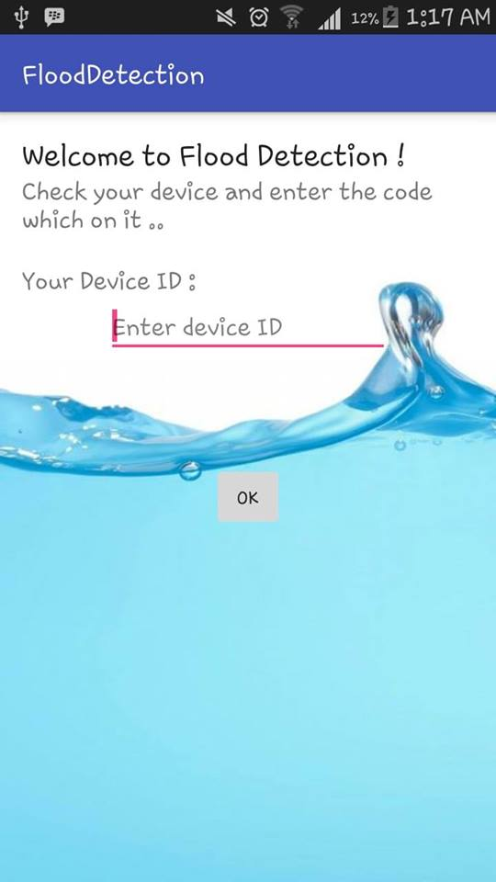
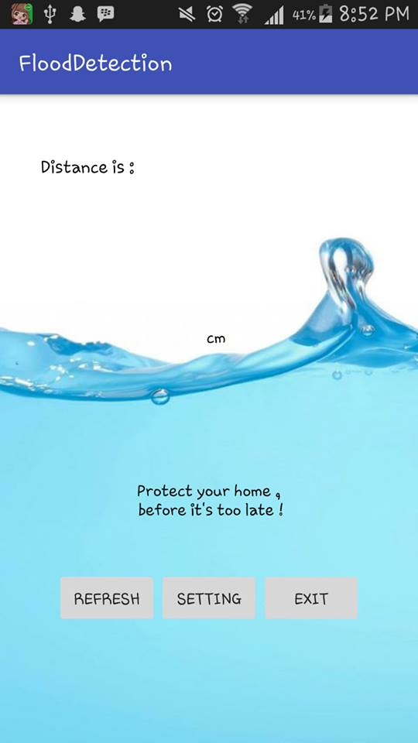
Approach(cont’d)

Slide 13
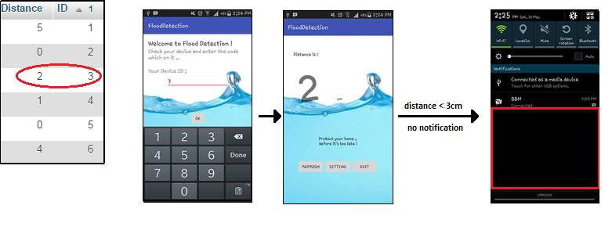
Results
If distance less than 3.

Slide 14
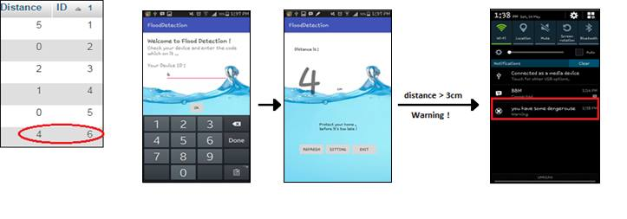
Results(cont’d)
If distance greater than 3.

Slide 15
Conclusion
Based on what we see from the flooding damages in the world, We believe that this project, which helps to indicate the homeowner for flooding at home will give a positive result through the services that offered by this device.

Slide 16
THANKS!
Any questions?

