Slide 1
Customer churn in banking industry!
By: Alaa Hamad Aljadani

Slide 2

TABLE OF CONTENTS
01
02
03
Introduction
Data
Tools
04
05
Algorithms
Conclusion

Slide 3
Introduction
Customer churn: is the percentage at which customers stop doing business with an entity.
Problem:
High competition in the banking industry
Improving customers retention rate by up to 5 % will increase your bank's profit by up to 85 %.
Attracting new customers costs more than retaining the old customers
Solution:
Machine learning models to predict customer churn!

Slide 4

So, Can machine learning predict which customer will churn?
We will see together

Slide 5
Data
RowNumber
CustomerId
Surname
CreditScore
Geography
Gender
Age
Tenure
Balance
NumOfProducts
HasCrCard
IsActiveMember
EstimatedSalary
Exited

Slide 6
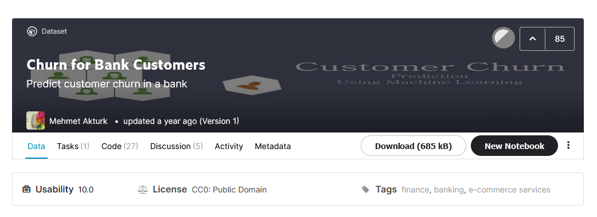
Data source

Slide 7
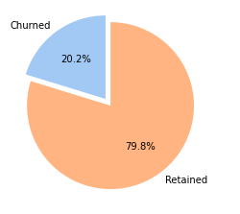

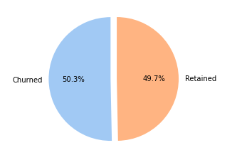
Data Cleaning
+
=

Slide 8
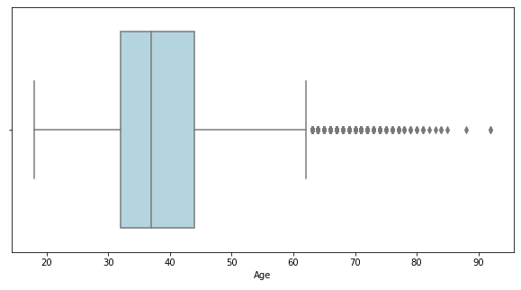
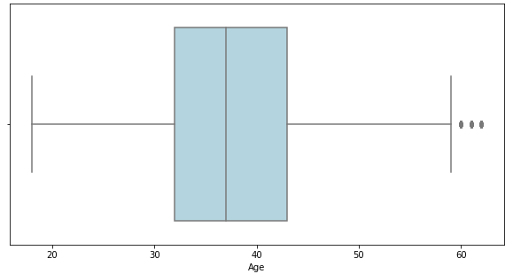
Data Cleaning
+
=

Slide 9




Tools

Slide 10
Algorithms

Slide 11
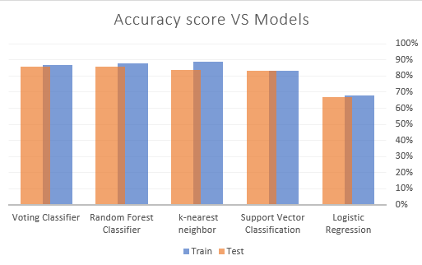
Accuracy score vs Models

Slide 12
Let's tune the Random Forest!

Slide 13
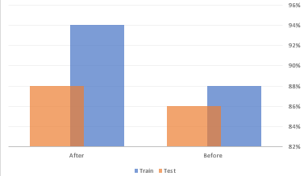
Hyperparameter Tuning

Slide 14
Conclusion
The accuracy of all algorithms was good, but after adjusting the random forest algorithm, it became better than others, so I recommend applying it.

Slide 15
Thank you! Do you have any questions?

