Slide 1
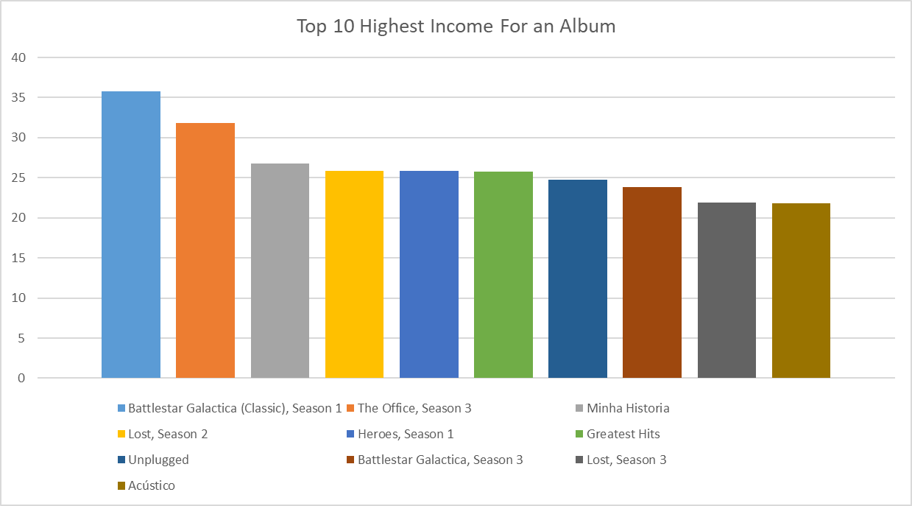
<Top 10 Income Album>
<visualization>
As we see in this chart the Highest Income Album is (Battlestar Galactica (Classic), Season 1)

Slide 2
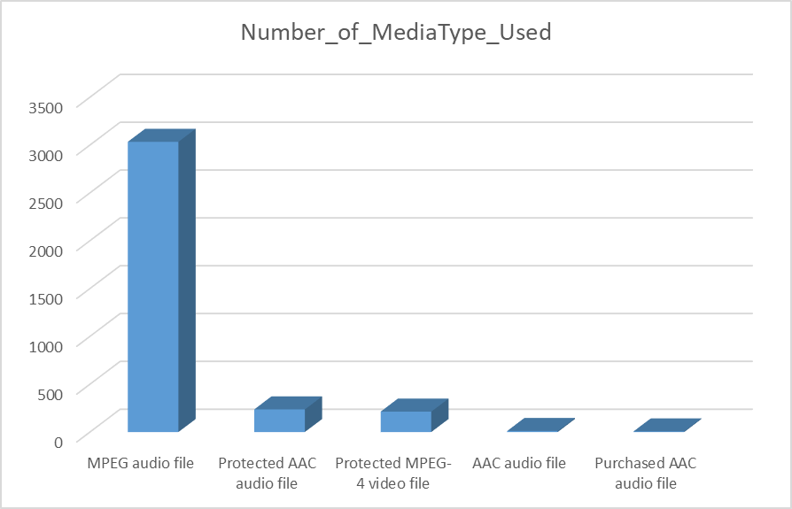
Mostly Used MediaType
<visualization>
As we see here most of Tracks Uses (MPEG audio file)

Slide 3
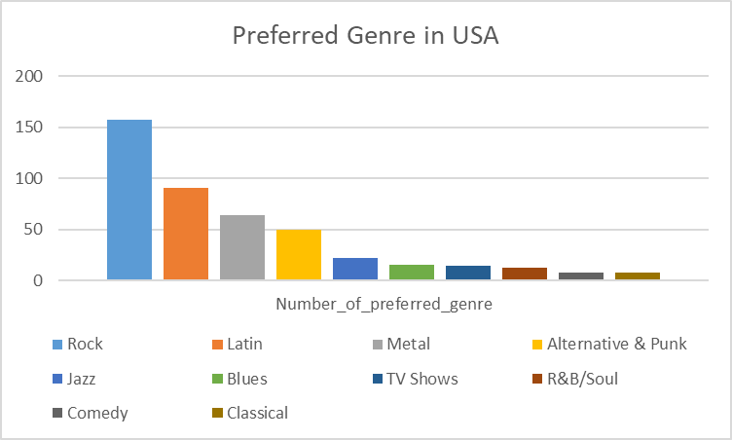
<USA preferred Genre>
<visualization>
Here we see the preferred genre depending on the invoices , It apears that “Rock” is the top then “Latin” then “Metal’

Slide 4
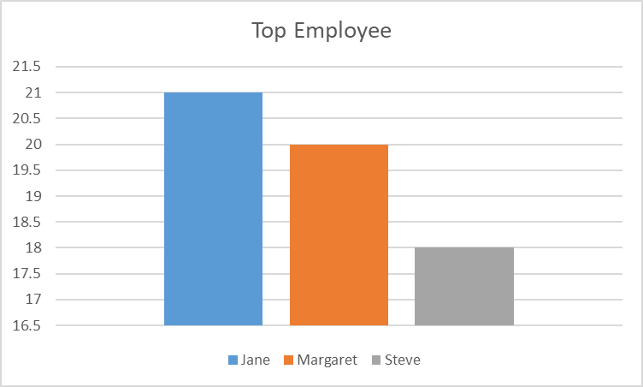
Top Employee
<visualization>
In this chart it clarify which employee Deserve a Bouns and it is “Jane” , this depends on number of customers that had a support

