Slide 1
Tourism management system

Slide 2
Main idea: This project is to improve Tourism traditional systems performance and quality and reduce services costs and performed manual operations and keep tourists comfortable when dealing with the system.
Problem Identification:- Although the current websites is of an international class and quality It’s Not realizing its maximum potential due to delay of activities by the current redundant manual system. OUR system, which would be friendlier to customers and the staff..1-
Improve customer care and service online..2-
3-Reduce the operational costs of the reservation.

Slide 3
Objectives Of The Proposed System
To enable online booking via phone. To enable automated data entry methods.
Ensure efficient and reliable communication within the internet .
Enforce security measures to avoid unauthorized access to tourists data.
Enable fast and easy retrieval of tourist records and data for fast reference activities.

Slide 4
Feasibility Study
-Economic Feasibility
Cost saving
Improve service level
Improve information level
Time saving
-Behavioral Feasibility
Easier working with manual Systems
Information gathering easier
Admin controls &manages user’s data

Slide 5

1-Essam Mohammed Ghorab (L*) .
2-Alaa Mahmoud Elfeki.
3-Reda Ismaiel Meki.
4-Mohammed Abd elsalam elalkamy.
5-Abdelrahman Silliman Moussa .

Slide 6
Functional Requirements
The functional requirements for the system are divided into three main categories, Reservation/Booking, Trips, and Management. For further details, refer to the use cases.
1. Reservation/Booking
-The system shall record reservations.
-The system shall record the tourists 'name.
-The system shall record the number of occupants.
-The system shall should have a contact with favorite places.
-The system shall allow the tourists to explore about Egypt.
-The system shall automatically cancel reservations if the customer has not provided their credit card number

Slide 7
-The system shall record the expected check-in date and time.
-The system shall check-in Tourists
-The system shall allow reservations to be modified without having to reenter all the customer information
-The system shall record that the weather in required place.
-The system shall record the payments.
-The system shall record the payment type.
-The system shall record customer feedback.

Slide 8
3-Management
-The system shall display the tickets occupancy for a specified period of time
The system shall display trip revenue for a specified period of time
The system shall display an exception report, showing where the new places and most required sites.
The system shall allow for the addition of information, regarding Services, rates.
The system shall allow for the deletion of information, regarding reservations.
The system shall allow for the modification of information.
The system shall allow managers to assign user passwords.

Slide 9
Nonfunctional Requirements
1-Performance Requirements
-The load time for user interface screens shall take no longer than ten seconds.
-The log in information shall be verified within five seconds.
-Queries shall return results within five seconds
2-Logical Database Requirements
The logical database requirements include the retention of the following data elements.

Slide 10
3-Design Constraints
The Tourism Management System shall be a stand-alone system in any browser .The system shall be developed using Java and MySQL DB..
4-Standards Compliance
There shall be consistency in variable names within the system. The pages shall have a consistent look and feel.
5-Reliability
Specify the factors required to establish the required reliability of the software system at time of delivery.
6-Availability
The system shall be available 24 hours.
7-Security
Customer Service Representatives and Managers will be able to log in to the Tourism Management System. Customer Service Representatives will have access to the Reservation/Booking and other services. Managers will have access the various subsystems will be protected by a user log in screen that requires a user name and password.

Slide 11
8-Maintainability
The Tourism Management System is being developed in Java. JAVA is an object oriented programming language and shall be easy to maintain.
9-Portability
The Tourism Management System shall run in any any browser using PSC , Phones etc .

Slide 12
USE CASE
Scenario
The tourist is the main goal in this system. He can perform a login process depend on a E_mail and password which he has admitted. He also can read last news , find most familiar hotels , know travel agent , view all places and view travel agents.
The tourist can reserve a cinema ticket and a trip from the proposed
. in the site

Slide 13
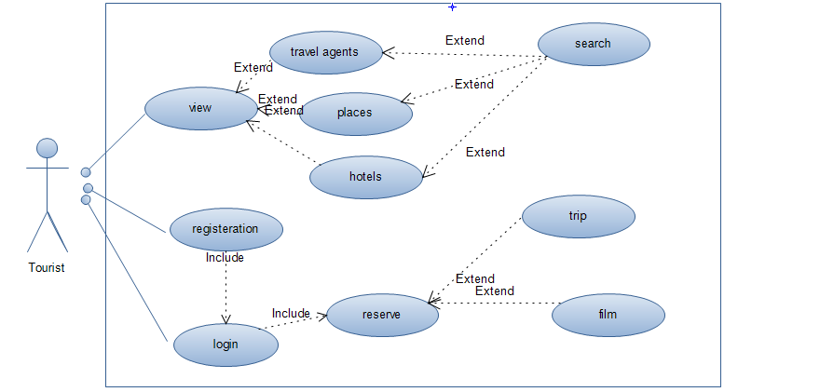
Use case tourist

Slide 14
use case
Scenario
Employee is admin to our web site he can view the site content
And can edit on the site by edit the data dynamicly on way add trip ,delete ,update , cancel trip ,add film ,delete ,update ,cancel reserve to customer and show message from inbox

Slide 15
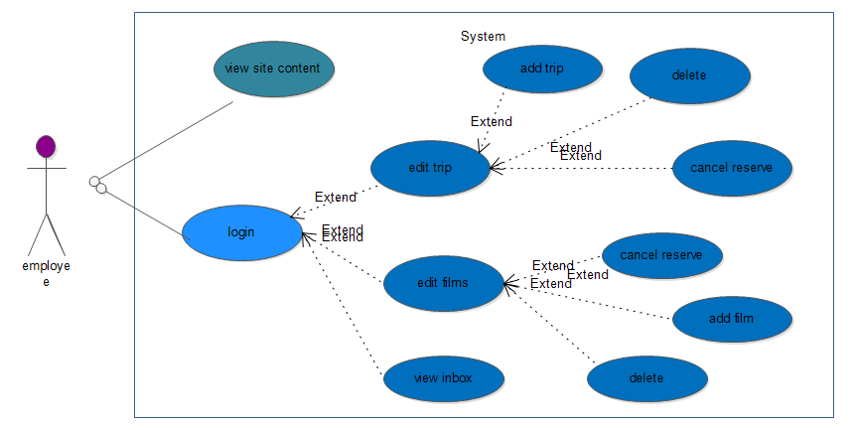
Use case Employee

Slide 16
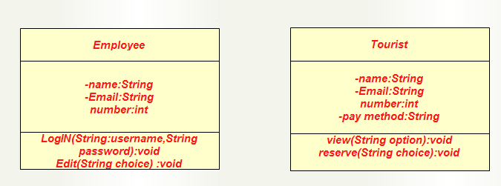

CRC

Slide 17
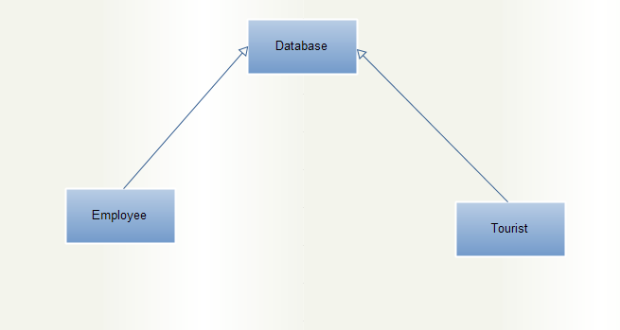
Class Diagram

Slide 18
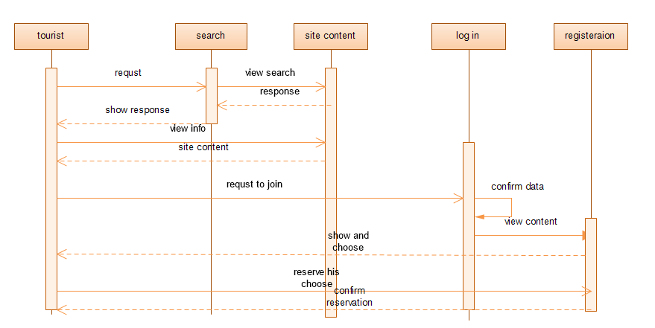
Sequence Diagram

Slide 19
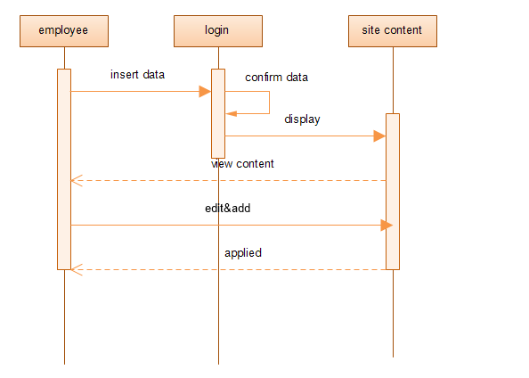

Slide 20


