Slide 1
ITRAQ-based Proteomics Approaches
1.آلاء أيمن عبدالغني محمد
2. آلاء محمد ثابت عبدالسلام
3. آلاء محمد عبد العال عامر
4. حبيبه أحمد صدقي

Slide 2
introduction
Isobaric tag for relative and absolute quantitation (iTRAQ) is an acronym
for isobaric tag for relative and absolute quantitation.
Applied Biosystems Inc. created iTRAQ in 2004.
iTRAQ is a method for determining the amount of proteins
from various sources in a single experiment using isobaric labelling.

Slide 3
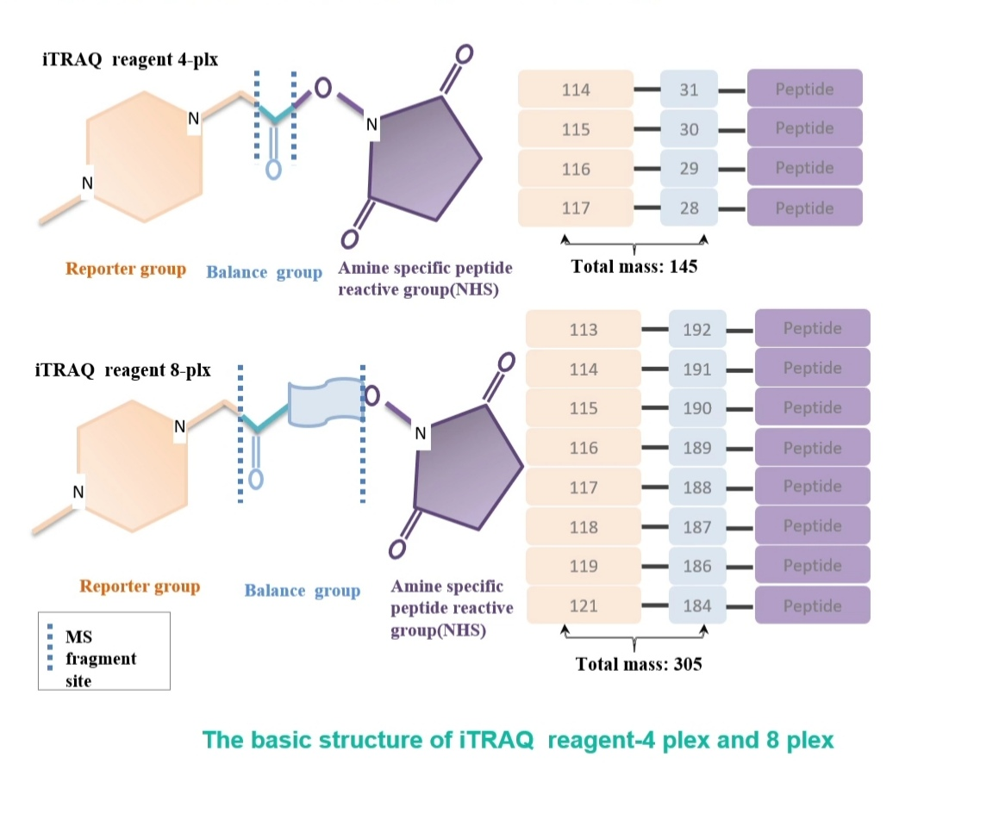
The principle and workflow of iTRAQ
The structure of iTRAQ reagents
A charged reporter group, a peptide reactive group, and a neutral balancing group make up the isobaric tagging reagents.
The peptide reactive group forms a covalent bond between an iTRAQ Reagent isobaric tag and each peptide's lysine side chain and N-terminus group, marking all peptides in a specific sample digest.
The neutral balancing group ensures that all iTRAQ labelled samples have the same mass, resulting in an overall mass of 145 Da for 4-plex and 305 Da for 8-plex samples.

Slide 4
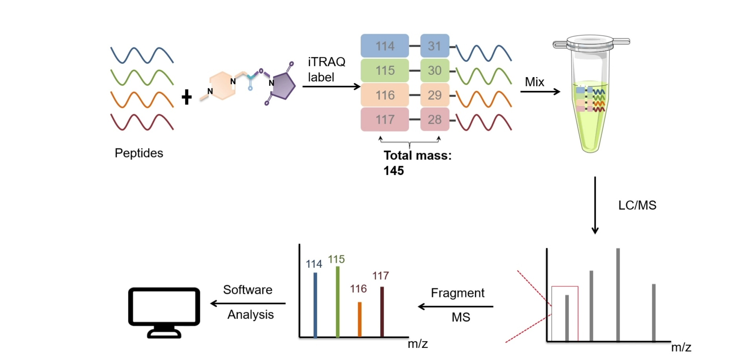
Principle of iTRAQ reagent 4-plex as an example

Slide 5
control
treatment
Control sample
Reduce, cysteine block and digest
Label with iTRAQ
Test sample1
Reduce, cysteine block and digest
Label with iTRAQ
Test sample7
Label with iTRAQ
Reduce, cysteine block and digest
…….
Combine the control and treatment sample digests that have been labelled with the iTRAQ reagent into one sample mixture.
Clean up perform high-resolution fractionation.
Use MS/MS to identify and quantify the proteins in the mixture.
Workflow of iTRAQ

Slide 6
Factors affecting results of iTRAQ
Labeling effectiveness and isotope impurity correction evaluation
Compression of the ratio and its adjustment
Ion intensity dynamic range of the reporter
Inferring protein ratios using unique and common peptides
Changes in protein fold estimation
Multiple isobaric labelling experiments are compared.

Slide 7
Advantages and disadvantages
Advantages
Disadvantages
Using mass spectrometry
Ability to analyze proteins from cell, tissues or serum
Multiplexing ability
Reduce overall time and variation
Costly
Very sensitive to contamination from salts
A requirement of sophisticated software
Variability arising due to the inefficient enzymatic digestion

Slide 8
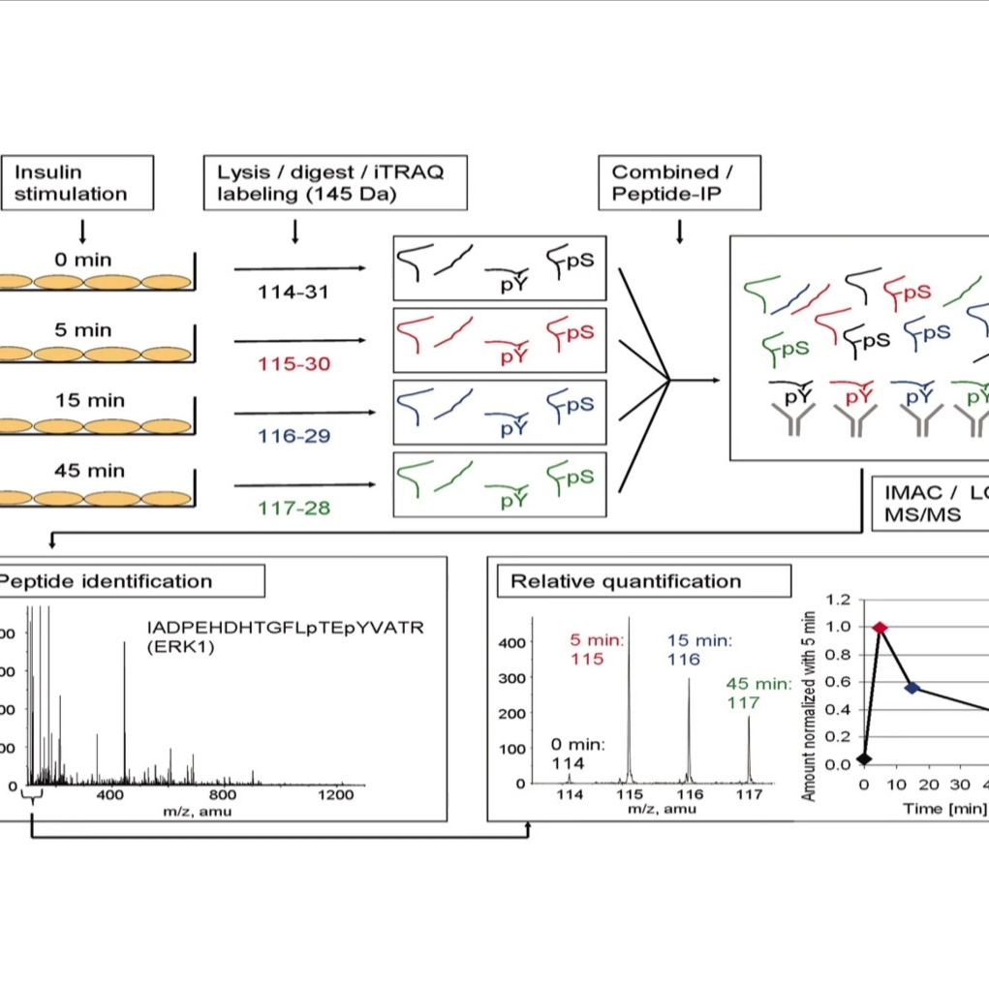
An example
When insulin is stimulated, iTRAQ is utilised to identify and quantify tyrosine phosphorylation sites.

Slide 9
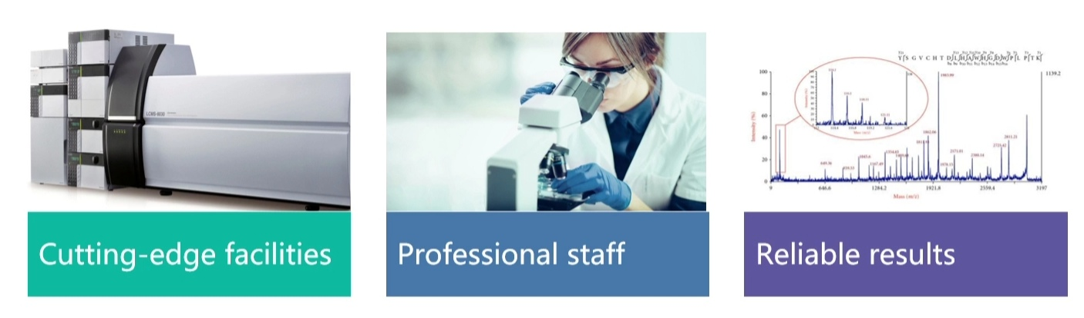
iTRAQ at Creative Proteomics
iTRAQ-based proteomics analysis service
TMT-based proteomics analysis service
SILAC-based proteomics analysis service
Absolute quantification (AQUA) service
Label-free quantification service
Semi- quantitative proteomics analysis service

