Slide 1

Weather forecast scheduler
Alaa Mousa Hasan

Slide 2
Agenda
Introduction to Weather Report Automation
The Approach to Automation
Strategy Planning for Implementing the Concept
Technical Implementation
Project Outcome

Slide 3
Introduction to Weather Report Automation
Project Overview:
Automates the process of fetching weather data, generating a report, and sending it via email.
Goal:
Fetches a 14-day weather forecast.
Generates a PDF report.
Sends the report via email.
Weather data web
Get
Weather app
Send
Target Email

Slide 4
The Approach to Automation
Problem Statement:
Manually checking, formatting, and sending weather reports.
Solution:
A fully automated system that:
Fetches weather data.
Formats and generates a PDF report.
Sends the report automatically via email.
Automated
Weather data web
Weather app
Target Email

Slide 5
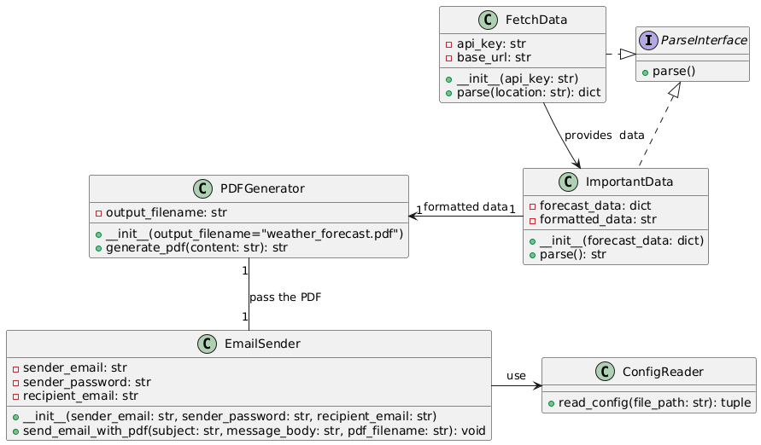
Strategy Planning for Implementing the Concept

Slide 6
Technical Implementation
Technologies:
Python
WeatherAPI
FPDF
Smtplib
Classes:
FetchData
ImportantData
PDFGenerator
EmailSender
ConfigReader
Windows Task Scheduler:
Runs the batch file to trigger the Python script.

Slide 7
Project Outcome
The system successfully automates:
Fetching weather data.
Extracting and formatting the weather information.
Generating a PDF report.
Sending the report to the recipient's email.

Slide 8
Thanks Happy to hear your question

