Slide 1
Credit Card Clustering
Done by :
Sondos Mahmoud Bsharat
Alaa Alnabulsi

Slide 2
Outline :
Understand the problem (Look at the big picture)
Load and get understand of Our Data Set
Exploratory Data Analysis
Clean and prepare data for the training
Clustering

Slide 3
Look At the big Picture
1

Slide 4

Credit Card Clustering

Slide 5
Load Our DataSet
2

Slide 6
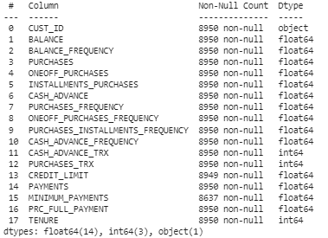
Size of the dataset : (8950, 18)
Data Types of attributes in the datasets:

Slide 7
Exploratory Data Analysis(Visualization )
3

Slide 8
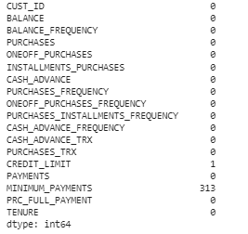
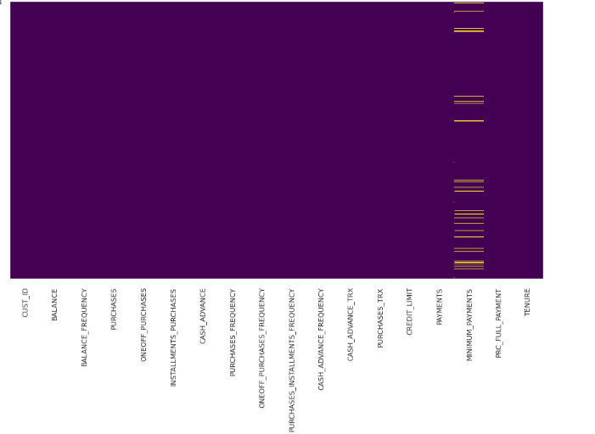
Missing Values:

Slide 9
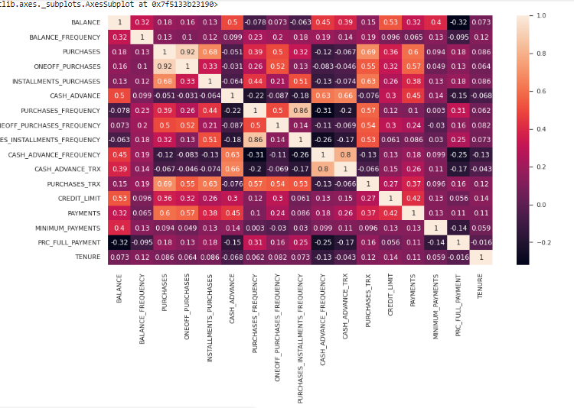
Correlation attributes :

Slide 10
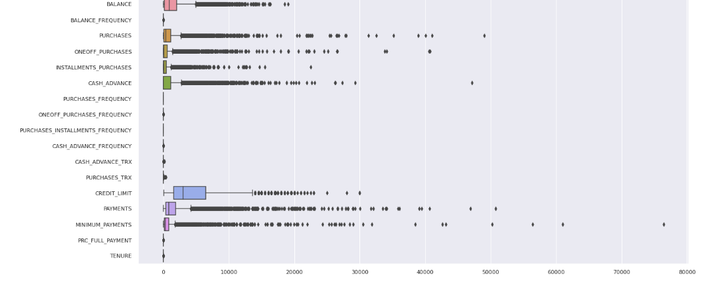
Outliers :

Slide 11
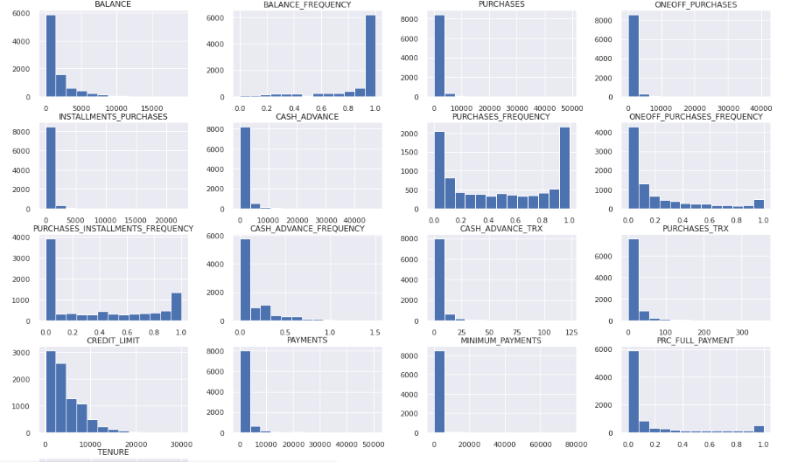
Histogram representation of the attributes

Slide 12
Data Cleaning
4

Slide 13
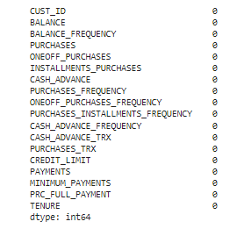
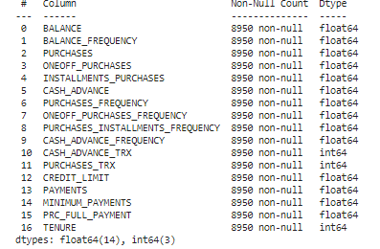
1- Fill the missing data:
Fill by the mean value
Replace the missing data in CREDIT_LIMIT and MINIMUM_PAYMENTS columns
2- Dealing with Categorical Features:
1- CUST_ID: 8950 unique value
Remove CUST_ID column
3-Remove Outliers:
CREDIT_LIMIT
MINIMUM_PAYMENTS
PAYMENTS
CASH_ADVANCE
INSTALLMENTS_PURCHASES
ONEOFF_PURCHASES
PURCHASES

Slide 14
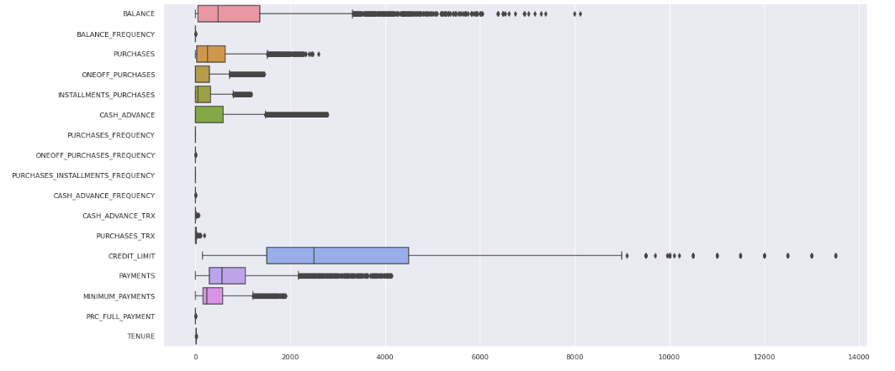
After removing the Outliers

Slide 15
Clustering
5

Slide 16
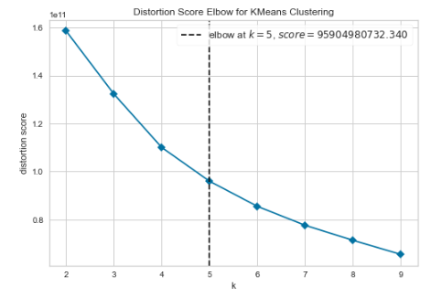
KMeans:
Elbow Method : k=(2,10)

Slide 17
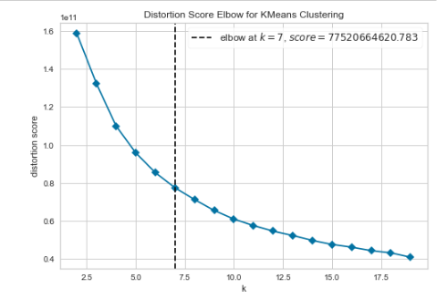
Elbow Method : k=(2,20)
.
.

Slide 18
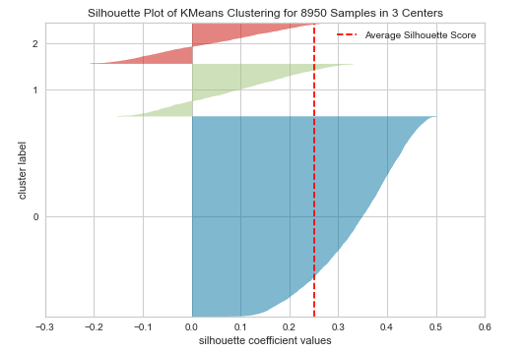
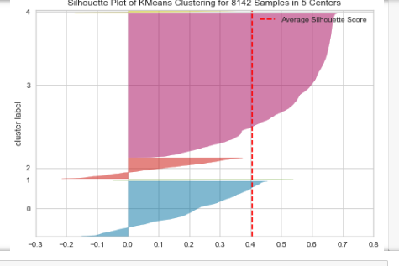
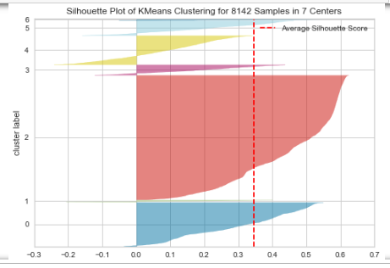
Silhouette method

Slide 19


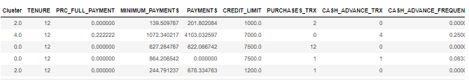
Number Of Clustering :
Counts of each cluster(group):

Slide 20
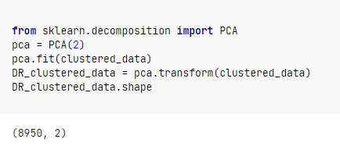
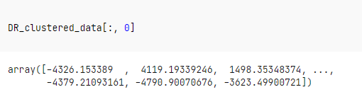
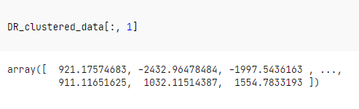
Dimensionality Reduction (PCA)

Slide 21
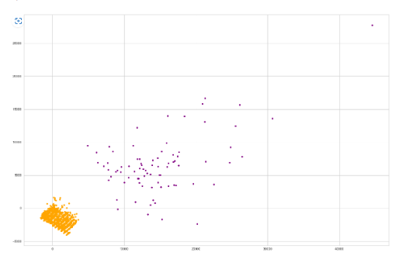

Visualize Clusters (k-Means)

Slide 22
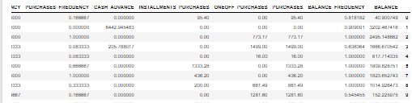
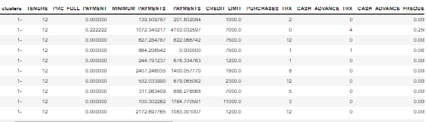
DBSCAN

Slide 23

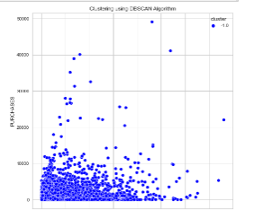
Counts of Each Cluster

Slide 24
Thank You

