Slide 1



Deploying micro-services app on AWS
Cost optimized application CI/CD model

Slide 2
Contents:
Why CI/CD ?
Cost optimization
Deploy on AWS

Slide 3


WHY CI/CD?
CI/CD is a powerful engine of software development and it has untold benefits for businesses such as:
CI/CD pipelines Automation reduces the cost !
Deliver faster,
The business bottom line: Expensive developer resources aren’t sitting idle when a successful CI/CD pipeline is in play
Ensure superior code quality, That concept of “failing fast” means teams aren’t wasting time or resources with buggy code , and devs aren’t plagued with endless “fix” requests when they’ve moved on to other projects. Time is saved, money is saved.
Simplified rollback
The ability to easily rollback code saves teams time, energy, and resources and leads to faster fixes of problem code.

Slide 4
Deploy on AWS
Amazon Web Services (AWS) delivers reliable, scalable, and cost-effective computing resources on which to host your applications.
Businesses can consume applications that are hosted online,
enabling them to lower their costs by paying only for what they use,
enjoy seamless and painless upgrades in functionality,
and integrate easily with their existing data and systems.

Slide 5
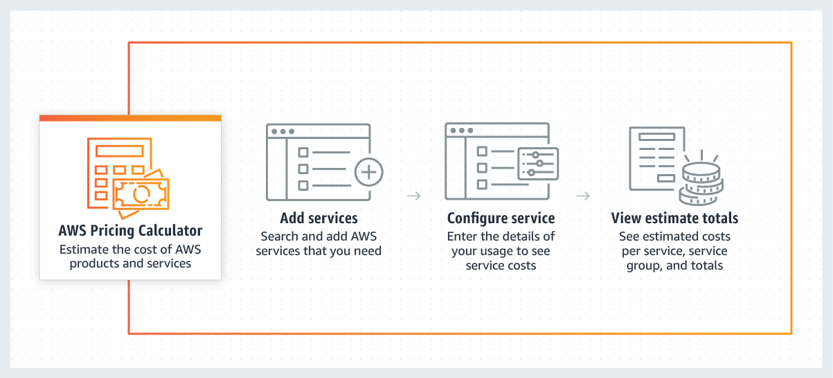
Cost optimization
Deploying applications on AWS cloud using CICD tools is superior in Time and Cost saving
Most of the CICD tools are open-source tools which can be used for free with no need to buy license such as: Jenkins and Gradle.
AWS provides a free pricing calculator that allows you to start your estimate with no commitment and explore AWS services and pricing for your architecture needs.

Slide 6
Cost optimization
Also, AWS services provide many financial management solutions. you can,
Organize and Report Cost and Usage based on User-Defined Methods
Manage Billing and Control Costs
Optimize Costs with Resource and Pricing Recommendations
Improved Planning with Flexible Forecasting and Budgeting

Slide 7
Thanks !
Hope it was helpful and convenient

