Slide 1
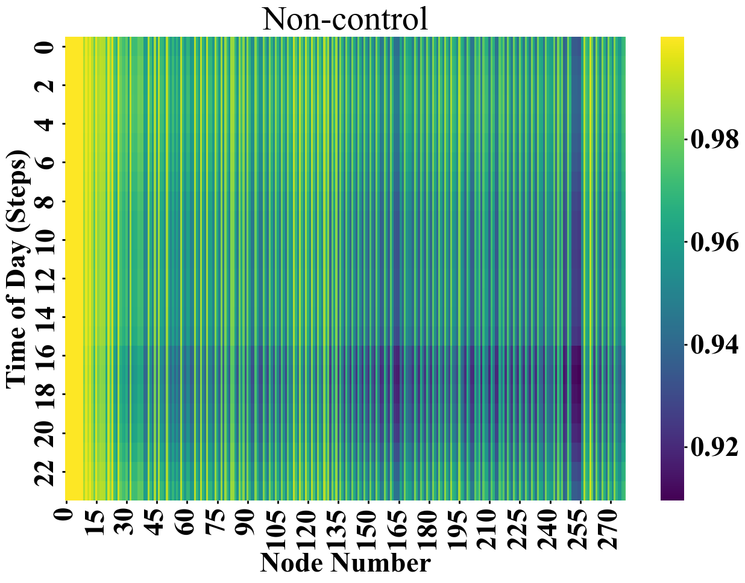
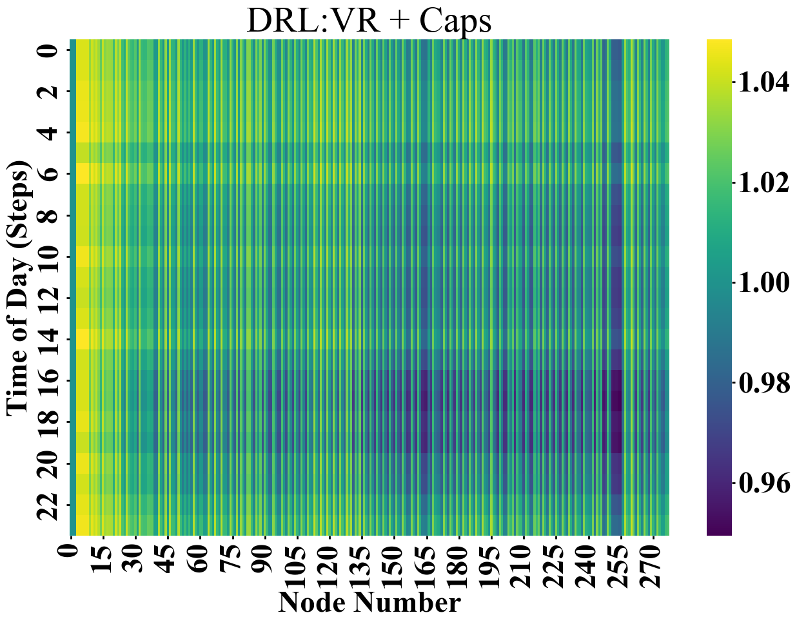
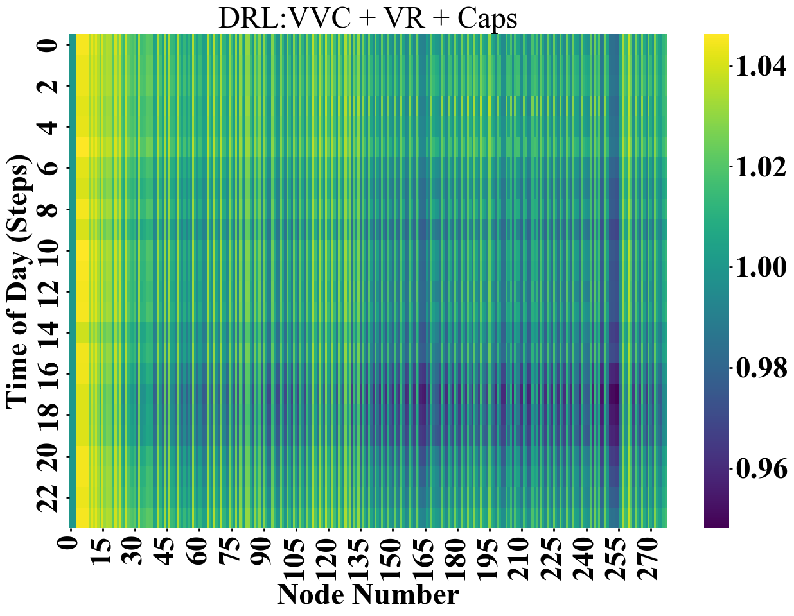
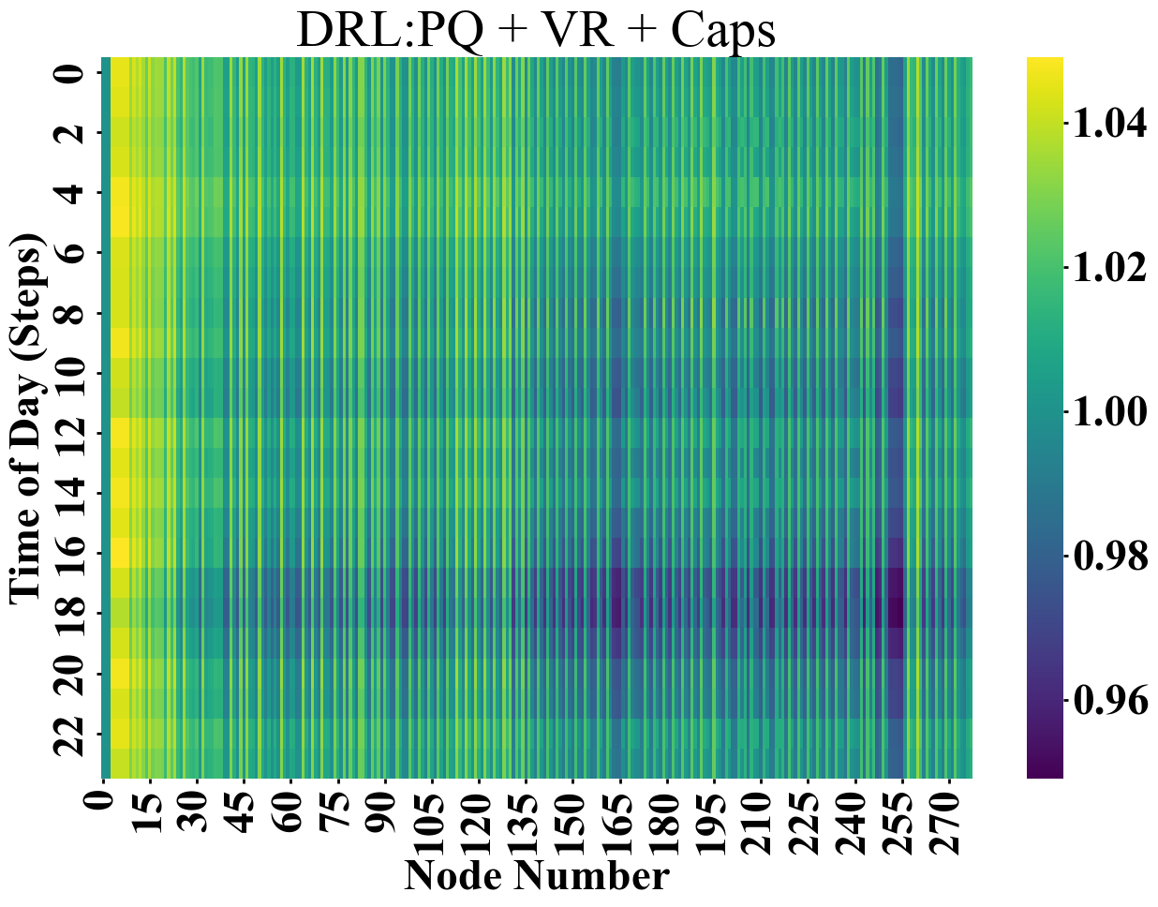
Loading the system is triggered to observe various violations at different nodes and with respect to the time of the day
DRL-IMPALA is applied here to avoid voltage violations focusing on the most impacted nodes at their most stressed time.

