Slide 1
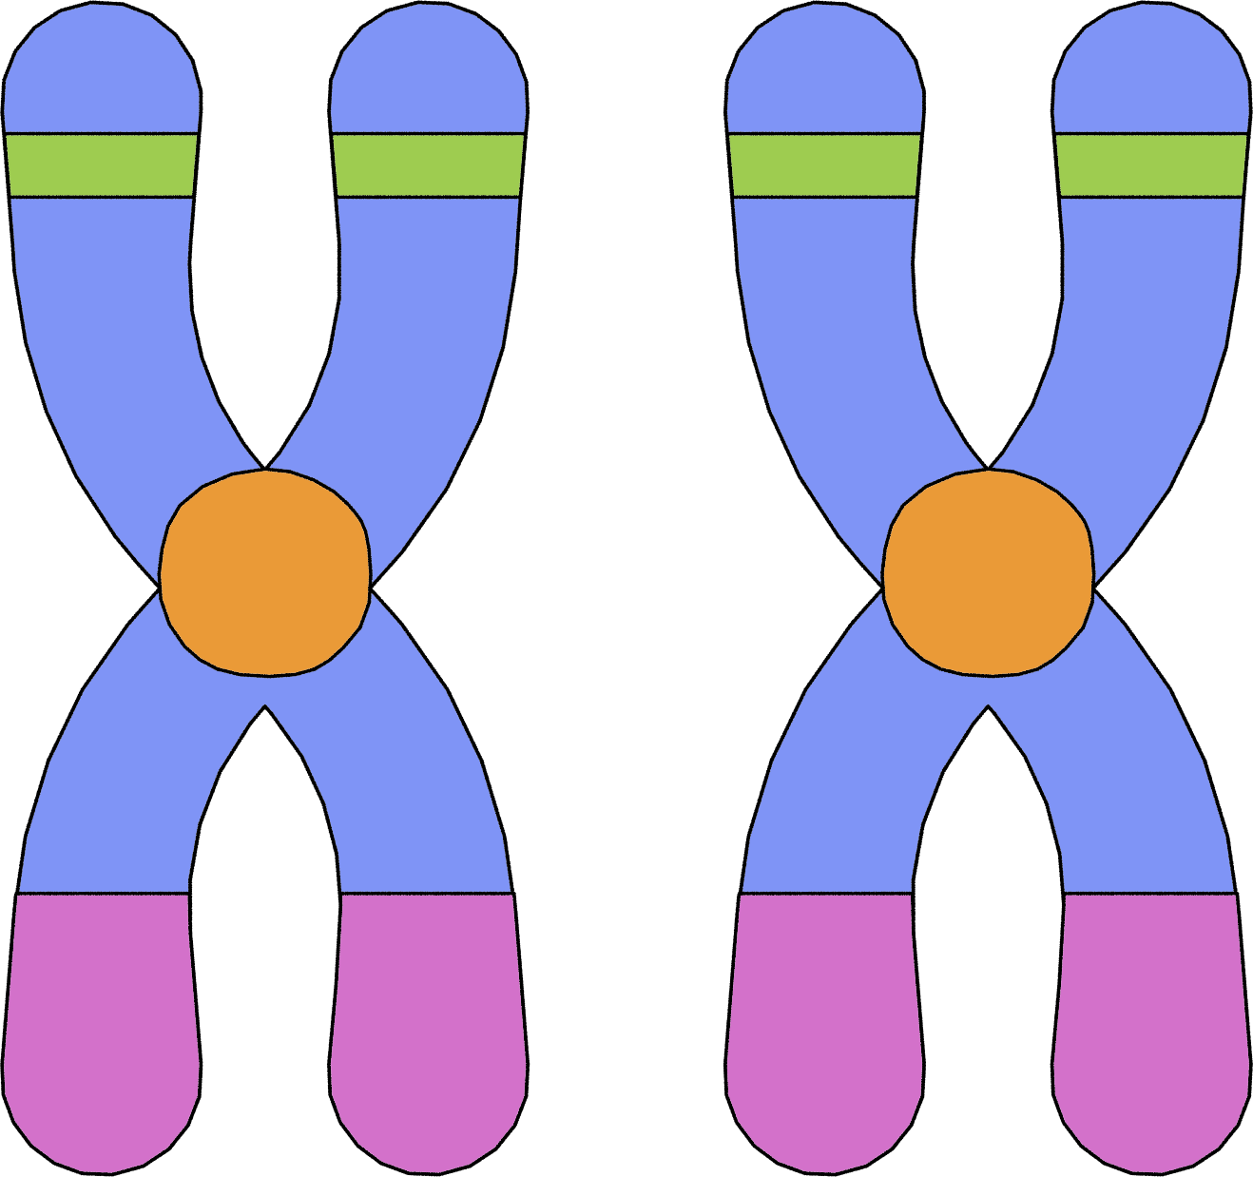
Cancer Type Prediction Using Gene Expression Data
prepared by
Alaa Khaled Shukair
ID:221002049
CBIO313 – Data Mining and Machine Learning Spring 2026

Slide 2

Project Objective
Predict cancer type using gene expression data
Apply preprocessing and feature engineering
Compare multiple machine learning algorithms
Deploy the final model using Streamlit
Project question
Can machine learning predict the cancer type of a sample using gene expression data?

Slide 3
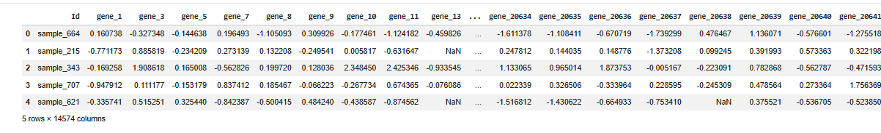
Dataset Overview
Dataset contains gene expression values
150 samples and 14,574 features
Multi-class cancer classification problem
Real-world biomedical dataset

Slide 4

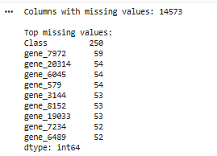
Missing Values & Data Cleaning
Missing values detected in many genes
Missing values handled during preprocessing
Dataset cleaned successfully
Final dataset ready for analysis

Slide 5
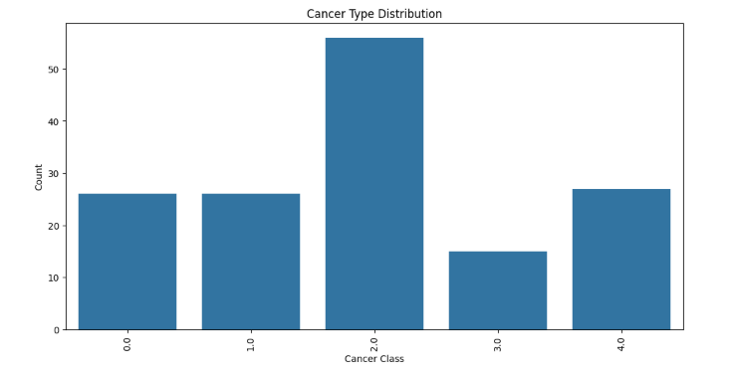
Exploratory Data Analysis
Class distribution analyzed
Some classes contain more samples than others
Dataset shows moderate imbalance

Slide 6
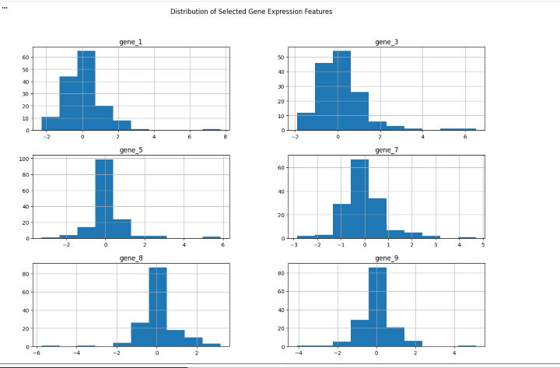
Feature Distribution
Distribution of selected gene expression features
Most genes centered around zero
Presence of outliers and variability

Slide 7
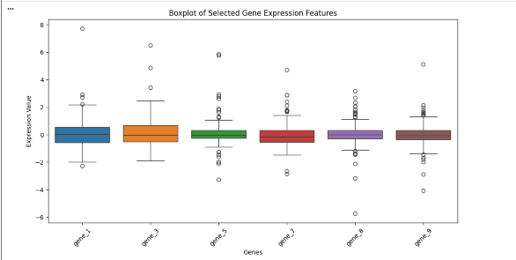
Boxplot Analysis
Outliers detected across several genes
Gene expression values show variability
Important for understanding data spread

Slide 8
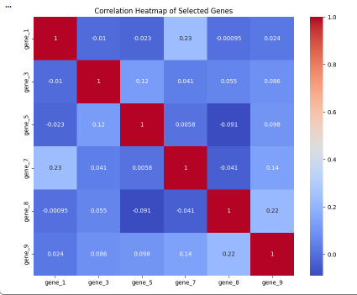
Correlation Analysis
Relationship between gene features visualized
Different cancer classes overlap partially
Indicates classification complexity

Slide 9
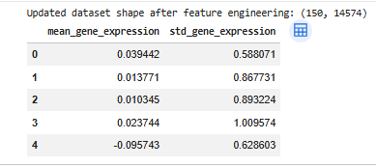
Feature Engineering
Created new statistical features
Mean gene expression
Standard deviation of gene expression
Improved feature representation

Slide 10

Feature Selection
SelectKBest with ANOVA F-test used
Reduced features from 14,574 to 100
Helps reduce dimensionality
Improves model efficiency

Slide 11

Train/Test Split
Dataset split into training and testing sets
StandardScaler applied
Prevented data leakage
Improved model performance

Slide 12
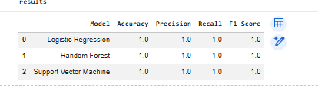
Machine Learning Models
Logistic Regression
Random Forest
Support Vector Machine
Models compared using multiple metrics

Slide 13
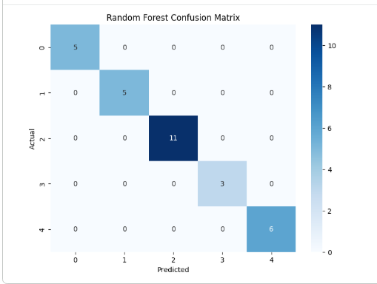
Best Model Evaluation
Random Forest achieved best performance
High classification accuracy
Excellent class prediction capability

Slide 14
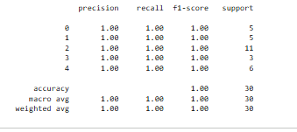
Classification Report
Precision, Recall, and F1-score evaluated
Strong performance across all classes
Balanced model behavior

Slide 15

Hyperparameter Tuning
GridSearchCV used for optimization
Tuned Random Forest parameters
Improved cross-validation performance

Slide 16
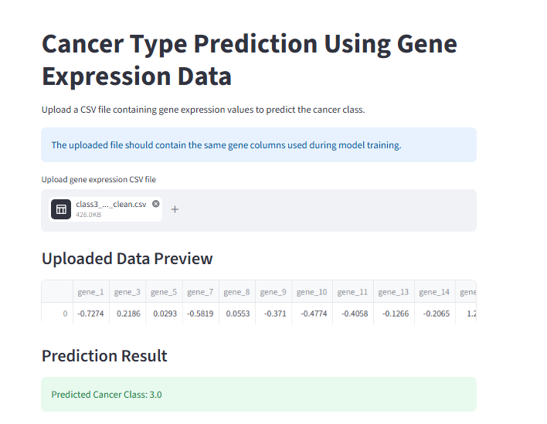
Streamlit Deployment
The final model was deployed using Streamlit.
The user uploads an Excel/CSV sheet containing gene expression values.
The app preprocesses the uploaded gene data using the saved scaler and selected features.
The trained model predicts the cancer class automatically.
The prediction result is displayed directly on the web app.

Slide 17

Conclusion
Successfully predicted cancer classes
Feature selection improved efficiency
Random Forest achieved best results
Streamlit deployment completed successfully

