Slide 1
Model-Agnostic Meta-Learning Networks for Remote Sensing Scene Classification
Adam DiChiara ▪ Vincent Filardi ▪ Quincy Hershey ▪ Alexander Moore ▪ Scott Tang

Slide 2
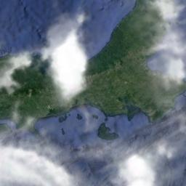
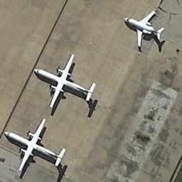
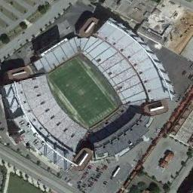
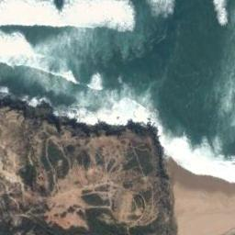
Problem Area
Remote sensing scene classification
Classifying images taken from airborne or spaceborne sensors
Previous work
Poor generalization across datasets
Data variance is a key vulnerability
Data intensity challenges existing methods
Why is this different?
Meta-learning trained network using image augmentations to address generalization, robustness and data intensity

Slide 3
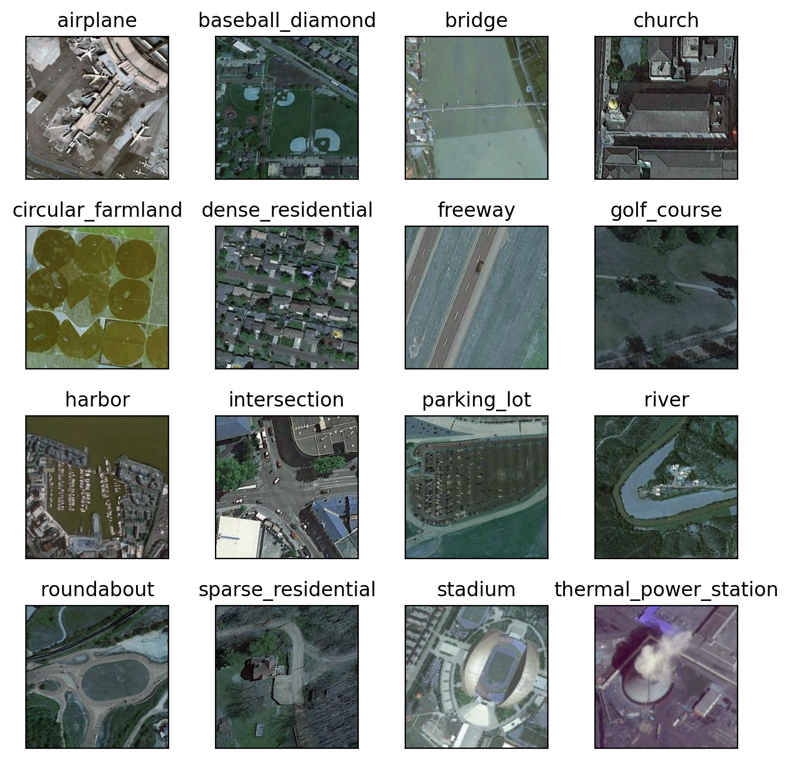
Dataset
NWPU – RESISC45
Google Earth (256x256) images
31,500 images in 45 classes
UC Merced – Land Use
USGS National Map Urban Area Imagery (256x256) images
2,100 images in 21 classes
Challenges
Image variance in scale and quality
Within class variation
Multiple objects within scenes
Scale of dataset
Class overlap

Slide 4
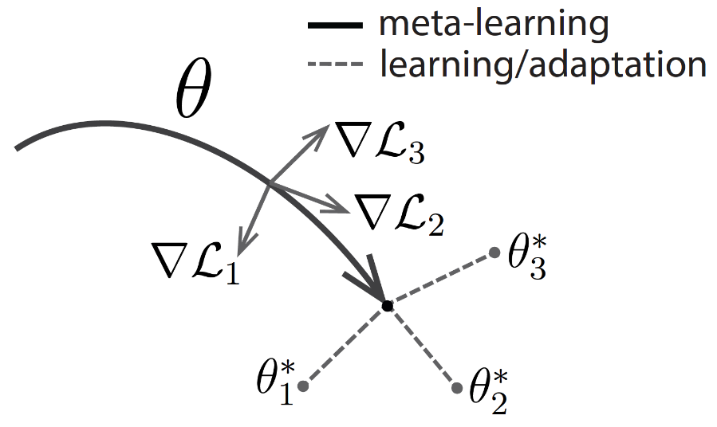




MAML
Optimizing parameter initialization
improves performance in few shot scenarios
Off the shelf – with some training
versus pre-trained model strictly off the shelf
Model parameters minimizing the sum of losses of all tasks
Model parameters obtained by MAML
L² (task 2 loss)
L¹ (task 1 loss)
L² (task 2 loss)
L¹ (task 1 loss)
$${\hat{θ}}^{2}$$
$${\hat{θ}}^{1}$$
$$∅$$
model parameters
$$∅$$
$${\hat{θ}}^{2}$$
model parameters

Slide 5
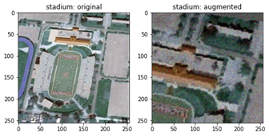
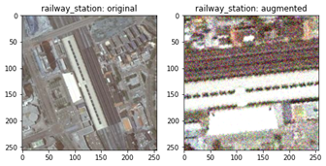
Tasks
Task Augmentations
Each Task consists of up to seven image augmentations applied in sequence
Augmentations are predefined in a task matrix and applied on the fly
Task index [0:127] - All Augmentation Combinations Full Factorial Boolean Matrix
 | 1 | 2 | 3 | 4 | ... | 26 | … | 59 | ... | 87 | ... | 127
Horizontal Flip
Vertical Flip
Rotation
Perspective
Crop
Gaussian Noise
Brightness

Slide 6
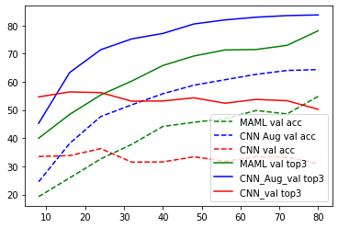
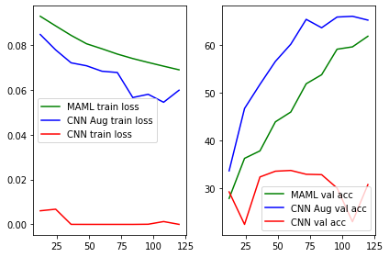
Results
Best Results† | CNN | Augmented CNN | MAML CNN 1st Order Approx. | MAML CNN
RESISC45 Top 1 Accuracy (%) | 34.70% | 70.60% | 60.26% | 52.47%
RESISC45 Top 3 Accuracy (%) | 55.43% | 89.50% | 84.19% | 75.09%
UC MERCED Top 1 Accuracy (%) | 45.05% | 67.12% | 62.19% | 26.57%
UC MERCED Top 3 Accuracy (%) | 69.35% | 88.34% | 85.10% | 47.32%
20% training, of which 20% validation, learning rate 0.0006 and batch size 32 for CNN & 1st Order Approximation

