Slide 1

UA – CIROH’s 2i2c infrastructure
CUAHSI CYBERSEMINAR

Slide 2
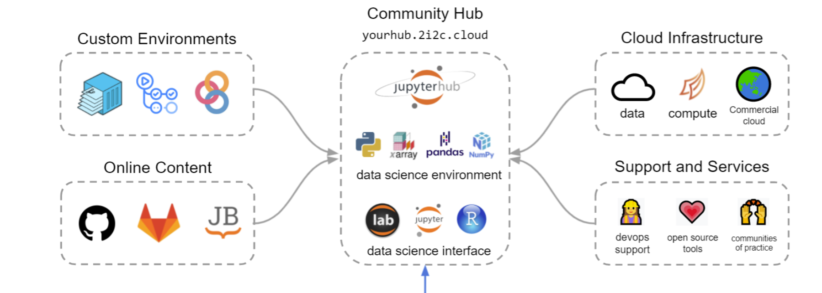
2i2c HuB
2i2c- Interactive computing and storage for the community
Provides managed Jupyterhub service
2i2c Url : https://2i2c.org/
Notes:
2i2c designs, develops, and operates JupyterHubs in the cloud for communities of practice in research & education. It builds and supports open source infrastructure that serves these communities.

Slide 3
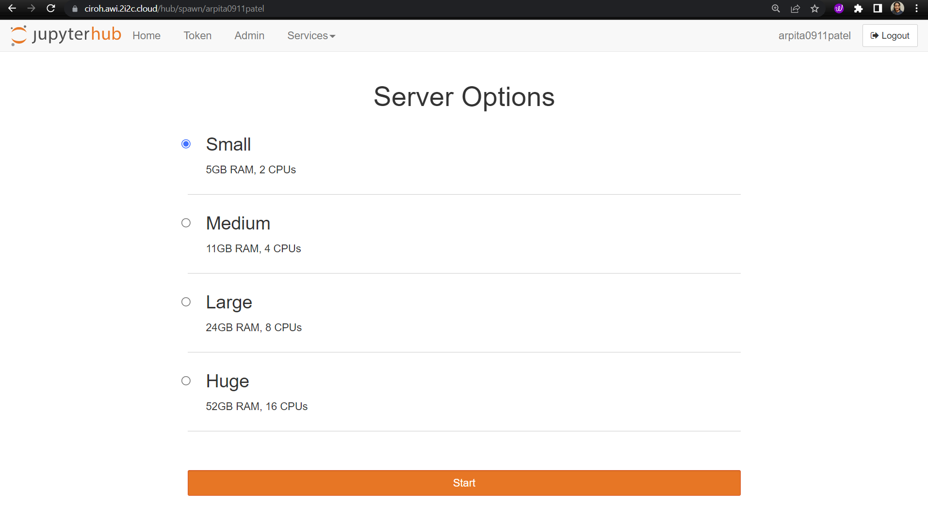
CIROH-UA Jupyterhub
Production env:
https://ciroh.awi.2i2c.cloud/
Staging env:
https://staging.awi.2i2c.cloud/

Slide 4
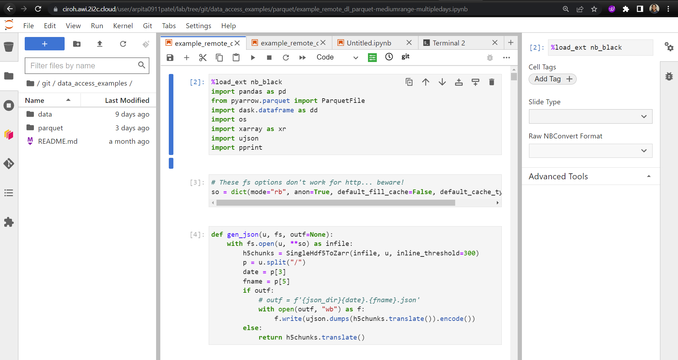
Hub Homepage

Slide 5
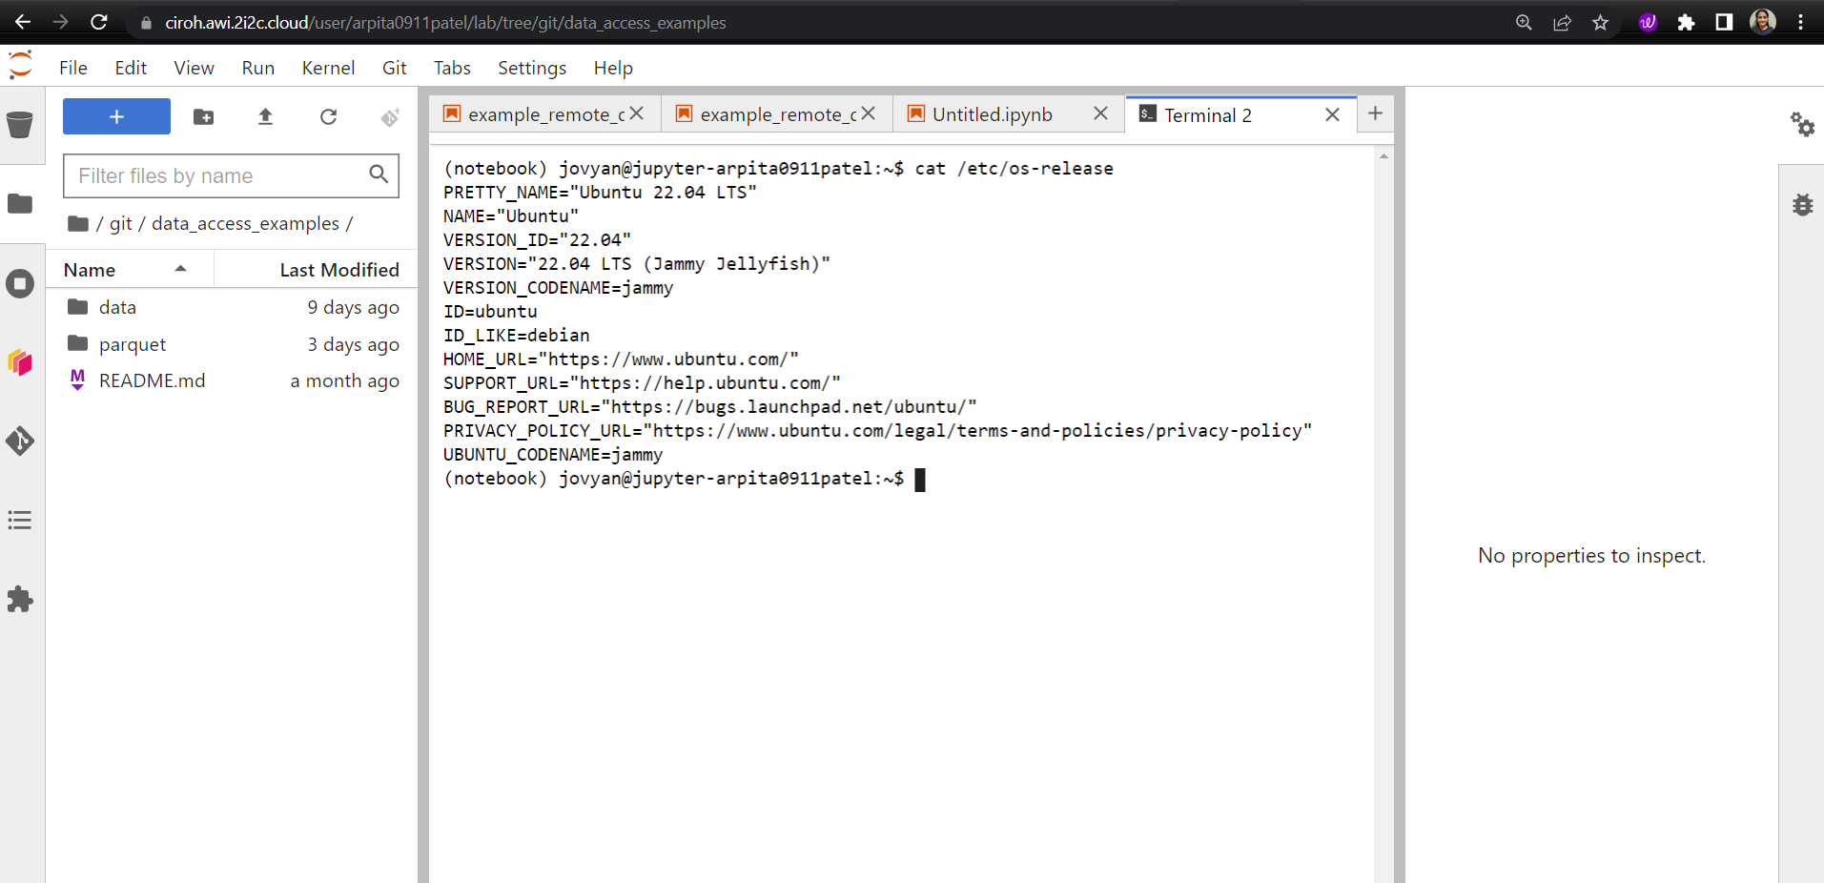
Terminal VIEW

Slide 6
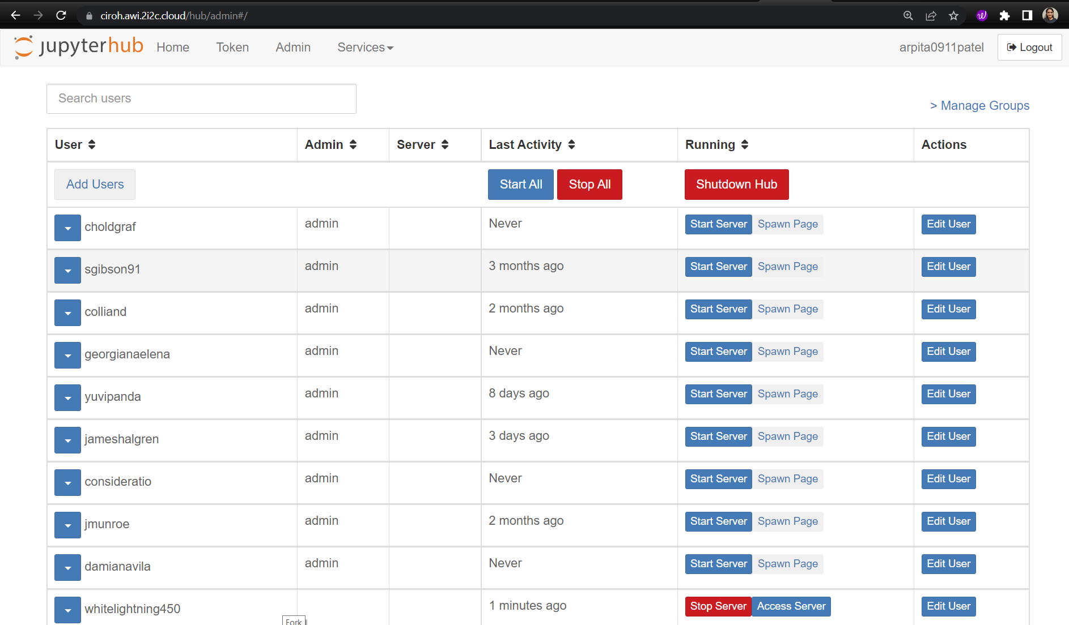
Admin SUPPORT

Slide 7
2i2c - Technology stack
Docker – to build customized image for the users
Kubernetes - to manage resources on the cloud
Helm v3 - to configure and control the packaged JupyterHub installation
Terraform – to build Kubernetes clusters on cloud providers.
Storage – object storage, cloud storage (s3, gcsfs)
Cloud Providers - Google Cloud, Microsoft Azure, Amazon EC2, IBM Cloud…
JupyterHub – to give users access to a Jupyter computing environment
Domain registration - make the hub available at https://your-domain-name.com

Slide 8
2i2c – Services
JupyterHub is an open-source project for providing and managing interactive computing sessions to multiple users, usually deployed on shared infrastructure.
JupyterHub for Kubernetes is a distribution of JupyterHub designed for use with the scalable Kubernetes platform.
The Right to Replicate is a guiding principle of 2i2c Hub infrastructure. It gives communities the right to replicate their infrastructure in its entirety elsewhere, with or without 2i2c.

Slide 9
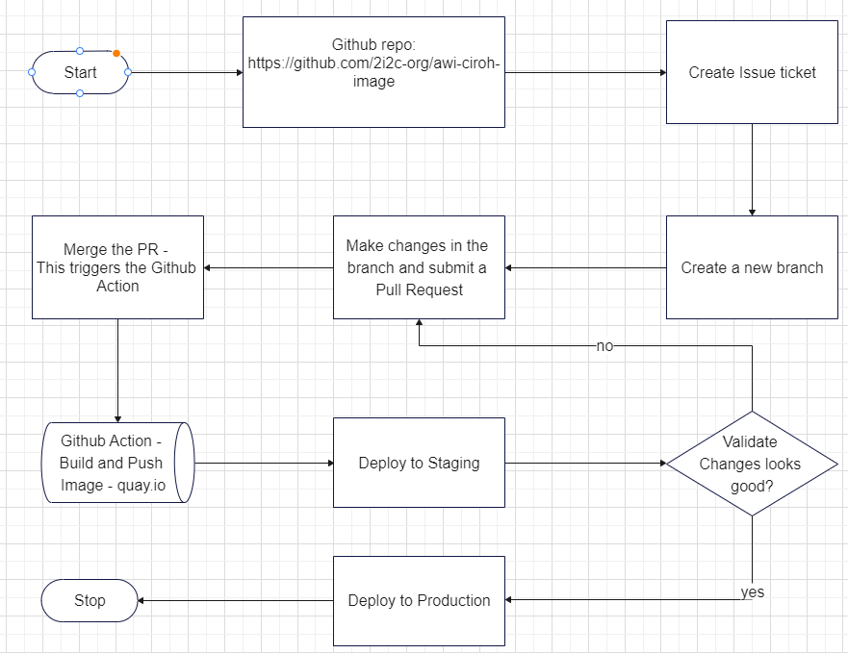
CI/CD
Notes:
Go to 2i2c-AWI-CIROH-Image github repo and create a new ticket for feature/hotfix/documentations etc.
Create a new branch for the changes and make changes to your code.
Open a Pull Request and merge the PR.
Triggers the Github Actions that will build, validate and push the image to Quay.io
Hook the image -> staging or production env.

Slide 10
References
2i2c AWI-CIROH Image: https://github.com/2i2c-org/awi-ciroh-image
2i2c Projects: https://2i2c.org/projects/
2i2c Github: https://github.com/2i2c-org/
2i2c Hub Service Guide: https://docs.2i2c.org/en/latest/
2i2c Infrastructure Guide: https://infrastructure.2i2c.org/en/latest/

