Slide 1


Intro to GitHub
CIROH/AWI REU, May 21, 2026
Quinn Lee Russell
qylee@ua.edu
GitHub: @quinnylee

Slide 2


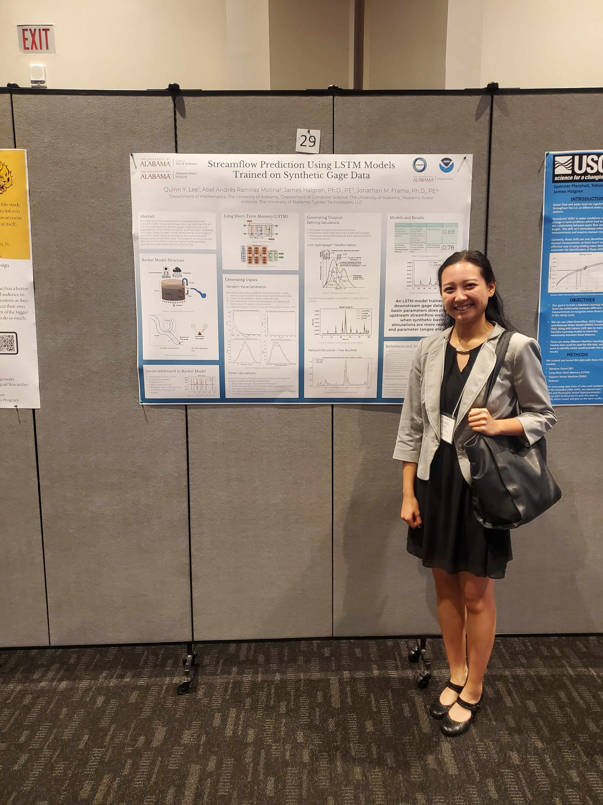

Who am I?
Programmer Analyst for CIROH Science Team
University of Alabama graduate (2024)
Former REU participant (2024)

Slide 3
Agenda
What is Git/GitHub?
How does it all work?
Attitudes for success
Practice time!

Slide 4
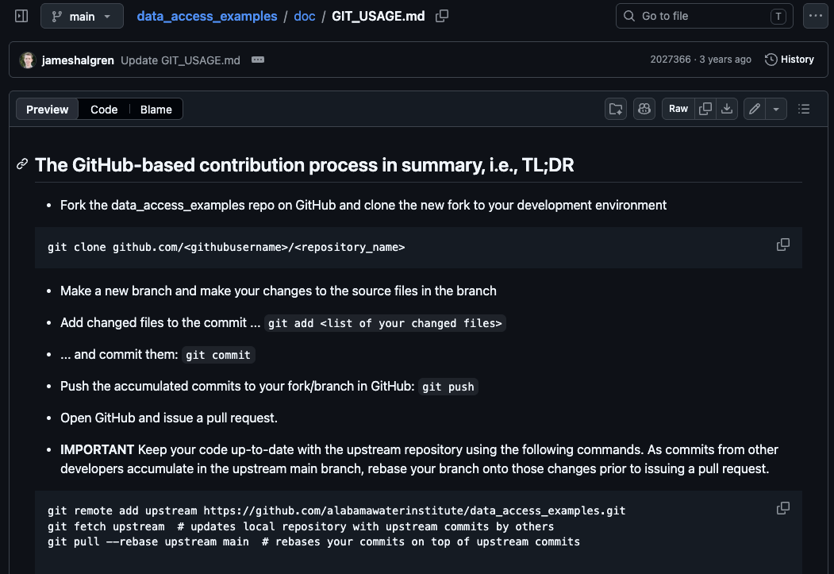
Acknowledgments
Dr. James Halgren’s GitHub workflow document
https://github.com/AlabamaWaterInstitute/data_access_examples/blob/main/doc/GIT_USAGE.md
Git docs
https://git-scm.com/docs

Slide 5
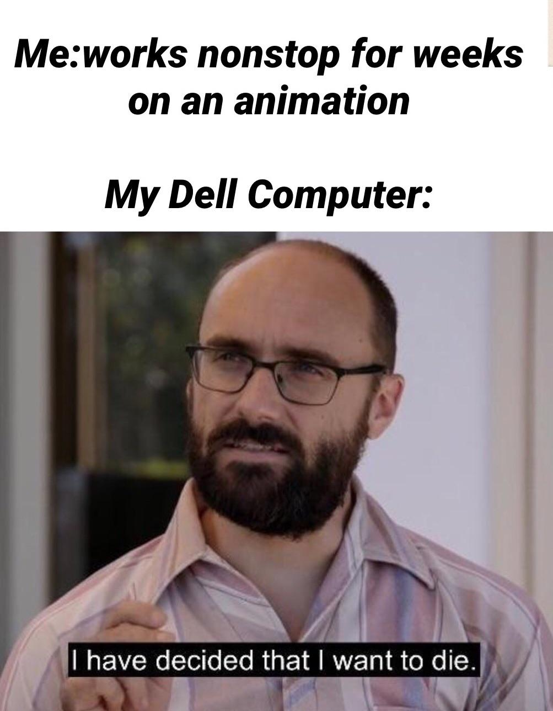
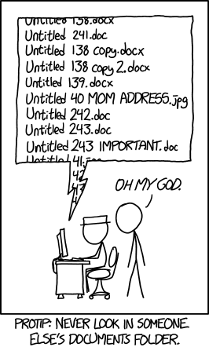
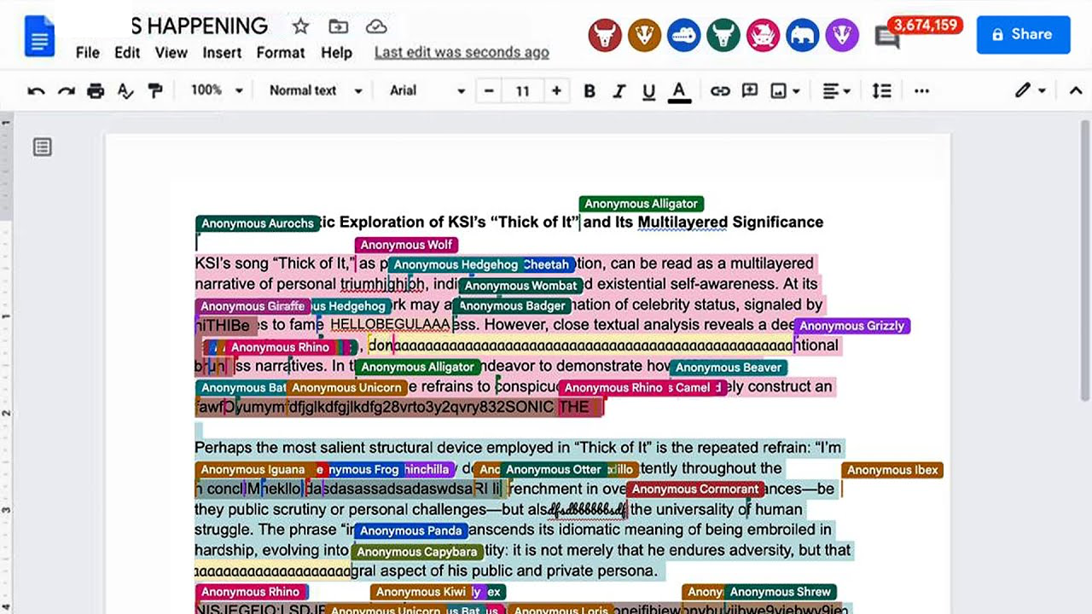
What is Git/GitHub?
Has this ever
happened to you?

Slide 6
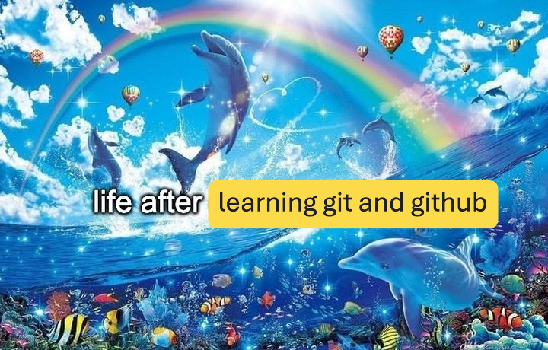
What is Git/GitHub?
Imagine this…
Every change made is accessible and trackable, comes with a description, and is tied to a specific person
Every mistake can be reverted
Multiple people can work on the same project on their own computers simultaneously
Copies of the project exist on the cloud and on the computer of each contributor

Slide 7

What is Git/GitHub?
So… what actually is
Git??
Git is a “version control system”
“Git thinks of its data more like a series of snapshots of a miniature filesystem. With Git, every time you commit, or save the state of your project, Git basically takes a picture of what all your files look like at that moment and stores a reference to that snapshot.” – Pro Git, Scott Chacon and Ben Straub (2014)
Every change made to a codebase is captured by a “snapshot”
Each “snapshot” has an ID and the name of who took the picture

Slide 8

What is Git/GitHub?
What is GitHub?
GitHub is a Git server
Locally made changes to a Git codebase can be uploaded to GitHub, and Git codebases can be downloaded from GitHub, and so on…
Anyone with a GitHub account (and permissions to the codebase) can upload changes and download changes
Everything on GitHub is stored on the cloud

Slide 9
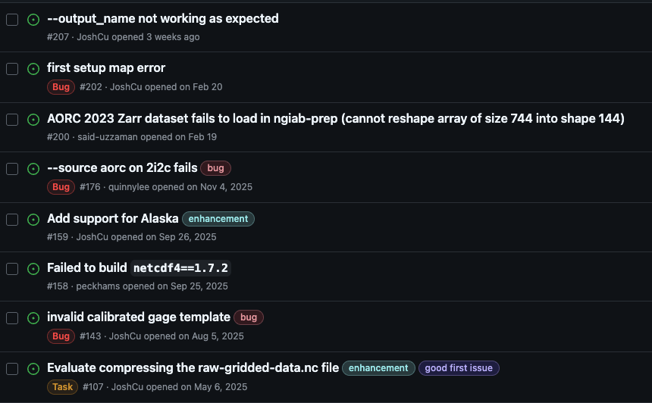
What is Git/GitHub?
Other neat GitHub
features
Documentation
Discussion boards
Project management tools
Bug reports and feature requests
Automated deployment pipelines

Slide 10
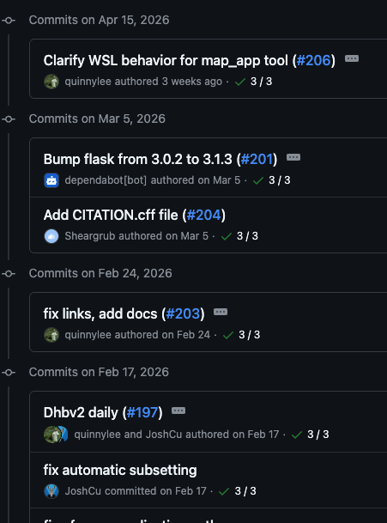
What is Git/GitHub?
Some Git/GitHub terms
Commit - snapshot
Commit author – person who took the snapshot
Commit ID – ID of the snapshot
Commit message – description of the snapshot
Repository (repo) – a project/codebase

Slide 11
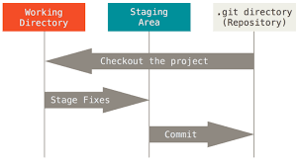
How does it work?
Basic structure – local
changes

Slide 12
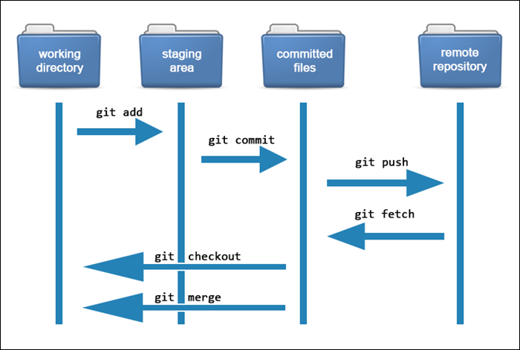
How does it work?
Basic structure – local
to remote

Slide 13
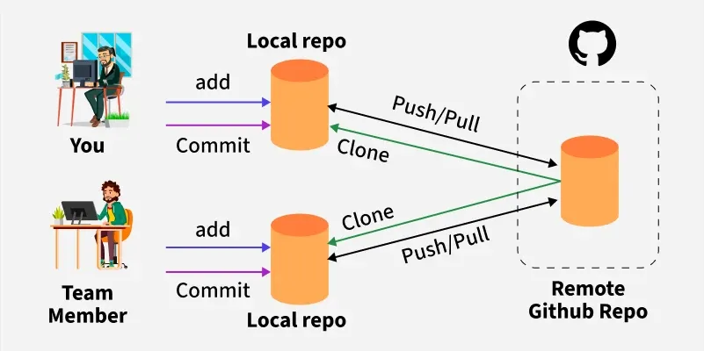
How does it work?
Basic structure – local
to remote w/ collaborators

Slide 14
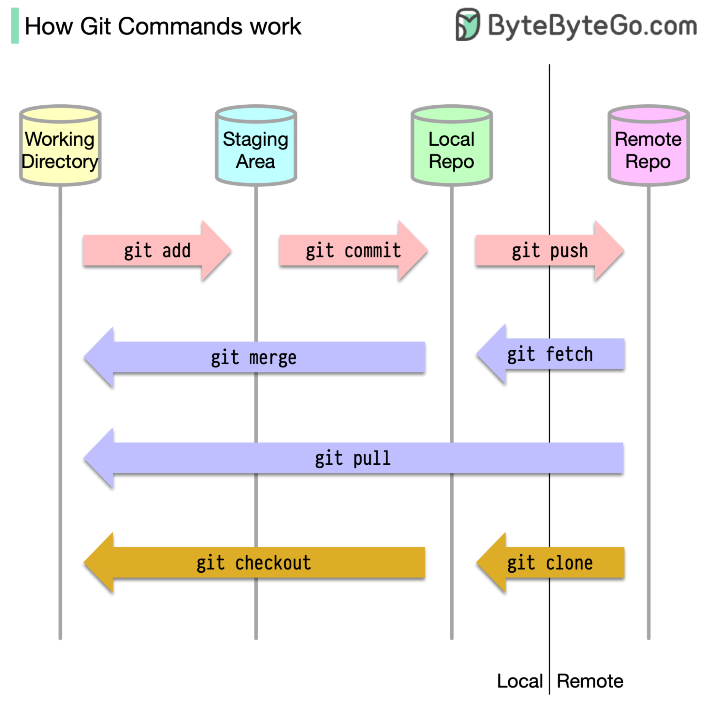
How does it work?
Commands

Slide 15
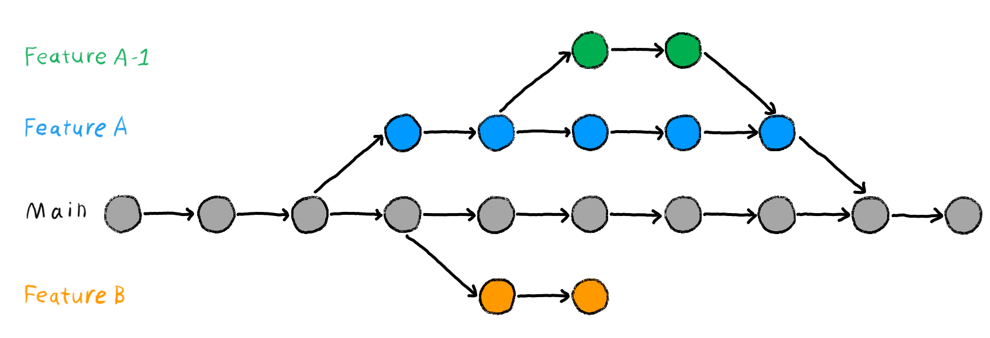
How does it work?
Branches
Can (and should) be on both local and remote repos!

Slide 16

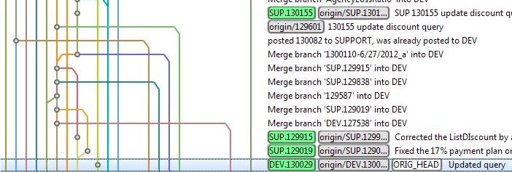
Attitudes for success
What do you do here?

Slide 17


Attitudes for success
What is success?
Perseverance
Small, gradual improvements
Building confidence that you can learn and do hard things
What success is not
Instant perfection
“Getting it” without having to work for it
Despair and giving up
Pretending to “get it” but actually using LLMs to do your work

Slide 18
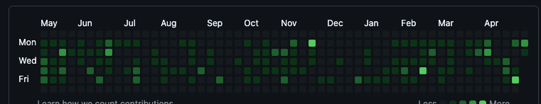
Attitudes for success
How do we get there?
Practice
Practice
Practice
Practice
Practice
Practice
Practice
Practice
Practice
Practice
Practice

Slide 19
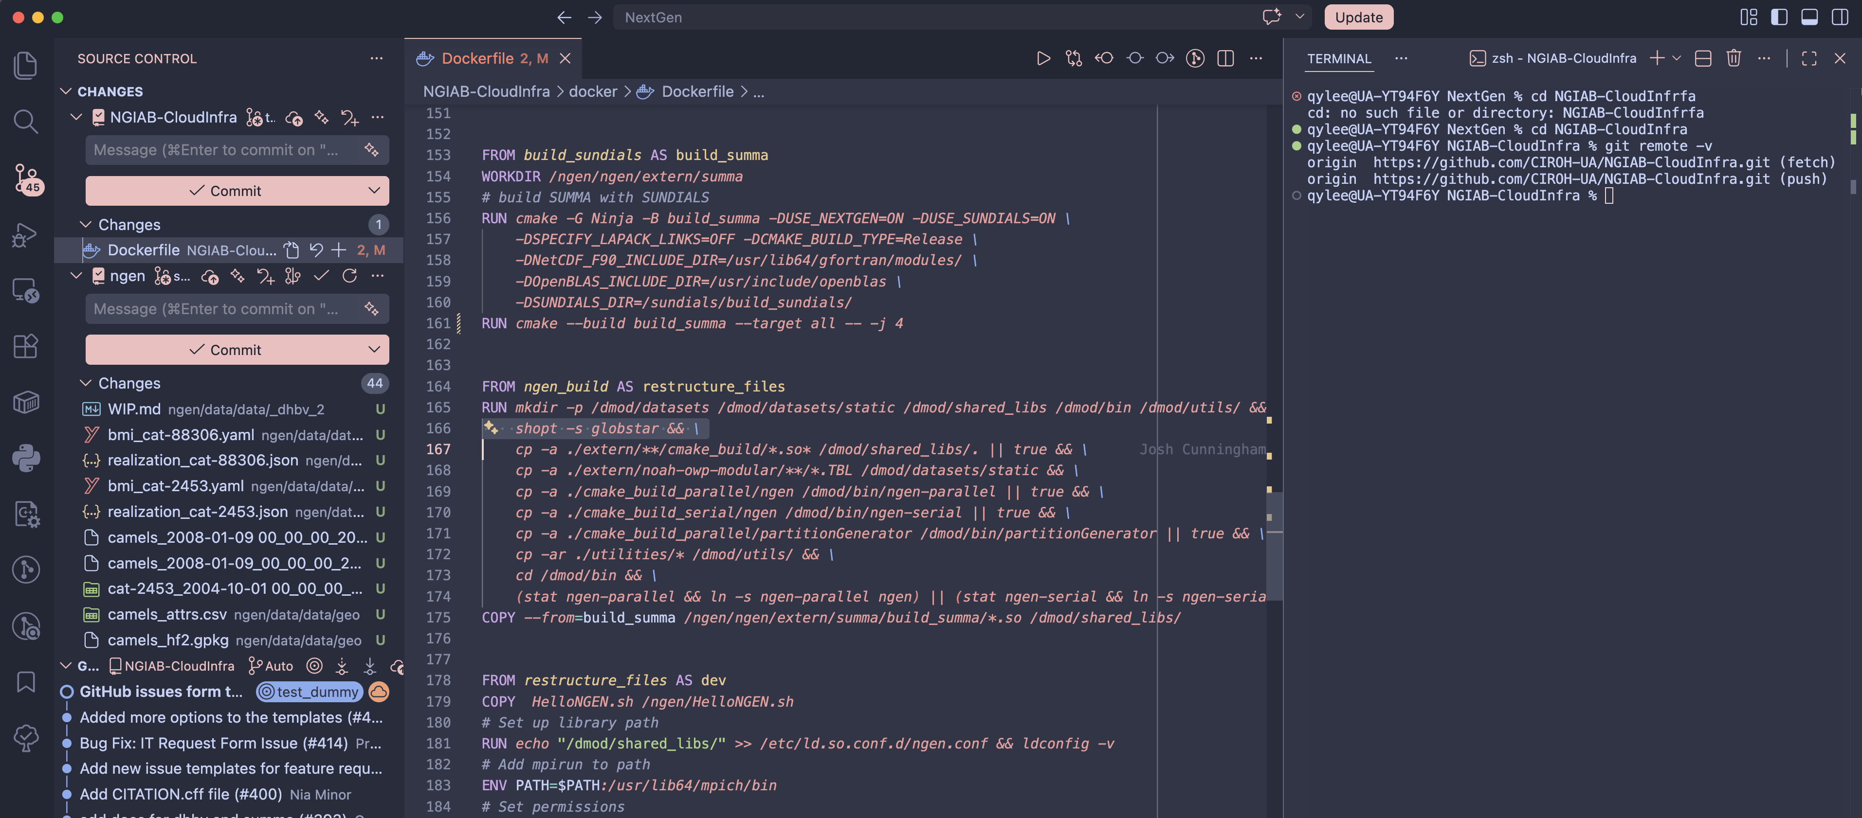
Practice time
What tools should I use?
Git(Hub) can be used in the terminal, which is powerful, but a little annoying…
My editor and IDE of choice: Visual Studio Code
Git support is built in
A useful Git/GitHub extension (very optional, but useful for collaboration): GitLens

Slide 20
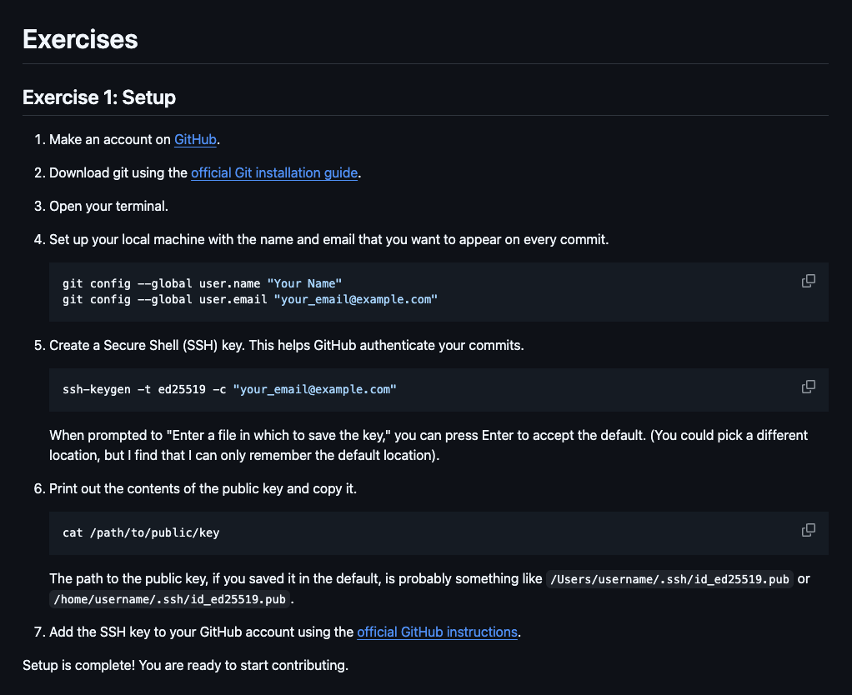
Practice time
Exercise time
https://github.com/AlabamaWaterInstitute/git_practice

