Slide 1
Lesson 2: Images and links
KS4 – HTML and CSS
Notes:
Last updated 02-02-21
Resources are updated regularly — the latest version is available at: ncce.io/tcc.
This resource is licensed under the Open Government Licence, version 3. For more information on this licence, see ncce.io/ogl.

Slide 2
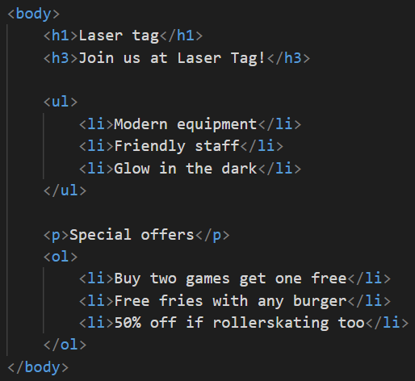
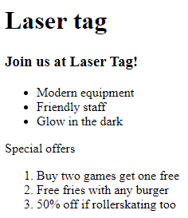
Compare with your homework – Did you get it right?
Starter

Slide 3

2: Images and links
Objectives
In this lesson, you will:
Recap on the learning from the previous lesson using homework
Describe what is meant by the term ‘accessibility’
Extend an HTML page to include:
Images <img>
Hyperlinks <a href>

Slide 4

Accessibility
Activity 1
What is meant by the term ‘accessibility’?
Accessibility refers to having ability to access something.
Users of IT systems can have a wide range of needs, conditions or disabilities.
Notes:
Image source: https://pixabay.com/illustrations/lee-berger-desk-laptop-homo-naledi-978052/

Slide 5

Accessibility
Activity 1
Can you think of anything you could do on a website to support users with visual impairments?
Think/Pair/Share

Slide 6
Accessibility
Activity 1
Watch this short video about design considerations that you can use to make your website as accessible as possible.
Notes:
Watch video from start until 4:00. This enough to give your learners an impression that there are wide variety of users with different needs who may be viewing their websites.

Slide 7

Finding an image for your webpage
Activity 2
There are millions of images of pretty much everything on the internet from cats to architecture.
In this task you will find a suitable image online for your webpage, get its source (the URL for the image), and insert it into your webpage.
Notes:
Image source: https://pixabay.com/vectors/image-pictures-icon-photo-1271454/

Slide 8
Finding an image for your webpage
Activity 2
Open the Activity 2 worksheet that contains instructions on how to insert an image into your webpage.
Notes:
Image source: https://pixabay.com/vectors/image-pictures-icon-photo-1271454/

Slide 9
Image attributes
Activity 3
You may now be wondering how to resize your image if it is too big or small. There are attributes for this.
The width attribute lets you change how wide the image will be in pixels. If you change the width, the height will scale proportionally. If you change the height and the width attributes then you risk squashing the image.
Example
<img src="source goes here" width = 300 height = 200 alt="Pizza" >

Slide 10
Image attributes
Activity 3
The alt attribute is for people who use screen readers. If the alt tag is not there, the screen reader will read out the full source. If the alt tag is left blank (i.e. “”) , the screen reader will say nothing. Neither of these things would be useful for people with disabilities.
You need to take users’ needs into account when creating webpages.
Example
<img src="source goes here" width = 300 height = 200 alt="Pizza" >

Slide 11
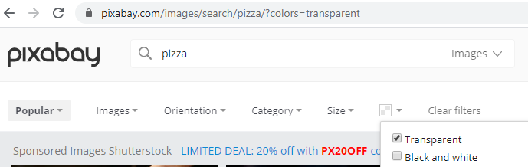
Other image tips
Activity 3
When designing for the web we may want part of an image to be transparent.
PNG and GIF images have the ability to be transparent.
When searching for images, you can put extra keywords such as ‘transparent’ or ‘PNG’ into your search query.
Sometimes search engines also allow you to specify that you want to get transparent images. For example, in pixabay you can filter to see only images with transparency:

Slide 12
Image accessibility
Activity 3
Open the Activity 3 worksheet, which contains instructions on how to implement accessibility features for images, and complete the tasks.
Notes:
Image source: https://pixabay.com/illustrations/lee-berger-desk-laptop-homo-naledi-978052/

Slide 13
Inserting hyperlinks
Activity 4
HTML stands for HyperText Markup Language. The text is called ‘hypertext’ because it is text extended to have the ability to be clicked on and linked to somewhere else.
The format for a hyperlink is:
<a href="link url"> link text</a>
Example:
<a href="https://www.google.co.uk"> Click here to visit Google</a>

Slide 14
Using an image as a hyperlink
Activity 4
To create an image as a hyperlink you combine the things you have learnt about already in this lesson.
Where you would usually put the text for the link, you can replace this with an image:
Open the Activity 4 worksheet, which contains instructions on how to create hyperlinks, and complete the tasks.
<a href="link url"> <img src="image source goes here" alt="Pizza" width = 300></a>

Slide 15
What is wrong with these tags?
Plenary
<img scr= "www.website.com/pizza.jpg">
<a href= "http://www.google.co.uk" > Google <a>
<img src= www.website.com/pizza.jpg >
<img href= "http://www.google.co.uk" > Google </img>
<img src= "image source goes here" alt = "Pizza" width = 0 >

Slide 16
What is wrong with these tags? – Answers
Plenary
<img src= "www.website.com/pizza.jpg"> (scr should be src)
<a href= "http://www.google.co.uk" > Google </a> (missing closing tag)
<img src="www.website.com/pizza.jpg"> (missing quotation marks)
<a href= "http://www.google.co.uk" > Google </img> (correct tag is a href)
<img src= "image source goes here" alt = "Pizza" width = 0 > (zero width)

Slide 17
Next lesson
Summary
In this lesson, you…
Found out what is meant by the term ‘accessibility’
Extended your page to include:
Images <img>
Hyperlinks <a href>
Next lesson, you will…
Identify the common features of existing websites and the basics of what makes good web design
Design and create two more pages for your ‘favourite things’ website
Create hyperlinks between pages
Insert images stored locally within a folder

