Slide 1
Campus Beats’18
FineWine | Go-to-market Strategy

Slide 2
TEAM DETAILS
Team Name - Schrodinger's cat
Amina Sultana
Alabhya Vaibhav
Kumar Aniket

Slide 3

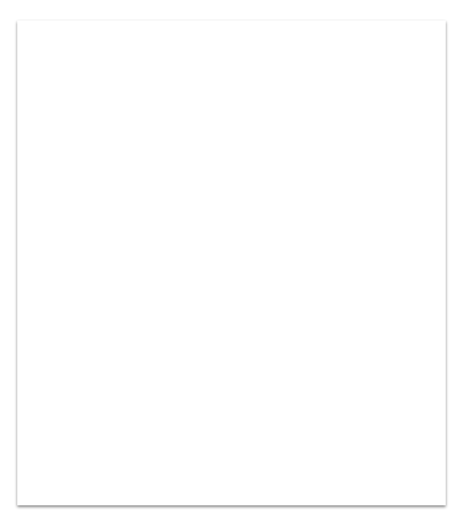
1. Introduction
FineWine an Indian wine company is looking to expand its European operation.
FineWine has been in the wine business since early 1990s and is one of the largest wine distiller in India. They recently entered the Spanish market in 2014.
As it had great success, which is primarily due to strong distillation capabilities, it is looking to embark on an ambitious expansion plan to other European countries.
It has a been backed up by a strong investor and has a mandate to grow.
In this presentation we propose a strategy to the above mentioned problem statement based on the analysis of the data provided.

Slide 4
OBJECTIVE OF THE EXPANSION PLAN:
Set up a manufacturing plant in Spain. This will allow the winemaker to
Use local, high-quality raw material and specific climatic conditions to enhance the quality and expand the offerings to meet local preferences
Reduce the time spent and cost on transportation from India to European countries
Enter three additional countries in Europe: Portugal, France, Italy
The regional marketing and sales team are currently based in Seville (Spain) and sell to distributors and a few large retailers
The company will need additional sales representatives to sell in Portugal, France and Italy, but given how different these markets are as compared to Spain, the company is not sure about the number of reps it will need to hire

Slide 5
Based on assessment of the market potential, what is the expected demand for FineWine products in Portugal, France, and Italy?

Slide 6
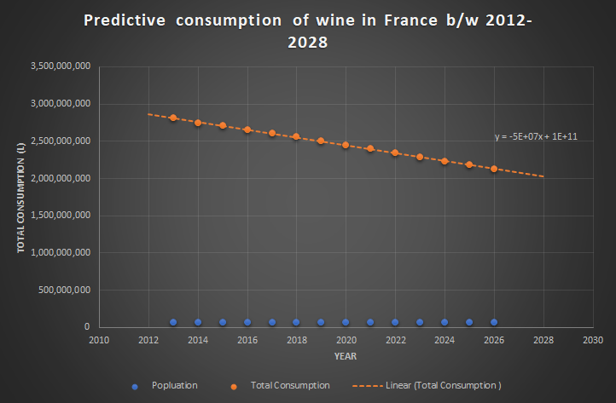

Slide 7
The graph above shows the wine consumption trend in France over the period 2013-2026.
As we can infer from the graph that there is a gradual decrease in consumption over the period. Using equation of linear regression, the following equation was formed y=-5e+07x+1e+11.
Where x represents the year and y represents the total consumption.
We figure out there is a linear decrease in the consumption of wine. So, there will be a gradual downfall in the demand of FineWine products in France.

Slide 8
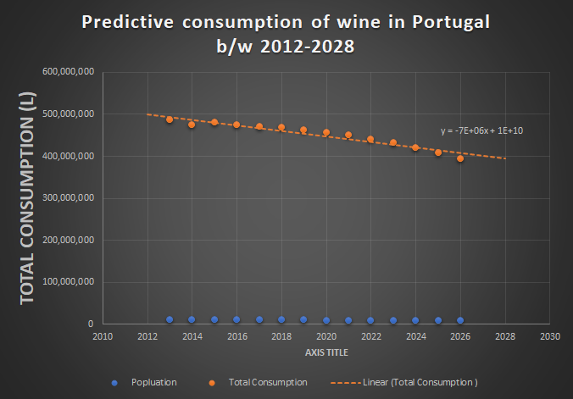

Slide 9
The graph above shows the wine consumption trend in Portugal over the period 2013-2026.
As we can infer from the graph that there is a decrease and then a gradual increase and then a gradual decrease in consumption of wine over the period. Using equation of linear regression, the following equation was formed y=-7e+06x+1e+10.
Where x represents the year and y represents the total consumption.
We figure out there initially there is a inconsistency in the consumption of wine but there a gradual downfall in the demand of FineWine products in Portugal can be predicted.

Slide 10
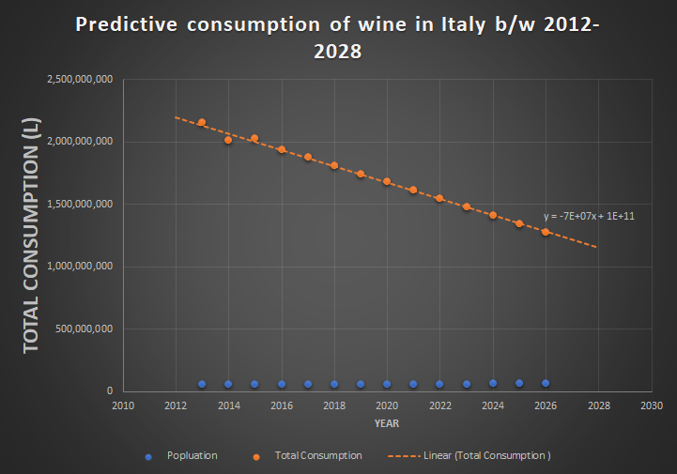

Slide 11
The graph above shows the wine consumption trend in Italy over the period 2013-2026.
As we can infer from the graph that there is a gradual decrease in consumption over the period. Using equation of linear regression, the following equation was formed on, y=-7e+07x+1e+11.
Where x represents the year and y represents the total consumption.
We figure out there is a linear decrease in the consumption of wine. So, there will be a gradual downfall in the demand of FineWine products in Italy.

Slide 12
2. For the three additional countries (Portugal, France, and Italy), what is the expected size of sales force that should be deployed?

Slide 13
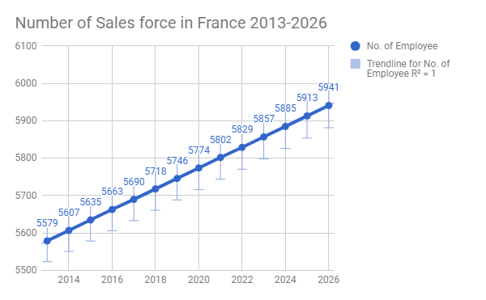

Slide 14
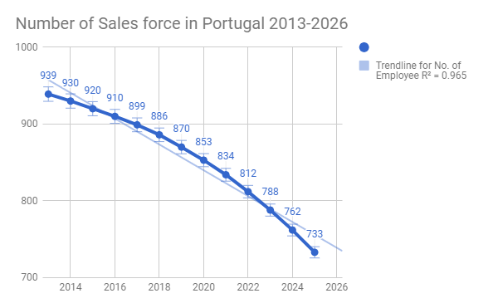

Slide 15
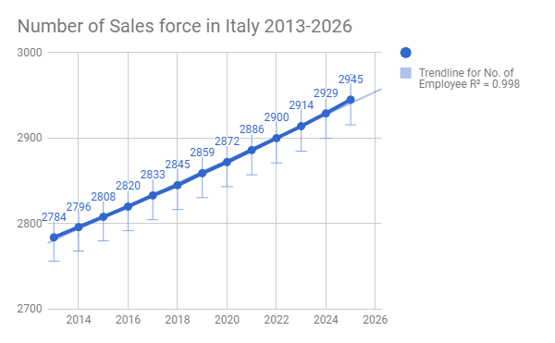

Slide 16
2.Sales reps will be going to three types of customers broadly:
Wholesalers and Distributors
Large retail chains
Small retailers
In your opinion, how will the activities of the reps differ across the three customer types, and therefore what should FineWine do about it?

Slide 17
Organizations put a lot of thought and effort into fine tuning complex sales strategies. But even the best sales strategies will fail without an effective, properly-sized sales structure.
As at FineWines we are following the Breakdown Method, which is probably the most simplistic, but also the most accessible. As we have divided the customer broadly into three categories: wholesalers and dealers, large retail chain and small retailers.
So accordingly we can divide the sales force into three groups, the first group handles the wholesalers and retailers, second group can handle the large retail chains and the third group can assist the small retailers.
The activities of all the three groups of sales reps would differ because the will tackle the different customer base.
Based on the demographic there should be a fixed number of wholesalers and dealers with which the sales reps should collaborate. Suppose we have 4 wholesalers and dealers in the North,South,East and West region respectively. So then the large retail chains in the respective area can be directed to these dealers by the sales reps of group 2 and similarly sales rep of group 3 would direct the small retailers to the large retailers of the area.

Slide 18
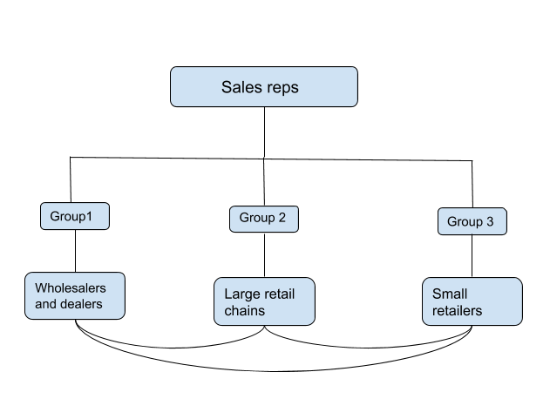

Slide 19
3.For the sales reps, what kind of incentives should be paid? What might be some drawbacks of incentivizing the reps based on the number of units they sell? Are there any other payment plan that can be used to incentivize the sales representatives?

Slide 20
Paid Time Off
Offering paid time off when your sales people achieve a certain goal, whether it’s a half-day Friday, the chance to sleep in and come in at noon on a Monday, or a full day off, can really motivate.
Games and Prizes
Creating scratch-off cards. Giving a card for every win, the majority of your prizes will be inexpensive but with one big-ticket item like a flat-screen TV or tickets to an event.Every sales person will receive a prize for each order, but because there’s a big prize to be won, they’ll be motivated to keep closing sales left, right, and centre to get a chance at winning it.
System to appreciate the sales rep
Have all of your employees write up inexpensive gift options or recognition ideas that they’d like, then put them all in an appreciation jar or a box. Every time reps are recognized for something, have them pick an idea at random from the jar and follow through.
INCENTIVES

Slide 21
The drawbacks of incentivizing the reps based on the number of units they sell is
The profit margins per unit reduces, which might lead to increase in the price of the product.
Can create rifts between employees.
The reps might try to sell the product to anyone out of our target customer with the motive to increase the sales number. Hence losing out on customer retention and also the outreach might be hampered.
DRAWBACKS

Slide 22
Territory Volume
Territory volume sales compensation plans are most often used in team-based corporate cultures. They work through the calculation of territory volume at the end a compensation period. The total sales for the territory are then split equally among all of the sales reps who worked that territory. This plan works best when your sales territories are clearly outlined, when your sales team supports each other to reach common goals, and when your territories are rich enough to support competitive wages.
ALTERNATIVES

Slide 23
4.What kind of reporting solution should be developed to track sales Performance?

Slide 24
In every sales department in the world, the amount of work that needs to be done usually outstrips the number of hours the sales team has available to do it.Making your sales team more productive doesn't have to be a matter of bringing on additional staff. A more efficient team gets more work done in a shorter amount of time.
Here are a few simple steps FineWine can follow to increase and track sales performance:
i) Automated Systems Work
The most important part of the sales team's job is interacting with the customer. That's not the whole job, though. A certain amount of administrative, clerical, and record-keeping activity has to get done every day in order to keep the team on track.
Standardizing the team's processes can go a long way towards making them more efficient. The sales reps should keep a record of important point and discuss these with fellow team members. Batching some of these activities to keep them from disrupting your workflow can make everyone more efficient.
A good sales representative does research before speaking with a customer, even if it's simply reviewing CRM records. This process can get drawn out and detract from productive work, though.
We need to set up a strict workflow for customer research to keep it on a reasonable time table.

Slide 25
ii) Use the Right Software Tools
Modern sales professionals have plenty of software tools available to make their jobs easier. They only save the team time if they're used correctly, though.The sales VP needs to familiarize himself with the managerial and reporting functions that allow him to track the team's work.
If the sales team needs a productivity boost, consider adopting one of the leading sales management tools. The examples listed here have all helped struggling sales teams find their way to productivity:
Ambition Sales Performance Management Platform
Sales Cloud by Salesforce
Infusionsoft
Xceleration
Leveleleven
One can use a custom built tracker, by simply using Google sheets combined with conditional formating and macros.
i

Slide 26
iii)Build a Real Project Management System
Sales is very much a project to manage. This means one needs to familiarize with successful project management techniques and apply them appropriately. Keeping in mind that project management is constantly evolving! Part of our responsibility to our team is keeping our knowledge current and giving them the benefit of the latest management ideas.
Use our project management abilities to keep track of the larger, strategic performance of your team.Large-scale oversight will help the team stay productive and avoid wasting time and resources. Relate their day-to-day activities with the company's overall goals and make their value to the organization clear. At the same time, exercise the authority by giving your team clear priorities and showing them what to focus on.

Slide 27
References
The following are the external references used in the case study:-
Wine consumption reports
http://www.who.int/substance_abuse/publications/global_alcohol_report/profiles/fra.pdf
http://www.who.int/substance_abuse/publications/global_alcohol_report/profiles/ita.pdf
http://www.who.int/substance_abuse/publications/global_alcohol_report/profiles/prt.pdf

