Slide 1
TK2100: Informasjonssikkerhet Lesson 10: XSS
Dr. Andrea Arcuri
Westerdals Oslo ACT
University of Luxembourg

Slide 2
Goals
Understand why some special characters need to be escaped/sanitized
Understand how XSS attacks can be carried out
Learn that you should never trust user inputs

Slide 3
Data Escaping/Sanitization

Slide 4
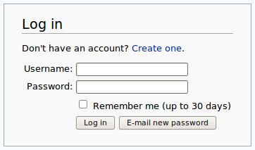
HTML Form Data
How is data sent in a HTML Form?
What is the structure of payload of the HTTP POST request?
JSON? eg {“username”:“foo”, “password”:123}
XML? eg <data><username>foo</username><password>123</password></data>

Slide 5
x-www-form-urlencoded
For textual data, like inputs in a HTML form
For binary data like file uploads, can use multipart/form-data
Old format which is part of the HTML specs
https://www.w3.org/TR/html/sec-forms.html#urlencoded-form-data
Each form element is represented with a pair <name>=<value>, where each pair is separated by a &
Eg.: username=foo&password=123

Slide 6
What if values contain “=” or “&”?
Eg, password: “123&bar=7”
(Wrong) result: username=foo&password=123&bar=7
The “bar=7” would be wrongly treated as a third input variable called “bar” with value “7”, and not be part of the “password” value

Slide 7
Solution: Special Encoding
Stay same: “*”, “-”, “.”, “_”, 0-9, a-z, A-Z
Space “ ” becomes a “+”
The rest become “%HH”, a percent sign and two hexadecimal digits representing the code of the character (default UTF-8)
So, “123&bar=7” becomes “123%26bar%3D7”
%26 = (2*16)+6 = 38, which is the code for & in ASCII
%3D = (3*16)+13 = 61, which is the code for = in ASCII
Recall, hexadecimal D=13 (A=10,…, F=15)

Slide 8
But…
What if I have a “%” in my values? Would not that mess up the decoding?
E.g, password=“%3D”, don’t want to be wrongly treated as a “=”
Not an issue, as symbol “%” is encoded based on its ASCII code 37, ie “%253D”
%25 = (2*16)+5 = 37

Slide 9
Text Transformations
We can represent text in various formats, eg, HTML, XML, JSON, x-www-form-urlencoded
Such formats use special symbols to define structures of the document
eg = and & in HTML form data, and <> in HTML/XML documents
Input text values should NOT use those special structure/syntax symbols
Need to be transformed (aka escaped) into non structure symbols
& into %26, and = into %3D in HTML form data

Slide 10
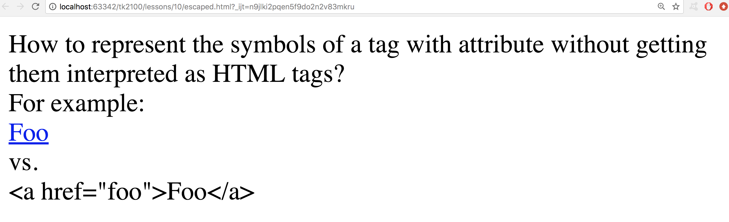
What About HTML???

Slide 11
HTML/XML Escaping
“&” followed by name (or code), closed by “;”
&quot; for “ (double quotation mark)
&amp; for & (ampersand)
&apos; for ‘ (apostrophe)
&lt; for < (less-than)
&gt; for > (greater-than)
These are most common ones

Slide 12
See “escaped.html” file
<a href="foo">Foo</a> vs. &lt;a href=&quot;foo&quot;&gt;Foo&lt;/a&gt;

Slide 13
What actually needs to be escaped depends on context
<div id="&quot;<p>&quot;"> "&lt;p&gt;" </div>p
Representing “<p>” (quotes included)
In attributes, quotes “ need to be escaped (&quot;), but no need there for <>, as those latter are no string delimiters
In node content, it is the other way round

Slide 14
XSS

Slide 15
User Content
Text written by user which is displayed in the HTML pages when submitted (eg HTML form)
eg, Chats and Discussion Forums
but also showing back the search query when doing a search
Also query parameters in URLs are a form of user input if crafted by an attacker
eg, www.foo.com?x=10 if then value of x is displayed in the HTML
recall, attacker can use social engineering to trick user to click on a link
What is the most important rule regarding user content given as input to a system???

Slide 16
NEVER TRUST USER INPUTS!!!

Slide 17
NEVER

Slide 18
TRUST

Slide 19
USER

Slide 20
INPUTS!!!

Slide 21
NEVER TRUST USER INPUTS!!!

Slide 22
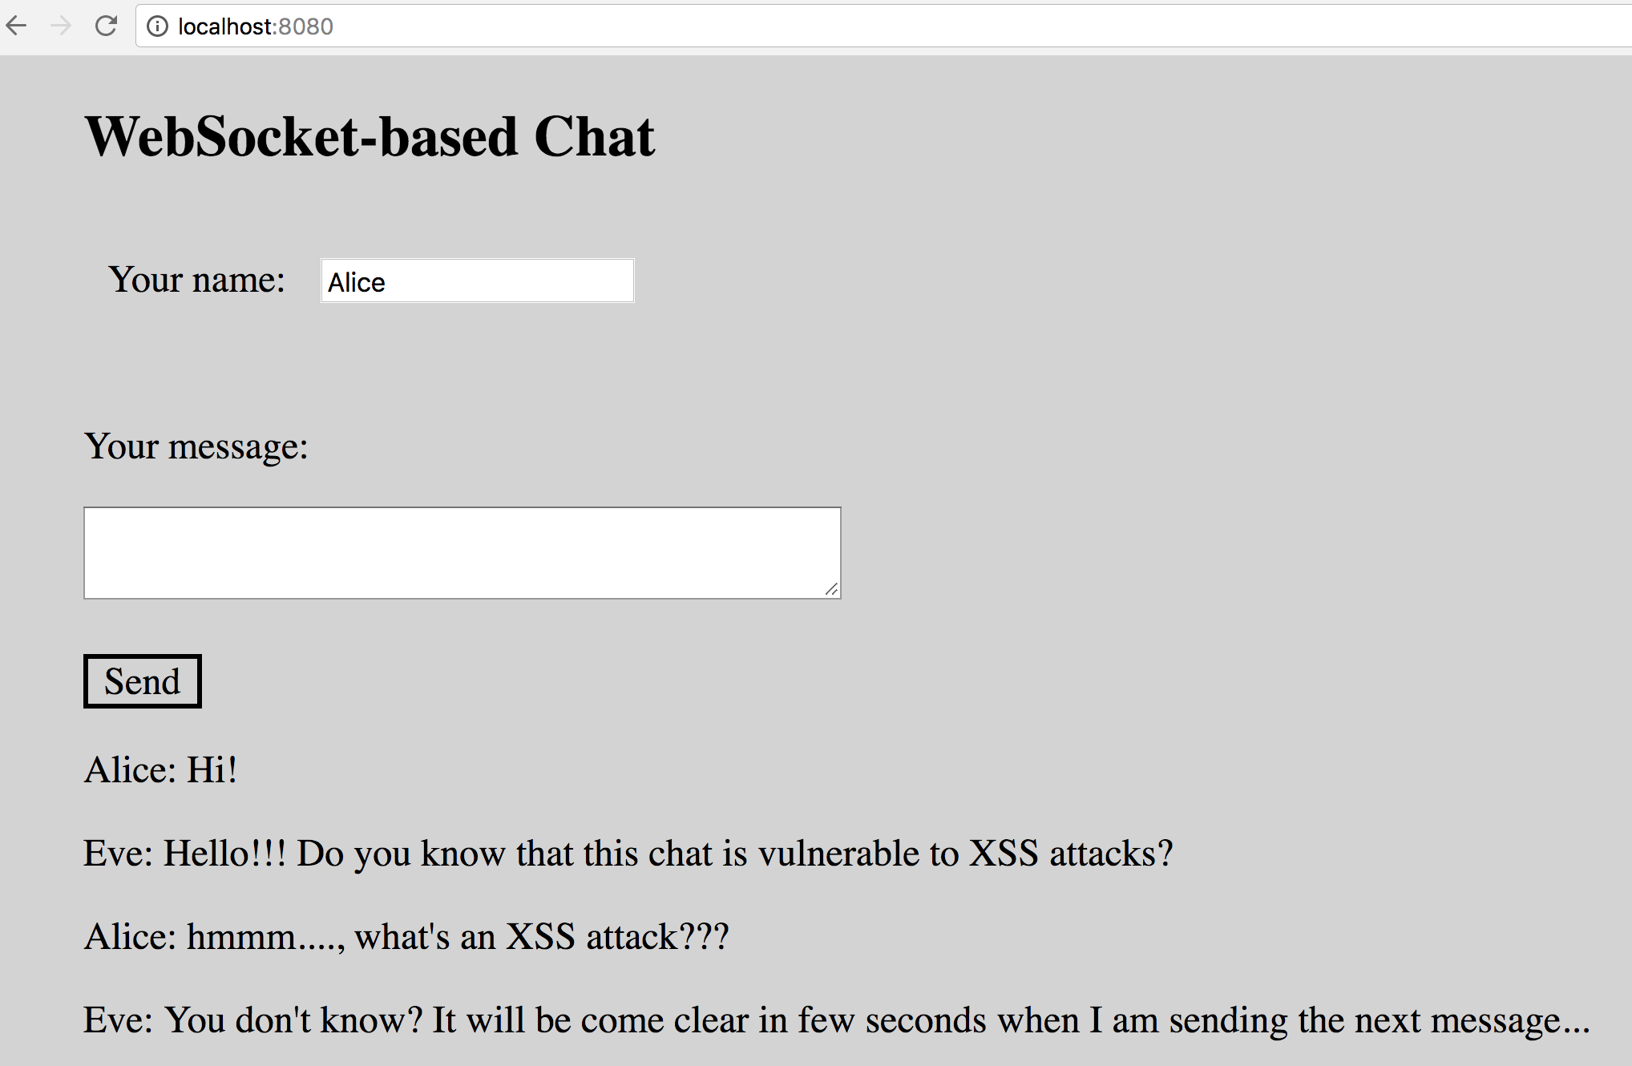
But Why???

Slide 23

After Eve’s message, chat program is gone on Alice’s browser…

Slide 24
What was the problem?
function updateMessages(dto){ var msgDiv = document.getElementById('messagesId'); var p = "<p>" + dto.author + ": " + dto.text + "</p>"; msgDiv.innerHTML += p; }

Slide 25
String Concatenation
var p = "<p>" + dto.author + ": " + dto.text + "</p>";
Should NEVER concatenate strings directly to generate HTML when such data comes from user
ie, that is a very, very bad example of handling user inputs
If data is not escaped, could have HTML <tags> that are interpreted by browser as HTML commands
Could execute JavaScript!!! And so do whatever you want on a page
Eg., dto.text = “<script>…</script>”

Slide 26
Cross-site Scripting (XSS)
Type of attack in which malicious JavaScript is injected into a web page
One of the most common type of security vulnerability on the web
Typically exploiting lack of escaping/sanitization of user inputs when generating HTML dynamically (both client and server side)

Slide 27
Browser Security
Most browsers will not execute any <script> block that has been dynamically added to the page
eg, when changing the HTML by altering “innerHTML”
But that is simply futile… because you can still create HTML tags with JS handlers that are executed immediately
<img src=’aURLthatNotExist' onerror=“… JS here…”>

Slide 28
What To Do?
When dealing with user inputs, always need to escape/sanitize them before use
This applies both client-side (JS) and server-side (Java, PHP, C#, etc.)
There are many edge cases, so must use an existing library to sanitize the inputs
This will depend on the programming language and framework
Do NOT write your own escape/sanitize functions

Slide 29
For Next Week
Book pages: 357-363
Note: when I tell you to study some specific pages in the book, it would be good if you also read the other pages in the same chapter at least once
Exercises for Lesson 10 on GitHub repository

