Slide 1

Sentiment trading
Jeff Brinker, Justin Leffew, Ameira Khaleq

Slide 2

Overview
Objectives
Create and compare sentiment-based trading (simple), ML strategy, and HODL approach
Start with $1,000 base investment to see profits/losses
Time Frame: 1-2 years

Slide 3

Data PREP & exploration
API Sources:
• Fastquant (Crypto volume, prices)
• Alternative.me (Fear & Greed Index)
• Pytrend (Google Search Trends)
Modularized into a single for loop
• Easily change time frame
• Scalability (apply to other cryptos)
ML models:
• Support Vector Machine Model (SVM)
• SciKitLearn*

Slide 4

Issues & Trouble Shooting
Time constraints
Data cleanup & preparation
SciKitLearn errors (version compatibility)
Limited data (time frame determinant variable)
Scope Creep
Only used Cardano (ADA)
BTC and ETH excluded

Slide 5

Indicators using our algorithms
When to Buy
When to Sell
When to Hold
Bitcoin (BTC)
Ethereum (ETH)
Cardano (ADA)
Cryptocurrencies used

Slide 6

Questions
1. Is it better to buy and hold or develop a trading strategy?
2. Would there be patterns in volatility between the three crypto coins?
3. Can you create a trading strategy to grow or preserve wealth in a bear market?

Slide 7
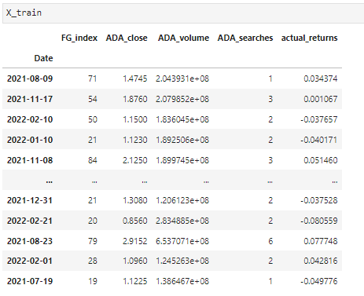
ML Training Dataset

Slide 8

Observations & findings
We had mixed results based on the timeframe we used.
The trading strategies we had were very much determined by the time frame we implemented them due to the market not being an average market with simple swings. Swings were drastic and in one direction.
HODL strategy significantly outperformed either trading strategy over 2 years but underperformed both over a 1-year timeframe.

Slide 9
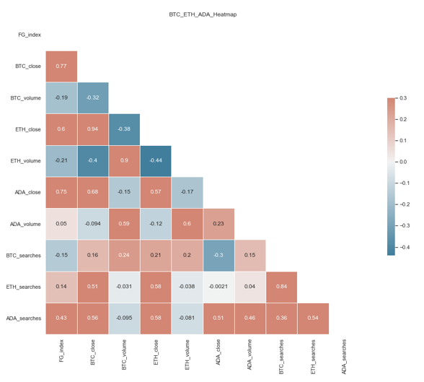
Strategy visuals **Heatmap correlations**

Slide 10
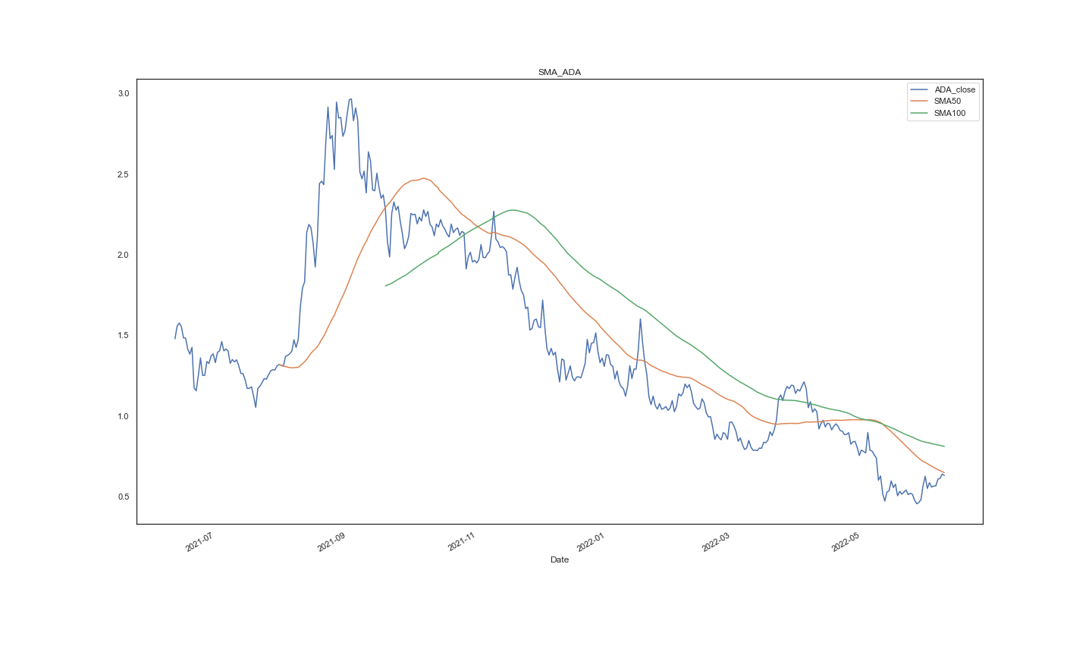
Strategy visuals **ADA Price, 50 day SMA, 100 day SMA**

Slide 11
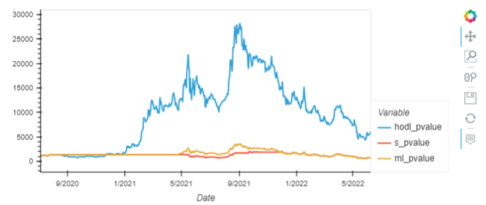
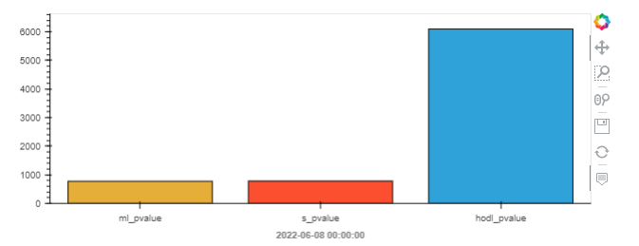
Strategy visuals **2-year window**

Slide 12
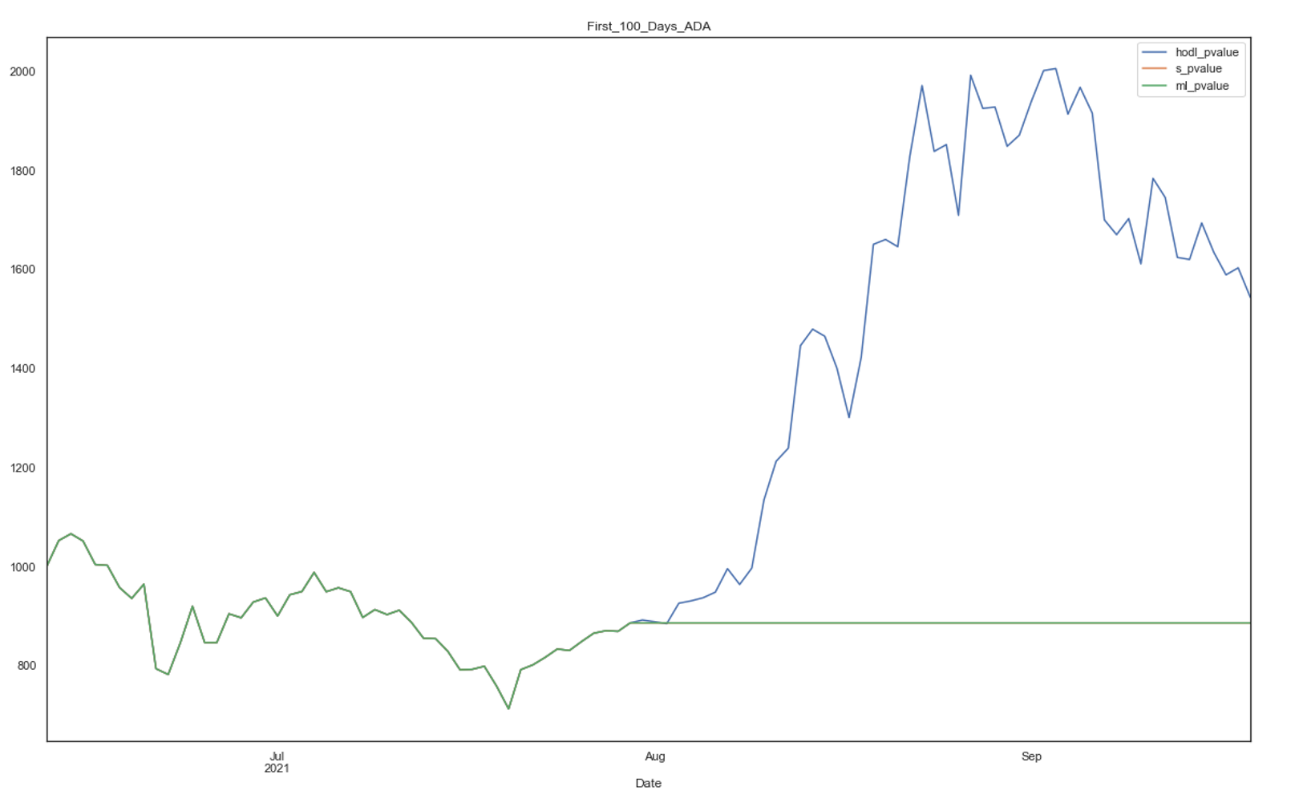
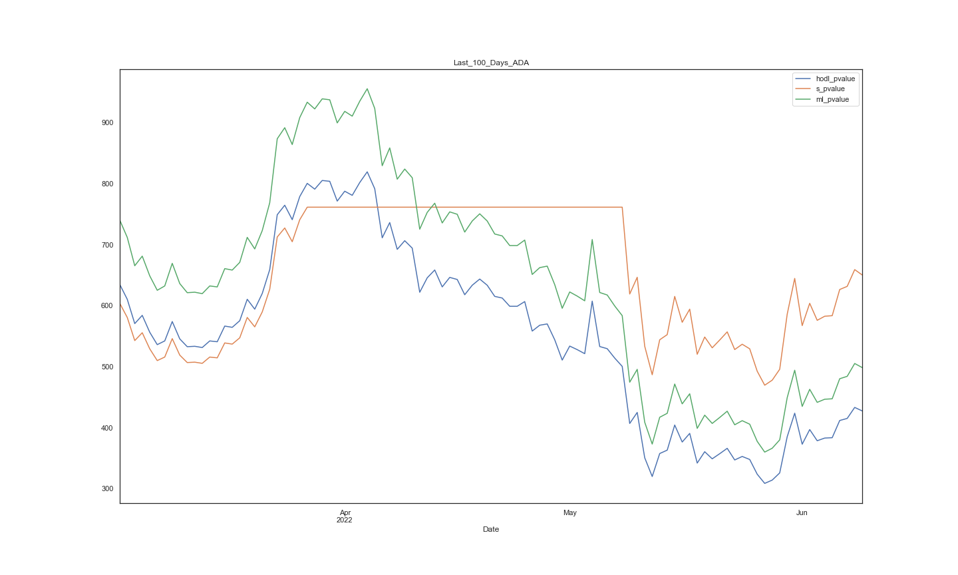
Strategy visuals **First 100 days vs last 100 days**

Slide 13
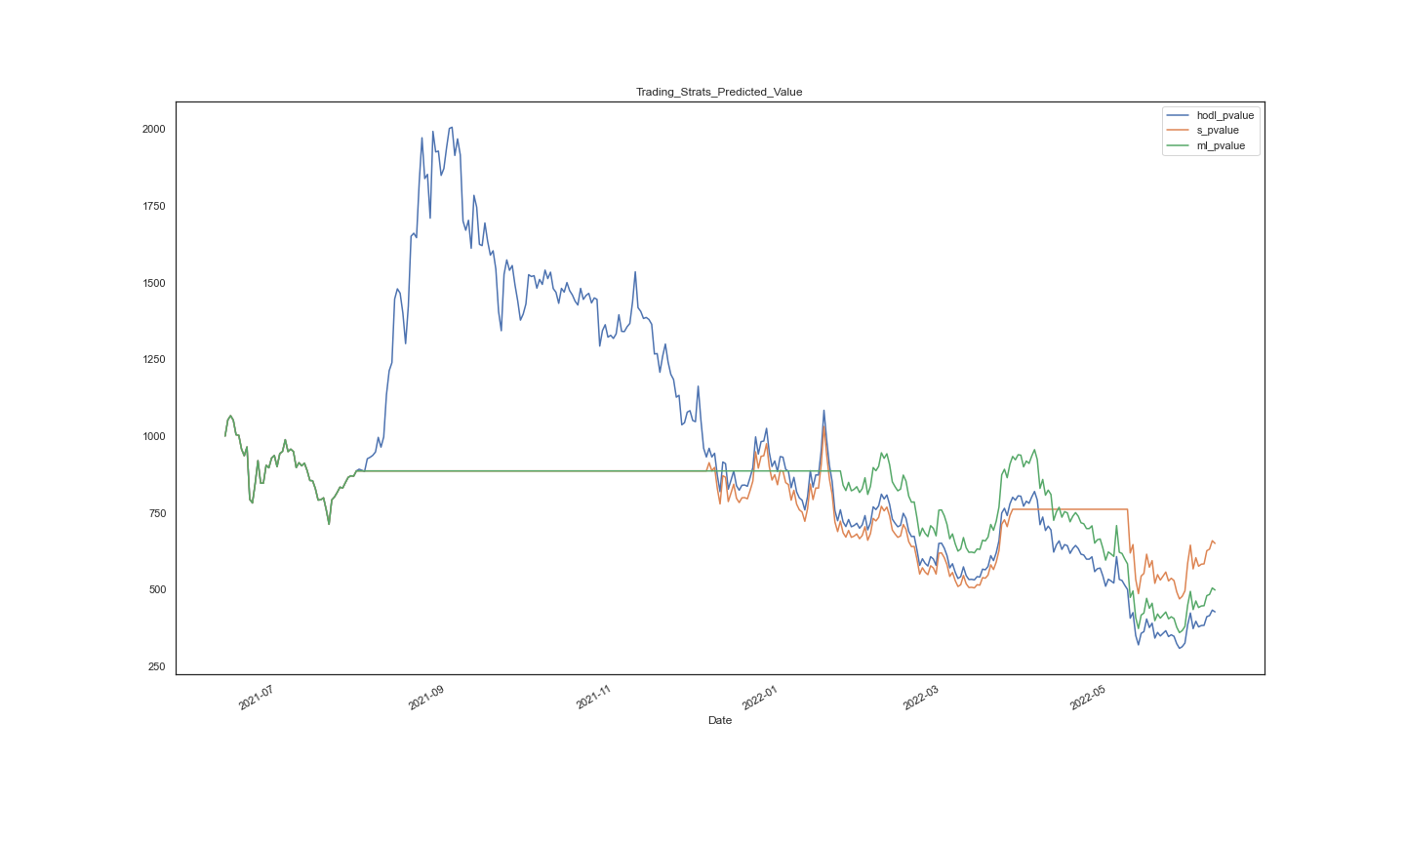
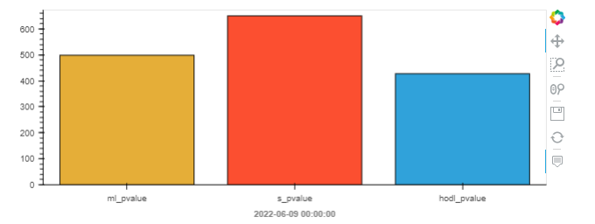
Strategy visuals **1-year window**

Slide 14
Questions??

