Slide 1

Sentiment trading
Jeff Brinker, Justin Leffew, Ameira Khaleq

Slide 2

Overview
Objective:
Create and compare sentiment-based trading (simple), ML strategy, and HODL approach
Start with $1,000 base investment to see profits/losses
Time Frame: 1-2 years

Slide 3

Data PREP & exploration
API Sources:
• Fastquant (Crypto volume, prices)
• Alternative.me (Fear & Greed Index)
• Pytrend (Google Search Trends)
Modularized into a single for loop
• Easily change time frame
• Scalability (apply to other cryptos)
ML models:
• Support Vector Machine Model (SVM)
• SciKitLearn*

Slide 4

Issues & Trouble Shooting
Time constraints
Data cleanup & preparation
SciKitLearn errors (version compatibility)
Limited data (time frame determinant variable)
Scope Creep
Only used Cardano (ADA)
BTC and ETH excluded

Slide 5

Indicators using our algorithms
When to Buy
When to Sell
When to Hold
Bitcoin (BTC)
Ethereum (ETH)
Cardano (ADA)
Cryptocurrencies used

Slide 6

Questions
Is it better to buy and hold or develop a trading strategy?
Would there be patterns in volatility between the three crypto coins?
Can you use a trading strategy to grow in a bear market?

Slide 7

Observations & findings
We had mixed results based on the timeframe we used.
The trading strategies we had were very much determined by the time frame we implemented them due to the market not being an average market with simple swings. Swings were drastic and in one direction.

Slide 8
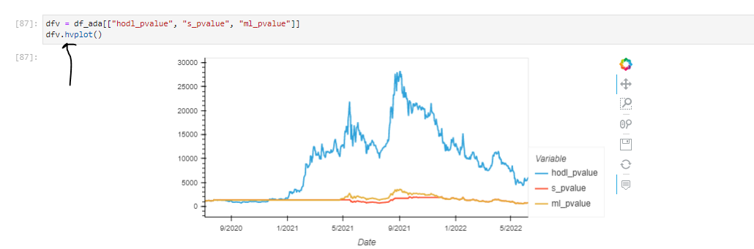
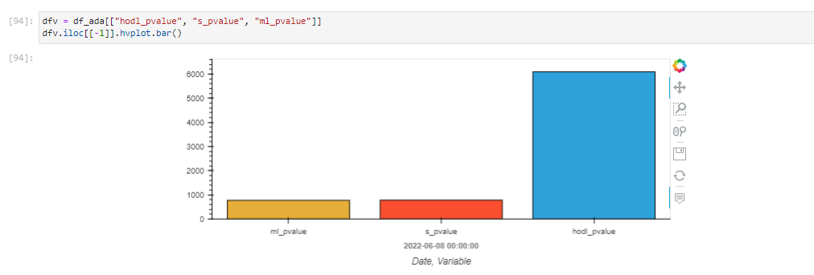
Strategy visuals **2 year window**

Slide 9
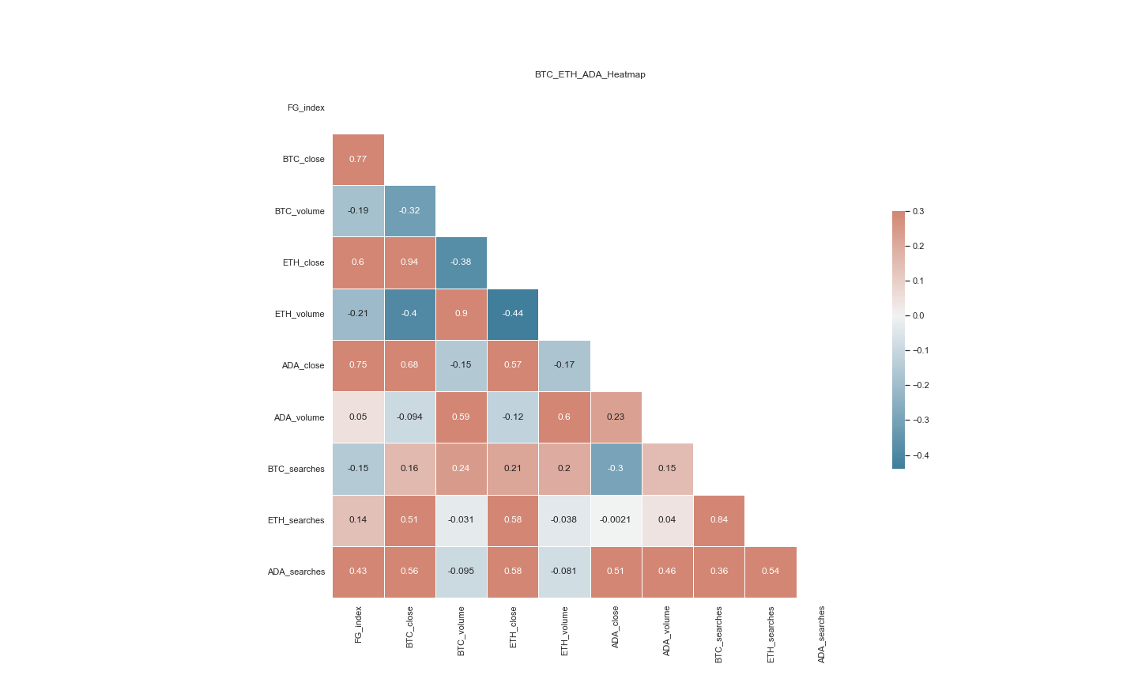

Slide 10
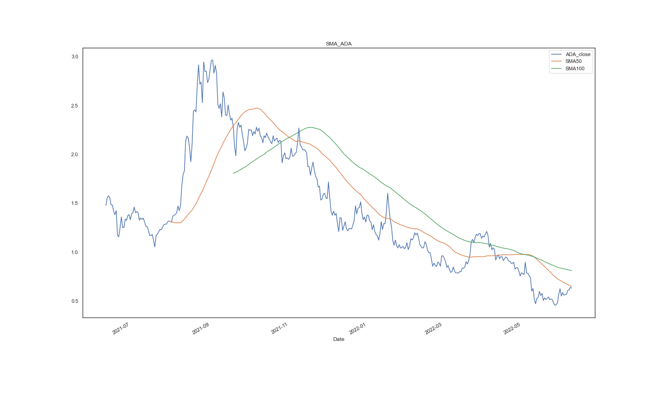

Slide 11
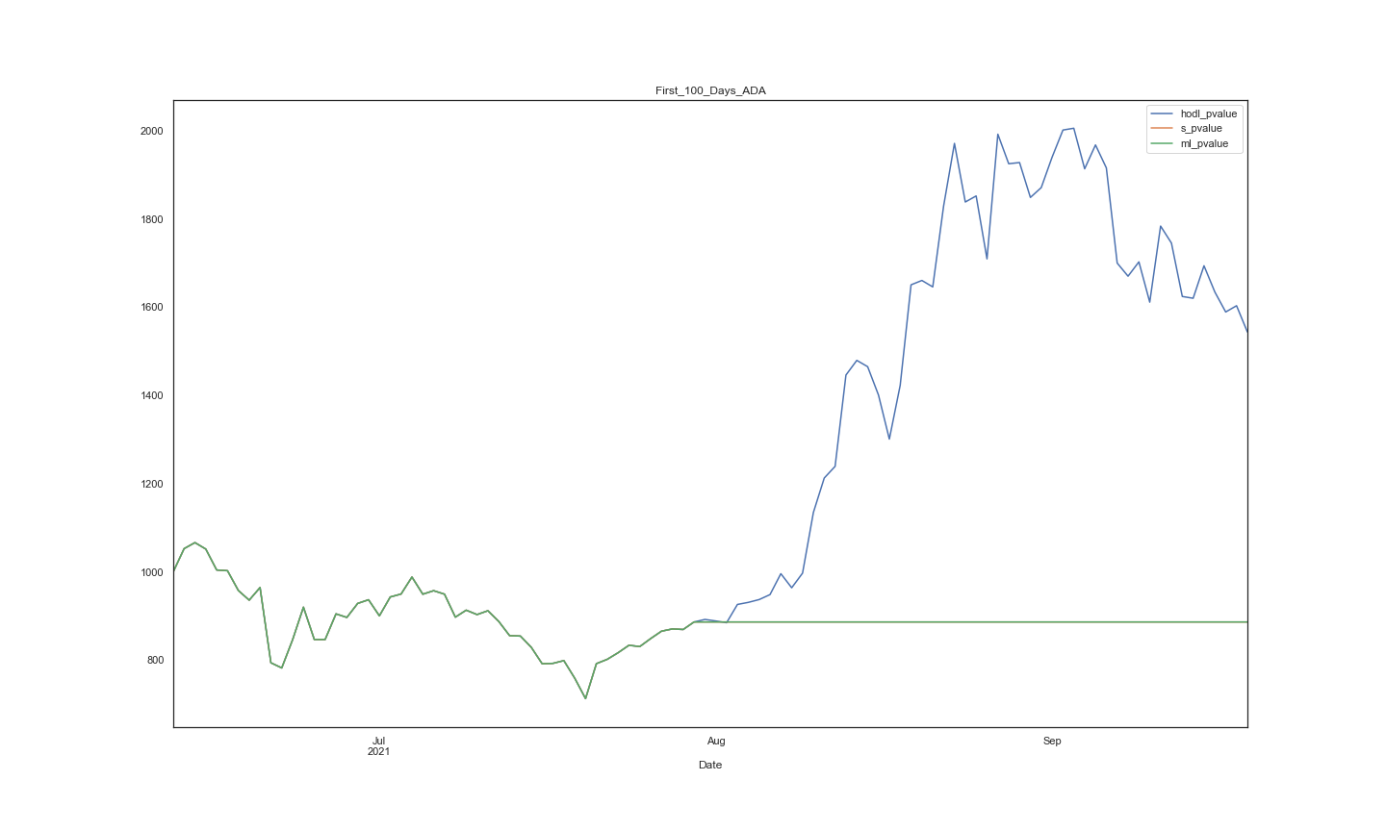

Slide 12
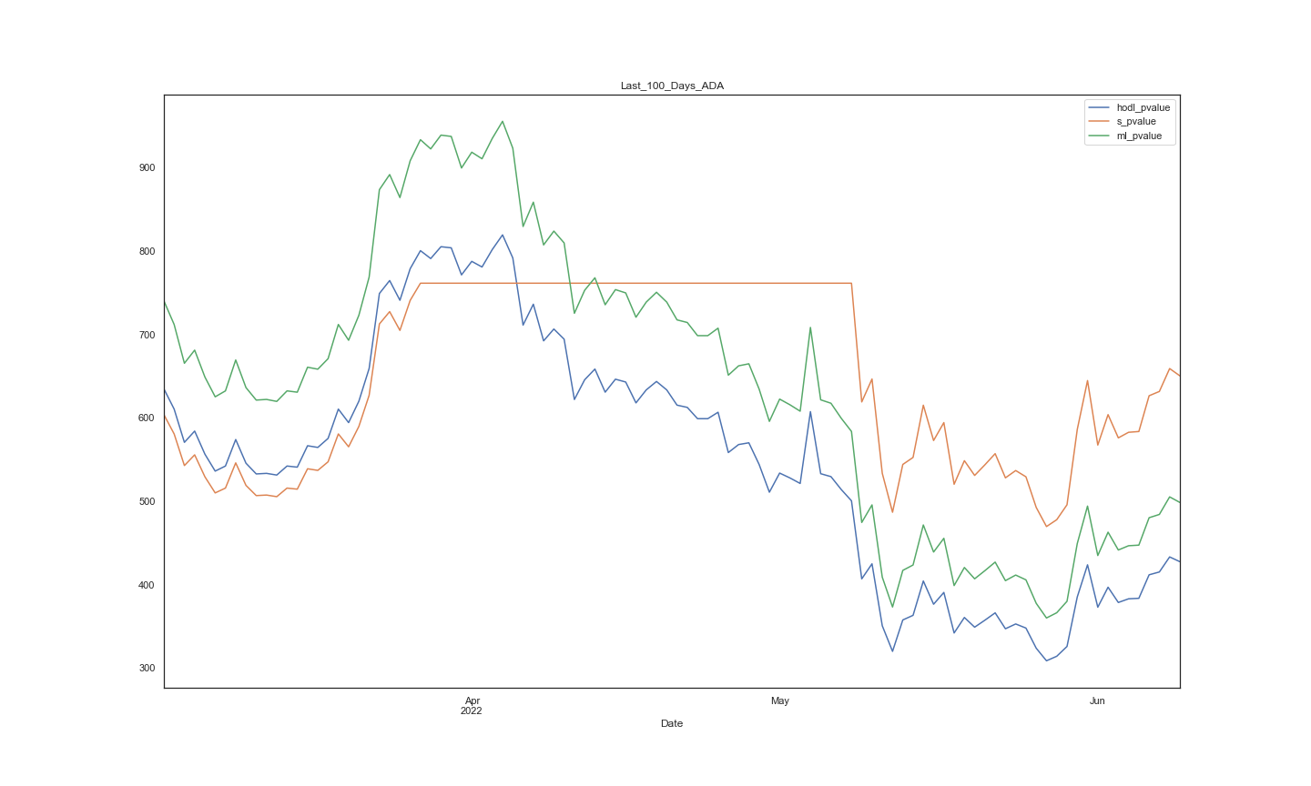

Slide 13
