Slide 1

Sentiment trading
Jeff Brinker, Justin Leffew, Ameira Khaleq

Slide 2

Data PREP & exploration
API Sources:
• Fastquant (Crypto volume, prices)
• Alternative.me (Fear & Greed Index)
• Pytrend (Google Search Trends)
Modularized into a single for loop
• Easily change time frame
• Scalability (apply to other cryptos)
ML models:
• Support Vector Machine Model (SVM)
• SciKitLearn*

Slide 3

Issues & Trouble Shooting
Time constraints
Data cleanup & preparation
SciKitLearn errors (version compatibility)
Limited data (time frame determinant variable)
Scope Creep
Only used Cardano

Slide 4

Overview
Observed & analyzed BTC,ETH,ADA to see the volatility over approximately the last 2 years to current day by applying algorithms and machine learning to assist in letting a crypto investor know to buy, sell, or hold on to their investments.
We applied $1000 as our base investment to see our profits and losses.

Slide 5
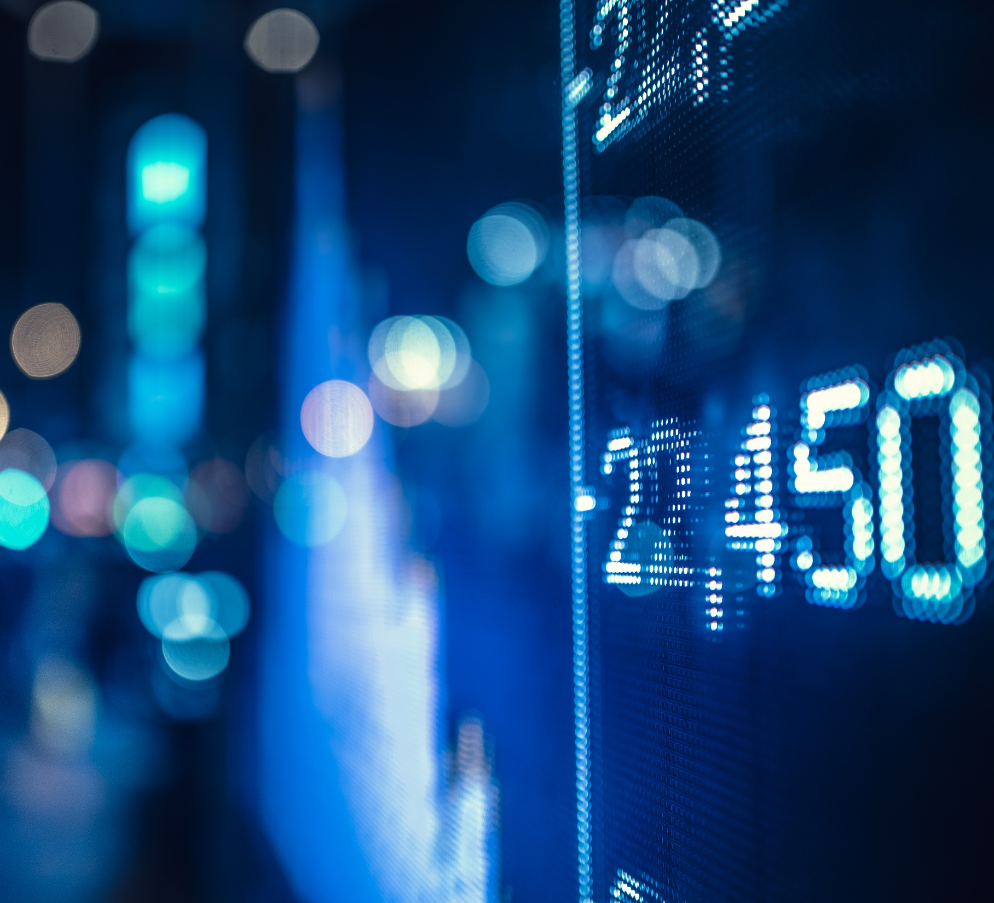
Indicators using our algorithms
When to Buy
When to Sell
When to Hold
Bitcoin (BTC)
Ethereum (ETH)
Cardano (ADA)
Cryptocurrencies used

Slide 6

Questions
Is it better to buy and hold or develop a trading strategy?
Would there be patterns in volatility between the three crypto coins?
Will our algorithms show us which direction to go with our investments in order to increase profit and minimize losses?

Slide 7

Observations & findings
We had mixed results based on the timeframe we used.
The trading strategies we had were very much determined by the time frame we implemented them due to the market not being an average market with simple swings. Swings were drastic and in one direction.

Slide 8
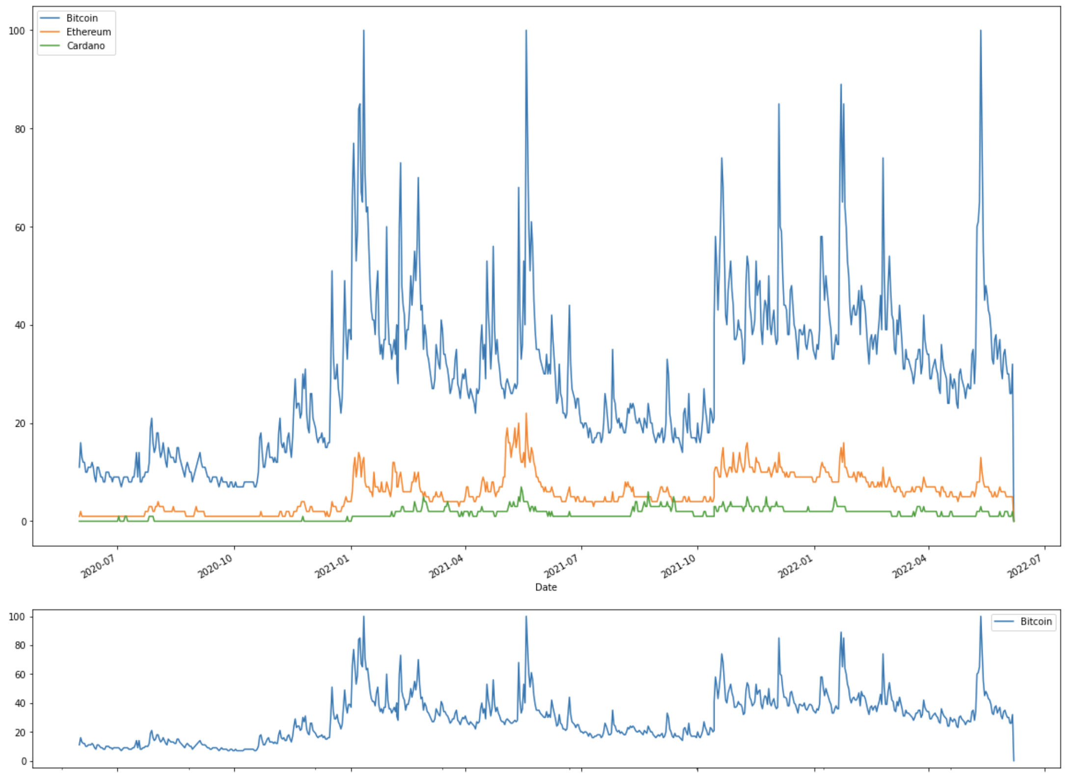
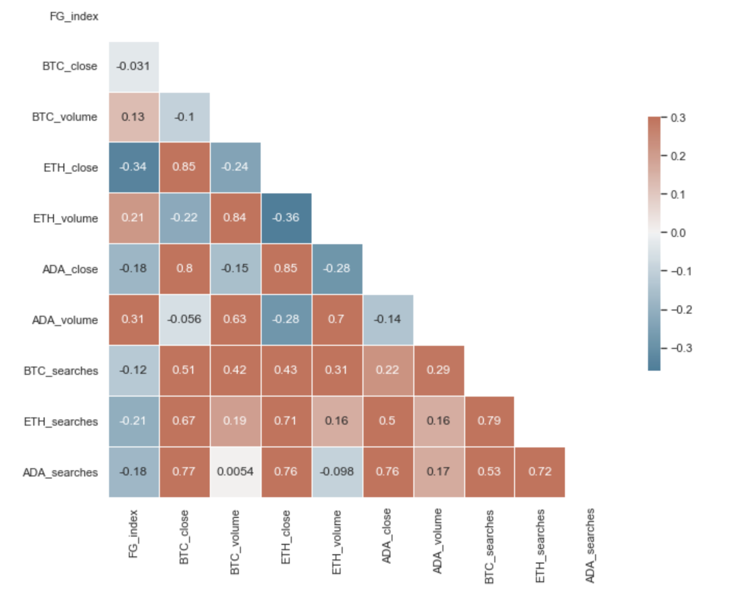
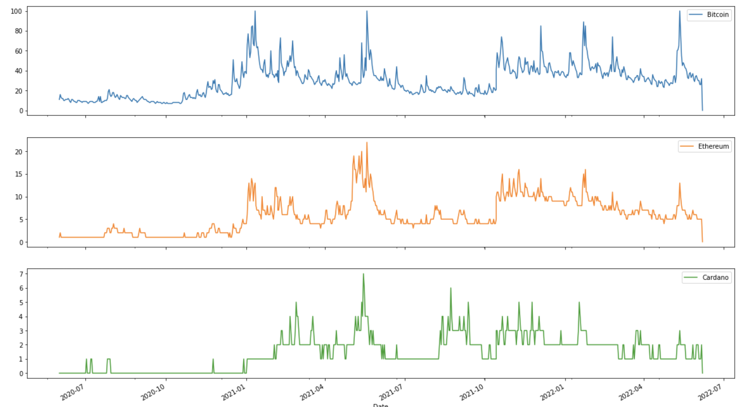
Strategy visuals **2 year window**

Slide 9
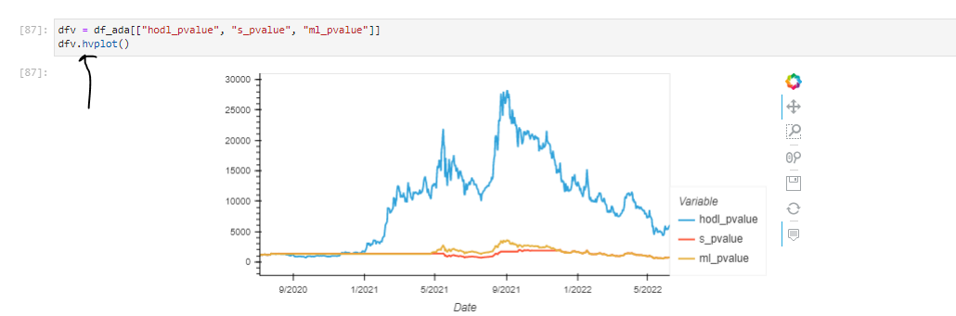
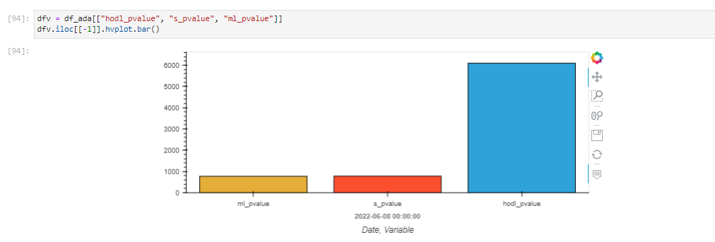
Strategy visuals **2 year window**

