Slide 1

Rear collision & Blind-spot detection Warning

Slide 2
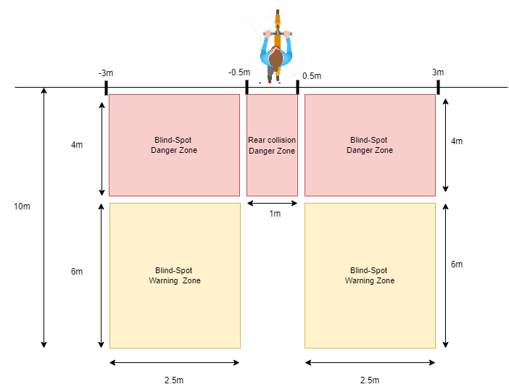
Rear collision and blind-spot zones

Slide 3
1/ Rear collision warning
Warning if any target represent a real danger for collision with the scooter (collision path + time to reach less than 3 seconds / stop distance for the target not enough to avoid collision)
conditions :
1/ Collision path between target and scooter
2/ time to reach less than 3 seconds or time to stop for the target not enough to avoid collision
Warning system :
1/ Beeping to notify rider
2/Display the target path so the rider can avoid collision
Warning system will turn off if there is no risk for collision

Slide 4
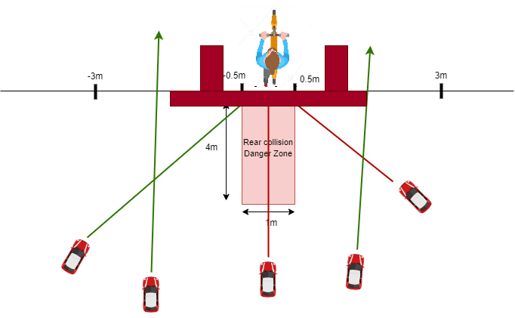
Collision path : it’s the projection of the target current path, if this path projection have an intersection with the reds rectangles , so it’s considered as collision path (reds rectangles can be variable based on the target dimensions ;truck,bus,car,bike..)

Slide 5
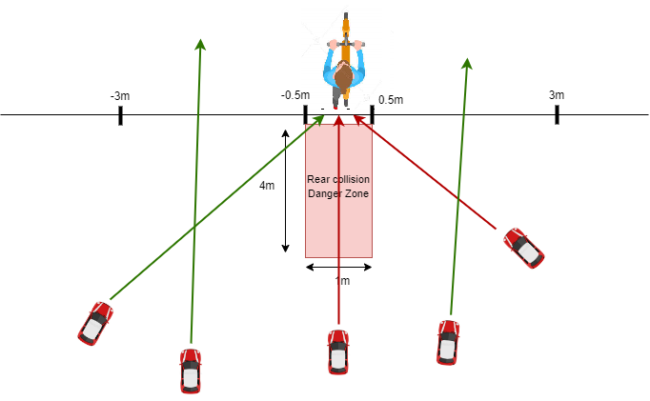
-Rear collision path
-time to reach less than 3 second/ stop distance not enough
target with no danger
-Collision parth
-too far to make any decision
target with no rear collision danger
not on collision path
-Rear collision path
-time to reach less than 3 second/ stop distance not enough

Slide 6
1/ Rear collision warning
b)Notify the rider if any target exist inside the rear collision danger zone and don’t fit the collision criteria
Conditions : 1/ Target inside rear collision danger zone 2/ with speed equal or less to the scooter
Warning system : 1/ Visual warning (blinking LED) 2/ Beeping if the rider slow down or the target become into collision conditions warning system will turn off if the target outside the rear collision danger zone

Slide 7
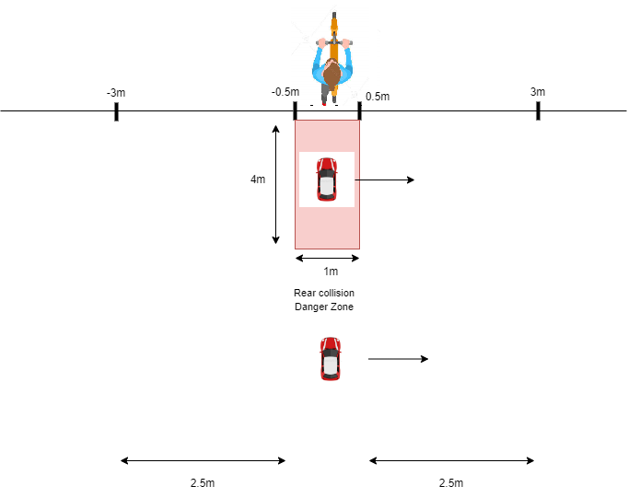
Tailgate warning
Target inside RCDZ
Target speed less or equal to scooter speed
=> blinking LED to notify Rider
Target outside RCDZ
=> no blinking LED

Slide 8
2/ Blind-spot detection warning
Blinking LED to notify rider for the presence of any target inside the blind-spot warning zone
Conditions : - Target inside blind-spot warning zone
Warning system : - Blinking LED
if there is a target inside blind-spot detection warning zone and fit all rear collision condition, the rear collision warning will be set

Slide 9
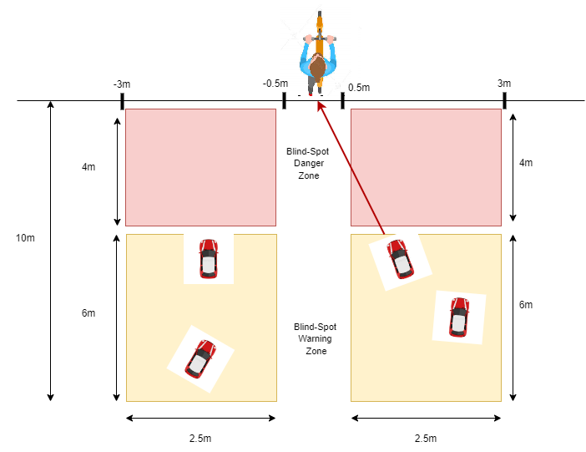
Rear collision warning
Beeping+display
Blinking LED for targets inside this zone
Blinking LED for targets inside this zone

Slide 10
2/ Blind-spot detection warning
b)Constant LED ON to notify rider for the presence of any target inside the blind-spot danger zone
Conditions : - Target inside blind-spot danger zone
Warning system : - Constant LED ON
if there is a target inside blind-spot detection danger zone and fit all rear collision condition, the rear collision warning will be set

Slide 11
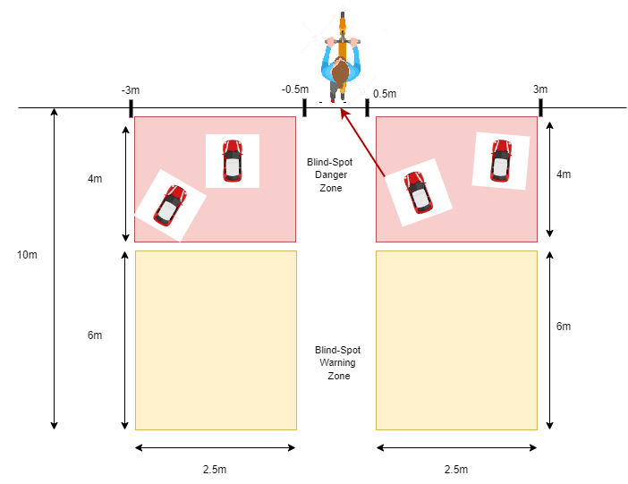
Constant LED ON for targets inside this zone
Constant LED ON for targets inside this zone
Rear collision warning
Beeping+display

Slide 12
2/ Blind-spot detection warning
C) If the rider try to turn right/left and there is target in blind spot zone right/left
Conditions : -Scooter turning right/left - Target inside blind-spot right/left zone
Warning system : - Constant LED ON -beeping

Slide 13
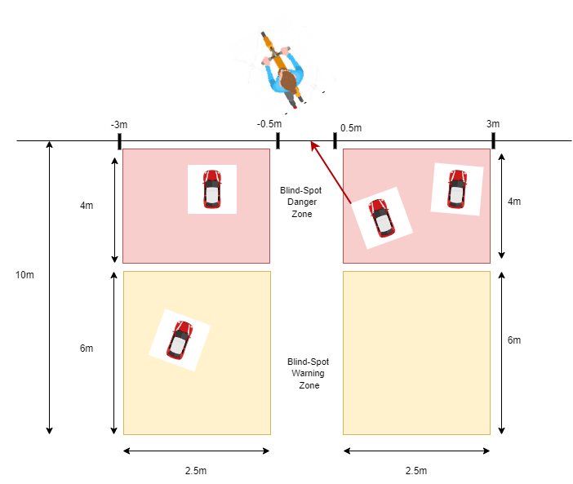
Rider start turning right + Target exist on the blind spot right zone =>Beeping
(turning detected by IMU)

Slide 14
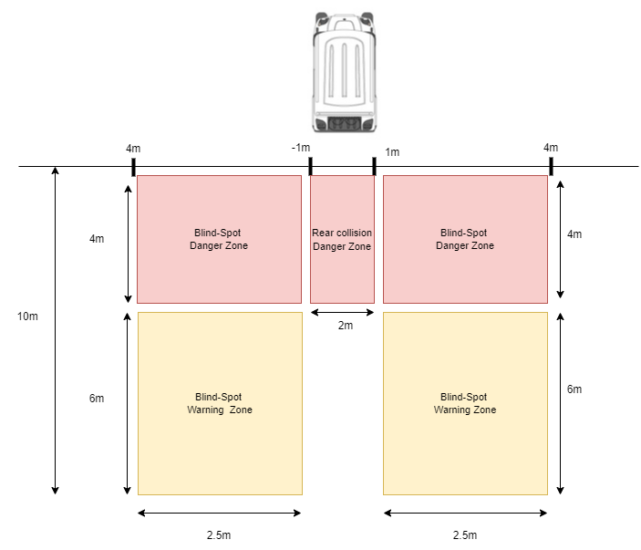
Rear collision and blind-spot zones dimensions can be changed based on other vehicles types dimensions

Slide 15
Warning System
1/Visual System Alert :
-Display that shows targets path, so the rider can avoid them
-LED or dots display (to notify rider for target exist in blind spot zone (right/left) or in the back
2/Buzzer / speaker
3/Vibration on Handlebar ?

