Slide 1







VIEWPOINT AND VIEWS
THE ARCHITECTURE
STRATEGIC VIEWS
STRATEGIC VIEWPOINT
Executives, CTO, CIO
CONTEXT VIEWS
CONTEXT
VIEWPOINT
Product owners, UX, developers
PHYSICAL VIEWS
PHYSICAL
VIEWPOINT
Operations, security
Notes:
ECOSYSTEM MAP

Slide 2
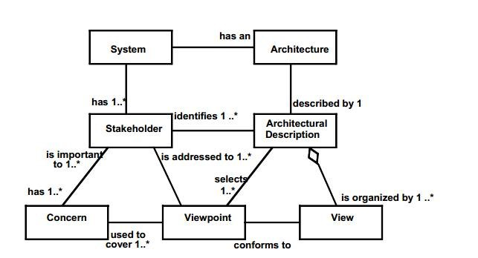

Slide 3
1.Plan
2.Design
3.Market
4.Build
HR-Enterprise
CAD-MAN
CAD-MAN
Biz-Report
Biz-Report
Biz-Report
Project-Plan
FX4-Design
Collabor8
Collabor8
Collabor8
Collabor8
Market-CRM
Flow-ERP
Flow-ERP
Flow-ERP
Flow-ERP

Slide 4
Biz-Report
Project
status
Prognos
HR
status
Project-Plan
Market-CRM
HR-Enterprise
Sales,
Capacity,
Produced Units
Prognos
Flow-ERP
FX4-Design
CAD-MAN
Product
documents
Visual
designs
Technical
designs
Collabor8

Slide 5


Market-CRM
Biz-Report
Sales,
Capacity,
Produced Units
Prognos
Production Orders
and Planning
Executives
Flow-ERP
Daily Report
Manufacturing
Users
Materiel
specifications
Materiel order
Product
documents
Design
Users
Collabor8
Material
Supplier

Slide 6
Receive Customer Order
Send
Confirmation
Create Production Order
Send
Out of Stock
Plan Production Order
Order
Stock
Manufacture
Order
Deliver
Order

Slide 7
