Slide 1
CODE QUALITY BOT FOR GITHUB
GROUP 19
14th April, 2023
Client Team • Group 11

Slide 2
Meeting Statistics
Client Team | Internal Meeting
Total meetings - 9 | Total meetings - 85
All attendees present | All attendees present
Average meeting duration – 30 mins | Average meeting duration – 60 mins

Slide 3
Summary
GitHub app for code quality
Identify common code smells
Custom threshold values
Block low-quality merge requests
Dashboard for code quality trends

Slide 4
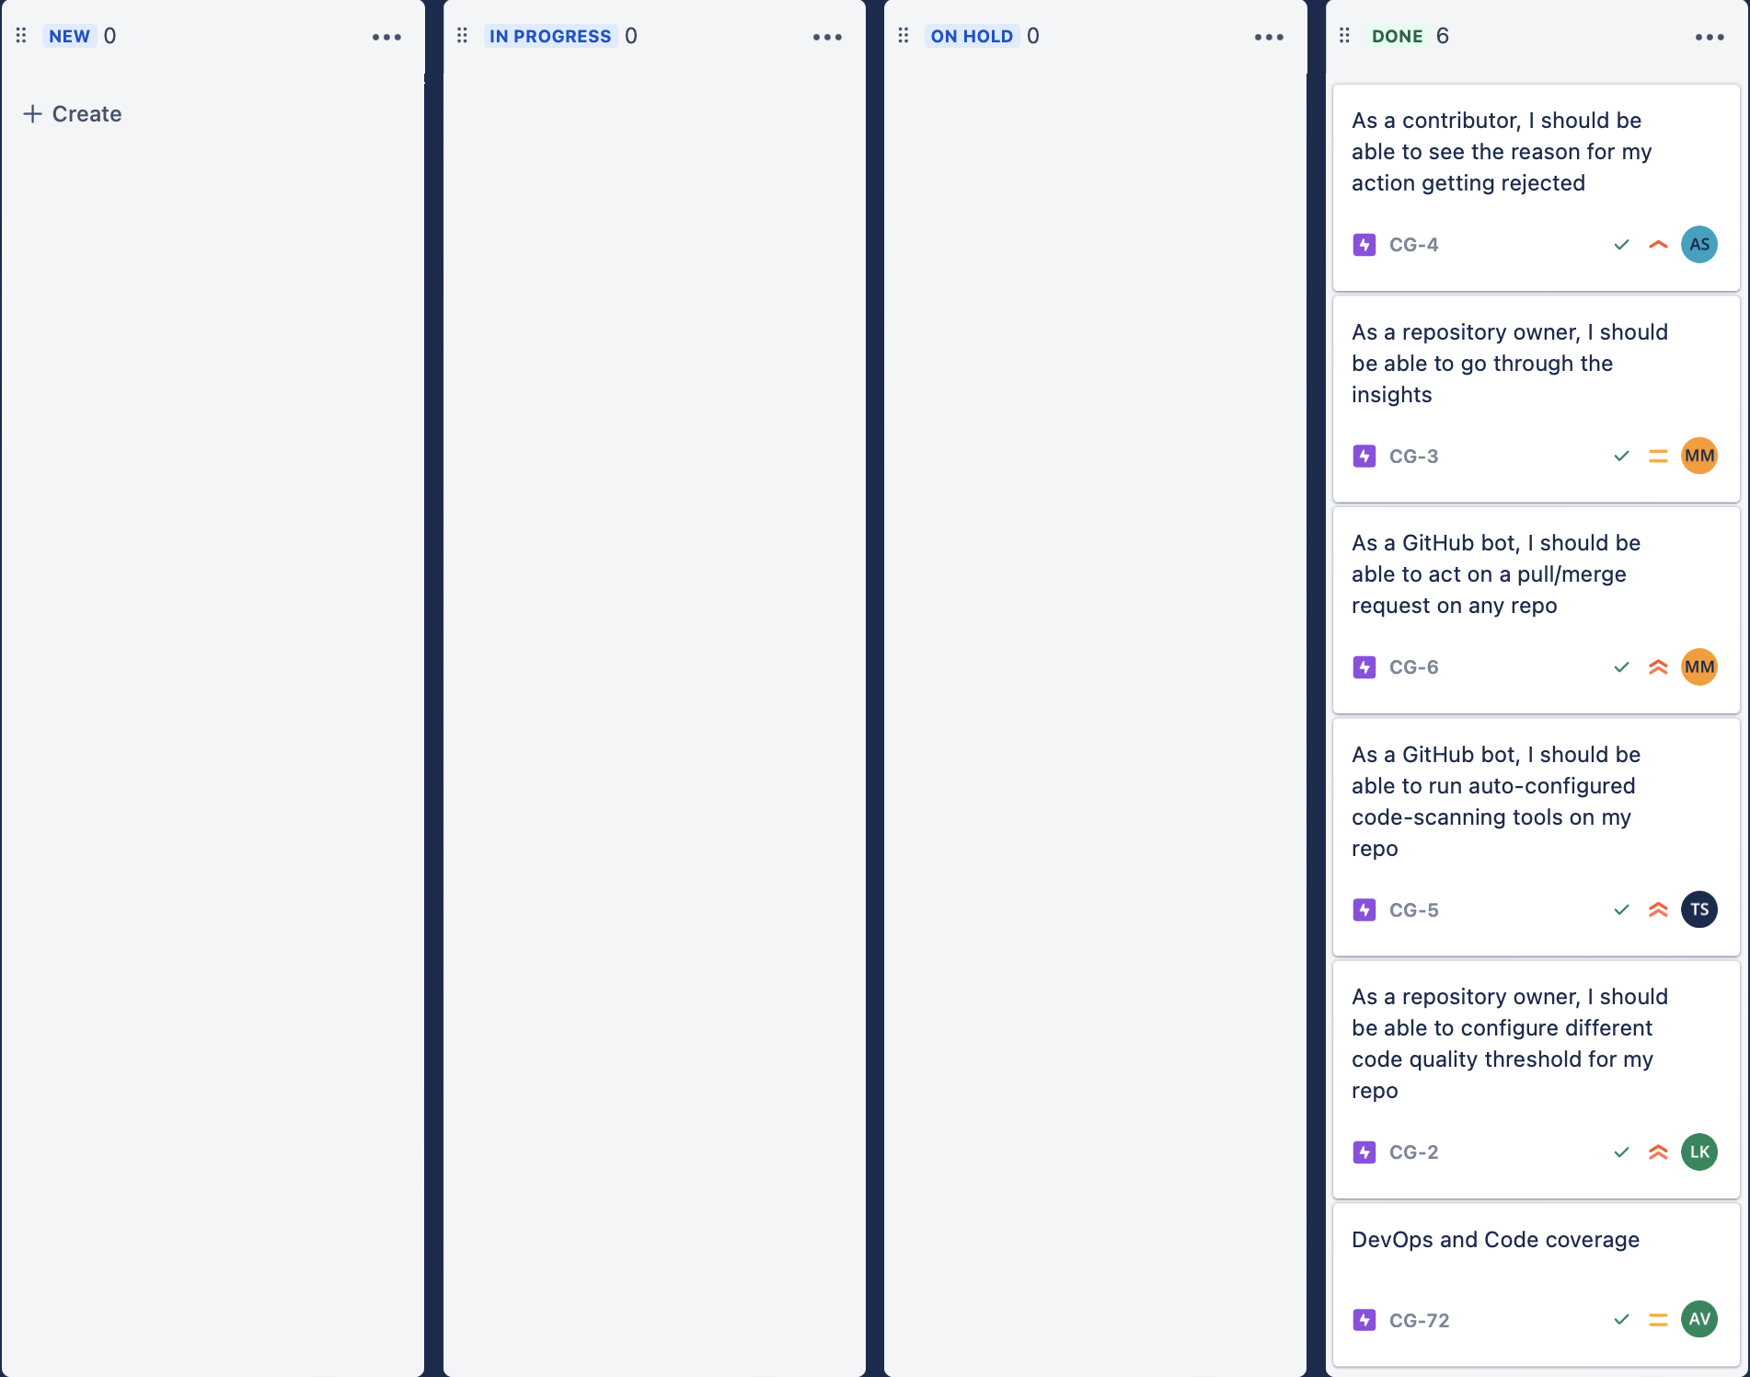
Dashboard

Slide 5
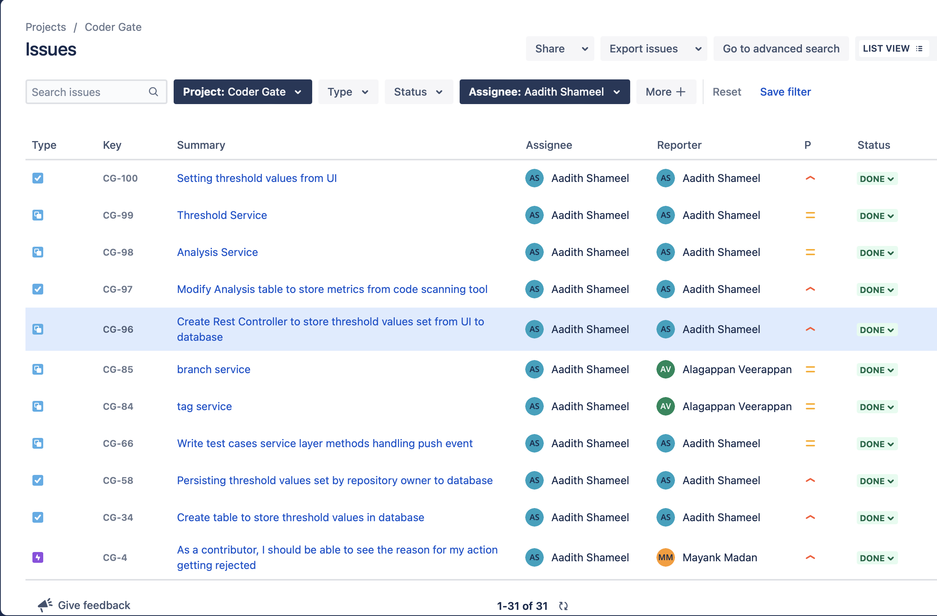
Tasks Completed by Team Members

Slide 6
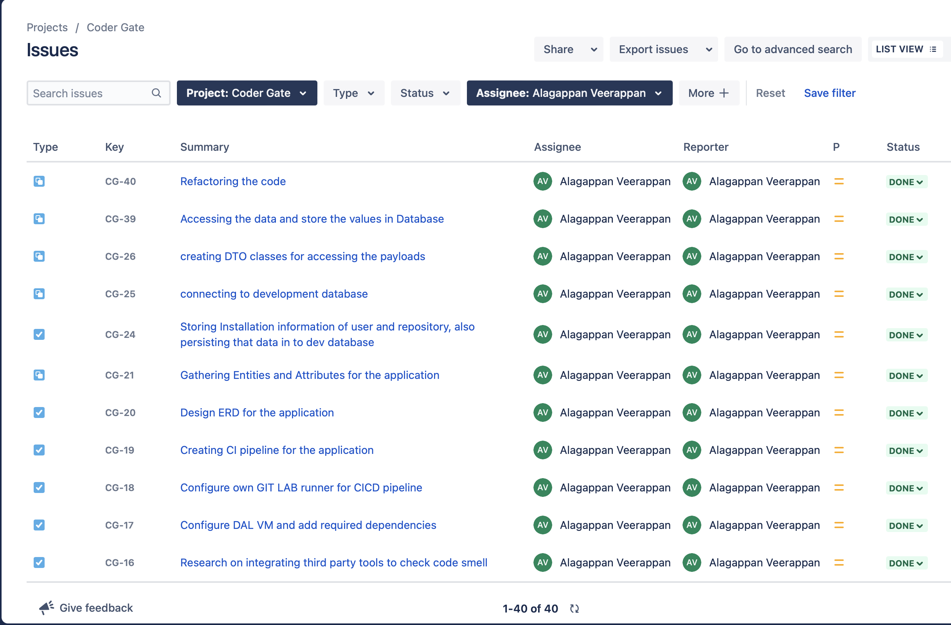
Tasks Completed by Team Members

Slide 7
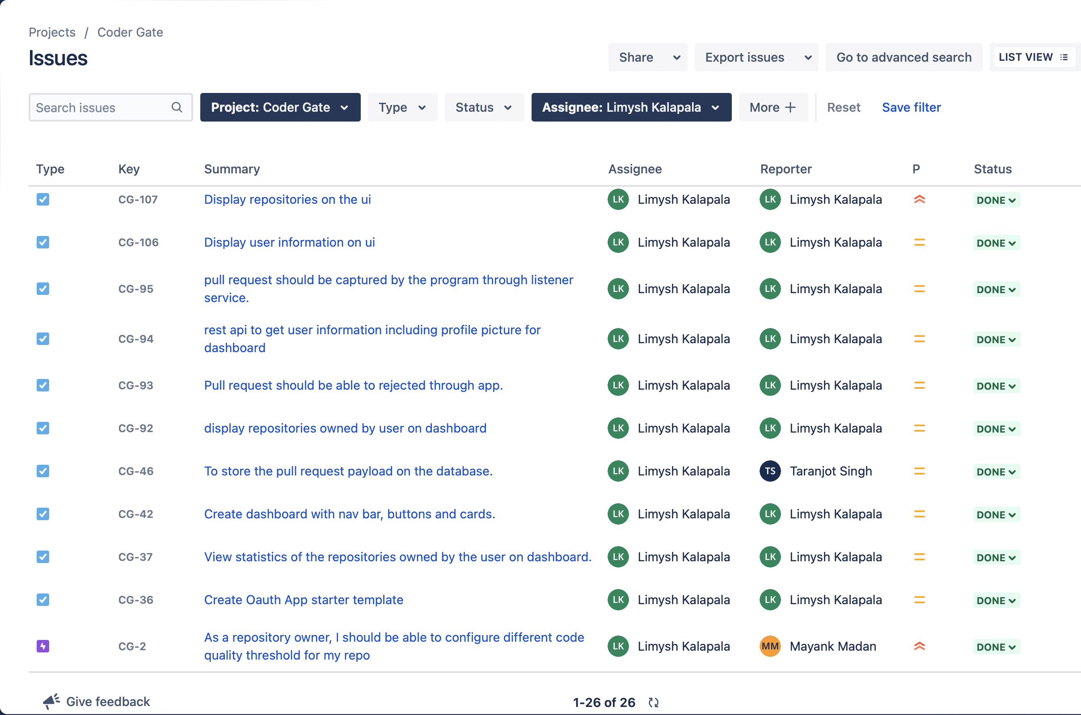
Tasks Completed by Team Members

Slide 8
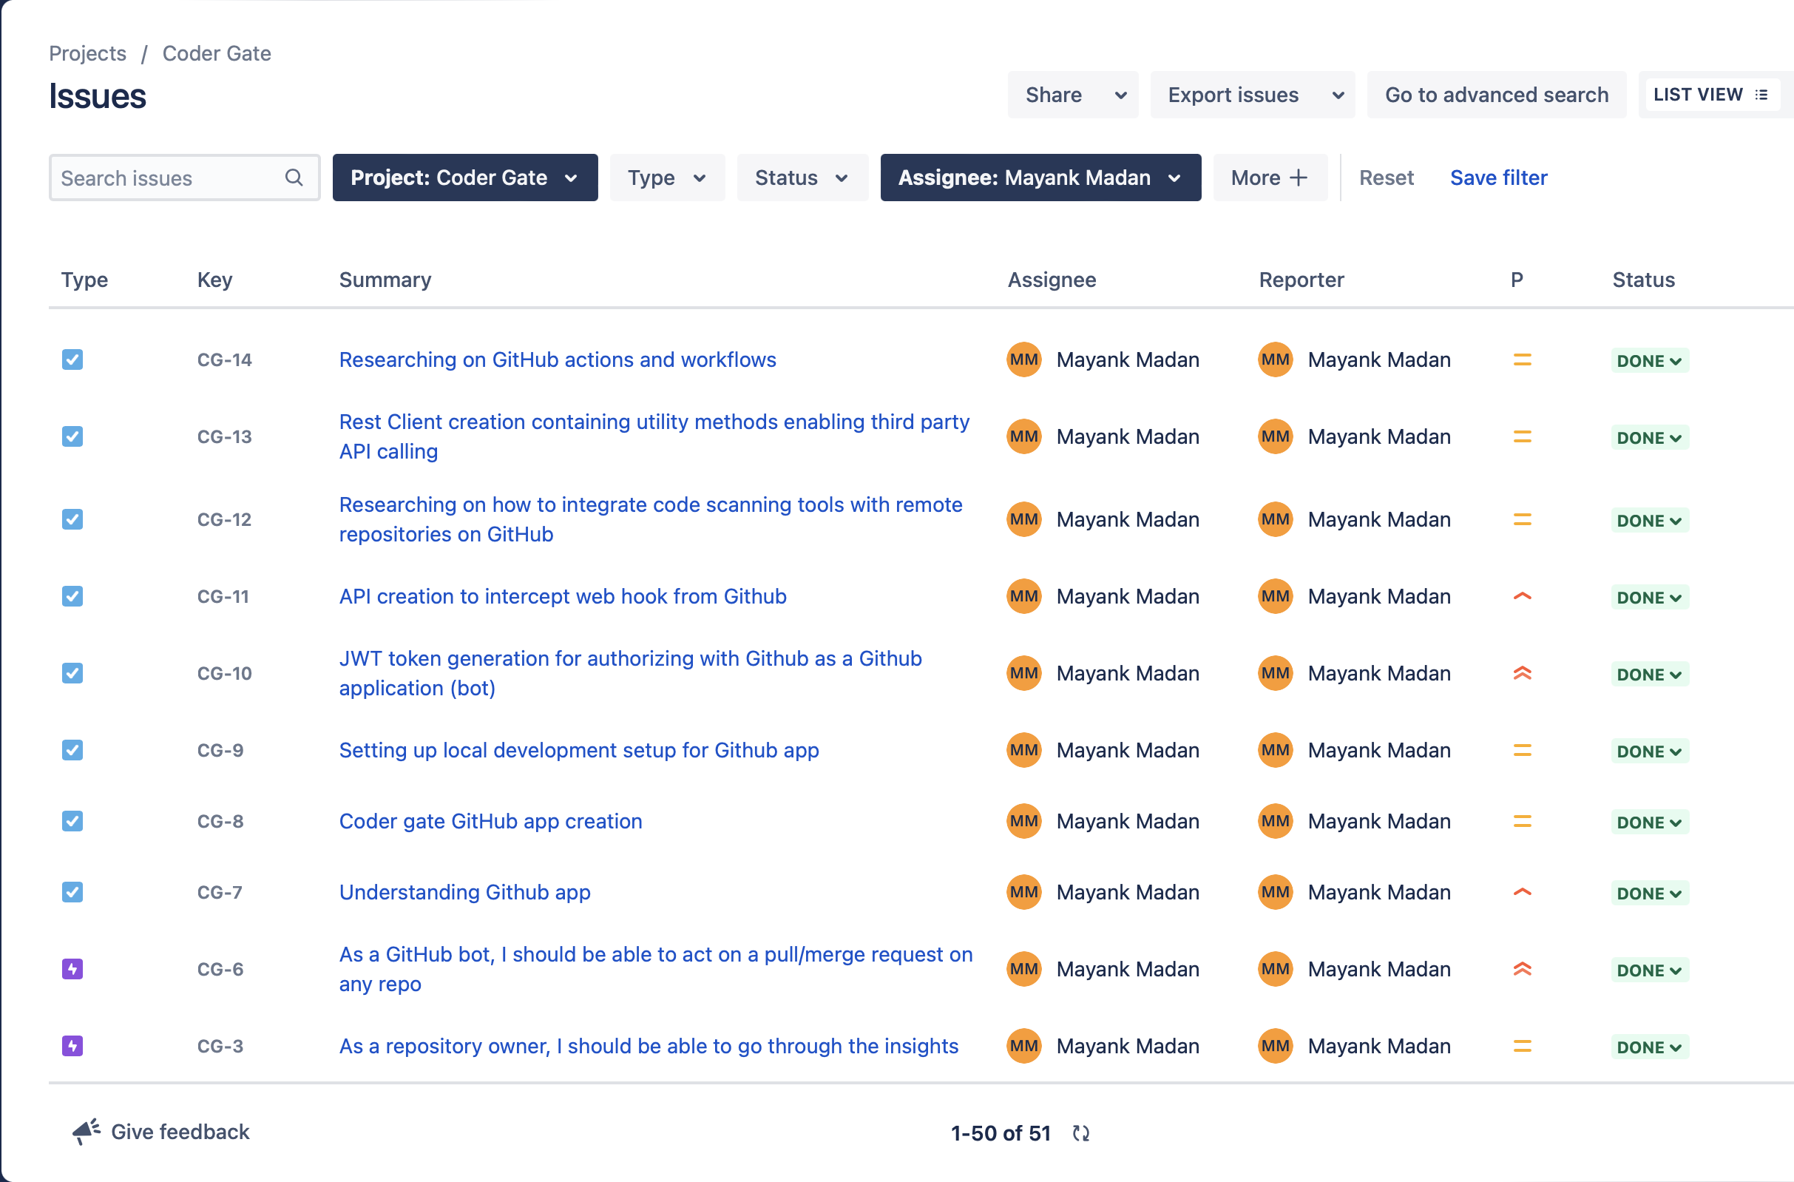
Tasks Completed by Team Members

Slide 9
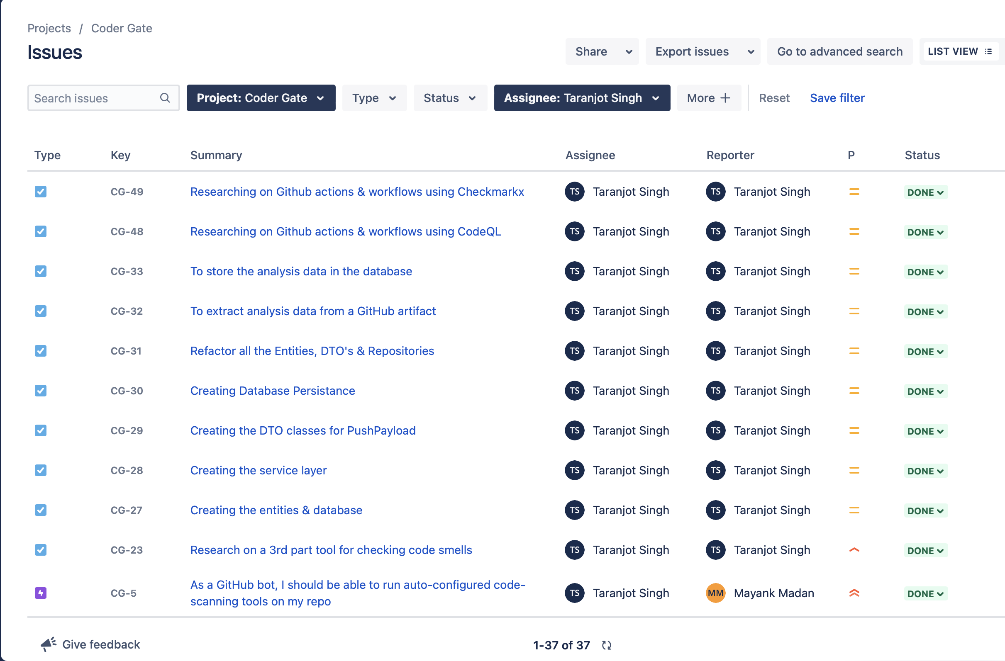
Tasks Completed by Team Members

Slide 10
Dashboard Stats
Total number of Tasks: 185
Number of tasks per team member:
Aadith: 31
Alagappan: 40
Limysh: 26
Mayank: 51
Taranjot: 37

Slide 11
Demo

Slide 12

Project Status
Goal | Status
Seamless GitHub App Installation for Repositories
Automated Code Quality Scanning
User Defined Thresholds
Automated Pull Request Actions & Feedback
Repository Insights & Code Quality Trends Visualization

Slide 13
New Features
Feature | Detail
Block Merge or Alert Contributor On Pull Request | Flexibility for repository owner to decide if they want to block a merge request if code quality passes threshold or to just alert the contributor through GitHub Issues

Slide 14
Learning Outcomes
Understanding of code quality standards: Gained an understanding of what constitutes good code quality and how to measure it using various code quality tools.
﻿
Knowledge of GitHub integrations: Gained understanding on how GitHub works and how to interact with its APIs. This experience helped team members gain valuable experience in integrating third-party tools with other platforms.
﻿
Experience with agile development methodologies: The project was developed using agile methodologies, such as Scrum. Thishelped the team learn how to break down tasks into smaller, manageable units and collaborate effectively with their team members.
﻿
Improvement of technical skills: Building a code quality bot required team members to develop technical skills such as software development, programming, testing, and debugging. Through this project, team members improved their technical skills and gained practical experience in using them.

Slide 15
Learning Outcomes
Experience with project management: Successfully completing this project required the team to plan, organize, and manage their time effectively. This experience helped team members develop project management skills that can be applied to future projects.
﻿
Awareness of best practices: Through researching and implementing various code quality tools and techniques, the team gained an understanding of best practices for writing clean, maintainable, and scalable code. This awareness can be applied to future projects, making the team better developers.
﻿
Overall, the project provided team members with valuable technical and soft skills that they can apply to future projects and careers

