Slide 1
Imam Abdulrahman Bin Faisal University - College of Business Administration
Ticket Sales Management System
COMP308 - Programming for Business | Final Project
Academic Year 2025 - 2026
Group Leader: Mohammad Alahmadi
Group Members: Mohammed Abbas Algaramiz | Muhannad Almasad | Adeeb Alzahrani | Abdulsalam Almutairi

Slide 2
Agenda
• Problem Statement and Background
• Project Objectives
• Methodology and Tools
• System Features and Workflow
• Sample Data - Saudi Events
• Visualisations: Bar Chart and Line Chart
• Descriptive Statistics and Business Insights
• Values, Ethics and Data Privacy
• Teamwork and Task Distribution
• Conclusion and Recommendations
COMP308 - Programming for Business | IAU
2 / 15

Slide 3
Problem Statement and Background
The Saudi events industry is growing fast under Vision 2030.
• Mega events: Riyadh Season, MDLBeast Soundstorm, Saudi Pro League, Jeddah F1.
• Event companies need to track ticket sales, customers and revenue every day.
• Manual tracking on paper or spreadsheets is slow and error-prone.
• Reports for management are usually delayed or inconsistent.
• A simple, reliable digital system would save time and improve decisions.
COMP308 - Programming for Business | IAU
3 / 15

Slide 4
Project Objectives
• Build a working console-based Python application.
• Use pandas for data handling and matplotlib for charts.
• Store ticket records in a CSV file for persistence.
• Provide a menu: Add, View, Search, Reports, Quit.
• Generate a bar chart, a line chart and descriptive statistics.
• Handle invalid input and missing data without crashing.
• Apply the system to a realistic Saudi events dataset.
COMP308 - Programming for Business | IAU
4 / 15

Slide 5
Methodology and Tools
Approach
Tools and Libraries
• Read the project brief and agree on the plan.
• Design a modular structure (one function per feature).
• Write and test each function on its own.
• Combine the functions into a single program.
• Validate the output against the project requirements.
• Python 3.12 (programming language).
• pandas (data handling and statistics).
• matplotlib (bar chart and line chart).
• datetime (validate purchase dates).
• os (check that the CSV file exists).
• Visual Studio Code + GitHub for collaboration.
COMP308 - Programming for Business | IAU
5 / 15

Slide 6
System Features - Main Menu
Menu-driven interface, accessible after a successful login.
************MAIN MENU************** A: Enter Ticket Details B: View Ticket Details C: Search by Ticket ID D: Produce Reports Q: Quit / Log Out Please enter your choice:
Login: username admin / password admin123 - up to 3 attempts.
COMP308 - Programming for Business | IAU
6 / 15

Slide 7
Core Functions
• login() - validates credentials, allows three attempts.
• add_ticket() - auto-generates Ticket ID, validates date / price / quantity, calculates total cost, saves to CSV.
• view_tickets() - reads the CSV and prints all records in a clean table.
• search_ticket() - finds a single ticket by ID using pandas Boolean indexing.
• produce_reports() - creates the bar chart, line chart and descriptive statistics.
• main_menu() - the loop that shows the menu and routes the user's choice.
COMP308 - Programming for Business | IAU
7 / 15

Slide 8
Sample Data - Saudi Events
25 records covering 9 local events (October 2025 - February 2026).
Ticket ID | Event Name | Customer Name | Date | Total Cost (SAR)
1 | Riyadh Season Concert | Khalid Al-Saud | 2025-11-05 | 500.00
3 | Jeddah F1 Ticket | Faisal Al-Harbi | 2025-12-02 | 800.00
8 | MDLBeast Soundstorm | Omar Al-Zahrani | 2025-12-12 | 1200.00
10 | Diriyah Tennis Cup | Yousef Al-Subaie | 2026-02-05 | 400.00
18 | AlUla Music Festival | Nasser Al-Otaibi | 2026-01-18 | 600.00
COMP308 - Programming for Business | IAU
8 / 15

Slide 9
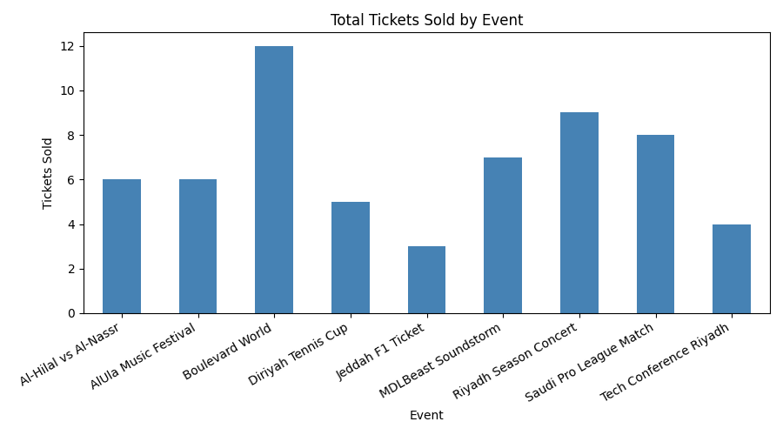
Visualisation 1 - Total Tickets Sold by Event
Top events:
• Boulevard World - 12
• Riyadh Season - 9
• Saudi Pro League - 8
• MDLBeast - 7
Low price drives high volume - Boulevard World leads on units sold.
COMP308 - Programming for Business | IAU
9 / 15

Slide 10
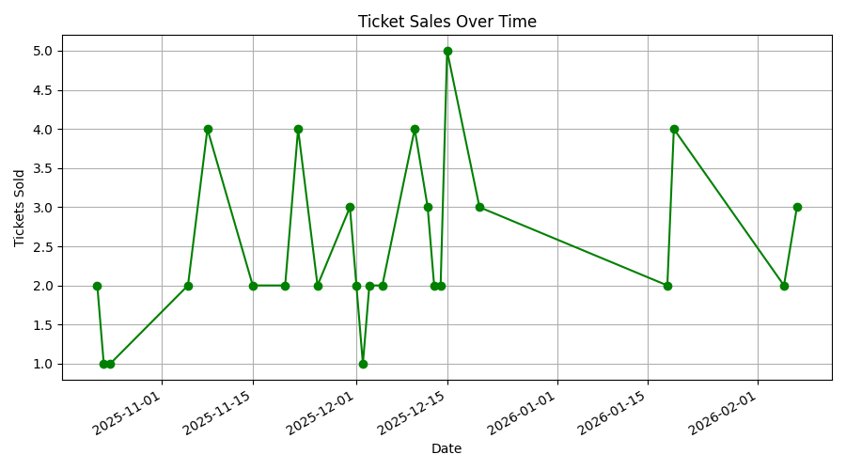
Visualisation 2 - Sales Over Time
Pattern:
• Peak: 15 Dec 2025 (5 tickets).
• Quiet days: 1 ticket only.
• Heaviest activity: mid-Nov to mid-Dec.
• Slow patch: late Jan - early Feb.
COMP308 - Programming for Business | IAU
10 / 15

Slide 11
Descriptive Statistics - Daily Sales
Statistic | Value
Mean | 2.50
Median | 2.00
Maximum | 5
Minimum | 1
Standard Deviation | 1.06
What the numbers tell us:
• Mean (2.5) > Median (2): a few peak days lift the average.
• Range = 4 tickets when avg is only 2.5 → uneven flow.
• Std dev 1.06 → typical day varies by ±1 ticket.
• Useful for staffing and marketing planning.
COMP308 - Programming for Business | IAU
11 / 15

Slide 12
Critical Interpretation - Business Insights
• Volume vs revenue: Boulevard World leads on units (12) but Jeddah F1 (3 tickets) brings more revenue (2,400 SAR vs 900 SAR).
• Pricing strategy: low price → high volume; premium price → high revenue. Both have a place in the company's portfolio.
• Demand clusters: ticket sales follow event hype and salary cycles, not a smooth daily flow.
• Action 1 - Promote on quiet days (e.g. mid-week email offers).
• Action 2 - Boost staffing on peak days to keep customer service smooth.
• Action 3 - Use "buy 2 get 1" type promotions to lift average days into peaks.
COMP308 - Programming for Business | IAU
12 / 15

Slide 13
Values, Ethics and Data Privacy
Designed in line with the Saudi Personal Data Protection Law (PDPL, 2023).
• Login required - prevents casual access to customer data.
• Local CSV storage - data never leaves the company's machine.
• Data minimisation - only essential fields collected (no IDs, phones, payment details).
• Limitations recognised: plain-text password and unencrypted CSV are fine for a prototype but not production.
• Future deployment would use hashed passwords and an encrypted database (e.g. MySQL).
COMP308 - Programming for Business | IAU
13 / 15

Slide 14
Teamwork and Task Distribution
Member | Main Responsibility
Mohammad Alahmadi (Leader) | Coordination, code structure, login & menu, final review
Mohammed Abbas Algaramiz | Sample data, CSV design, validation testing
Muhannad Almasad | Reports function, charts, descriptive statistics
Adeeb Alzahrani | Written report, methodology, references
Abdulsalam Almutairi | Slide design, ethics section, presentation
4 group meetings | WhatsApp + Google Drive | every section reviewed by at least one peer.
COMP308 - Programming for Business | IAU
14 / 15

Slide 15
Conclusion and Recommendations
We delivered a working system that meets every requirement in the project brief.
• Login + 5-option menu + CSV storage + 3 reports - all working.
• Real Saudi context produced realistic and meaningful insights.
• Modular code is easy to read, test and extend.
Future improvements:
• Hashed passwords + encrypted database (SQLite or MySQL).
• Graphical interface (Tkinter / Streamlit) for non-technical staff.
• Payment-gateway integration and monthly / quarterly reports.
COMP308 - Programming for Business | IAU
15 / 15

