Slide 1
Transponder Landing System (TLS)

Slide 2
What is TLS?
A transponder landing system (TLS) is an all-weather, precision landing system that uses existing airborne transponder and instrument landing system (ILS) equipment to create aprecision approach at a location where an ILS would normally not be available.
Conventional ILS systems broadcast using a number of "single purpose" antennas. One, located just off the end of the runway, provides a fan-shaped signal for azimuth direction (side to side) and another located beside the runway provides elevation to indicate a standard glideslope. ILS installations also include one or more "marker beacons" located off the end of the runway to provide distance indications as the aircraft approaches the runway. This complex set of antennas is expensive to install and maintain, and are often difficult to site in built-up areas.

Slide 3
Background
John Stoltz, president, CEO and chairman of the board for Advanced Navigation and Positioning Corp. is the brains behind the system. A military aerospace engineer, Stoltz stayed in the West when the F22 program moved east, preferring the peaceful Northwest to the packed Northeast.
The Transponder Landing System is developed by Advanced Navigation and Positioning Corp. of Hood River, Ore. The concept is simple, the ground installation easy, and the potential applications are endless.
When he contemplated leaving the world of military aviation, he had to see a future for the civil aviation industry. In his vision he saw 17,000 under-served airports, and 130,000 (by FAA account) aircraft equipped with conventional localizer and glideslope systems. His vision was cloudy when it came to Microwave Landing Systems, LAAS and WAAS DGPS systems. He could see the many popular resort destinations, like Sun Valley, Idaho, losing customers because of difficult access by air (with impossible access by land).

Slide 4
System Details
There are few components in the TLS system. The most visible are four units mounted in a 50 meter radius alongside the runway. There is a base station unit. a Calibration/Built-in-Test (BIT) unit that monitors station accuracy and integrity, and two angles of arrival antennas. The localizer and glideslope angle of arrival (AOA) sensors are used to define the flightpath from the transponder system as it nears the runway.
A central processor in the base station computes the aircraft position in three dimensions, calculates where it should be in relation to the approach, and transmits corrections to the aircraft over the localizer and glideslope transmitter.

Slide 5
System Details
The system is capable of tracking 25 aircraft (or even equipped ground vehicles as a way to prevent runway incursion accidents). One of the limitations of a single TLS system is that only one aircraft could be "on the beam" at a time, because the TLS generates a correction based on its position. However, the system isn't intended to replace the ILS at Denver International or DFW, with the constant parallel approaches. The TLS is a low traffic volume system.

Slide 6
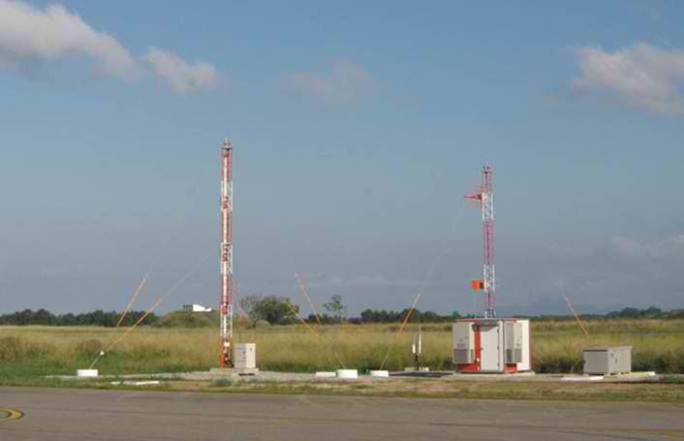
Transponder Landing System

