Slide 1


Unlocking Investment Opportunities through Instagram Data
An Innovative Approach to Financial Modeling
Alain Joss, Jakob Johannes Bauer, Santiago Ormando Aramburu

Slide 2
Setup
Given: Instagram data tracking popularity of brands.
Project Scope: Leveraging data to derive actionable insights: “How is a brand perception related to its future success?”
Task:
Identify significant deviations in trends
Isolate possible causes
Highlight noteworthy brands
Objective: Providing UBS investors an edge.

Slide 3
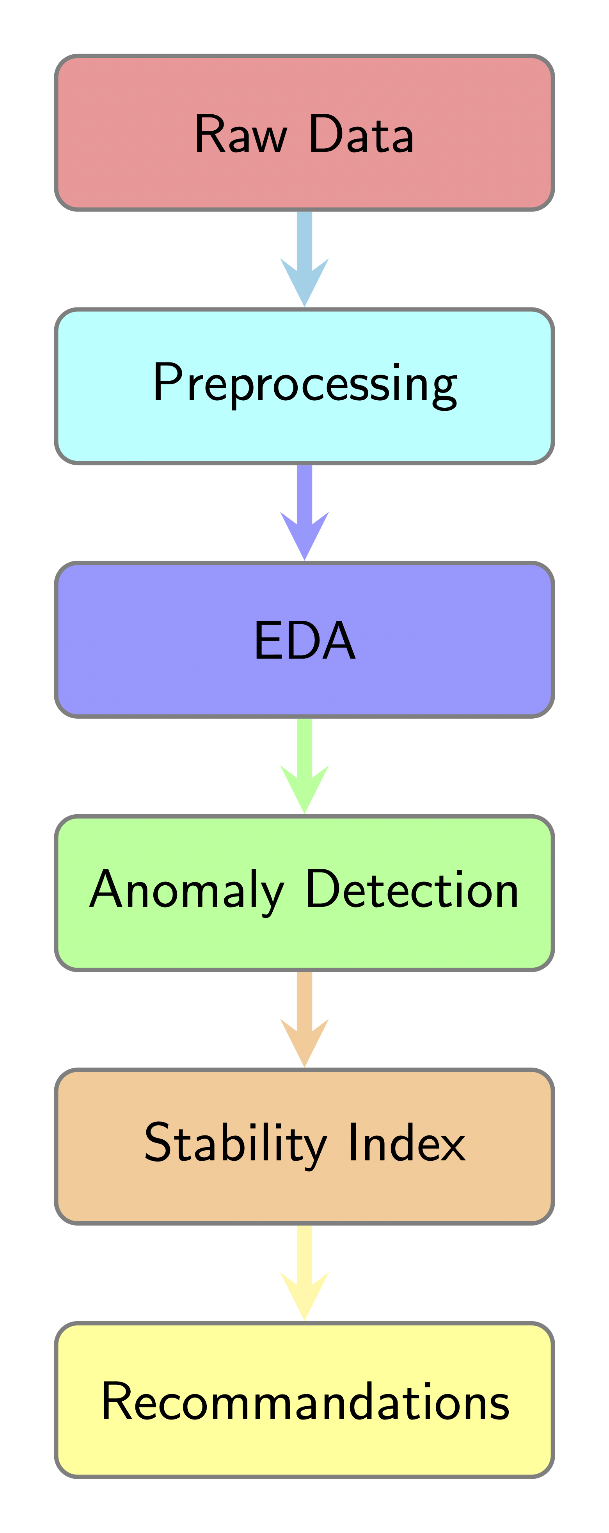
Pipeline

Slide 4
Data Preprocessing
Data Exploration and Cleaning:
Removed and interpolate missing values
Dropped categorical features
Feature Engineering:
Enhanced data set with new features (derived from Followers, Pictures Videos, Comments, Likes)
likes_per_content,
comments_per_likes,
likes_per_content_weekly_change,
followers_weekly_change
Integration of Financial Data: Yahoo API:
Closing_price_weekly_change

Slide 5
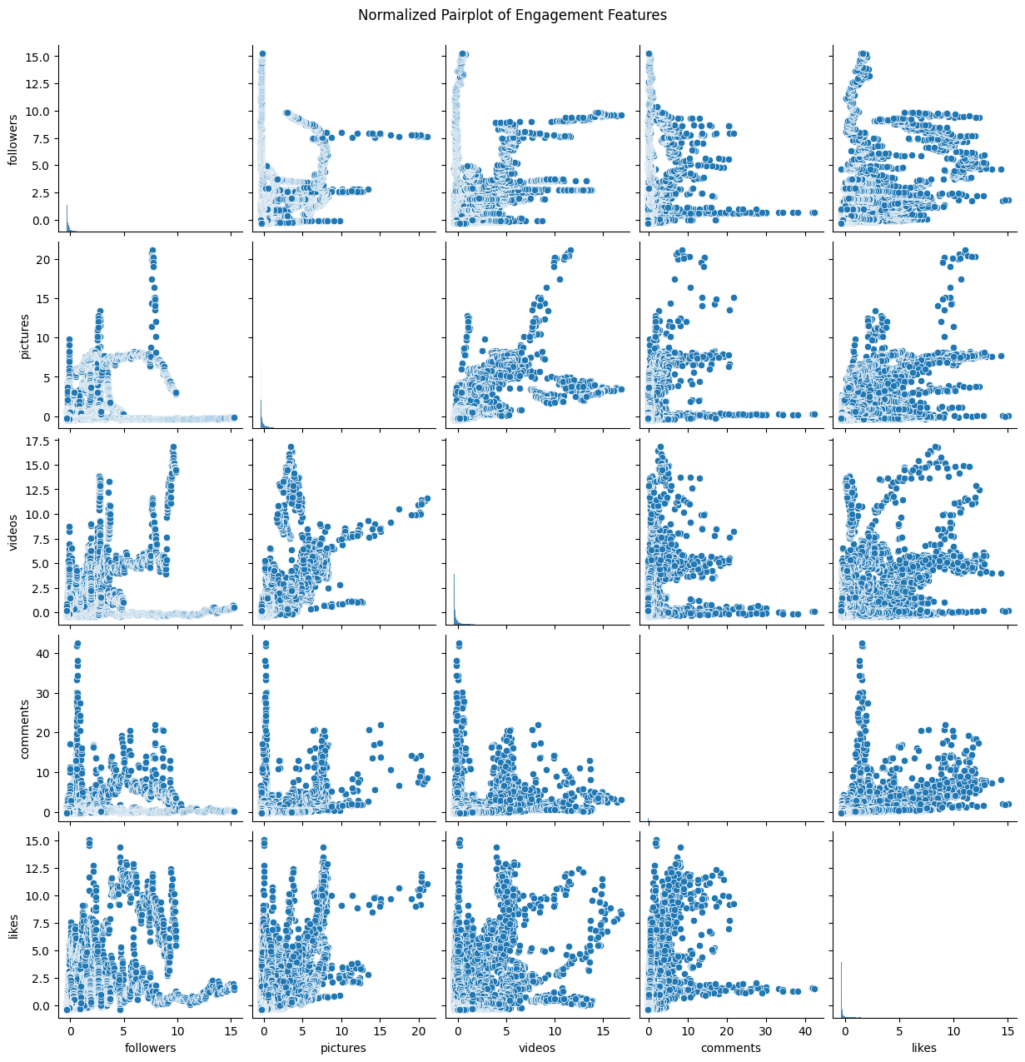
Exploratory Data Analysis
Engagement metrics pair-plot

Slide 6
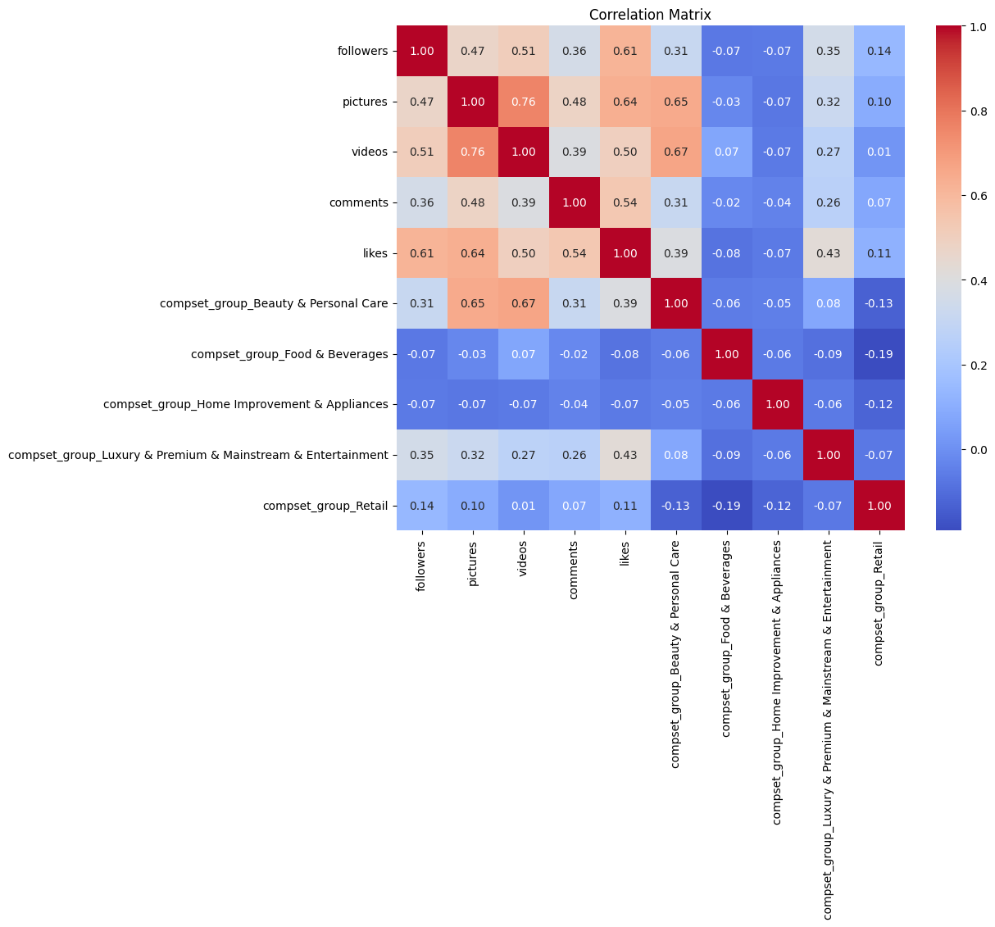
Exploratory Data Analysis
Correlations

Slide 7
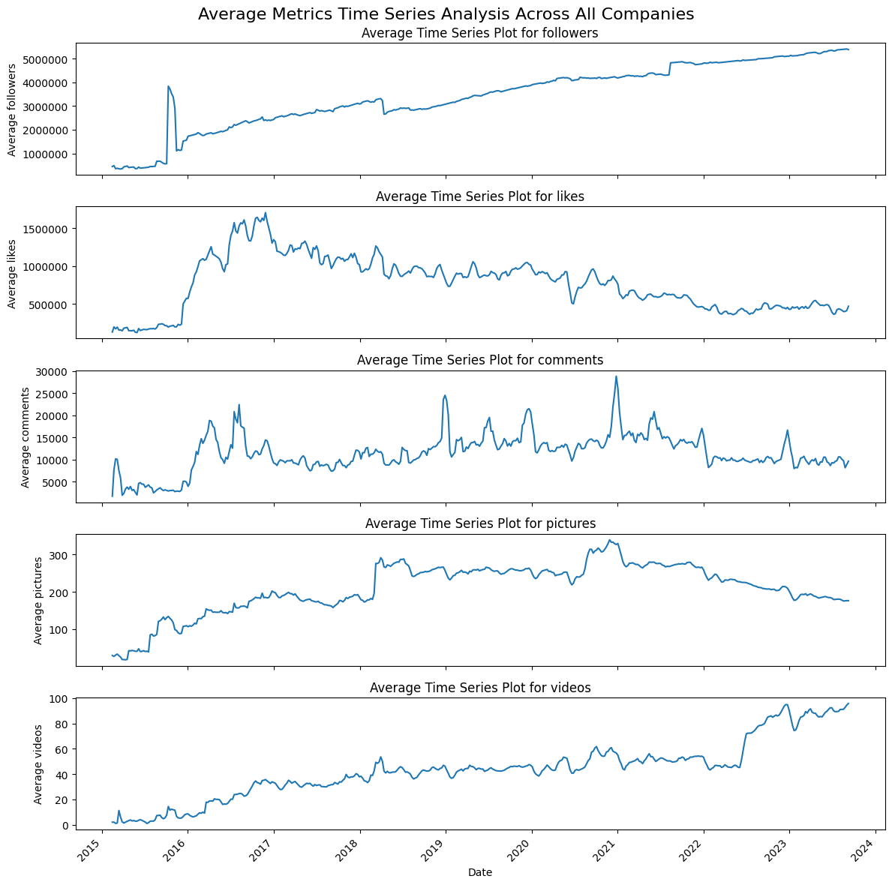
Exploratory Data Analysis
Time Series average

Slide 8
Anomaly Detection
Two methods implemented:
Autoencoder
Iso Forest
Statistical Methods implemented to find key features on Anomaly results.

Slide 9
Gained Insights and Strategy l: Sell
The weekly variation of “comments per like”: key variable.
The weekly variation of “followers” too, as expected.
Sell signal based on those events: 61% accuracy and precision, 100% recall and 75.76% f1-score, despite general market upwards trajectory.

Slide 10
Counterpart to the Selling Strategy
Good Selling Strategy already provides a lot of value.
How do we select stocks that carry little risk, to run the selling strategy?
→ Stable and established stocks for long term investments.
Statistical Analysis to find stable stocks, consisting of historical stock market data and Instagram sentiment.

Slide 11
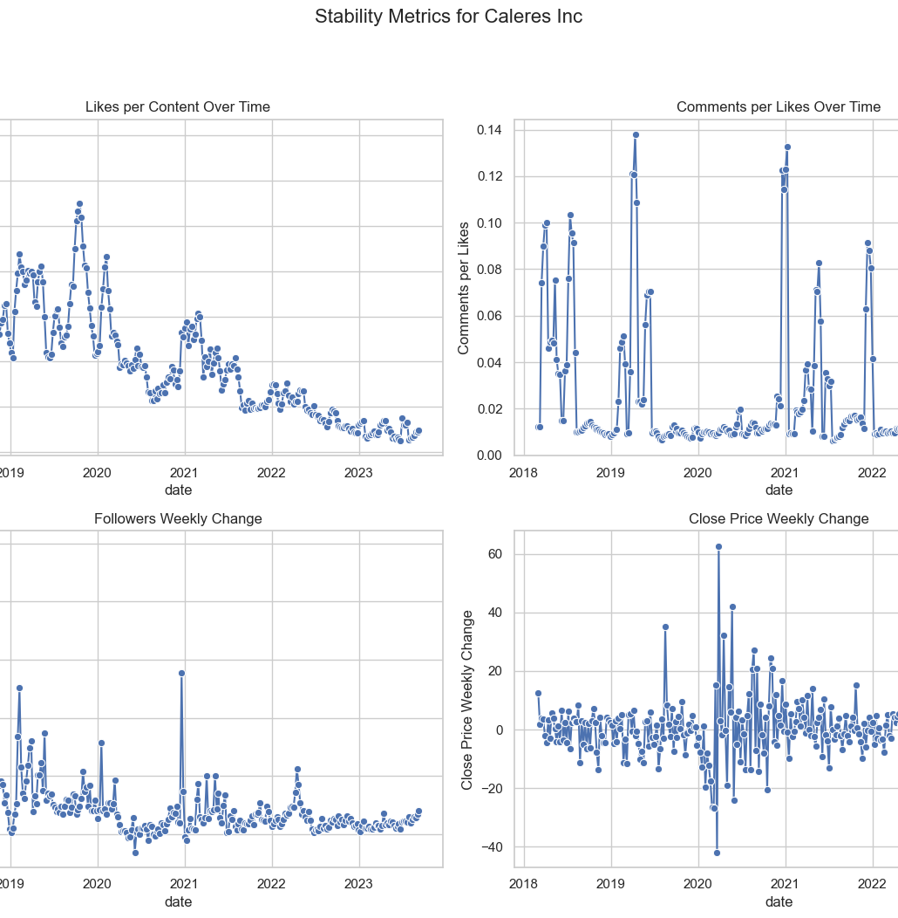
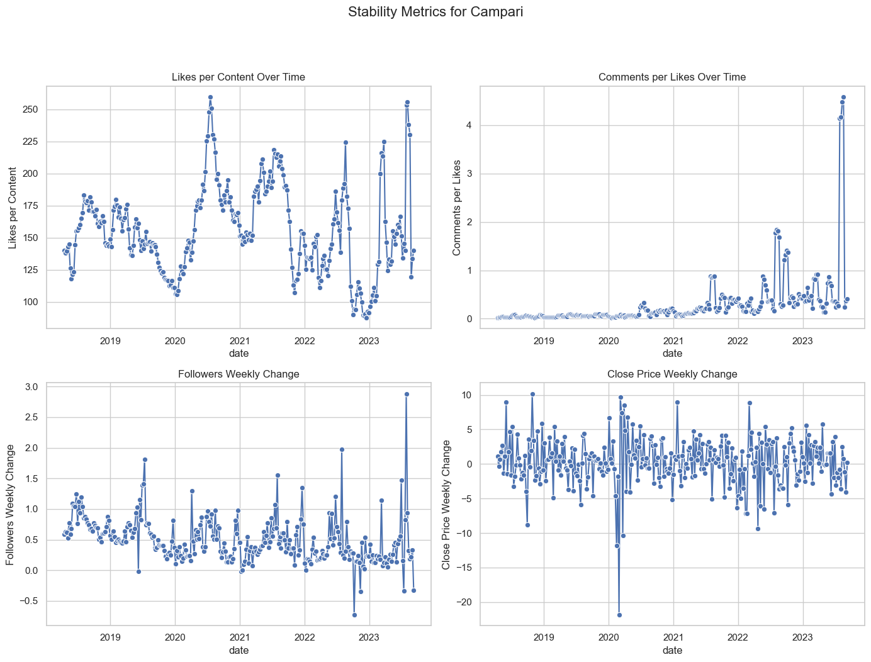

Slide 12
Conclusion and Future Directions
Summary: Our innovative use of Instagram data presents new pathways for data-driven investment strategies at UBS.
Future Work: Suggest further exploration into predictive analytics with expanded social media datasets and machine learning algorithms.
Improve performance evaluation and feature engineering.

Slide 13
Gained Insights
Alternative Approaches: Integrated external economic indicators to refine predictions and insights.
Strategic Insights: Insights derived from anomalies can guide strategic investments and risk management.

Slide 14
Conclusion and Future Directions
Summary: Our innovative use of Instagram data presents new pathways for data-driven investment strategies at UBS.
Future Work: Suggest further exploration into predictive analytics with expanded social media datasets and machine learning algorithms.

Slide 15

Questions?

Slide 16

Thank you for your attention

