Slide 1



Slide 2
Outlines
Introduction
- MongoDB
- Document Oriented
- Replication
- Sharding
- MongoDB Advantages & Disadvantages
- MongoDB Users
- Summary
- References

Slide 3
Introduction

Slide 4
SQL database & NoSQL database
SQL database
is collection of tables that stores a specific set of structured data.
NoSQL database
it’s non-tabular database and store data in documents.

Slide 5
SQL database Example
user
id | first_name | last_name | cell | city
1 | Omar | Alajaji | 066547 | Riyadh
hobbies
id | user_id | hobby
10 | 1 | Football
11 | 1 | Basketball
12 | 1 | Volleyball
What we need retrieve the data ?
Joining Operation

Slide 6
NoSQL database Example
{
“_id”: 1,
“first_name”: “Omar”,
“last_name”: “Alajaji”,
“cell”: “0665476”,
“city”: “Riyadh”,
“hobbies”: [“Football”,” Basketball”,” Volleyball”]
}
What we need retrieve the data ?
A single document can be retrieve no need for joining.

Slide 7
MongoDB

Slide 8
What is MongoDB ?
MongoDB
Is an open-source document-oriented database categorized under the NoSQL databases.
Features of MongoDB:
Document-oriented
Replication
Sharding
Etc..

Slide 9
Document-Oriented

Slide 10
What is document-oriented database ?
Document-oriented database
Basically, Storing the data in JSON format such as MongoDB.
Naming Differences
SQL | MongoDB
Database | Database
Table | Collection
Row | Documents
Column | Fields
Index | Index

Slide 11
Example document-oriented database
{
_id: ObjectId(7df78ad8902c)
title: 'MongoDB Course’,
tags: ['mongodb', 'database', 'NoSQL’],
likes: 100,
comments: [
{
user: ’Abdulrahman’,
message: ‘Good Video’,
dateCreated: new Date(2011,1,20,2,15),
like: 1
},
{
user:’Ziyad’,
message: ‘Give me likes’,
dateCreated: new Date(2011,1,25,7,45),
like: 5
}
]
}

Slide 12
Document-oriented Benefits
Fast, and easy to work with
Easier to add, delete and change the data
Developers usually prefer to work with document-oriented database because it works directly with the objects and arrays.

Slide 13
Easier to modify the data
In the first example, What if we decide to add a new hobby?
hobbies
id | user_id | hobby
10 | 1 | Football
11 | 1 | Basketball
12 | 1 | Volleyball
13 | 1 | Swimming

Slide 14
Easier to modify the data
{
“_id”: 1,
“first_name”: “Omar”,
“last_name”: “Alajaji”,
“cell”: “0665476”,
“city”: “Riyadh”,
“hobbies”: [“Football”,” Basketball”,” Volleyball”, “Swimming”]
}

Slide 15
Replication

Slide 16
What is Replication?
Coping the data across the servers.
Mongod
Background process, that handles the data request and perform background management operations.
Replica set
A group of mongod prosses that maintain the same dataset.

Slide 17
What is Replication? (cont)
Primary (Master)
Member of the replica set that receives writing operation.
Secondary (Slave)
It copies the oplog and apply the operations on its dataset

Slide 18
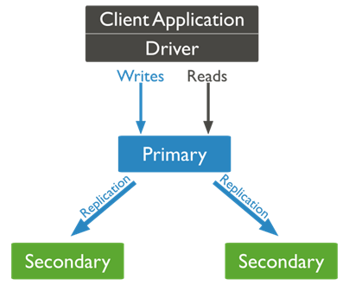
Example of a replica-set

Slide 19
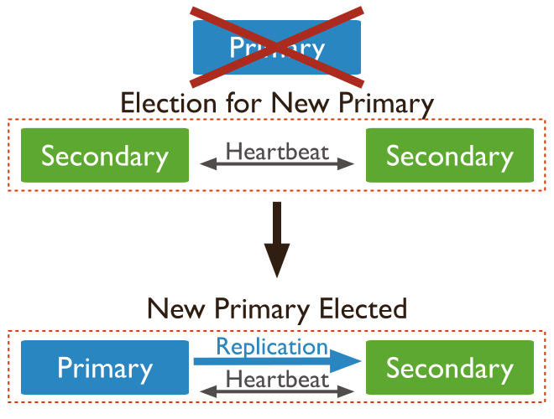
What will happen if the primary becomes unavailable?

Slide 20
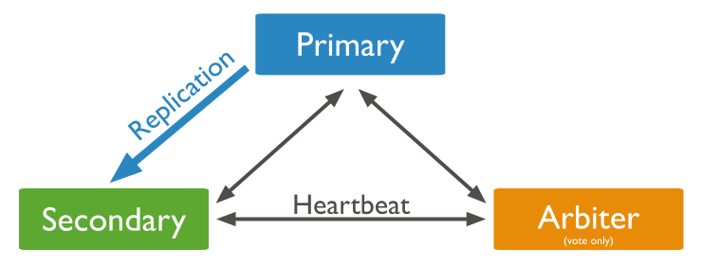
What is the Arbiter?
Mongod instance that can only vote and cannot be a primary.

Slide 21
Sharding

Slide 22
What is Sharding?
Sharding
Is a method for distributing data across multiple machines.
MongoDB uses Sharding to support deployments with very large data sets and high throughput operations.

Slide 23
Two methods of scaling
Vertical
works with enhancing single server performance by adding more powerful processors, upgrading RAM or adding more disk space to the system.
Horizontal
works with adding more servers and distribute the load on multiple servers

Slide 24
Sharding components
Shard
Each shard contains a subset of the sharded data. Each shard can be deployed as a replica set
Mongos
The mongos act as a query router, providing an interface between client applications and the sharded cluster
Config server
Config servers store metadata and configuration settings for the cluster.

Slide 25
What is Shard key?
Shard Key
The shard key is either a single indexed field or multiple fields covered by a compound index that determines the distribution of the collection's documents among the cluster's shards.

Slide 26
Example of Sharding
{_id:1, first_name: “Khaled”, last_name: “alradi”, cell: 0521398, city:"Riyadh"}
{_id:2, first_name: “omar”, last_name: “hamad”, cell: 0542393, city:"jeddah "}
{_id:3, first_name: “alex”, last_name: “alali”, cell: 0593849, city:"Riyadh"}
{_id:4, first_name: “john”, last_name: “mohamed”, cell: 0589074, city:"mekkah "}
{_id:5, first_name: “hamad”, last_name: “alkhaledy”, cell: 0538437, city:" jeddah"}
{_id:6, first_name: “mohamed”, last_name:“Alsalman”,cell: 0538744, city:"Riyadh"}
{_id:7, first_name: “mostfi”, last_name: “alex”, cell: 0522834, city:"Riyadh"}

Slide 27
Example of Sharding (cont)
S1
{_id:1, first_name: “Khaled”, last_name: “alradi”, cell: 0521398, city:"Riyadh"}
{_id:3, first_name: “alex”, last_name: “alali”, cell: 0593849, city:"Riyadh"}
{_id:6, first_name: “mohamed”, last_name:“Alsalman”,cell: 0538744, city:"Riyadh"}’
{_id:7, first_name: “mostfi”, last_name: “alex”, cell: 0522834, city:"Riyadh"}
S2
{_id:1, first_name: “Khaled”, last_name: “alradi”, cell: 0521398, city:"Riyadh"}
{_id:2, first_name: “omar”, last_name: “hamad”, cell: 0542393, city:"jeddah "}
{_id:3, first_name: “alex”, last_name: “alali”, cell: 0593849, city:"Riyadh"}
{_id:4, first_name: “john”, last_name: “mohamed”, cell: 0589074, city:"mekkah "}
{_id:5, first_name: “hamad”, last_name: “alkhaledy”, cell: 0538437, city:" jeddah"}
{_id:6, first_name: “mohamed”, last_name:“Alsalman”,cell: 0538744, city:"Riyadh"}
{_id:7, first_name: “mostfi”, last_name: “alex”, cell: 0522834, city:"Riyadh"}
{_id:2, first_name: “omar”, last_name: “hamad”, cell: 0542393, city:"jeddah "}
{_id:5, first_name: “hamad”, last_name: “alkhaledy”, cell: 0538437, city:" jeddah"}
S3
{_id:4, first_name: “john”, last_name: “mohamed”, cell: 0589074, city:"mekkah "}

Slide 28
MongoDB Advantages & Disadvantages

Slide 29
MongoDB Advantages
Advantages:
Higher performance compared to any rational database
Highly scalable
Easy to store and handle
Faster access to data
Etc..

Slide 30
MongoDB Disadvantages
Disadvantages:
High memory usage for data storage
No more than 16MB data in the document
No transaction support

Slide 31
MongoDB Users

Slide 32







MongoDB Users

Slide 33
Summary

Slide 34
Summary
- MongoDB is the most popular NoSQL database.
- It’s great for building a data warehouse.
- Easy to use and install
- It’s not replacing RDMBS software

Slide 35
References

Slide 36
References
https://www.mongodb.com/
https://www.openlogic.com/blog/what-sql-database/
https://www.geeksforgeeks.org/what-is-mongodb-working-and-features/
https://ravendb.net/articles/nosql-document-oriented-databases-detailed-overview/
https://www.w3schools.com/
https://www.ibm.com/docs/en/db2/11.5?topic=concepts-json-documents
https://hevodata.com/learn/implementing-mongodb-sharding-6-easy-steps/
https://www.guru99.com/mongodb-sharding-implementation.html
https://www.bmc.com/blogs/mongodb-sharding-explained/
https://geekflare.com/mongodb-sharding/
https://www.youtube.com/watch?v=ooF021_Kbck&ab_channel=VeMaRaHub

Slide 37
Any Questions?

Slide 38
Thank you for your time

