Slide 1


Slide 2
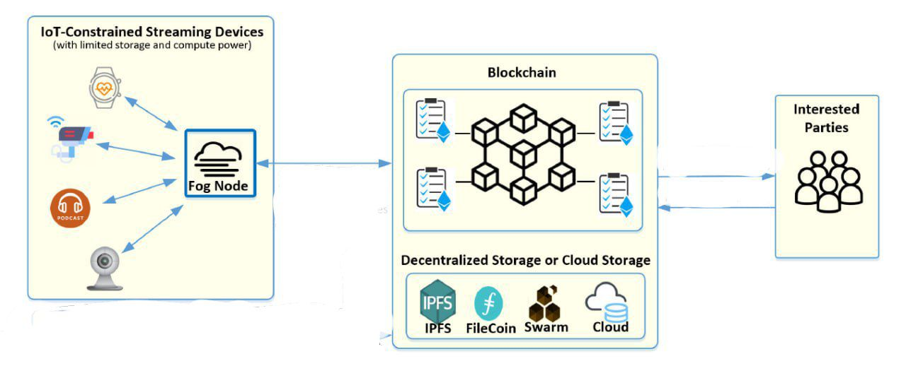
What is Sensorium’s idea?

Slide 3
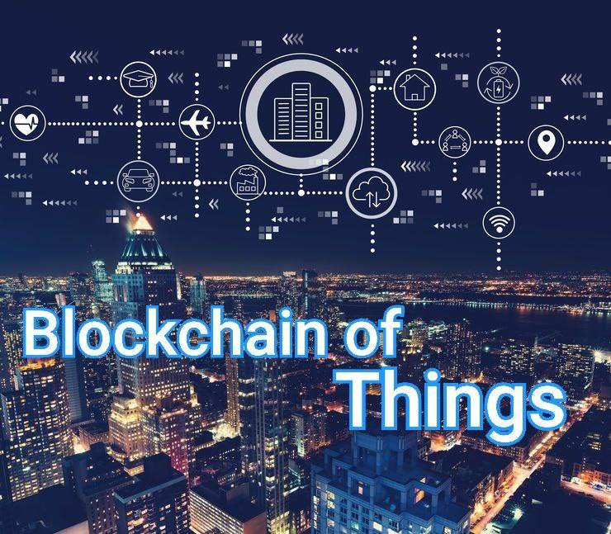
Why IOT field?

Slide 4
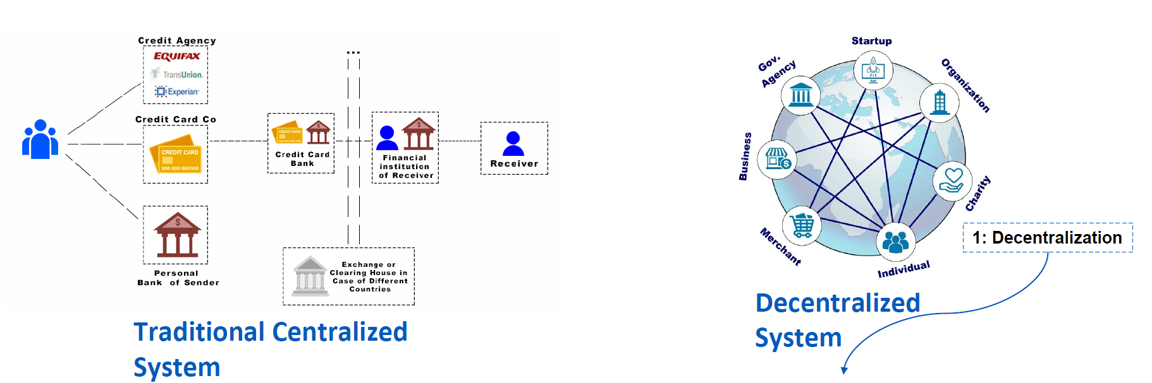


Slide 5
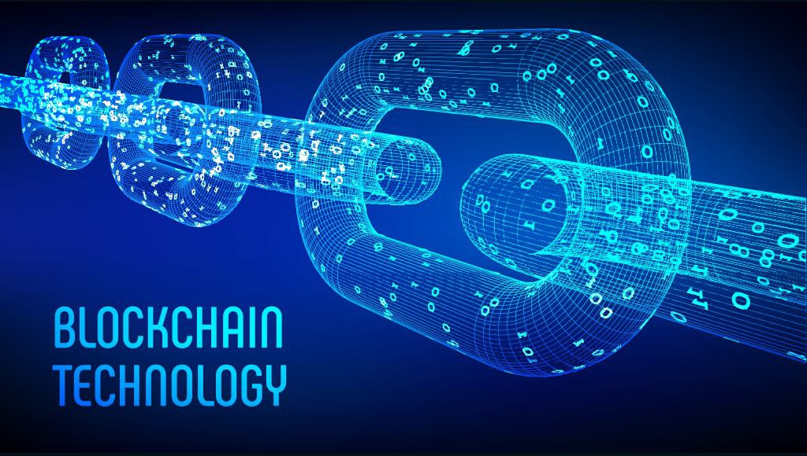
What is Blockchain?

Slide 6
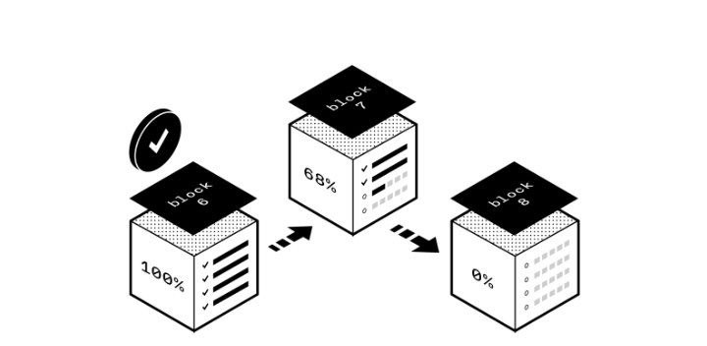
how does it works?

Slide 7
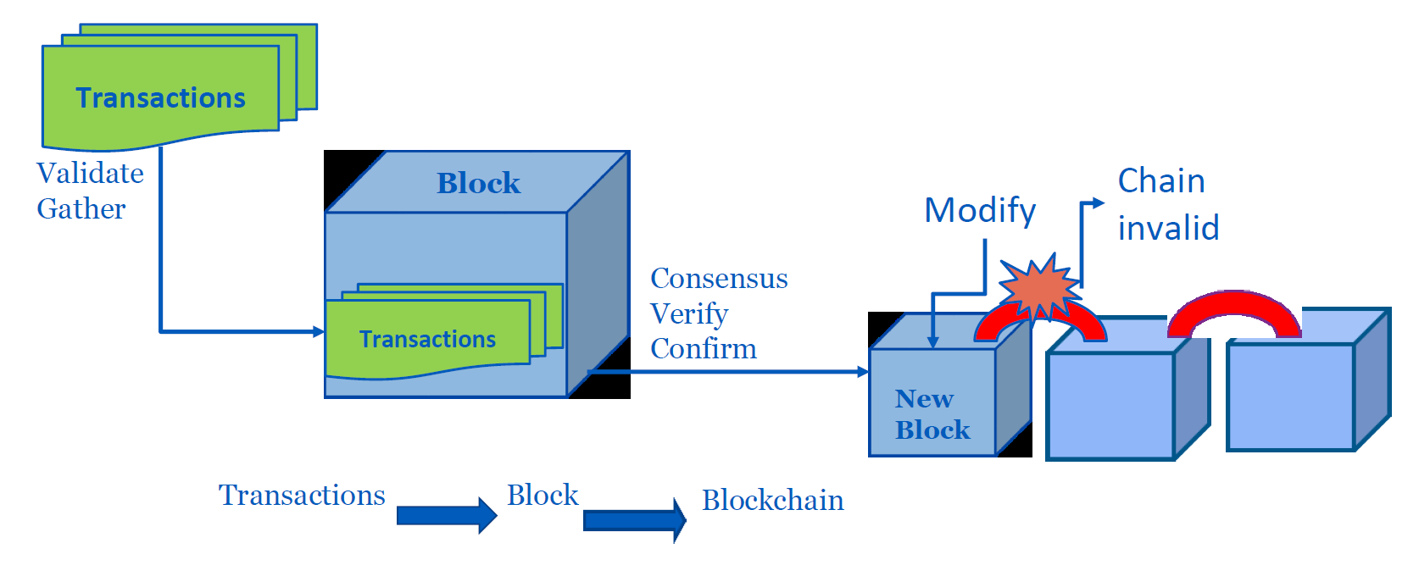

Slide 8
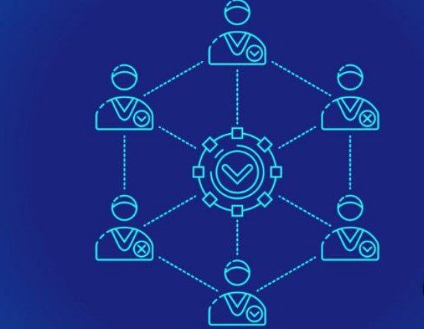
Consensus!

Slide 9
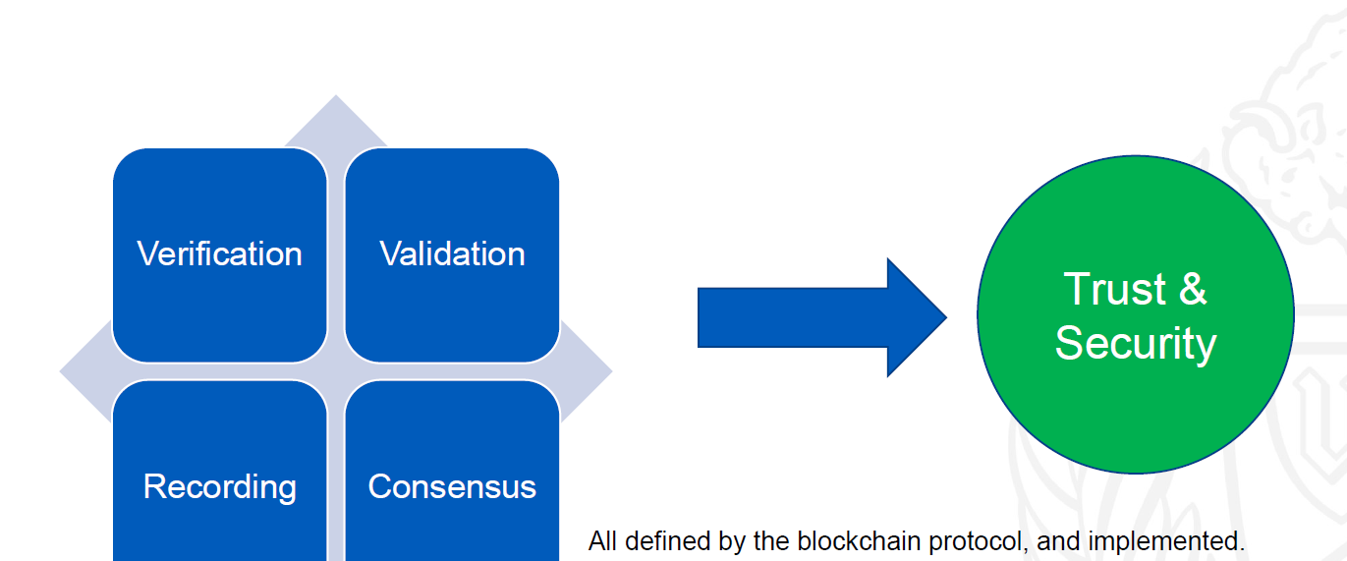

Slide 10
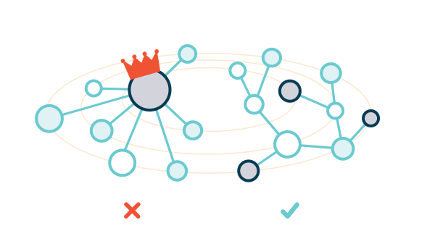
IPFS

Slide 11
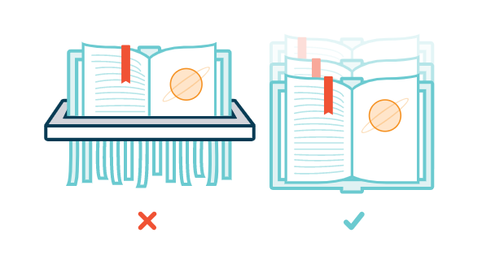
IPFS files

Slide 12
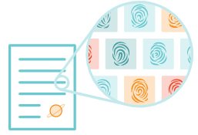
How it works?
Unique identification via content addressing.
Content linking via directed acyclic graphs (DAGs).
Content discovery via distributed hash tables (DHTs).

Slide 13
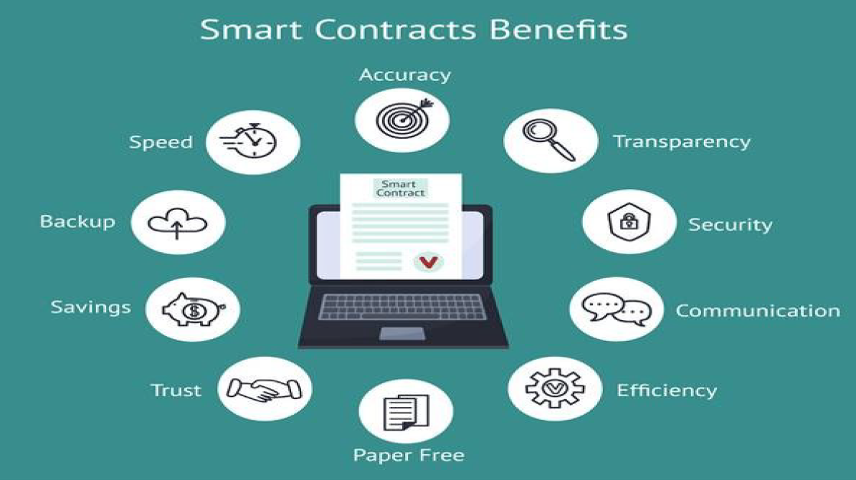
Smart Contract

Slide 14
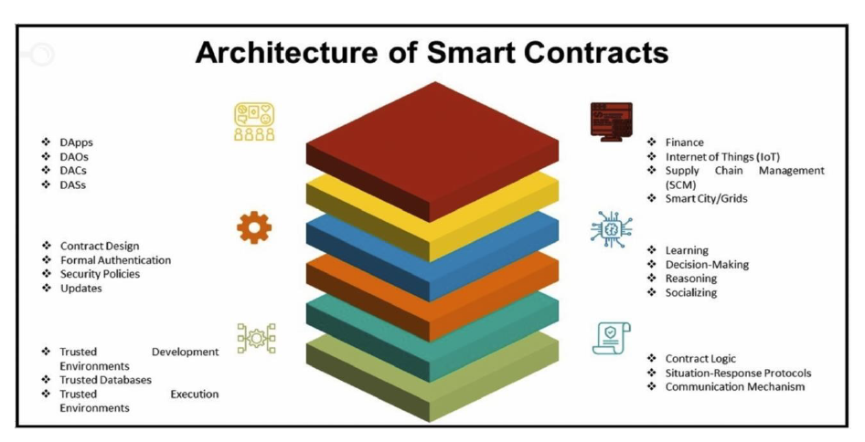

Slide 15
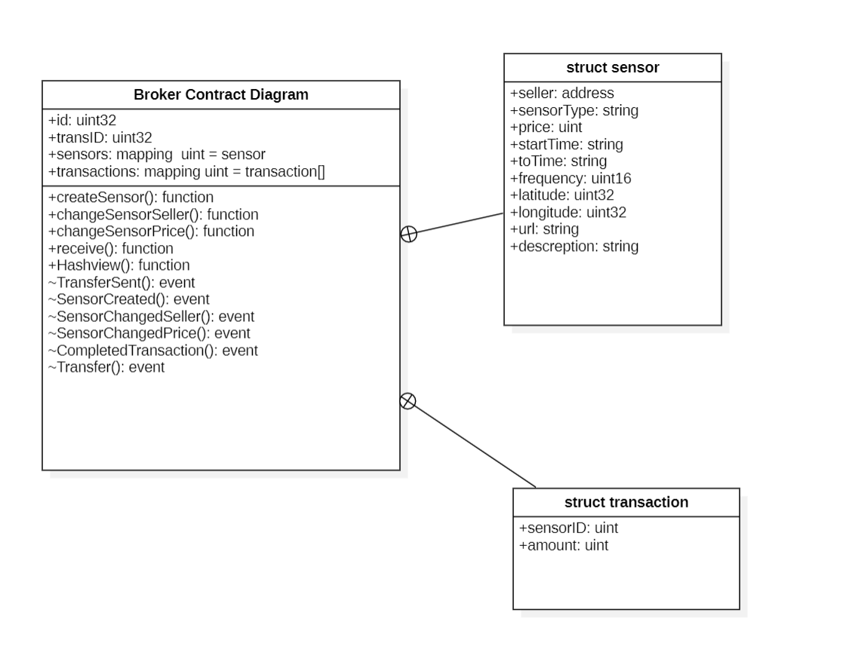
Our Smart Contract diagram:

Slide 16
Digital Assets, Transactions, Roles and Rules
The Digital Assets:
Buyers, Sellers (owner of sensor that can change seller accounts, or
sensor price).
Transactions : adding sensors data, change prices, change sellers
accounts and buy.
Roles: Buyer, Seller.
Rules:
Seller adding sensors Information and upload file to IPFS.
Only Seller can change prices and accounts.
Any one can buy sensors data and get the hash.

Slide 17
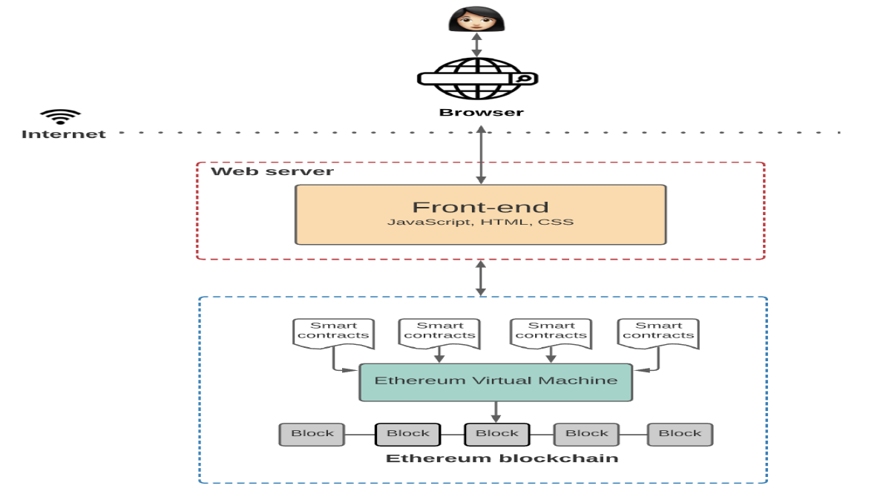
DApp:

Slide 18
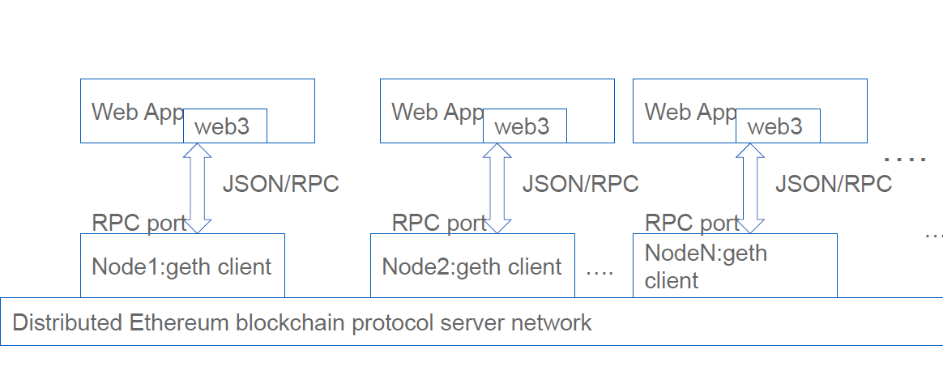
Architecture of a DApp:

Slide 19
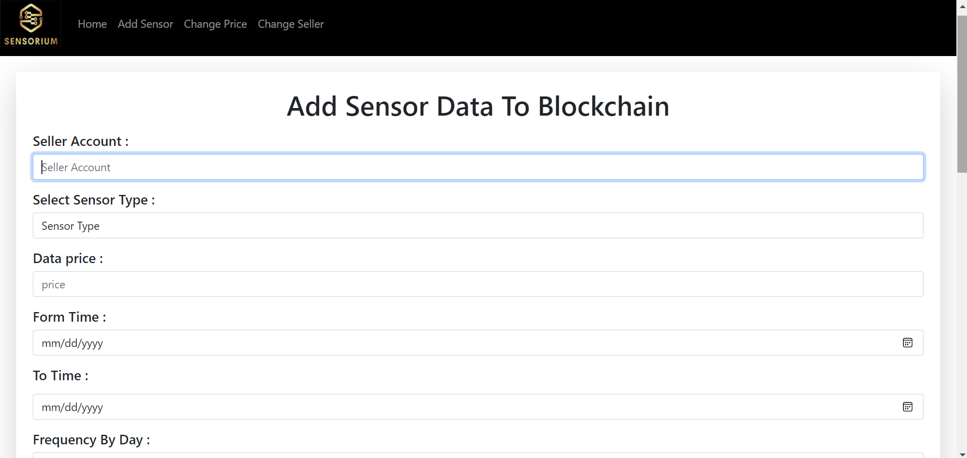

Slide 20
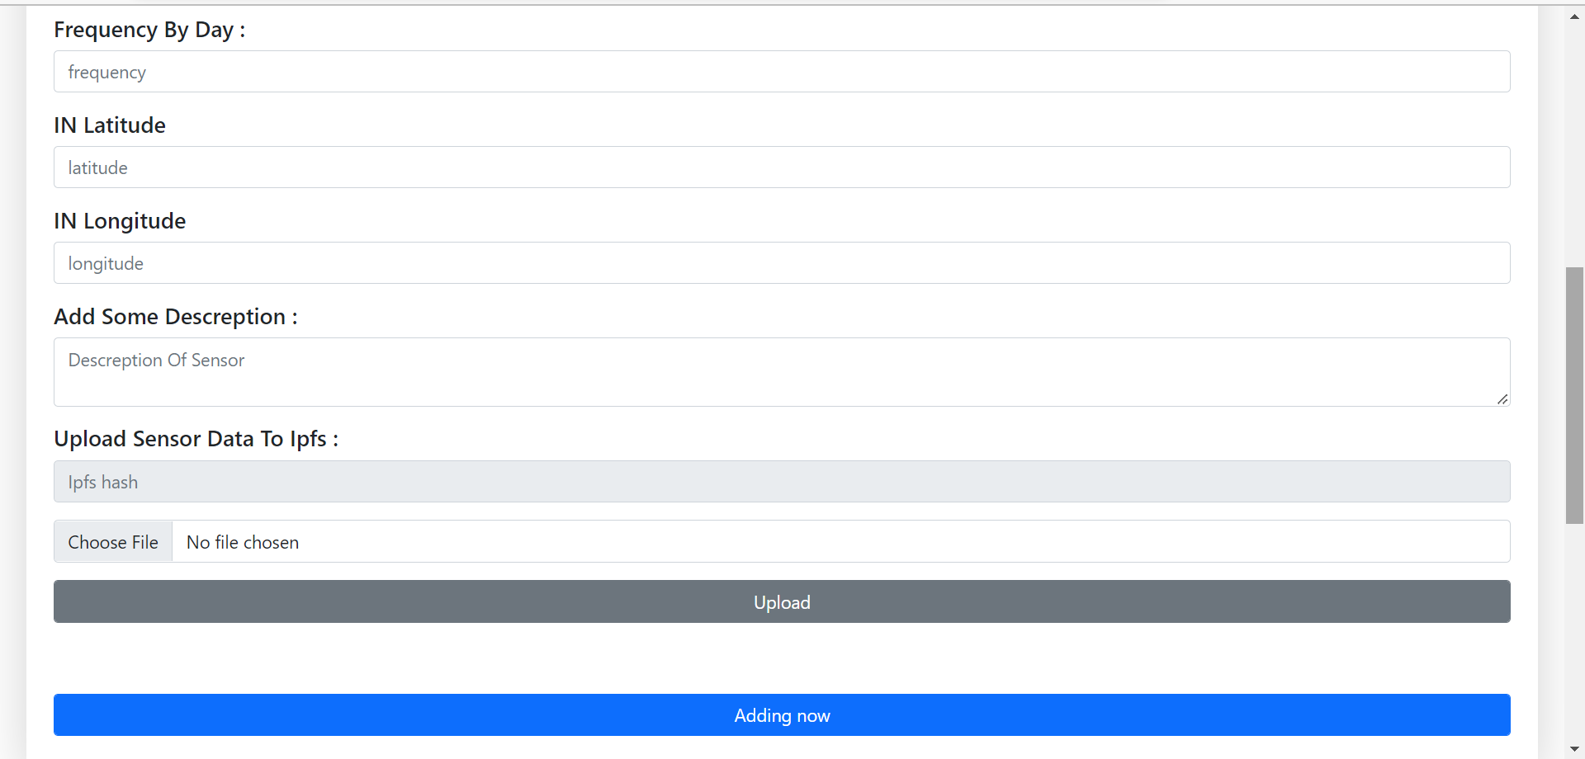
Upload data file to ipsf and then store the hash of file in Blockchain

Slide 21
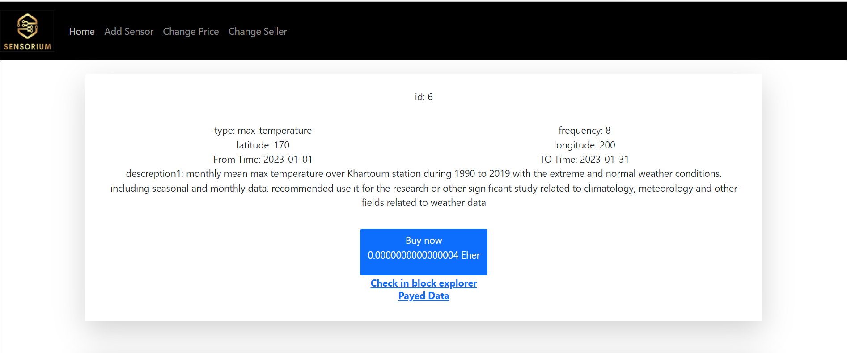
After adding the sensor data (Buy page).

Slide 22
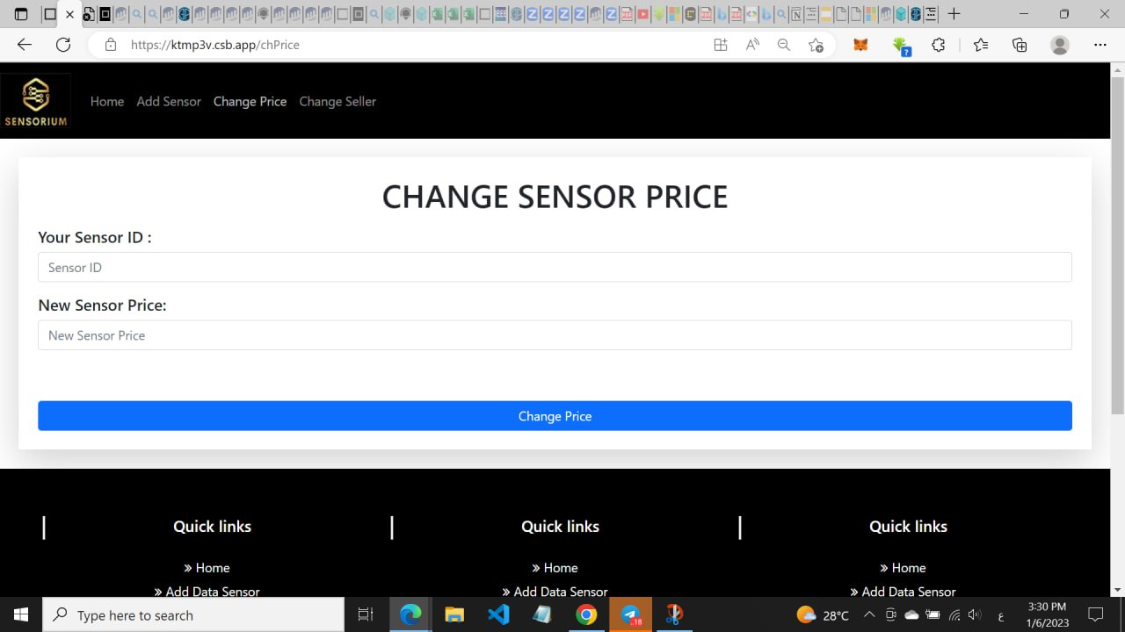

Slide 23
