Slide 1
OpenAI API Interaction & Web Crawler

Slide 2
Table of Contents
Introduction
Python Scripts Overview
JavaScript and Web Application
Styling & Appearance
Configuration & Dependencies
Conclusion

Slide 3
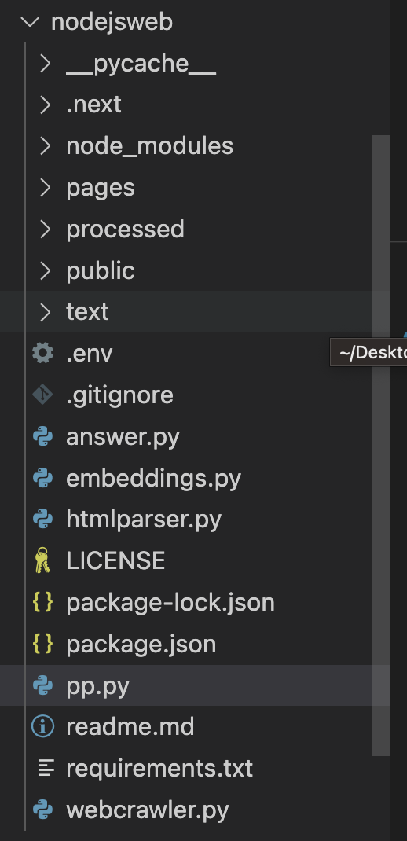
Introduction
This project comprises functionalities related to interaction with the OpenAI API and a web crawler. The codebase integrates Python scripts for backend processing and JavaScript for the frontend.

Slide 4
Python Scripts Overview
answer.py: This script is the bridge to OpenAI. It uses a pre-processed embeddings dataset to interact with the OpenAI API and obtain relevant answers based on the given context.\
embeddings.py: As the name suggests, this script is all about embeddings. Embeddings are generated and manipulated, which are then used to provide context for the questions posed to OpenAI.
htmlparser.py: An integral part of the web crawling mechanism. This script extracts hyperlinks from HTML content, paving the way for the web crawler to traverse websites effectively.
webcrawler.py: The heart of the web crawling mechanism. It's designed to crawl the openai.com domain, fetch web pages, and extract hyperlinks for further crawling.ers for AND Gate.

Slide 5
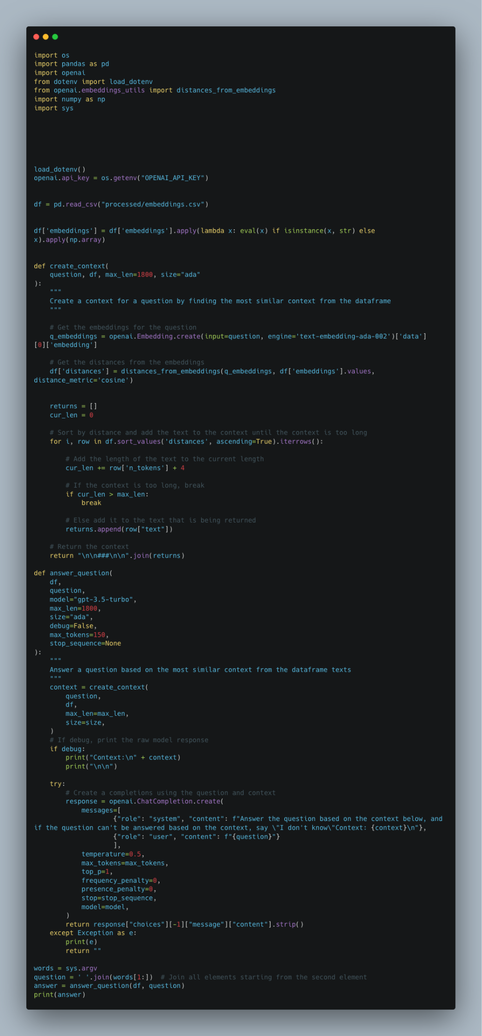
Answer.py
This script serves as the main interface with the OpenAI API. It reads a pre-processed embeddings dataset from a CSV file and uses it to provide context when querying the OpenAI API. The resulting responses from the API are processed and returned based on this context.

Slide 6
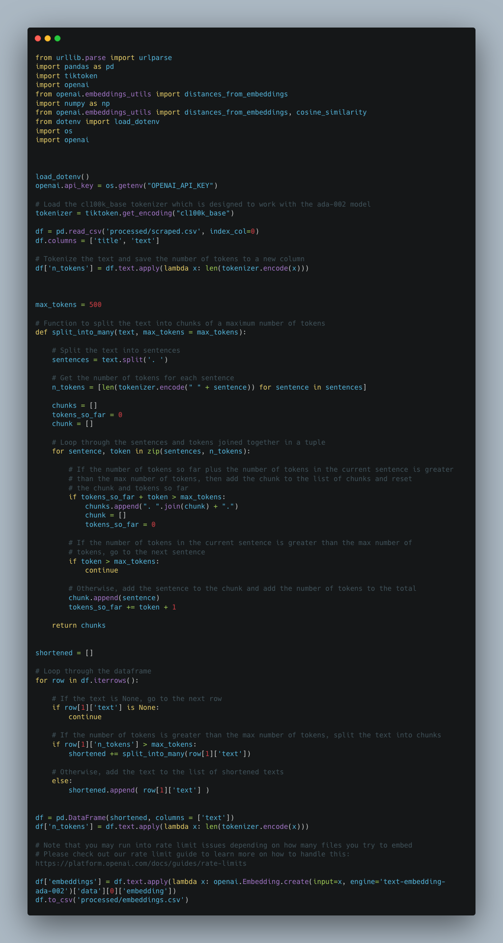
embeddings.py
The script sets up communication with the OpenAI API by loading the necessary API key from environment variables. Its primary function is to generate embeddings, which are vector representations of text data. After processing these embeddings, they are stored in a CSV file for subsequent use in the answer.py script.

Slide 7
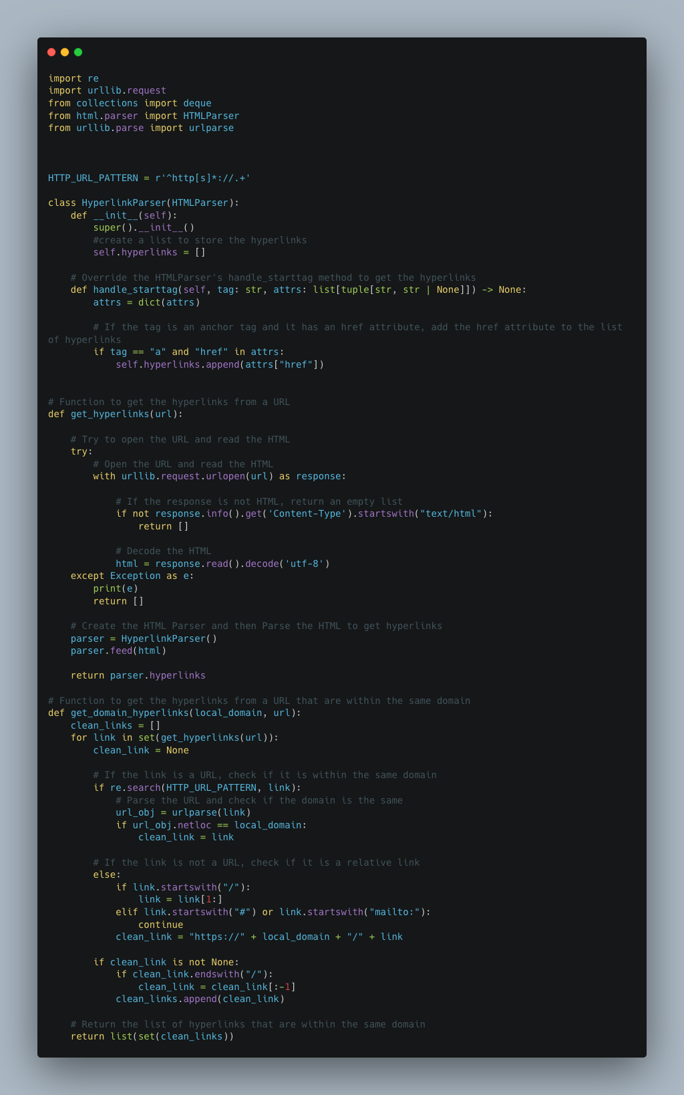
htmlparser.py
This script is an extension of the standard HTMLParser module. Its main objective is to parse provided HTML content meticulously. While doing so, it specifically looks for and extracts hyperlinks, which are then used by the web crawler for further navigation and data retrieval.

Slide 8
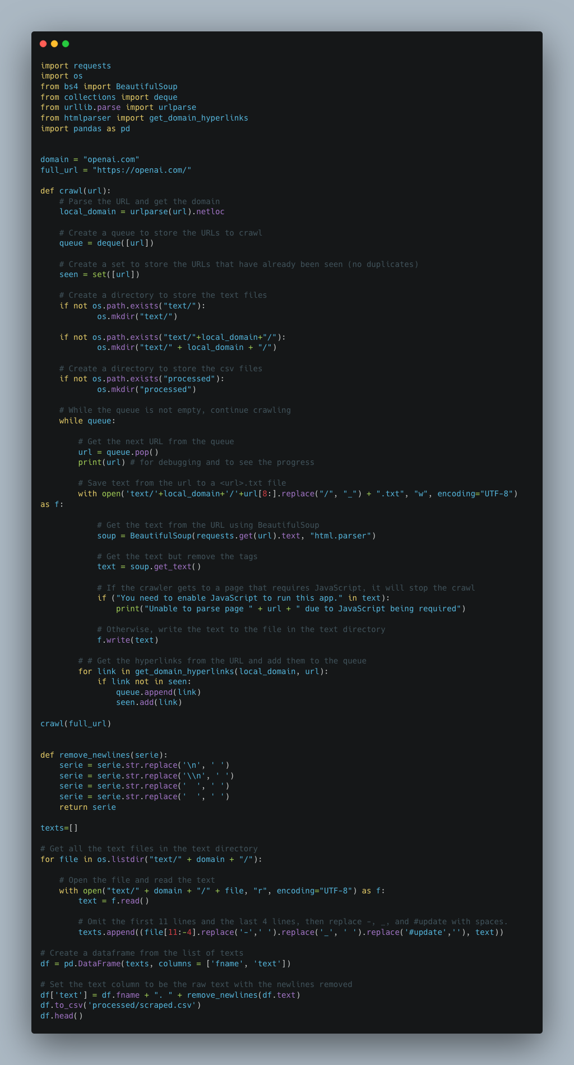
webcrawler.py
Aimed at the openai.com domain, this script functions as a web crawler. It fetches web pages from the targeted domain and, with the assistance of the htmlparser.py script, extracts hyperlinks from these pages. The script then follows these hyperlinks, recursively crawling and collecting data from linked pages.

Slide 9
JavaScript and Web Application
index.js: This is where the interaction happens on the client side. Users pose questions, which are then passed to the backend for processing. The returned answers are then displayed in a user-friendly manner.
generateAnswer.js: the bridge between the frontend and backend. It's an API route that gets invoked when a user asks a question. This script interacts with the Python scripts and the OpenAI API to fetch the answers.

Slide 10
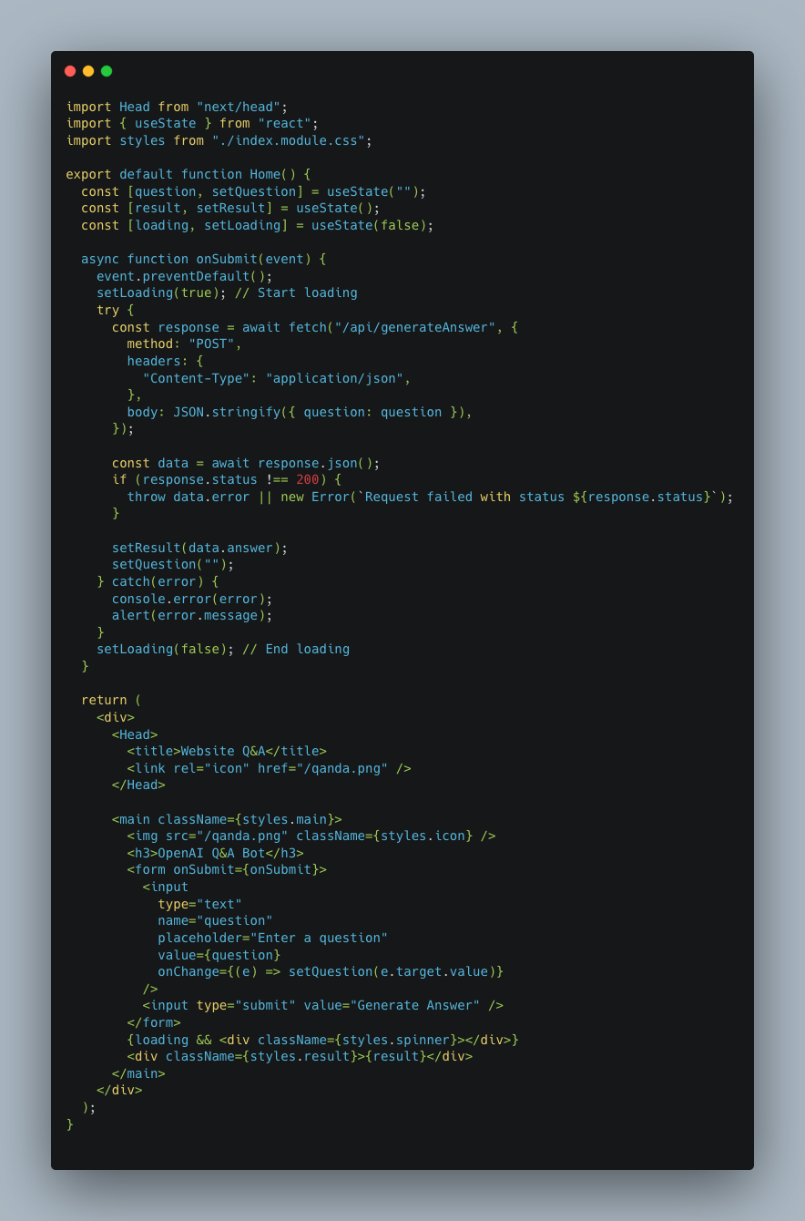
index.js
Acting as the central frontend file, it offers an interface for user interaction within the web application. Users can input queries here, which are then sent to the backend through the generateAnswer.js API route. Once the backend processes these queries and fetches answers, the script ensures that these answers are displayed to the user in a structured manner.

Slide 11
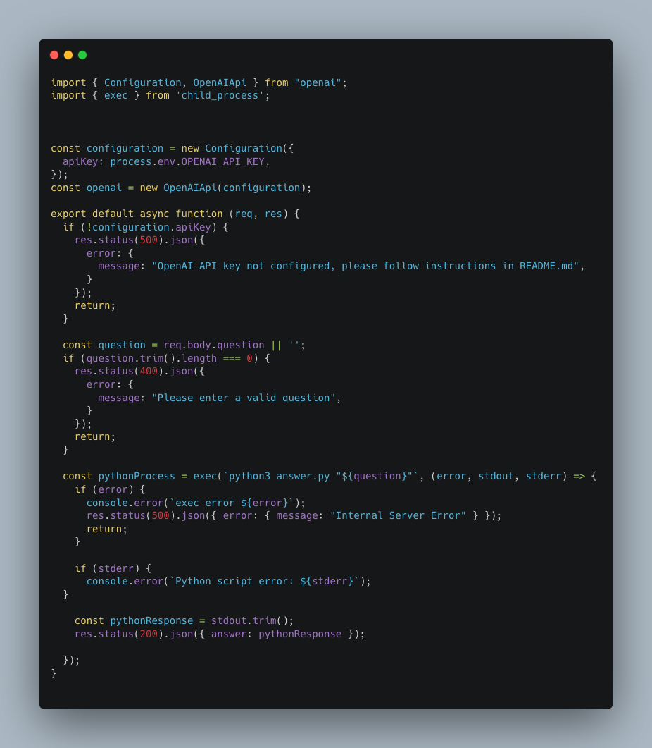
generateAnswer.js
This script functions as an intermediary between the frontend and backend. As an API route, it's designed to be invoked when a user submits a query. It takes this query, communicates with the Python scripts (particularly answer.py), and then interacts with the OpenAI API. The fetched answer is processed and sent back to the frontend for display.

Slide 12
Styling & Appearance
index.module.css: This CSS module defines the look and feel of our application. From fonts to layouts, it ensures our application is visually coherent and user-friendly.

Slide 13
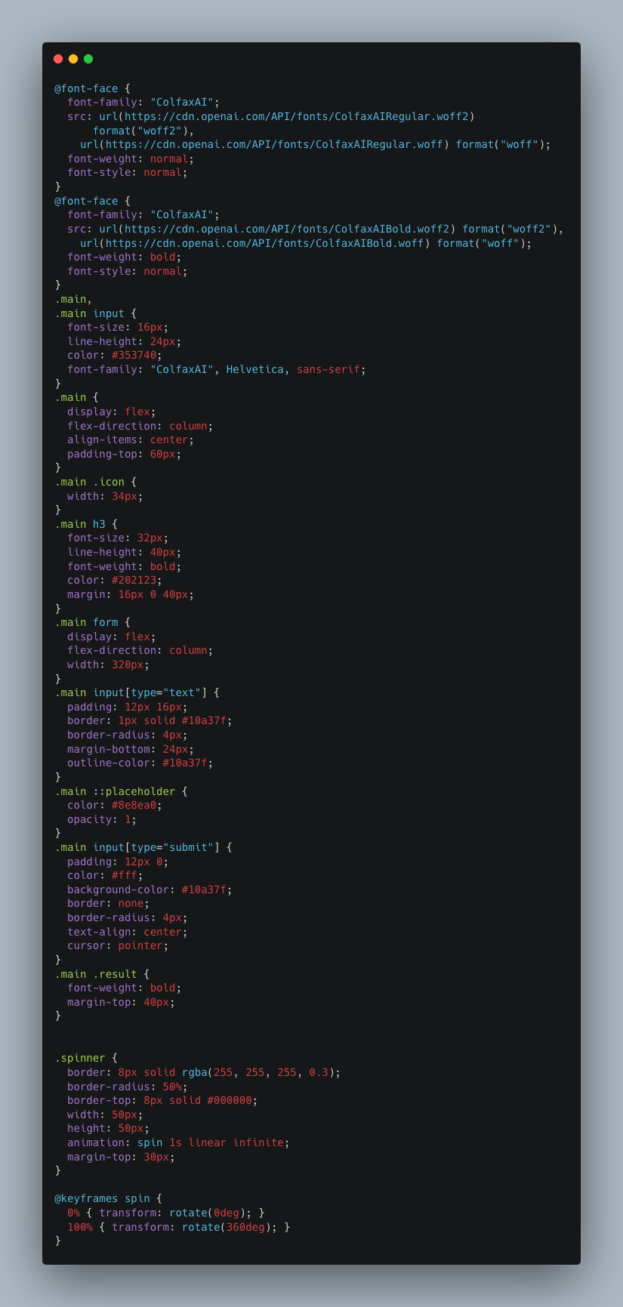
index.module.css
This stylesheet module is dedicated to defining the visual elements of the web application. It contains various CSS rules and properties, ensuring that elements on the frontend are presented uniformly and appealingly, enhancing the overall user experience.

Slide 14
Configuration & Dependencies
package.json: Node.js dependencies are listed here, ensuring the frontend runs seamlessly.
requirements.txt: This file lists all the Python packages required for backend processing. From handling web requests to data manipulation, these packages are essential.

Slide 15
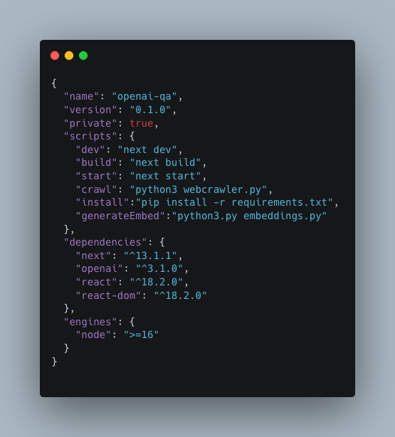
package.json
This configuration file is essential for any Node.js project. It enumerates the dependencies that the frontend relies on. Beyond dependencies, the file also provides metadata about the project, scripts for execution, and other configuration details.

Slide 16
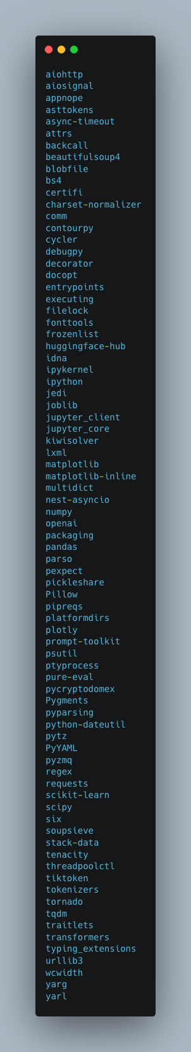
requirements.txt
This file is a list of Python packages and their respective versions that the backend scripts depend on. By having this file, it ensures that the backend, from API interactions to data processing, operates consistently across different setups.

Slide 17
Bibliography & Github Link
https://github.com/Alami64/cs589_week2_hw2_nodejs/tree/master
https://hc.labnet.sfbu.edu/~henry/sfbu/course/machine_learning/chatgpt/slide/exercise_chatgpt.html

Slide 18
Bibliography
https://hc.labnet.sfbu.edu/~henry/sfbu/course/machine_learning/deep_learning/slide/exercise_deep_learning.html
https://github.com/Alami64/Machine-Learning/tree/main/Deep%20Learning/Implementing%20Logic%20Gates%20using%20Neural%20Networks

