Slide 1
AI Email Generator

Slide 2
Table of Contents
Introduction
Design
Implementation
Test
Improvement Suggestions
Conclusion

Slide 3
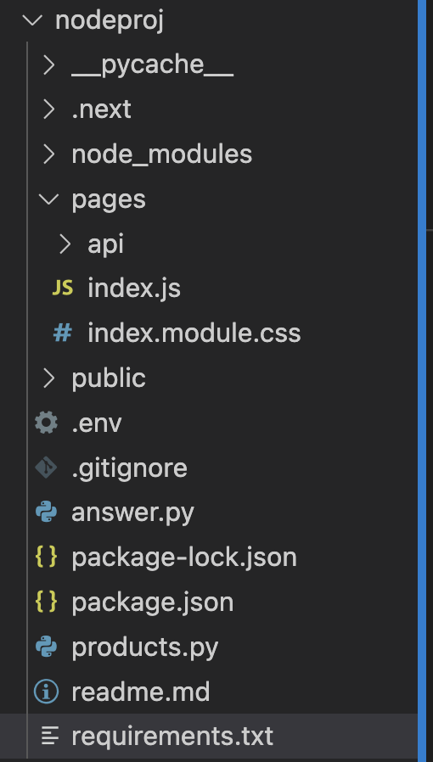
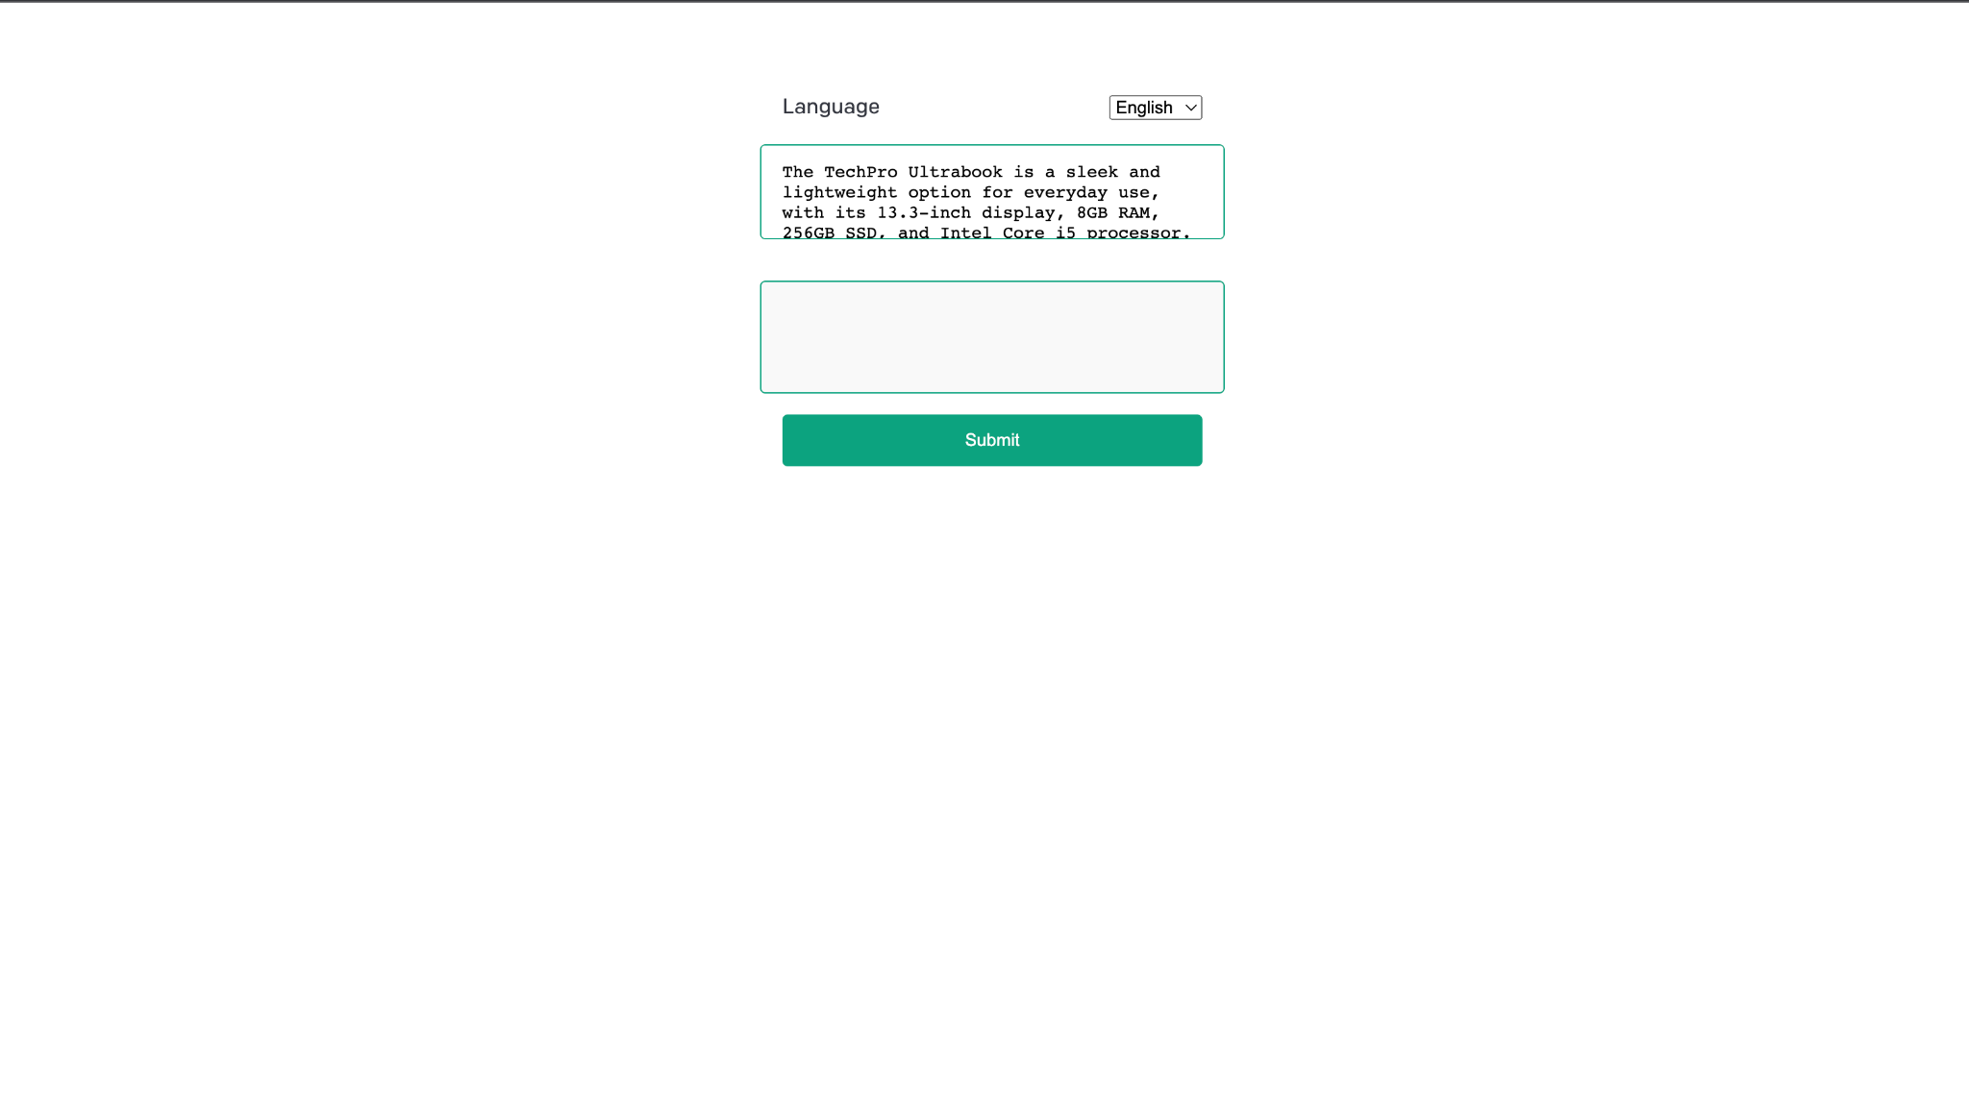
Introduction
Generating a Customer Email Project
Design and implement a system leveraging OpenAI's capabilities to generate content based on user input.
Frontend: Next.js
Backend: Python scripts and OpenAI API.

Slide 4
Design
Frontend: Built using the Next.js framework and React library. Provides the user interface for input and displaying results.
Backend: Python scripts that interface with the OpenAI API. The main logic for generating content.
Data Flow:
User inputs question and selects language on the frontend.
Backend receives input, processes it, and interacts with OpenAI.
Resulting content is sent back to the frontend for display.

Slide 5
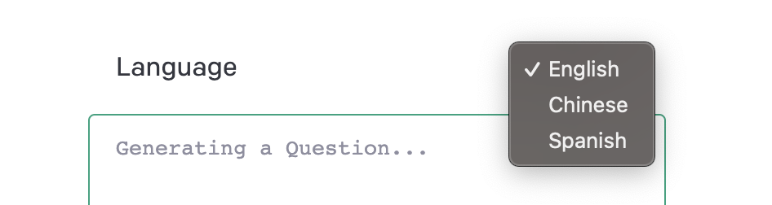
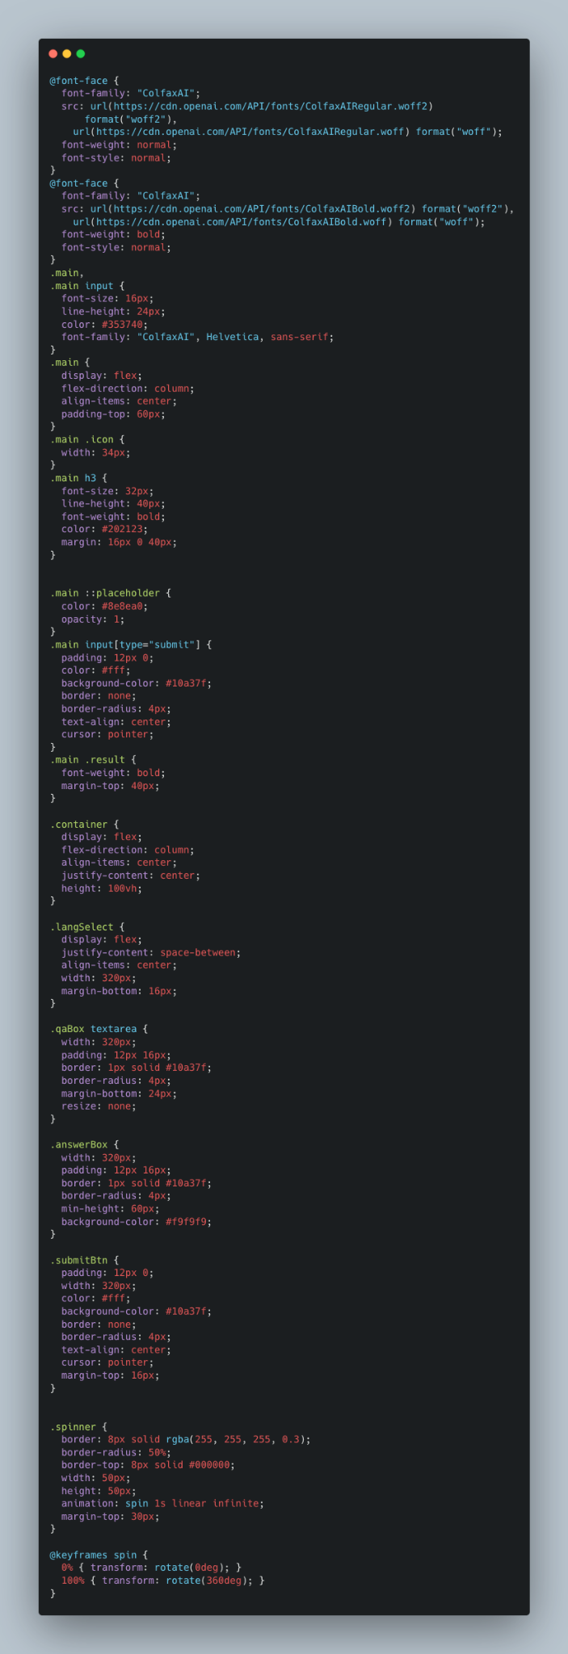
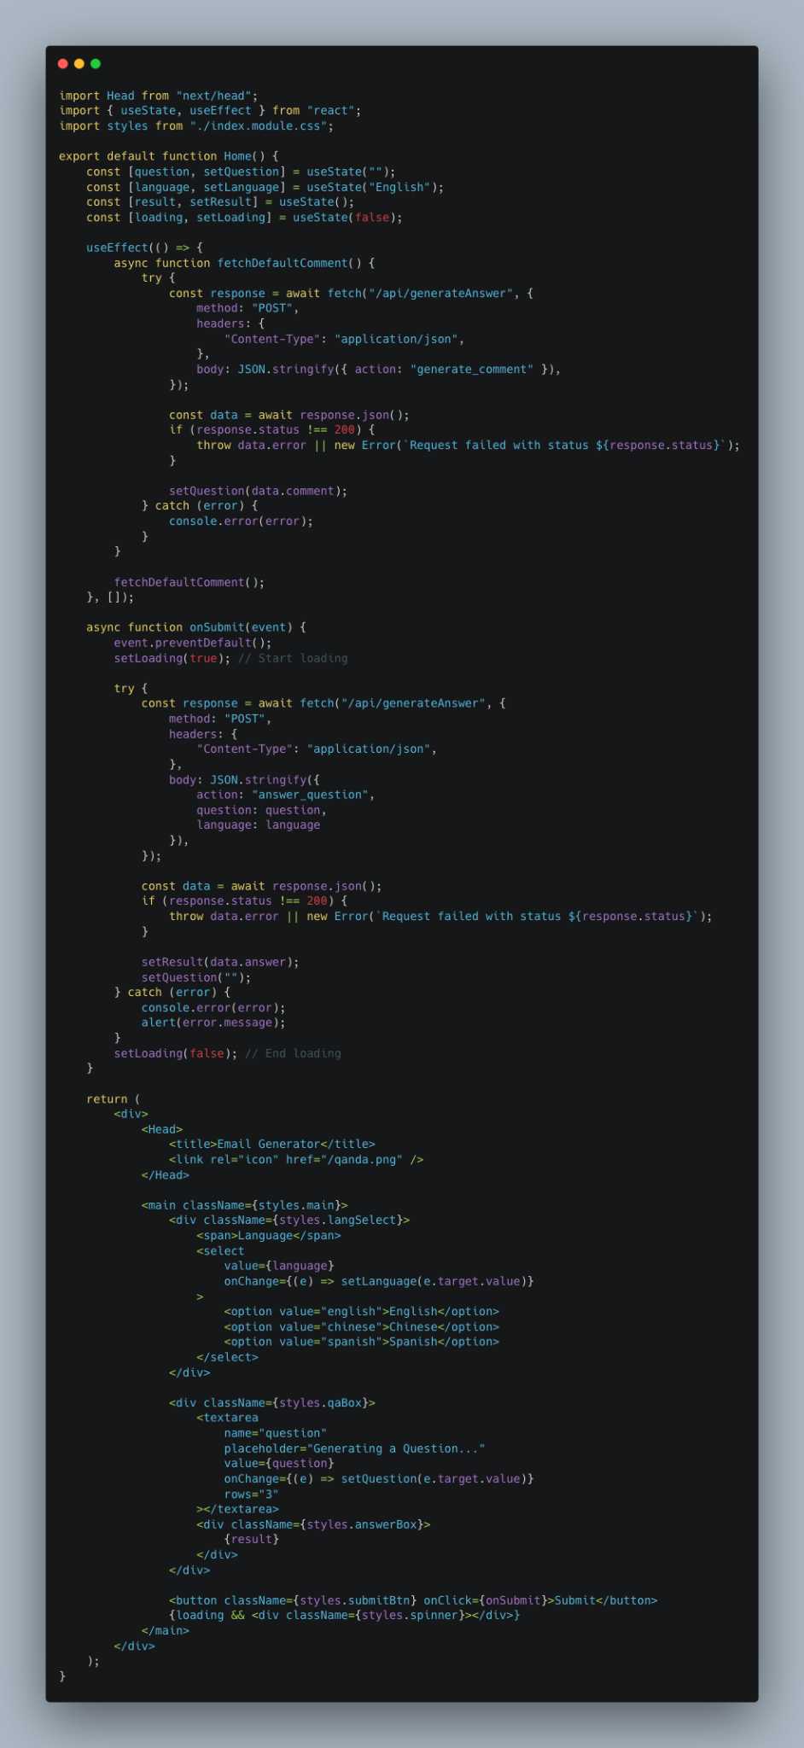
Implementation (Frontend)
Framework: Next.js – a React framework.
Main Components:
Language Selector: Dropdown menu that lets users choose between English, Chinese, or Spanish.
Question Box: Textarea for inputting or viewing the default customer comment.
Answer Box: Area where the OpenAI-generated content is displayed.
Submit Button: Initiates the content generation process.
Loading Spinner: Indicates data fetching in progress.
Styling: Custom CSS styles from index.module.css for layout and aesthetics.

Slide 6
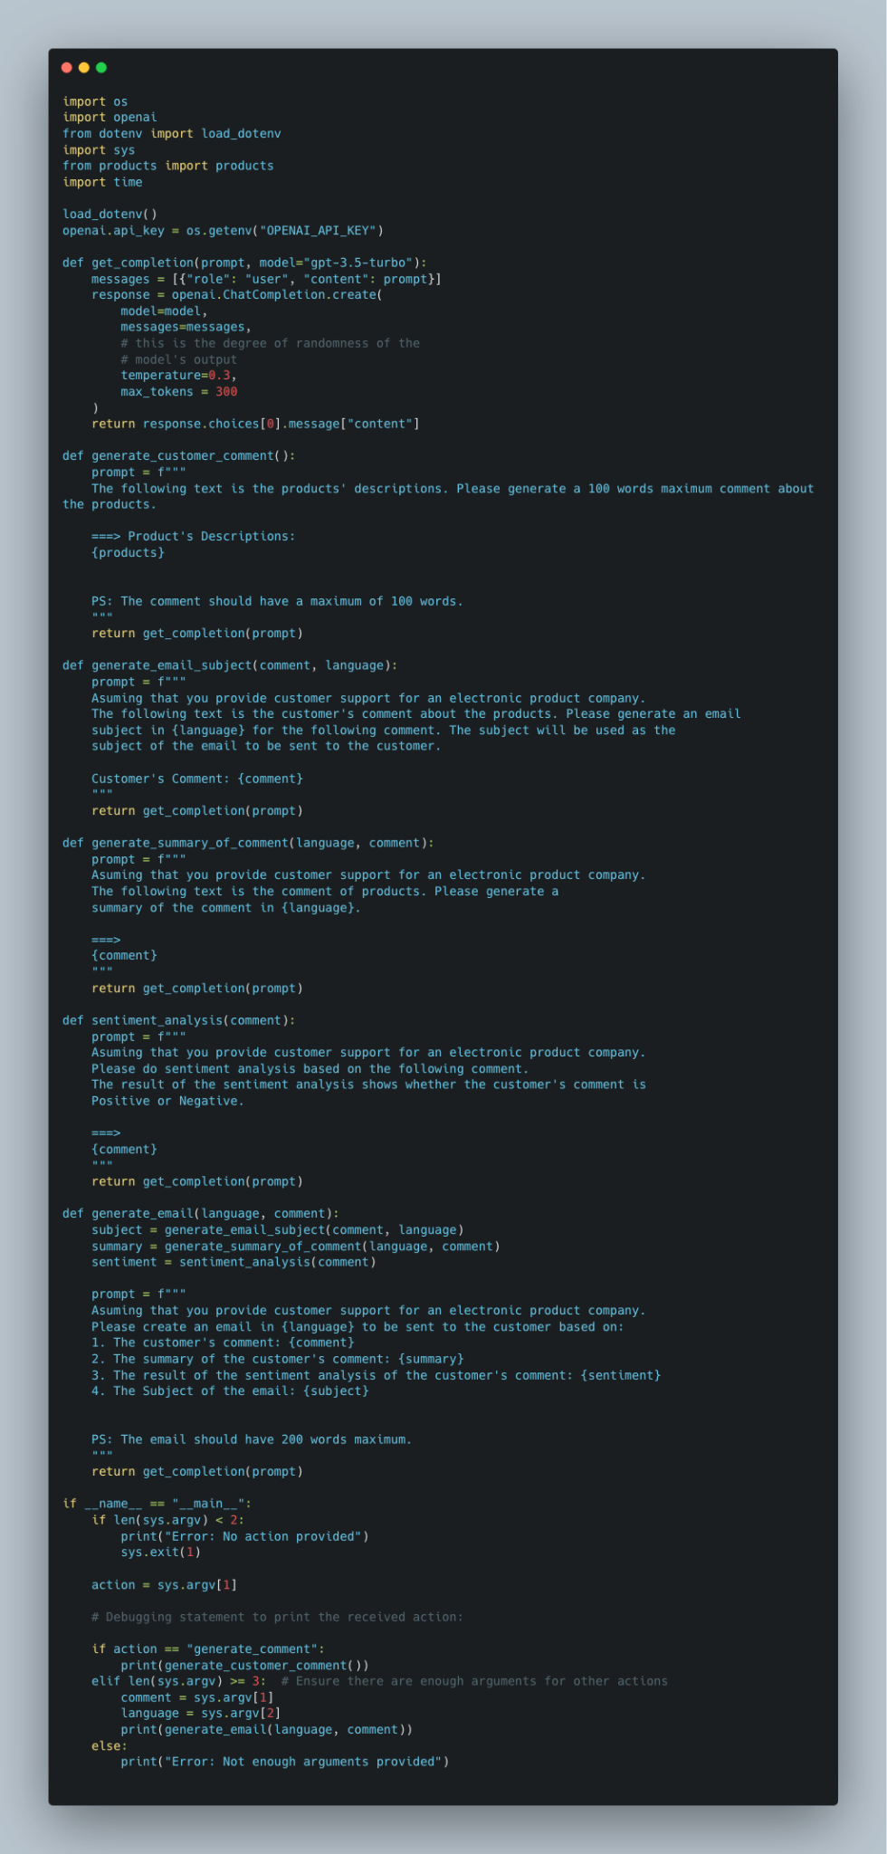
Implementation (Backend)
OpenAI Integration: The system uses the official OpenAI library for Python. API calls are made to generate content based on prompts.
Main Logic in answer.py:
generate_customer_comment(): Creates a product comment using OpenAI.
generate_email_subject(): Derives an email subject from a customer comment.
generate_summary_of_comment(): Summarizes a comment.
sentiment_analysis(): Assesses sentiment of a comment.
generate_email(): Constructs a full email from a comment, its sentiment, summary, and a subject.
Product Data in products.py: Contains a dictionary of product details used as a foundation for generating comments.

Slide 7
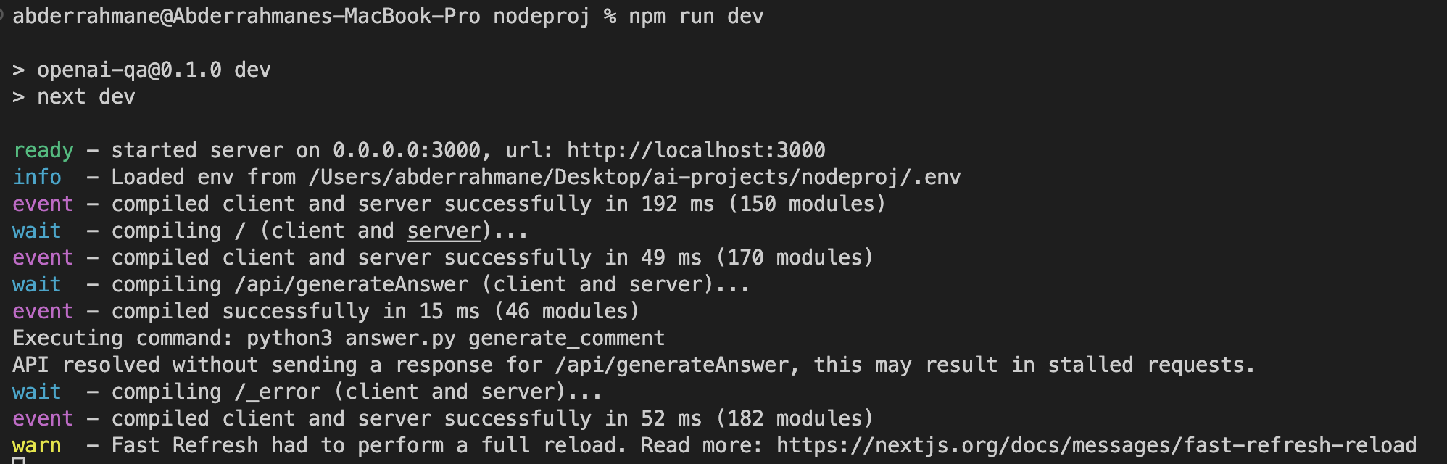
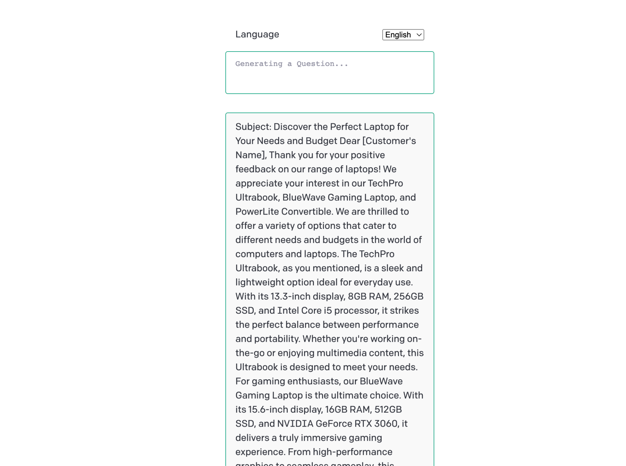
Test
Initial Load: On the first load, the system fetches a default comment to display.
User Interaction: On submission, the frontend communicates with the /api/generateAnswer endpoint, passing the user's question and selected language.
Backend Processing: Python script (answer.py) is executed, and the OpenAI API is queried.
Result Display: The frontend then displays the generated content in the answer box.

Slide 8
Improvement Suggestions
Expand Language Options: Incorporate more languages for broader user reach.
Advanced Error Handling: Implement better error handling for edge cases or unexpected OpenAI API behaviors.
User Customizations: Allow users to specify the type and style of content they want.
Optimize for Mobile: Ensure the platform is fully responsive for mobile users.

Slide 9
Conclusion
Achievements: Successfully built a system that leverages OpenAI to generate email content based on user input and product details.
Applications: Can be extended to other domains such as customer support, content generation, marketing, and more.

Slide 10
Bibliography & Github Link
https://github.com/Alami64/cs589_week3_hw2_customer_email
https://hc.labnet.sfbu.edu/~henry/sfbu/course/deeplearning_ai/chatgpt_prompt_eng_for_developer/slide/exercise_chatgpt_prompt_eng_for_developer.html

