Slide 1
Course Code : CSE – 200
Course Title : Software Development with JAVA(Sessional)
Project Name : Electricity Billing System
Team Members :
Karnis Fatema 1804052
Sayeda Tahmina 1804034
Sanjida Nuri Pearl 1804023
Submitted To :
Animesh Chandra Roy
Assistant Professor , Department of Computer Science And Engineering
Chittagong University Of Engineering & Technology

Slide 2
Contents
Introduction
Application
Motivation
Flow Chart
Output

Slide 3
Introduction
"Electricity billing system" is designed to override manual system issues. This software is a one-step solution for sending bills and collecting payment via electric mode. This is an intelligent system for time of use. It calculates the units consumed by the customer and makes bills. This system makes our lives a little easier by securing some of the busy moments of our lives.

Slide 4
Application
Real world Application
It doesn’t require any staffs as in the conventional system. Once it is installed on the system, only the meter readings are to be given by the customer. Manage the information of customer. It provides the searching facilities based on various factors such as customer, connection, electricity, payment. It tracks all the information of Bill, Bill Receipt, Electricity etc.
Virtual World Application
The software provides facility of data sharing. The electricity billing software calculates the units consumed by the customer and makes bill. In computer system the person has to fill the various forms & number of copies of the forms can be easily generated at a time.

Slide 5
Motivation
The traditional system of electricity billing is not so effective. One staff has to visit each customer’s house to note the meter readings and collect the data. Then, another staff has to compute the consumed units and calculate the money to be paid. Again, the bills prepared are to be delivered to customers. Finally, individual customer has to go to electricity office to pay their dues. Hence, the conventional electricity billing system is a lengthy process overall, requires many staffs to do simple jobs. In order to solve this lengthy process of billing, a web based computerized system is essential. The proposed electricity billing system project overcomes all these disadvantages. It is essential to both consumers and the company which provides electricity.

Slide 6
Flow Chart
Splash
Login
Registration
Calculate Bill
Pay Bill

Slide 7
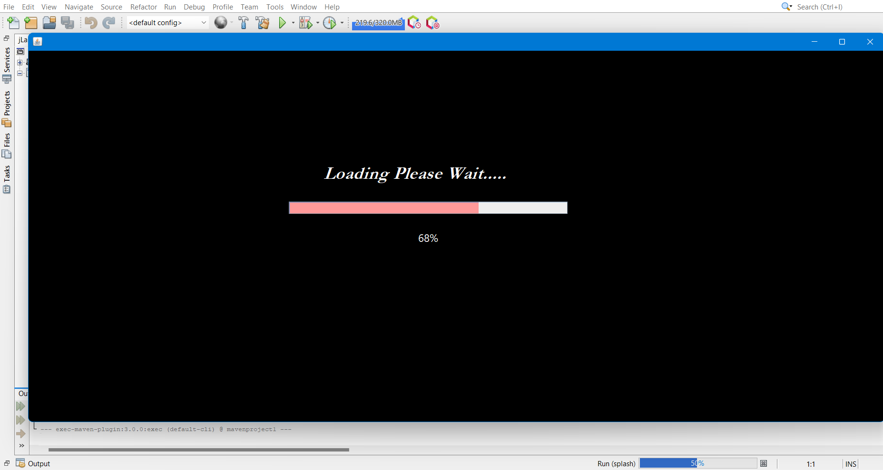

Slide 8
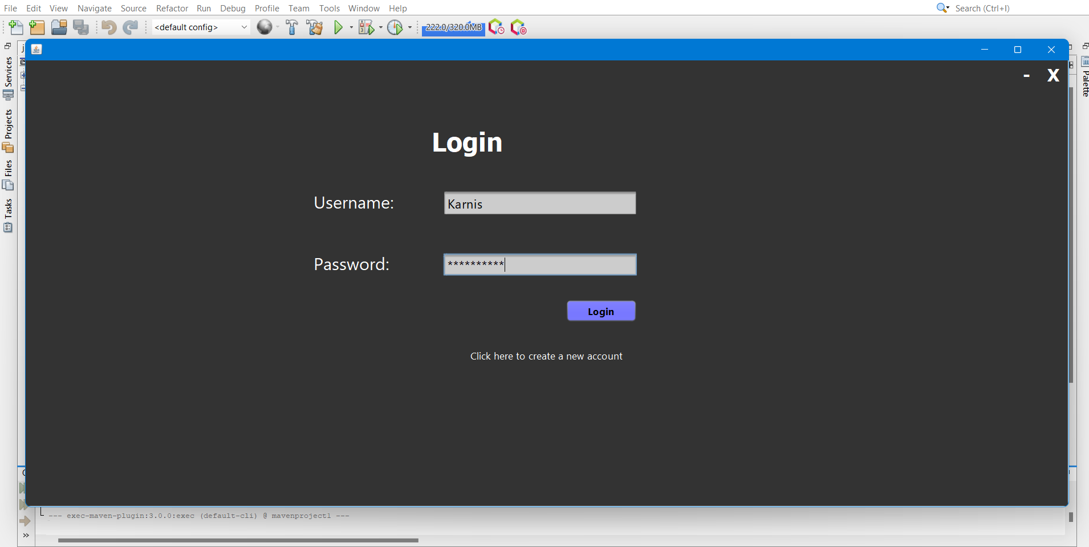

Slide 9
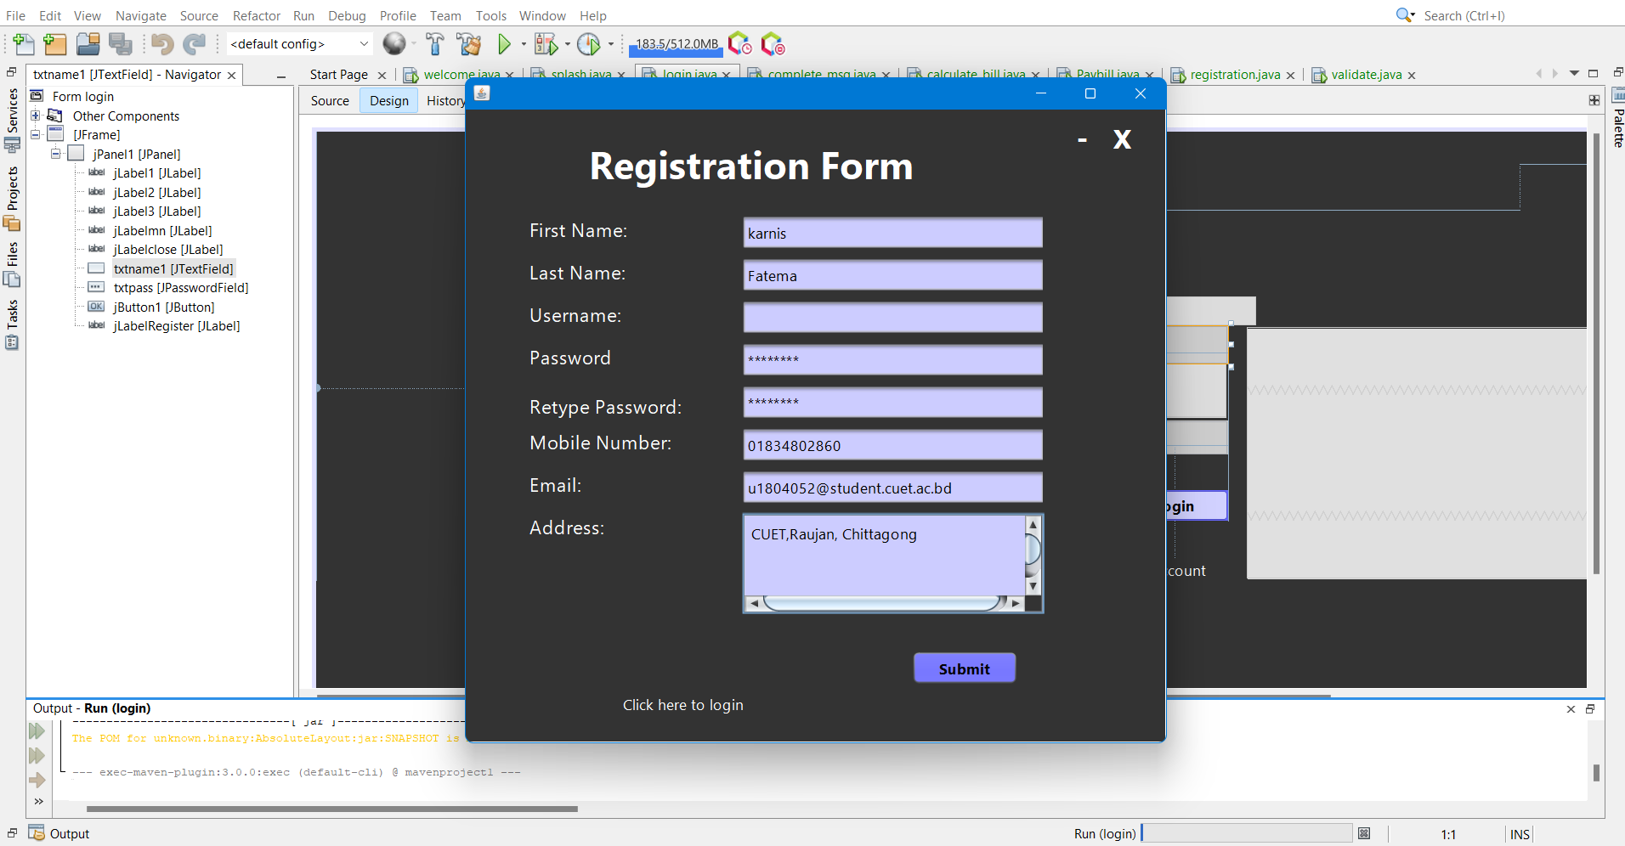

Slide 10
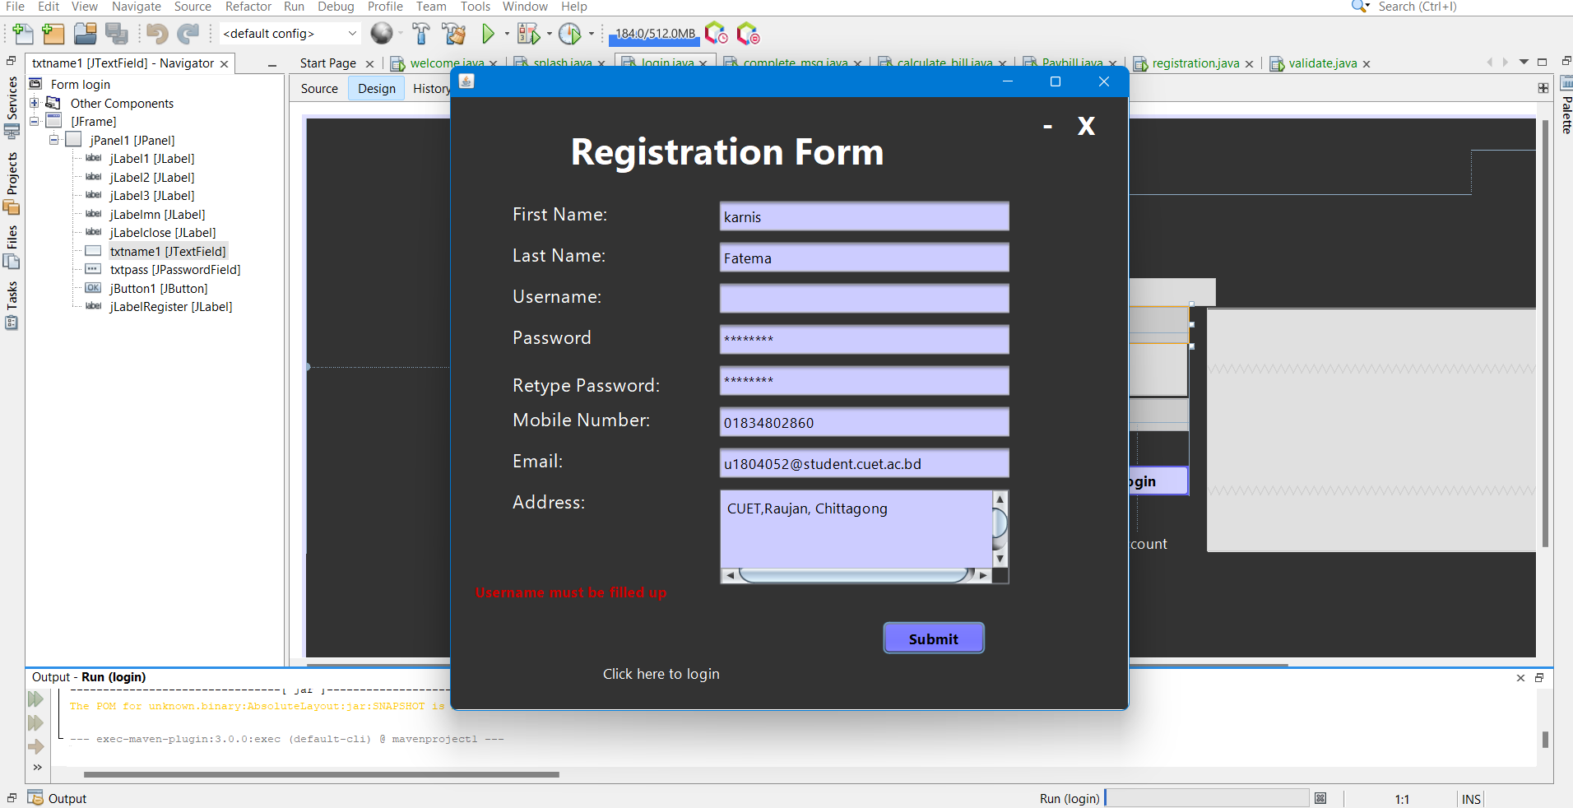

Slide 11
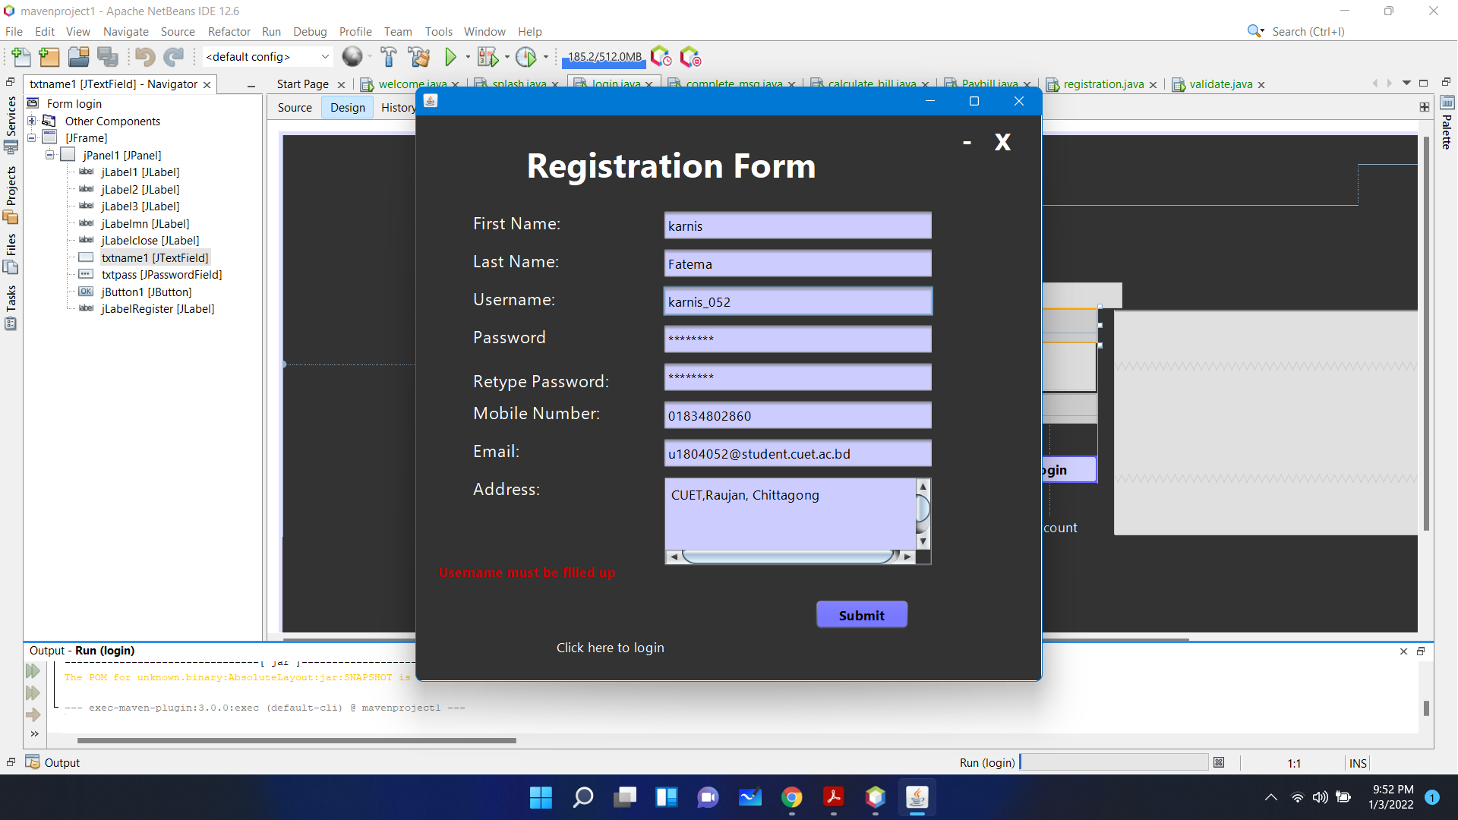

Slide 12
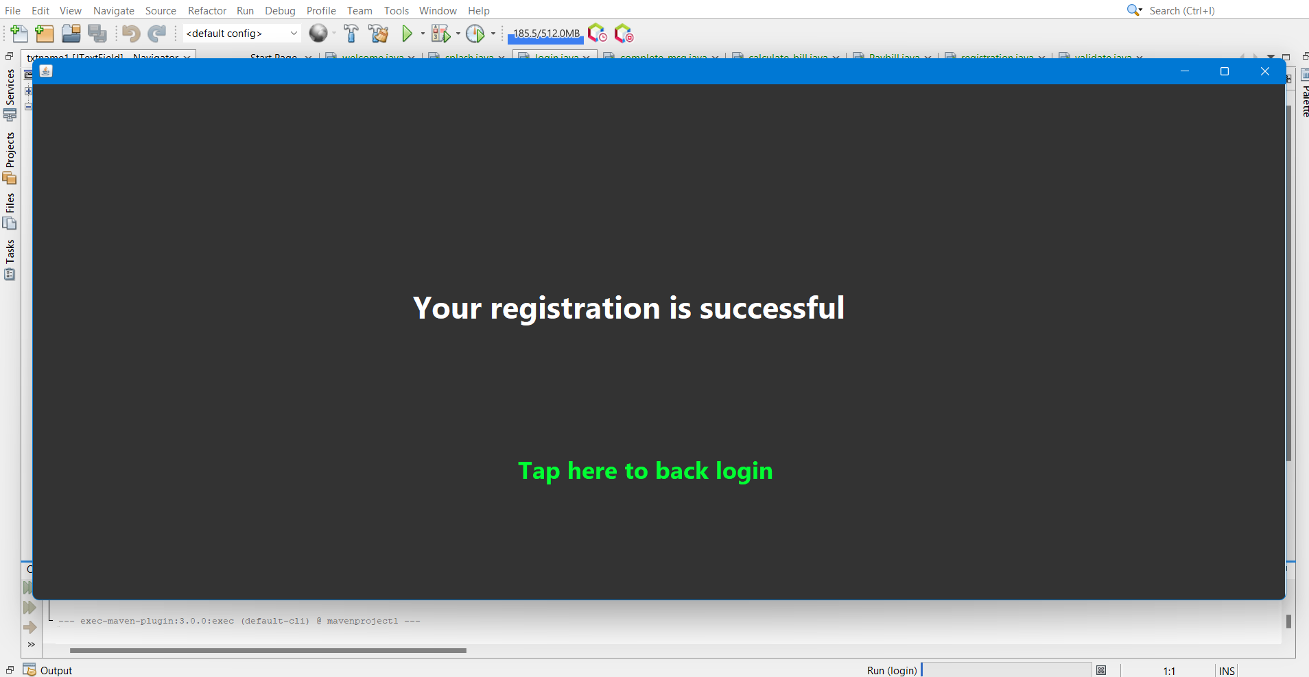

Slide 13
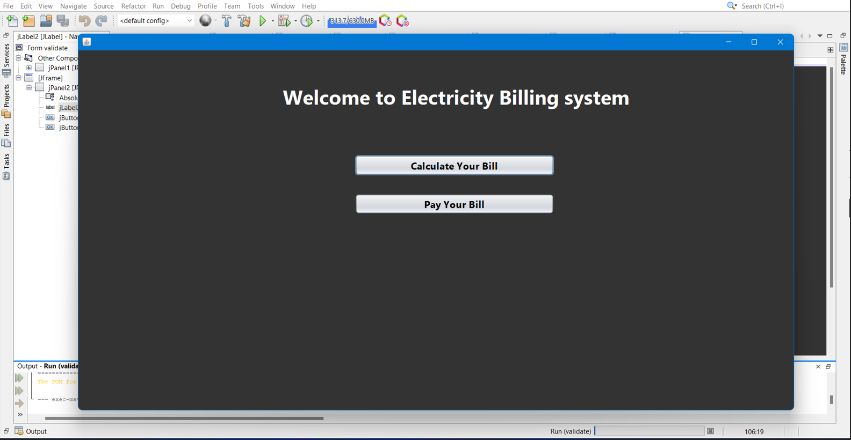

Slide 14
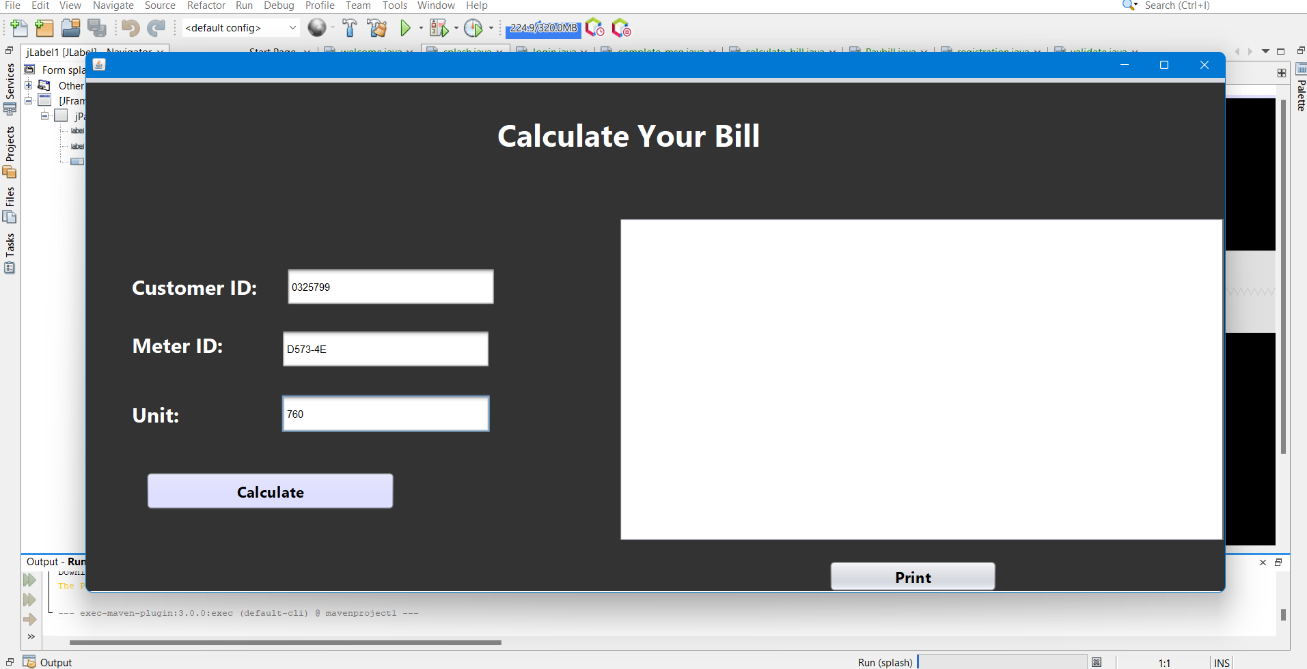

Slide 15
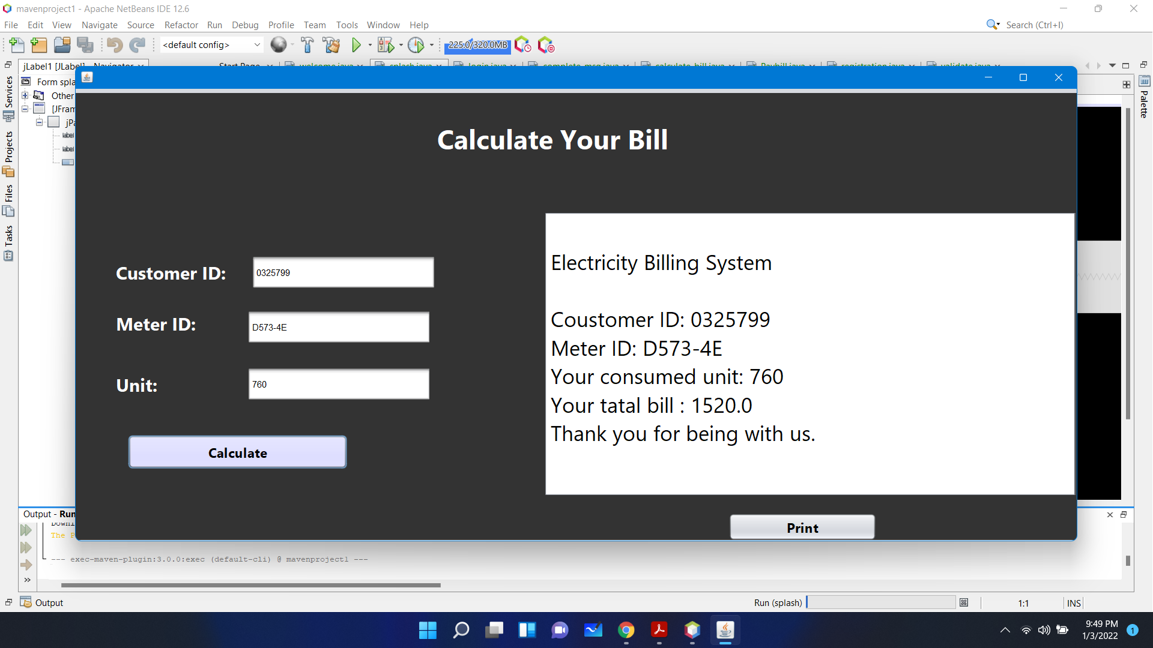

Slide 16
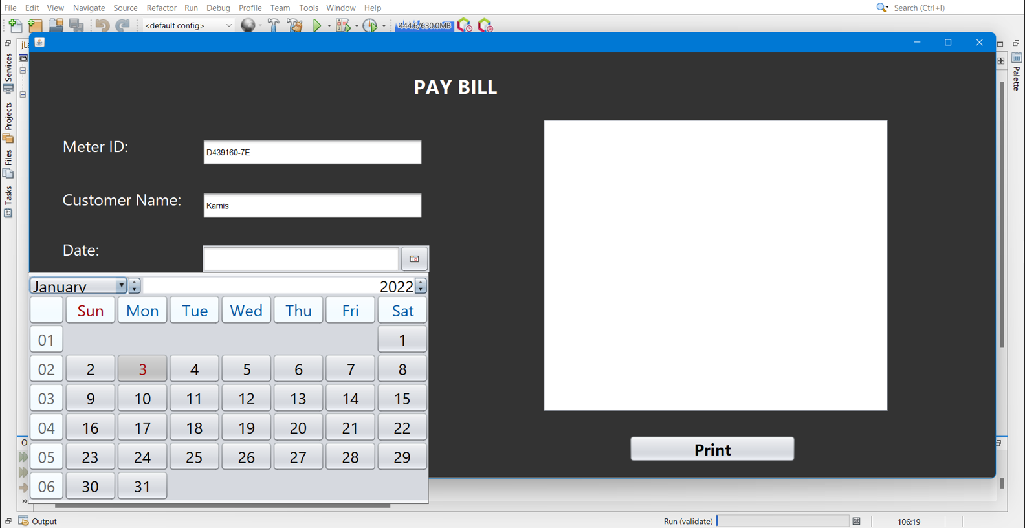
Thankyou

Slide 17
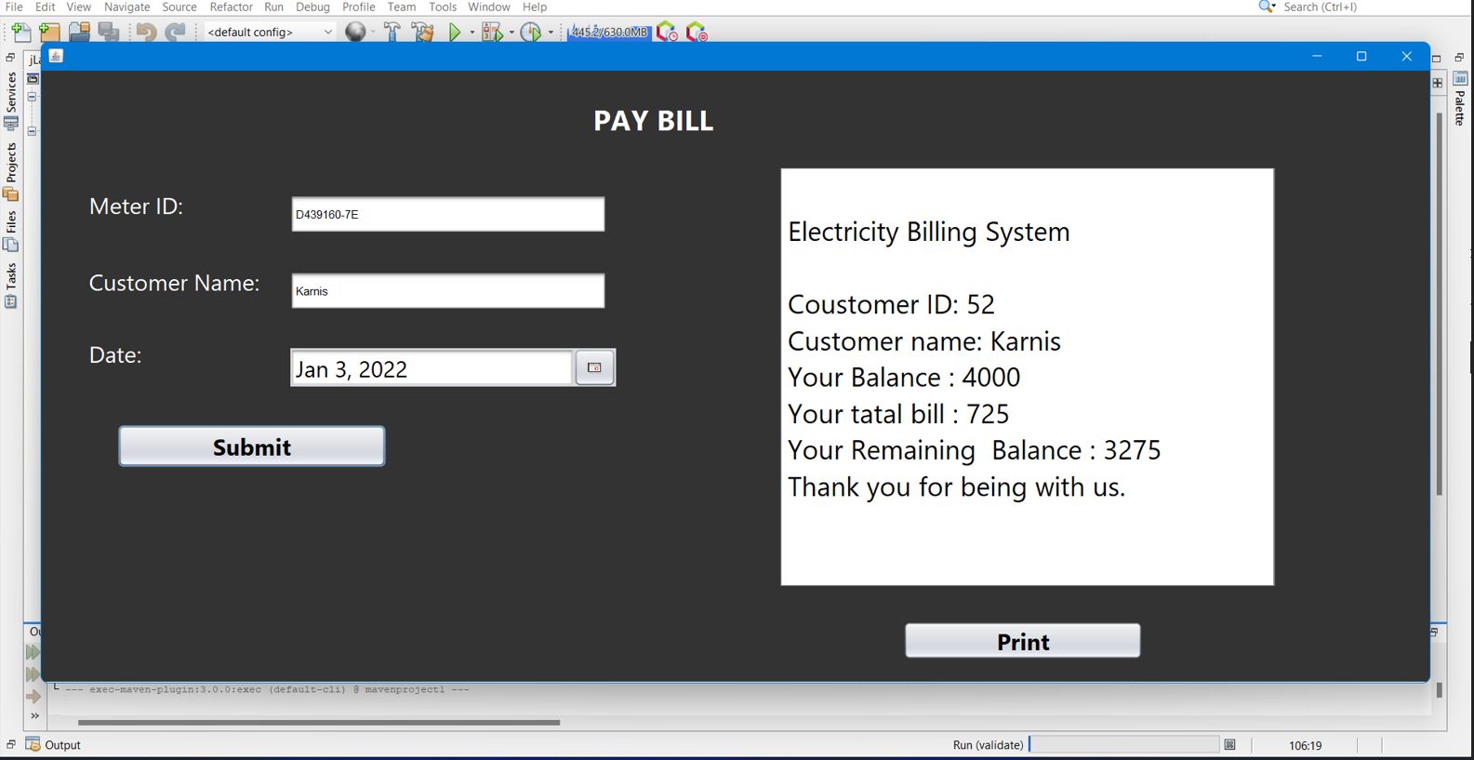

Slide 18
Thankyou

