Slide 1

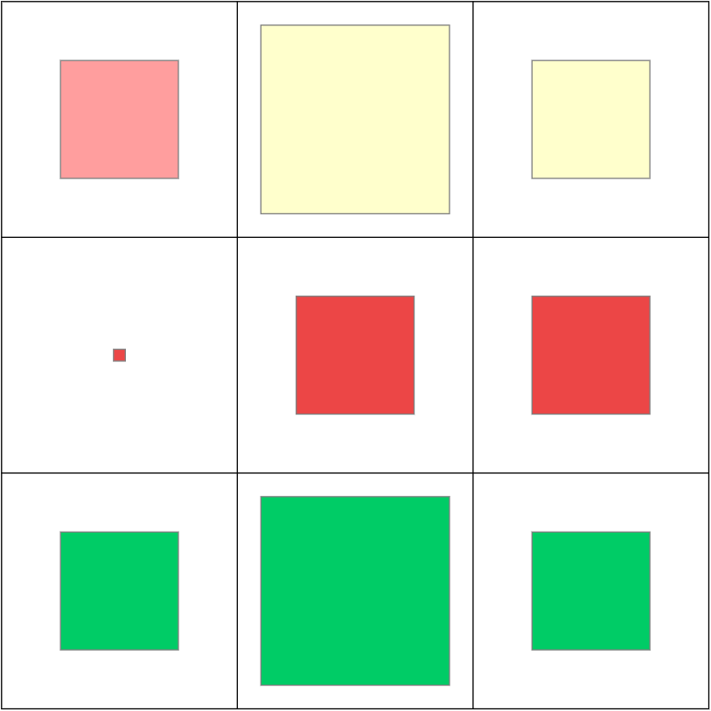
Texas | 2019-20 (19-12)
1708 shots
50.4%
735
175
347
213
Three
50.4%
47.1%
51.4%
51.4%
360
52
186
122
Range
Mid
31.4%
36.5%
31.2%
29.5%
Close
613
179
299
135
61.7%
62.6%
61.5%
60.7%
406
832
470
52.6%
50.5%
48.4%
Early
Mid
Late
Clock

Slide 2
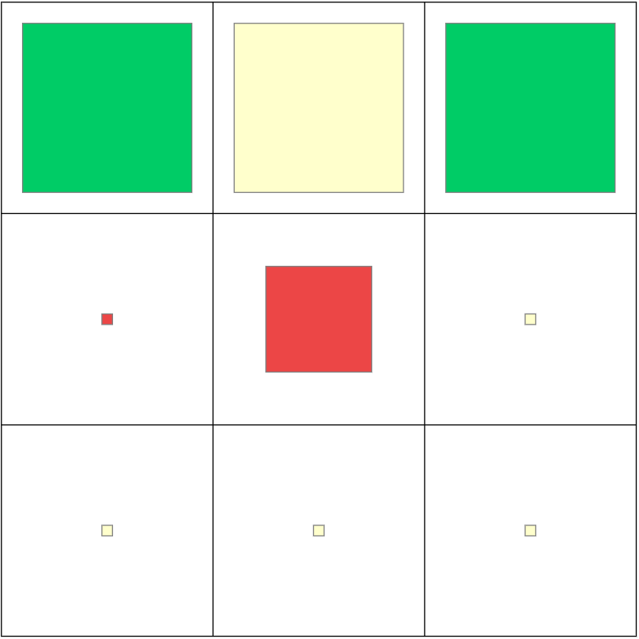
Jase Febres
Texas | 2019-20 (19-12)
188 shots
51.9%
148
45
66
37
Three
55.7%
60.0%
50.0%
60.8%
22
4
14
4
Range
Mid
27.3%
25.0%
21.4%
50.0%
Close
18
6
8
4
50.0%
50.0%
50.0%
50.0%
55
88
45
56.4%
45.5%
58.9%
Early
Mid
Late
Clock

Slide 3
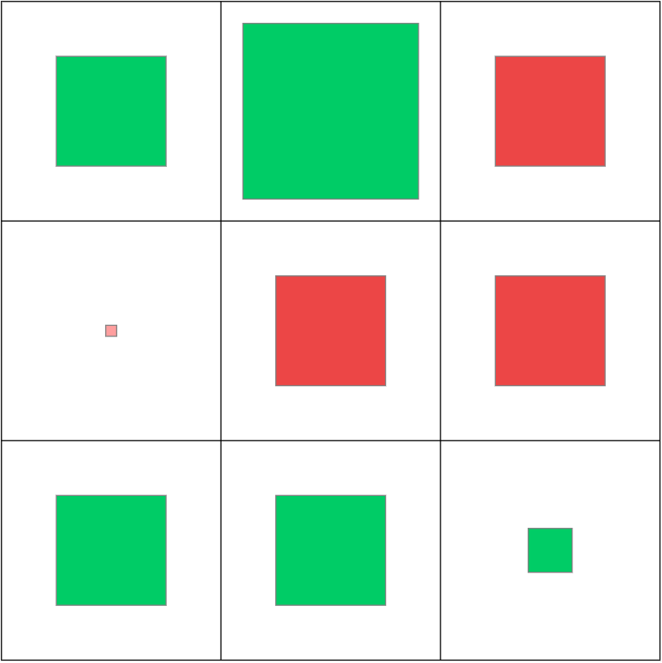
Matt Coleman
Texas | 2019-20 (19-12)
310 shots
52.1%
114
22
54
38
Three
59.2%
61.4%
69.4%
43.4%
95
15
41
39
Range
Mid
34.7%
46.7%
34.1%
30.8%
Close
101
40
40
21
60.4%
57.5%
62.5%
61.9%
77
135
98
56.5%
56.7%
42.3%
Early
Mid
Late
Clock

Slide 4
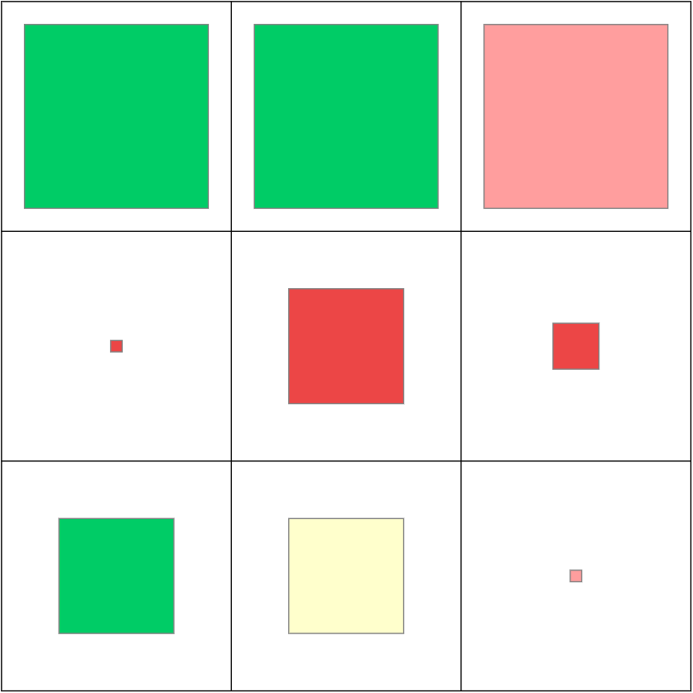
Andrew Jones
Texas | 2019-20 (19-12)
308 shots
51.3%
159
4
61
50
Three
58.5%
59.4%
68.9%
45.0%
68
15
36
17
Range
Mid
27.9%
33.3%
33.3%
11.8%
Close
81
35
35
11
56.8%
65.7%
51.4%
45.5%
98
132
78
57.7%
54.5%
37.8%
Early
Mid
Late
Clock

Slide 5
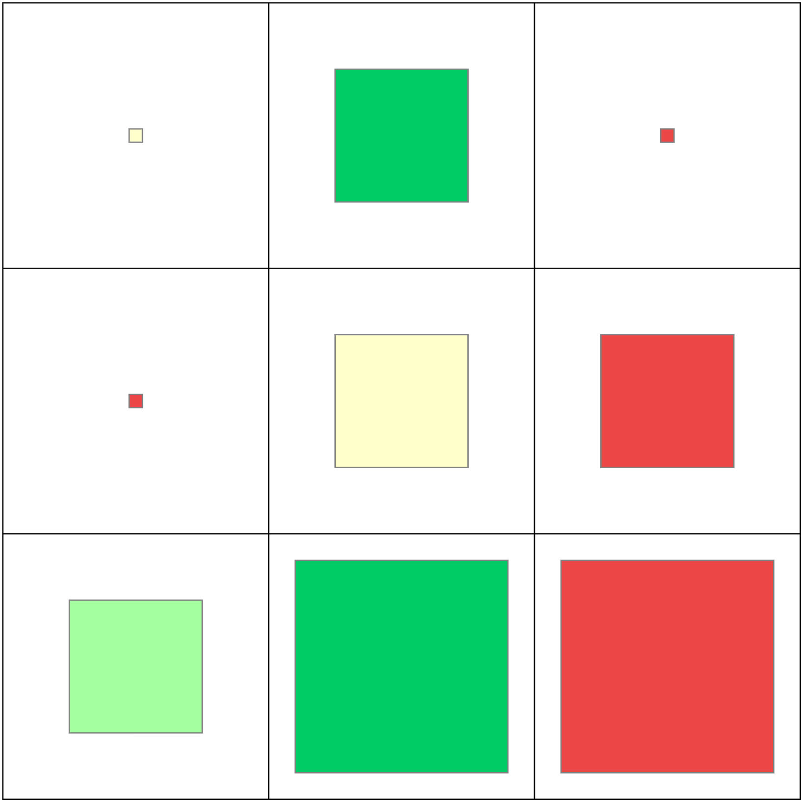
Gerald Liddell
Texas | 2019-20 (19-12)
61 shots
44.3%
12
3
8
1
Three
50.0%
50.0%
56.3%
0.0%
15
2
6
7
Range
Mid
20.0%
0.0%
50.0%
0.0%
Close
34
9
15
10
52.9%
55.5%
60.0%
40.0%
14
29
18
46.4%
56.9%
22.2%
Early
Mid
Late
Clock

Slide 6
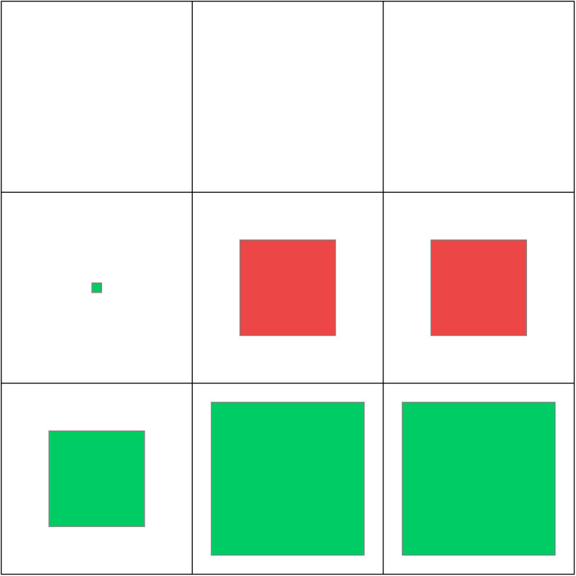
Jericho Sims
Texas | 2019-20 (19-12)
150 shots
67.3%
0
0
0
0
Three
0.0%
0.0%
0.0%
0.0%
29
1
17
11
Range
Mid
37.9%
100.0%
35.3%
36.4%
Close
121
11
77
33
74.3%
81.8%
74.0%
72.7%
12
94
44
83.3%
67.0%
63.6%
Early
Mid
Late
Clock

Slide 7
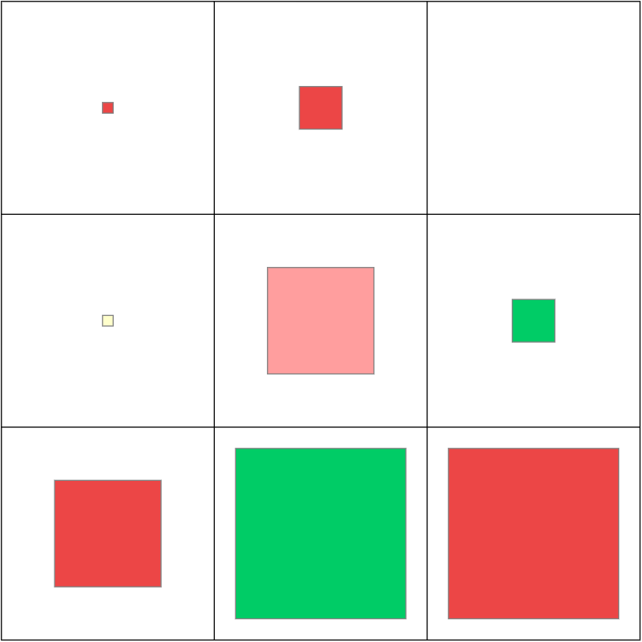
Royce Hamm
Texas | 2019-20 (19-12)
60 shots
48.3%
6
2
4
0
Three
0.0%
0.0%
0.0%
0.0%
15
2
9
4
Range
Mid
53.3%
50.0%
44.4%
75.0%
Close
39
6
22
11
53.8%
33.3%
68.2%
36.4%
10
35
15
30.0%
54.3%
46.7%
Early
Mid
Late
Clock

Slide 8
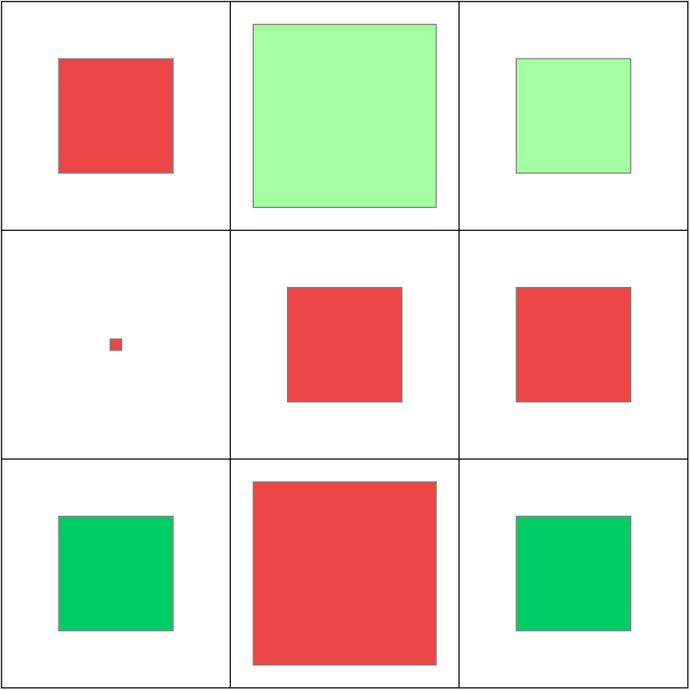
Courtney Ramey
Texas | 2019-20 (19-12)
316 shots
46.8%
130
26
61
43
Three
46.2%
11.5%
54.1%
55.8%
70
9
33
28
Range
Mid
37.1%
33.3%
33.3%
42.9%
Close
116
44
48
24
53.4%
59.1%
41.7%
66.7%
79
142
95
40.5%
45.1%
54.7%
Early
Mid
Late
Clock

Slide 9
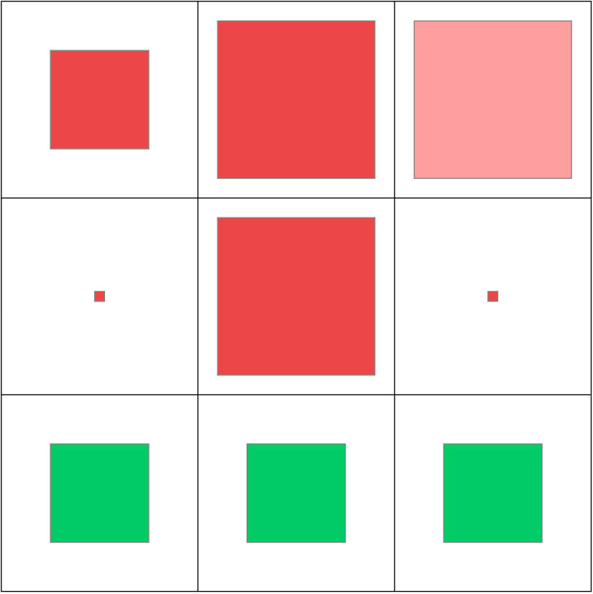
Donovan Williams
Texas | 2019-20 (19-12)
86 shots
43.0%
40
10
17
13
Three
37.5%
30.0%
35.3%
46.2%
22
4
15
3
Range
Mid
18.2%
25.0%
20.0%
0.0%
Close
24
9
8
7
75.0%
77.8%
75.0%
71.4%
23
40
23
47.8%
37.5%
47.8%
Early
Mid
Late
Clock

Slide 10
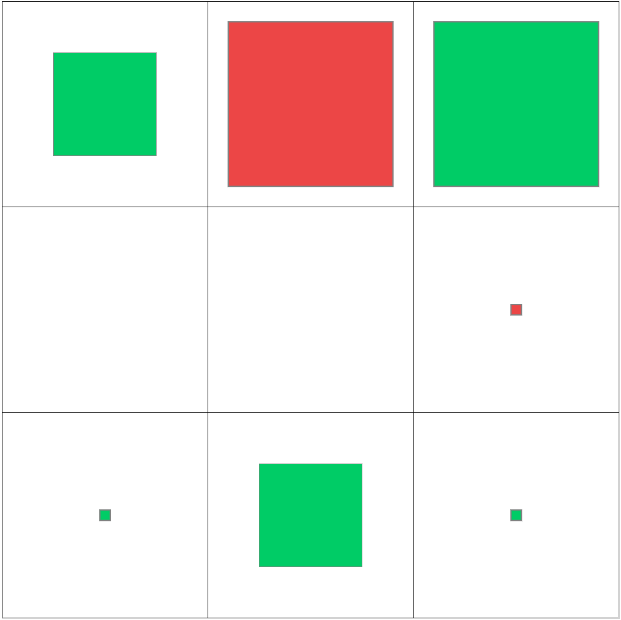
Kamaka Hepa
Texas | 2019-20 (19-12)
59 shots
49.2%
46
7
23
16
Three
45.7%
64.3%
26.1%
65.6%
2
0
0
2
Range
Mid
0.0%
0.0%
0.0%
0.0%
Close
11
2
8
1
72.7%
100.0%
62.5%
100.0%
9
31
19
72.2%
35.5%
60.5%
Early
Mid
Late
Clock

Slide 11
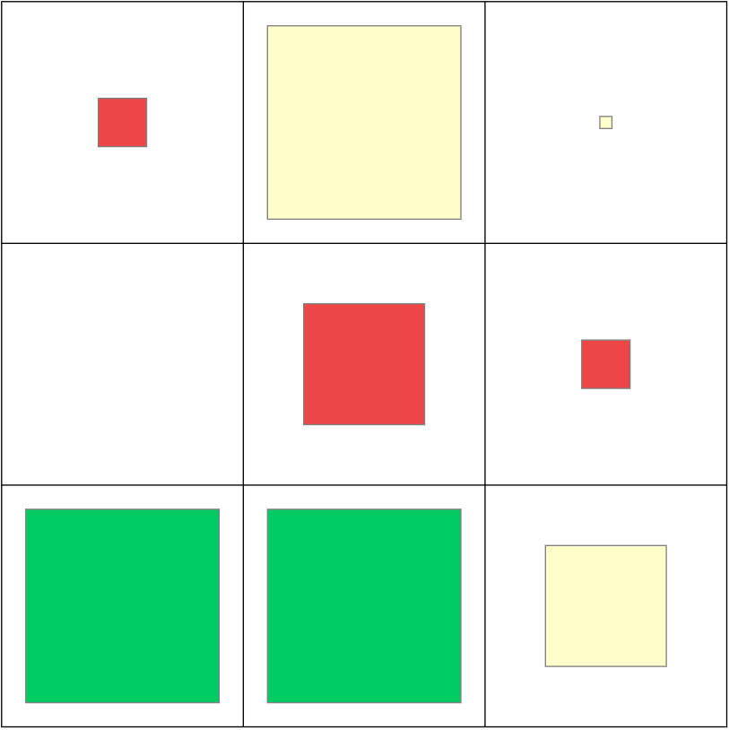
Kai Jones
Texas | 2019-20 (19-12)
75 shots
55.3%
23
5
15
3
Three
45.7%
30.0%
50.0%
50.0%
12
0
7
5
Range
Mid
16.7%
0.0%
14.3%
20.0%
Close
40
13
21
6
72.5%
76.9%
76.2%
50.0%
18
43
14
63.9%
57.0%
39.3%
Early
Mid
Late
Clock

Slide 12
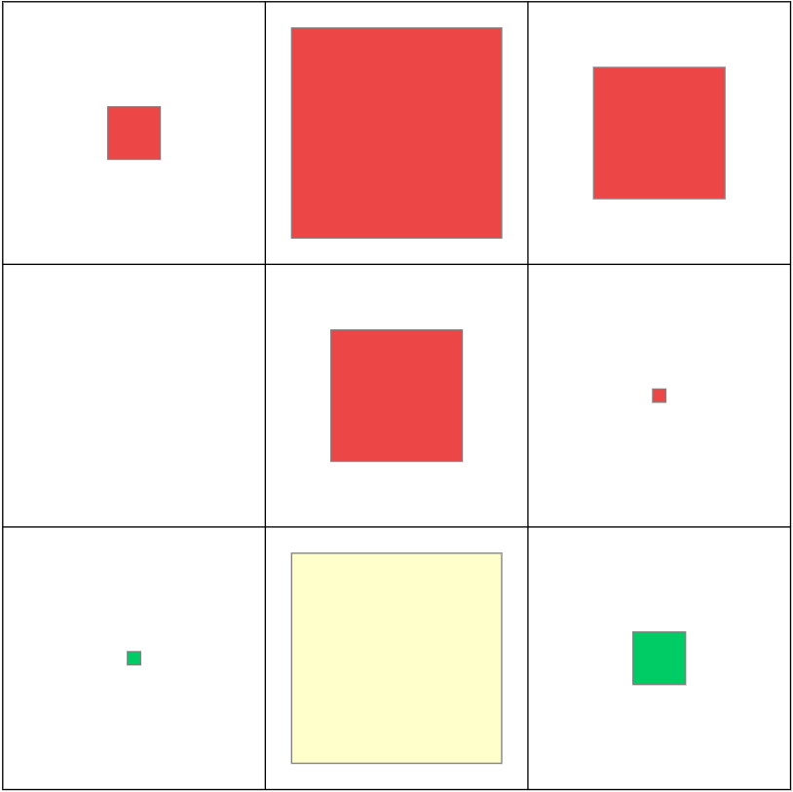
Will Baker
Texas | 2019-20 (19-12)
70 shots
31.4%
39
4
28
7
Three
23.1%
0.0%
21.4%
42.9%
10
0
8
2
Range
Mid
10.0%
0.0%
12.5%
0.0%
Close
21
1
16
4
57.1%
100.0%
50.0%
75.0%
5
52
13
20.0%
28.9%
46.2%
Early
Mid
Late
Clock

Slide 13
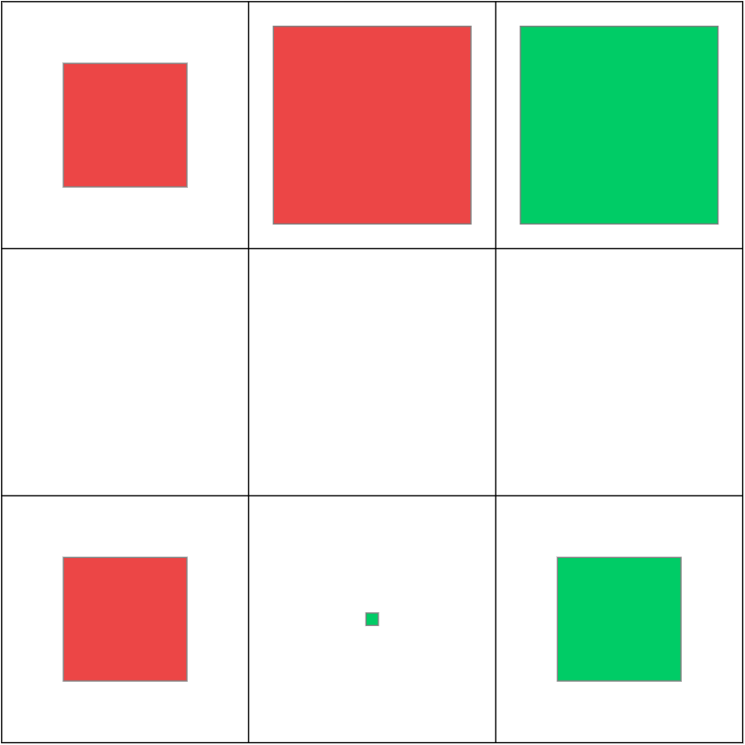
Brock Cunningham
Texas | 2019-20 (19-12)
24 shots
41.7%
17
3
9
5
Three
35.3%
0.0%
33.3%
60.0%
0
0
0
0
Range
Mid
0.0%
0.0%
0.0%
0.0%
Close
7
3
1
3
57.1%
33.3%
100.0%
66.7%
6
10
8
16.7%
40.0%
62.5%
Early
Mid
Late
Clock

