Slide 1
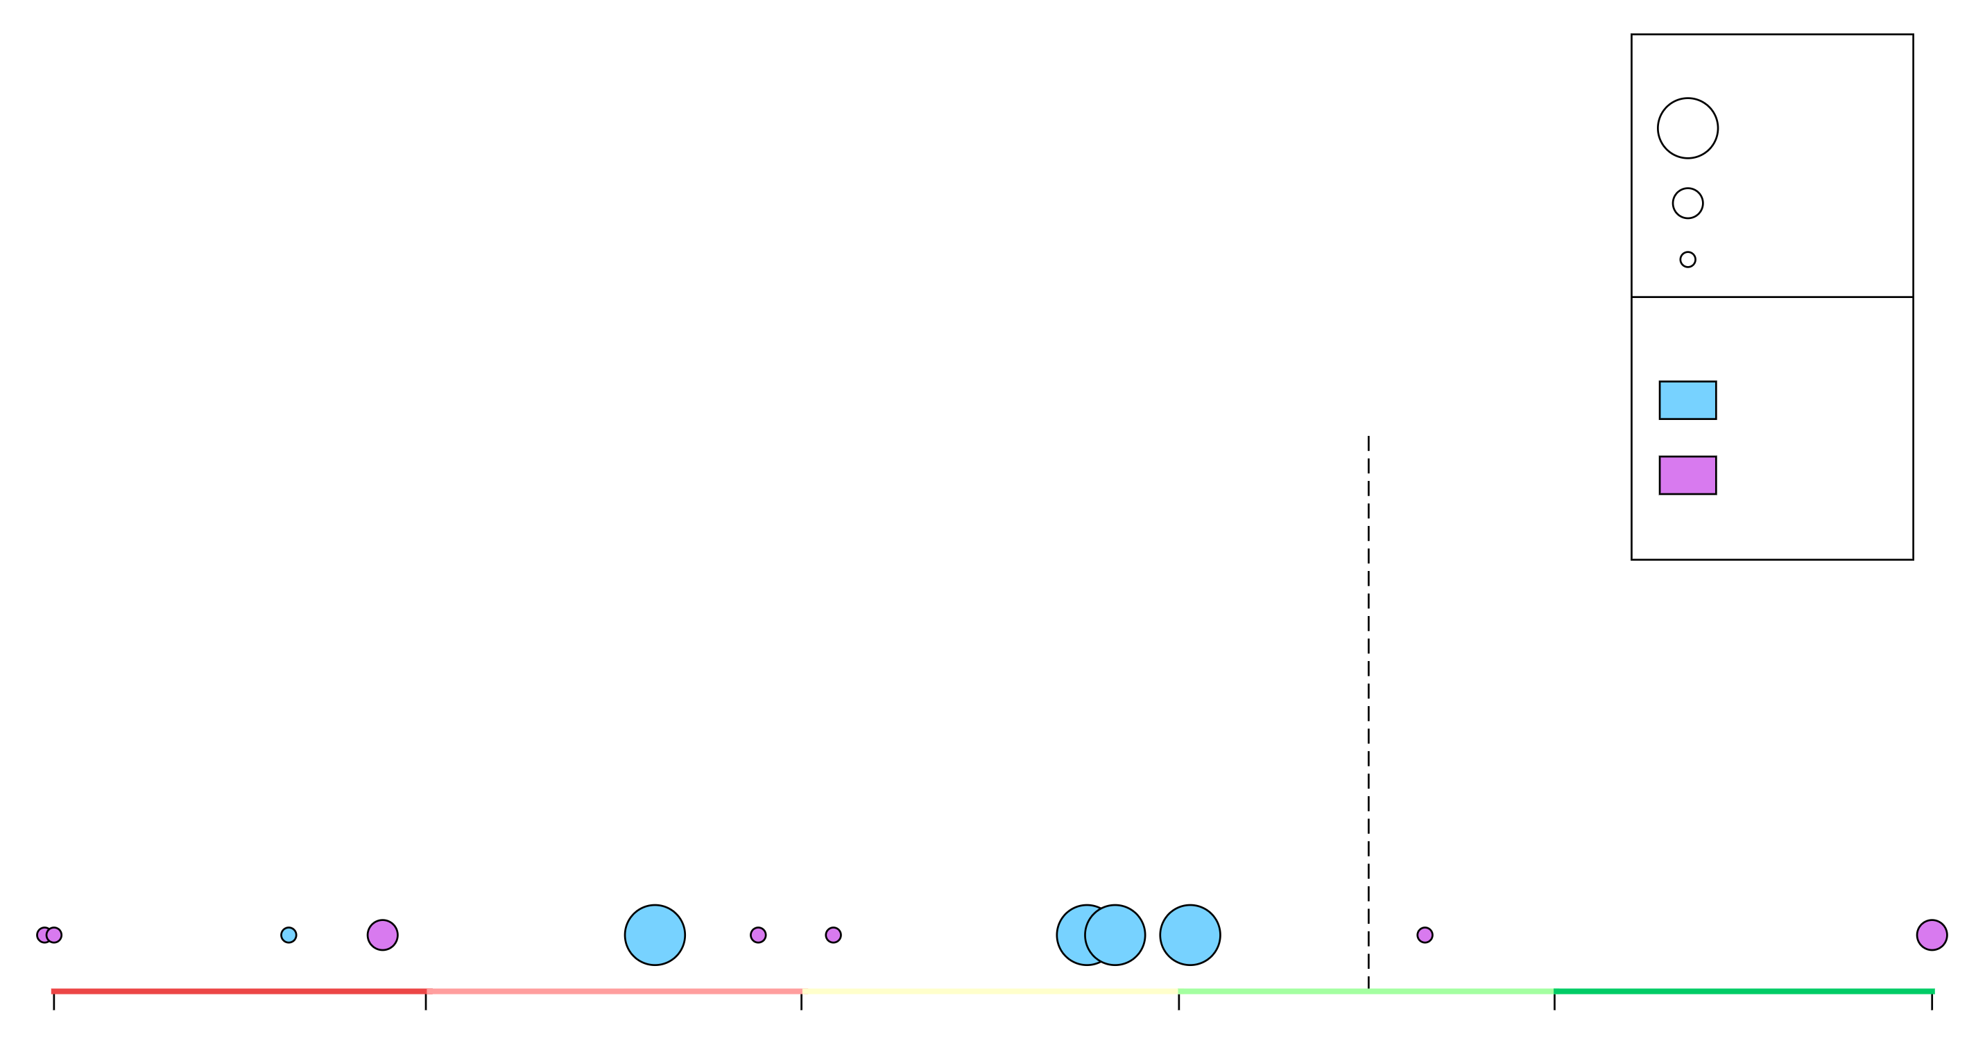

Texas | 2019-20 (19-12)
49.9% (3/154)
FGA per Game
8 – 12+
4 - 8
0 - 4
Position
54.0
G
F/C
D. Williams
G. Liddell
C. Ramey
R. Hamm
A. Jones
M. Coleman
J. Sims
W. Baker
K. Hepa
K. Jones
B. Cunningham
J. Febres
40.0
or Lower
44.0
48.0
52.0
56.0
60.0
or Higher
Shooting Efficiency (eFG%)

Slide 2

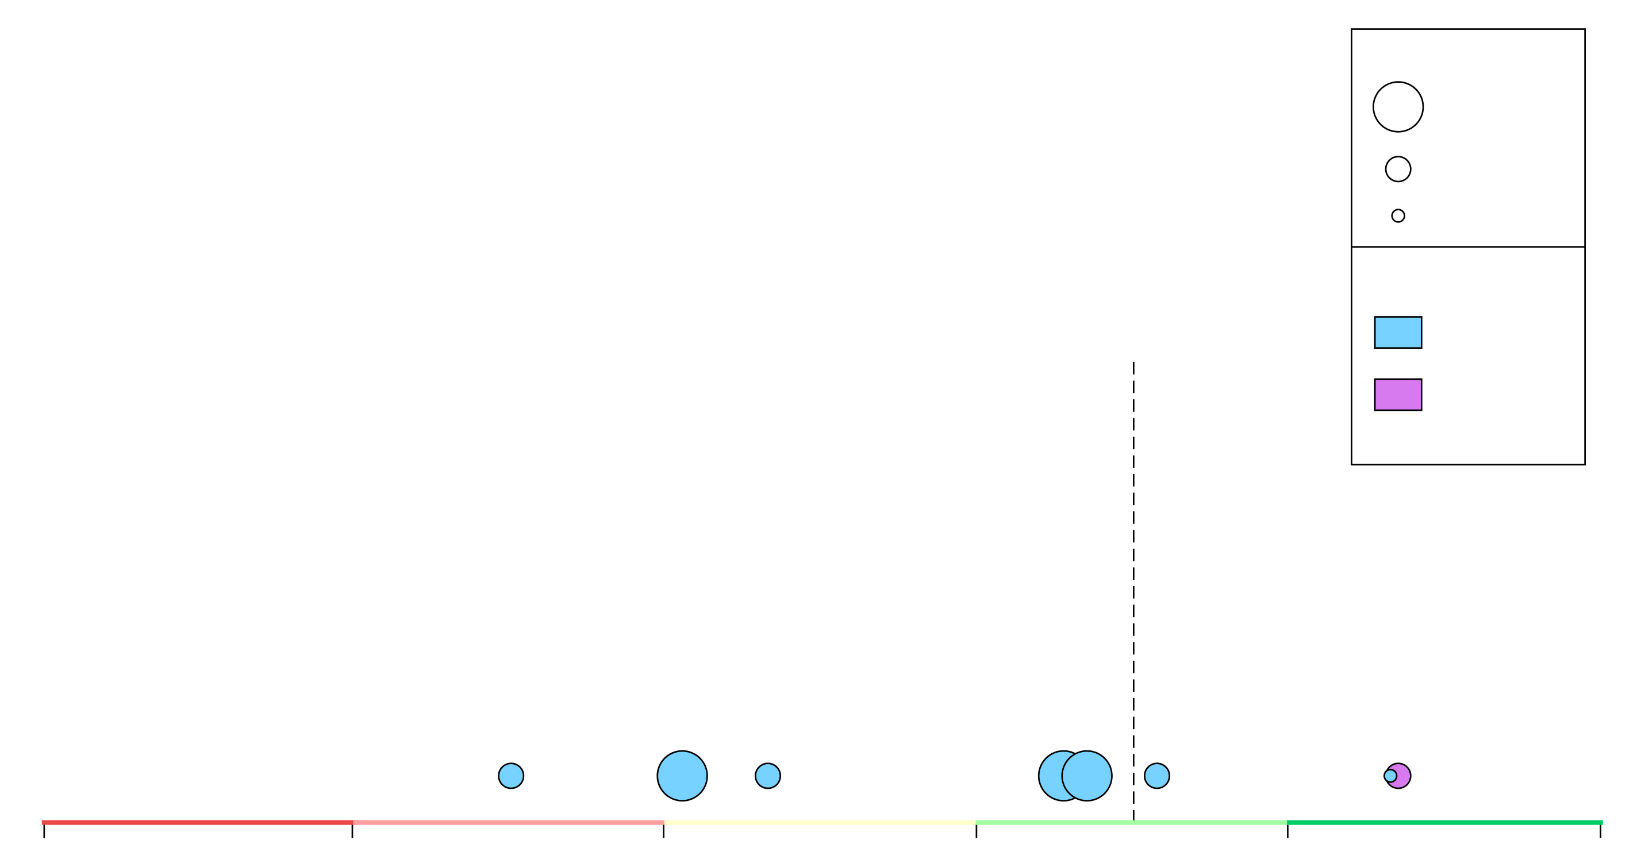
Texas Tech | 2019-20 (18-13)
51.7% (2/77)
FGA per Game
8 – 12+
4 - 8
0 - 4
Position
54.0
G
F/C
C. Clarke
K. Edwards
T. Shannon Jr.
J. Ramsey
D. Moretti
T. Holyfield
A. Benson
K. McCullar
40.0
44.0
48.0
52.0
56.0
60.0
Shooting Efficiency (eFG%)

Slide 3
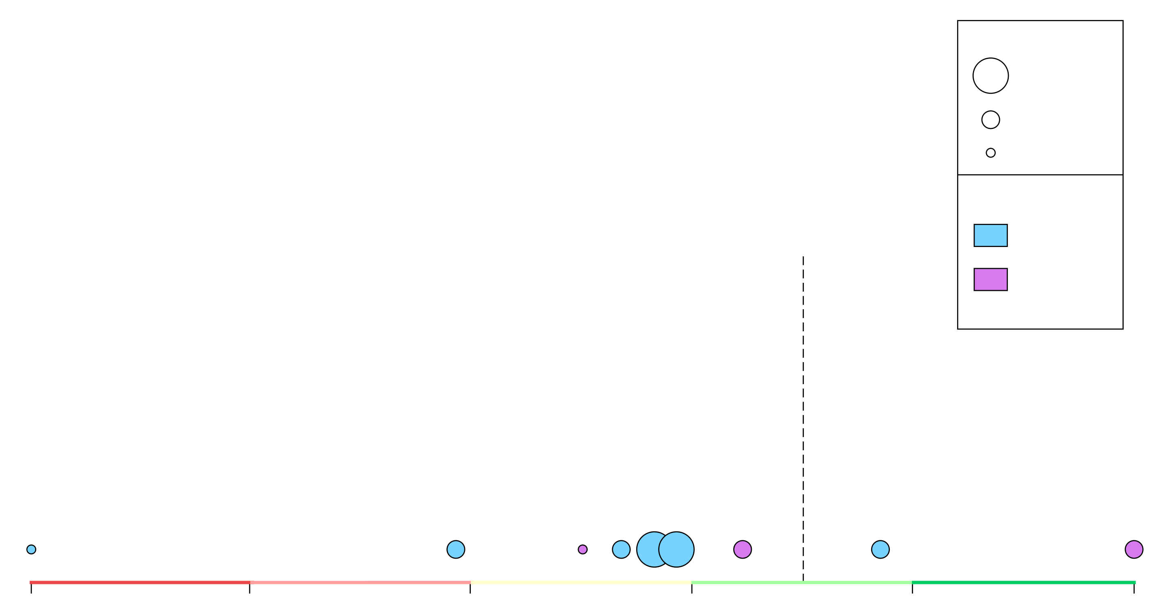

Kansas | 2019-20 (28-3)
53.7% (1/24)
FGA per Game
8 – 12+
4 - 8
0 - 4
Position
54.0
G
F/C
O. Agbaji
D. Dotson
T. Enaruna
M. Garrett
I. Moss
C. Braun
U. Azubuike
S. De Sousa
D. McCormack
40.0
44.0
48.0
52.0
56.0
60.0
Shooting Efficiency (eFG%)

Slide 4
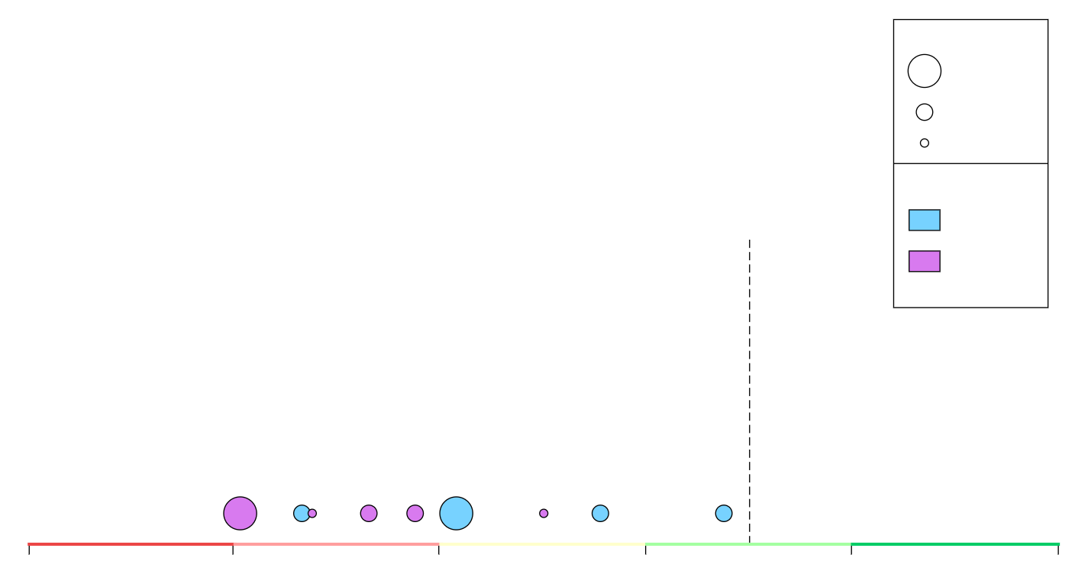

Kansas St. | 2019-20 (11-21)
47.5% (9/270)
FGA per Game
8 – 12+
4 - 8
0 - 4
Position
54.0
G
F/C
X. Sneed
D. Sloan
M. Mawien
M. Murphy
C. Diarra
D. Gordon
M. McGuirl
A. Gordon
L. Stockard III
40.0
44.0
48.0
52.0
56.0
60.0
Shooting Efficiency (eFG%)

Slide 5
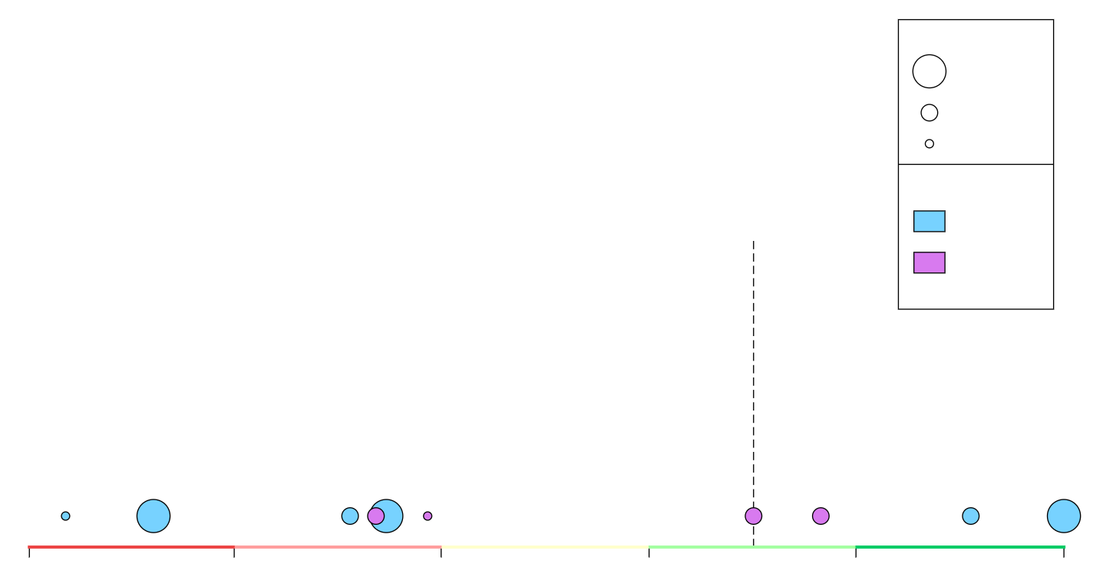

Iowa St. | 2019-20 (12-20)
49.8% (4/158)
FGA per Game
8 – 12+
4 - 8
0 - 4
Position
54.0
G
F/C
P. Nixon
M. Jacobson
R. Bolton
S. Young
G. Conditt IV
T. Lewis
T. Haliburton
C. Grill
T. Jackson
Z. Griffin
40.0
44.0
48.0
52.0
56.0
60.0
Shooting Efficiency (eFG%)

Slide 6
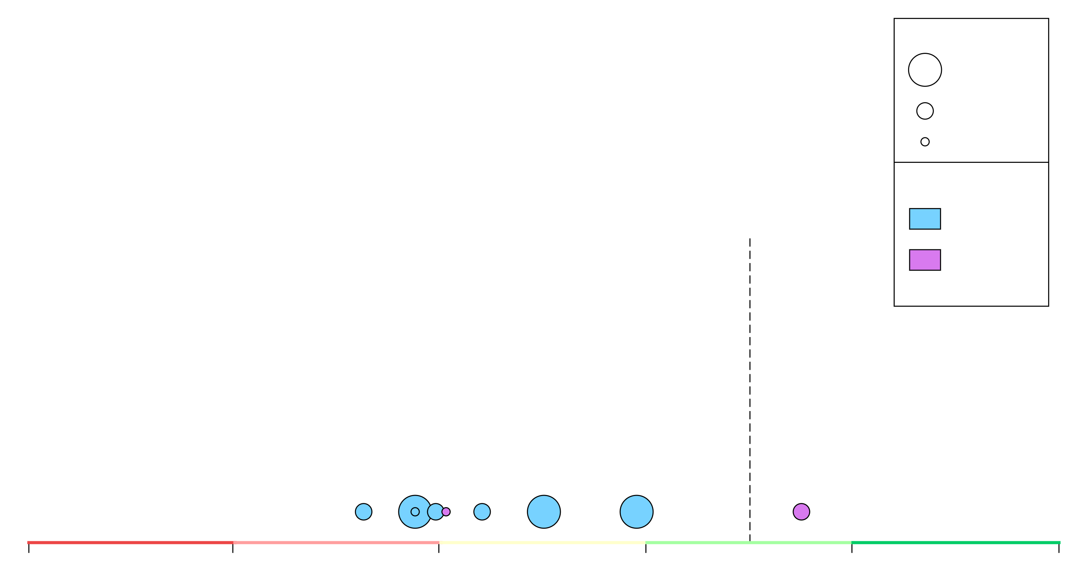

Baylor | 2019-20 (26-4)
49.4% (6/188)
FGA per Game
8 – 12+
4 - 8
0 - 4
Position
54.0
G
F/C
T. Clark
D. Mitchell
D. Bandoo
M. Teague
J. Butler
F. Gillespie
M. Mayer
M. Vital
F. Thamba
40.0
44.0
48.0
52.0
56.0
60.0
Shooting Efficiency (eFG%)

Slide 7
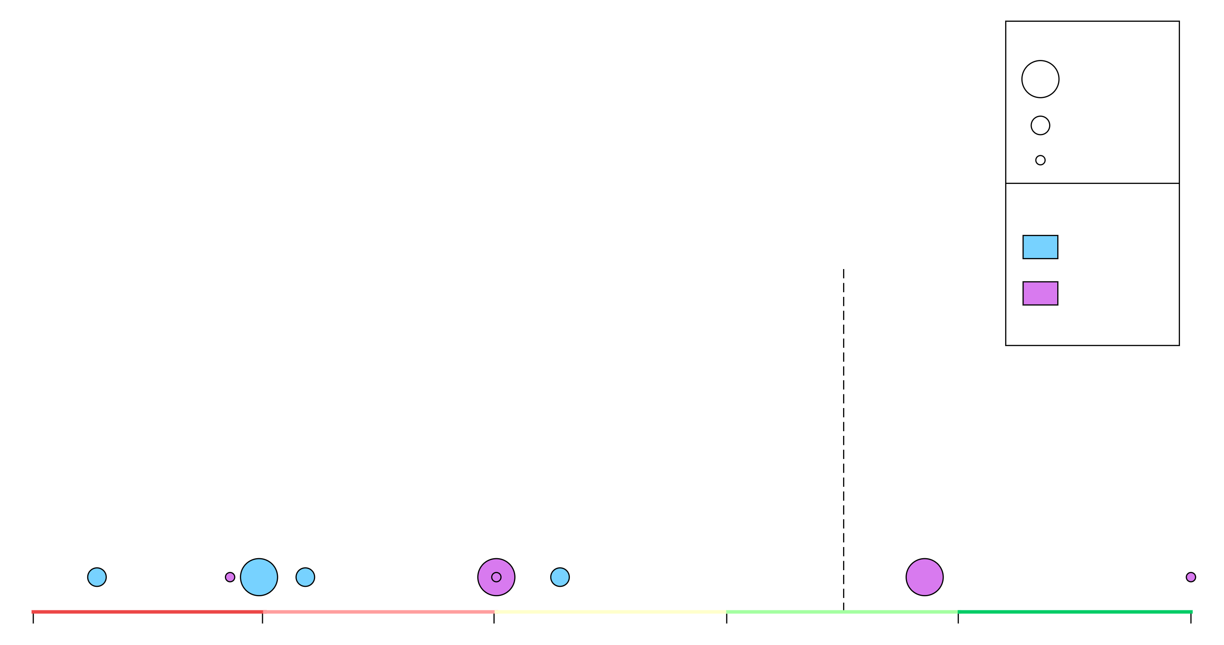

Oklahoma | 2019-20 (19-12)
48.2% (7/237)
FGA per Game
8 – 12+
4 - 8
0 - 4
Position
54.0
G
F/C
A. Reaves
V. Iwuakor
J. Bieniemy
D. Harmon
K. Doolittle
A. Williams
B. Manek
K. Kuath
J. Hill
40.0
44.0
48.0
52.0
56.0
60.0
Shooting Efficiency (eFG%)

Slide 8
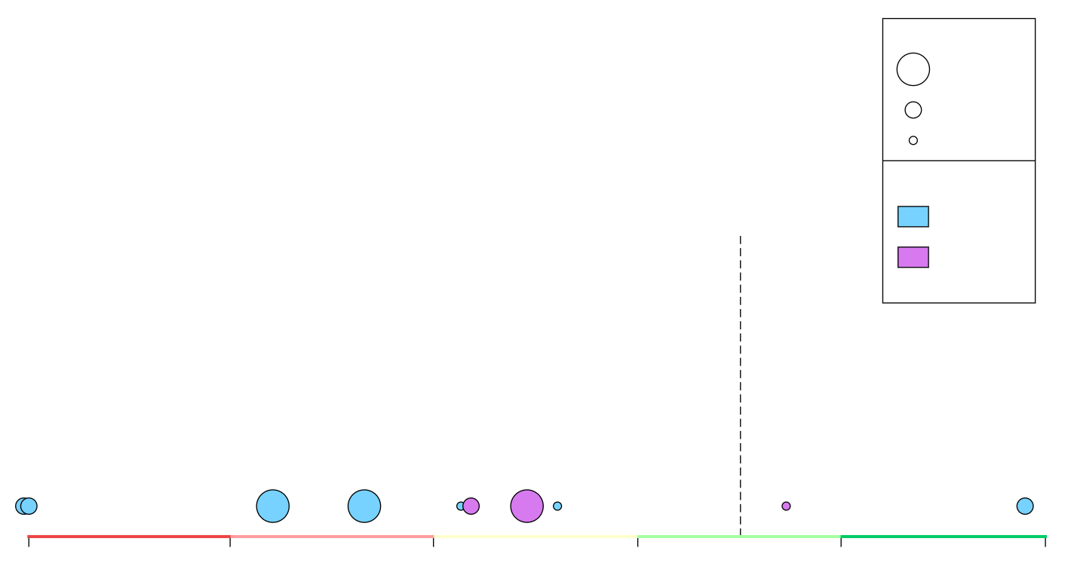

Oklahoma St. | 2019-20 (18-14)
47.8% (8/260)
FGA per Game
8 – 12+
4 - 8
0 - 4
Position
54.0
G
F/C
C. Harris Jr.
L. Waters
I. Likekele
Y. Anei
C. McGriff
T. Dziagwa
Ka. Boone
A. Anderson III
Ke. Boone
J. Laurent
40.0
44.0
48.0
52.0
56.0
60.0
Shooting Efficiency (eFG%)

Slide 9
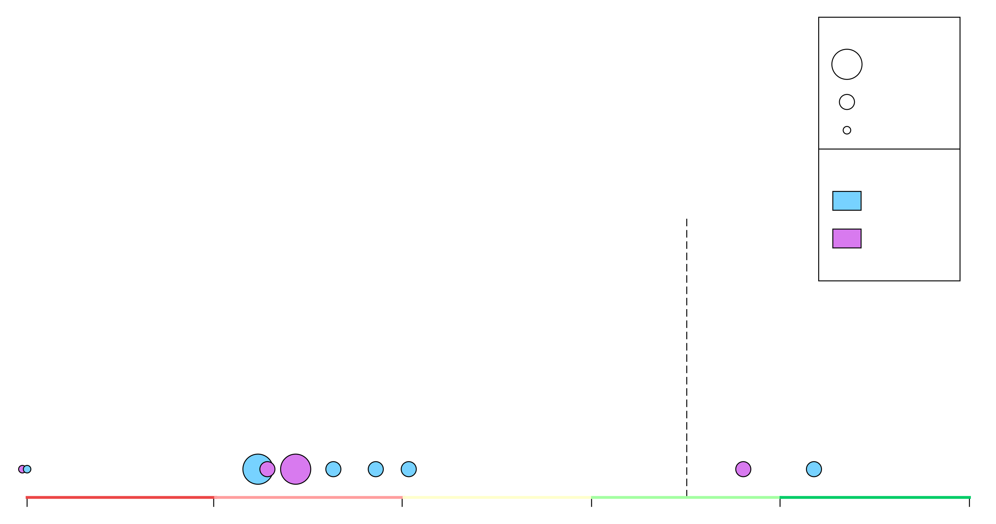

West Virginia | 2019-20 (21-10)
46.5% (10/308)
FGA per Game
8 – 12+
4 - 8
0 - 4
Position
54.0
G
F/C
E. Matthews Jr.
G. Osabuohien
M. McBride
D. Culver
T. Sherman
O. Tshiebwe
J. Haley
J. McCabe
C. Harler
S. McNeil
40.0
44.0
48.0
52.0
56.0
60.0
Shooting Efficiency (eFG%)

Slide 10
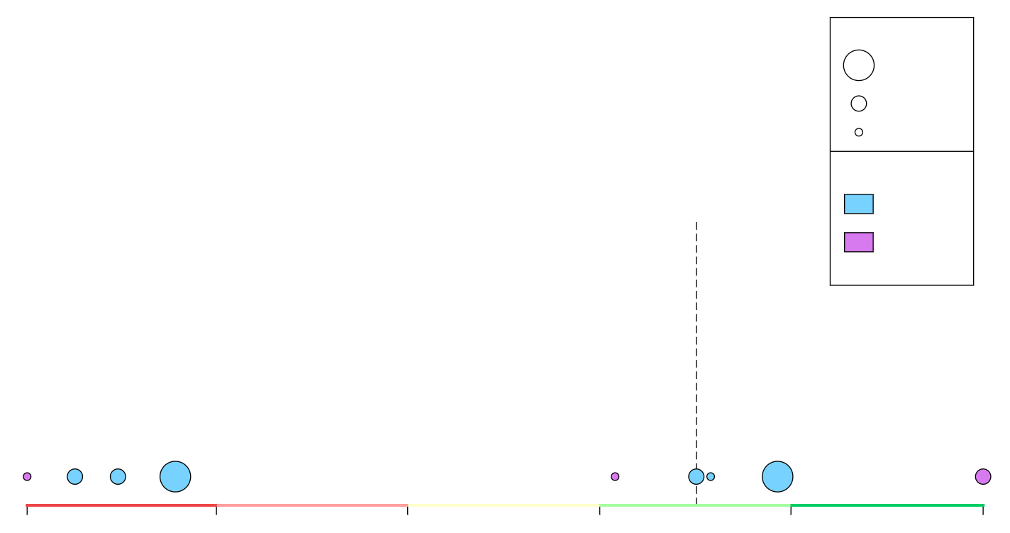

TCU | 2019-20 (16-16)
49.4% (5/187)
FGA per Game
8 – 12+
4 - 8
0 - 4
Position
54.0
G
F/C
D. Smith
P. Fuller
R. Nembhard
F. Farabello
D. Bane
K. Samuel
J. Ledee
E. Dennis
J. Grayer
40.0
44.0
48.0
52.0
56.0
60.0
Shooting Efficiency (eFG%)

Slide 11
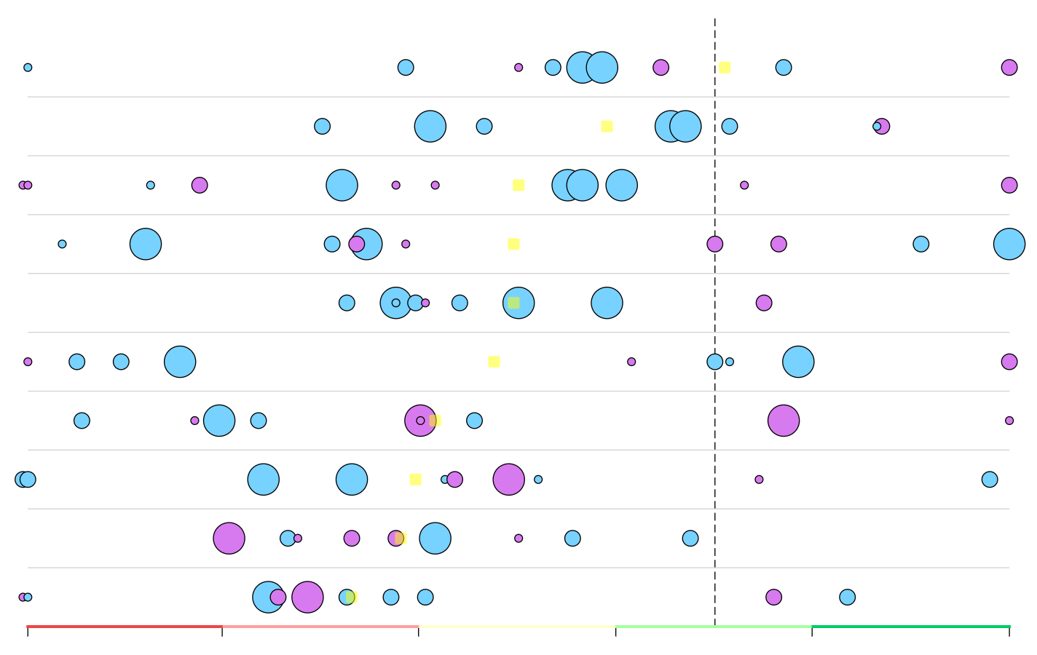
Big 12 | 2019-20
40.0
or Lower
44.0
48.0
52.0
56.0
60.0
or Higher
Shooting Efficiency (eFG%)

