Slide 1

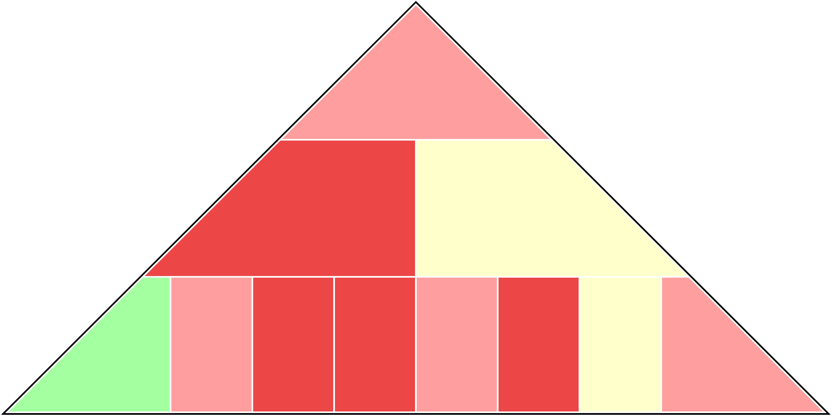
Texas | 2019-20 (19-12)
11.5 (7/61)
Net Rtg
11.5 (7/61)
OER
104.1 (9/153)
DER
92.6 (5/24)
FTA
Rate
22.0%
(10/350)
FTA
Rate
35.3%
(7/246)
eFG%
49.9%
(3/154)
TO%
20.5%
(7/278)
OREB%
26.6%
(9/218)
DREB%
67.8%
(10/330)
TO%
20.8%
(6/60)
eFG%
46.9%
(7/61)

Slide 2


Texas Tech | 2019-20 (18-13)
19.3 (4/21)
Net Rtg
19.3 (4/21)
OER
109.8 (3/47)
DER
90.5 (4/9)
FTA
Rate
34.5%
(5/127)
FTA
Rate
35.4%
(8/250)
eFG%
51.7%
(2/77)
TO%
19.7%
(6/237)
OREB%
28.0%
(8/172)
DREB%
70.7%
(5/237)
TO%
23.0%
(2/17)
eFG%
46.2%
(4/37)

Slide 3

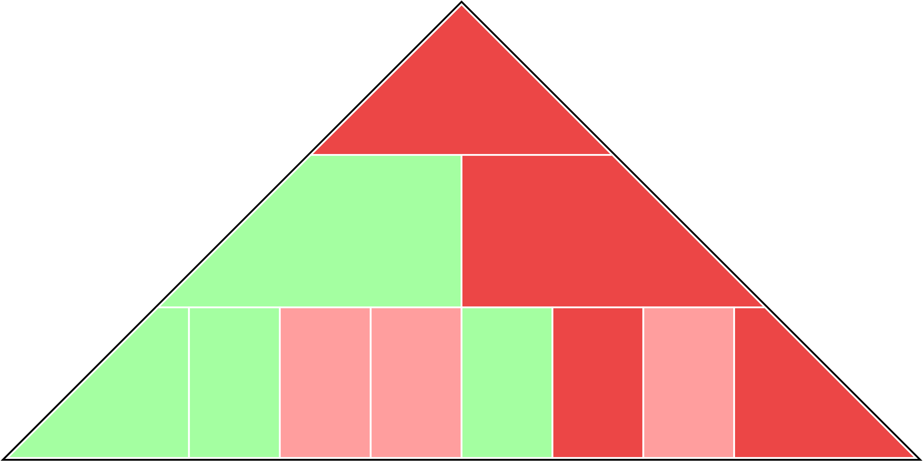
Iowa St. | 2019-20 (12-20)
8.4 (9/89)
Net Rtg
8.4 (9/89)
OER
109.6 (4/48)
DER
101.2 (10/147)
FTA
Rate
28.5%
(8/281)
FTA
Rate
28.0%
(3/67)
eFG%
49.8%
(4/158)
TO%
18.7%
(4/167)
OREB%
29.2%
(7/131)
DREB%
68.4%
(9/317)
TO%
20.6%
(7/70)
eFG%
51.8%
(10/282)

Slide 4

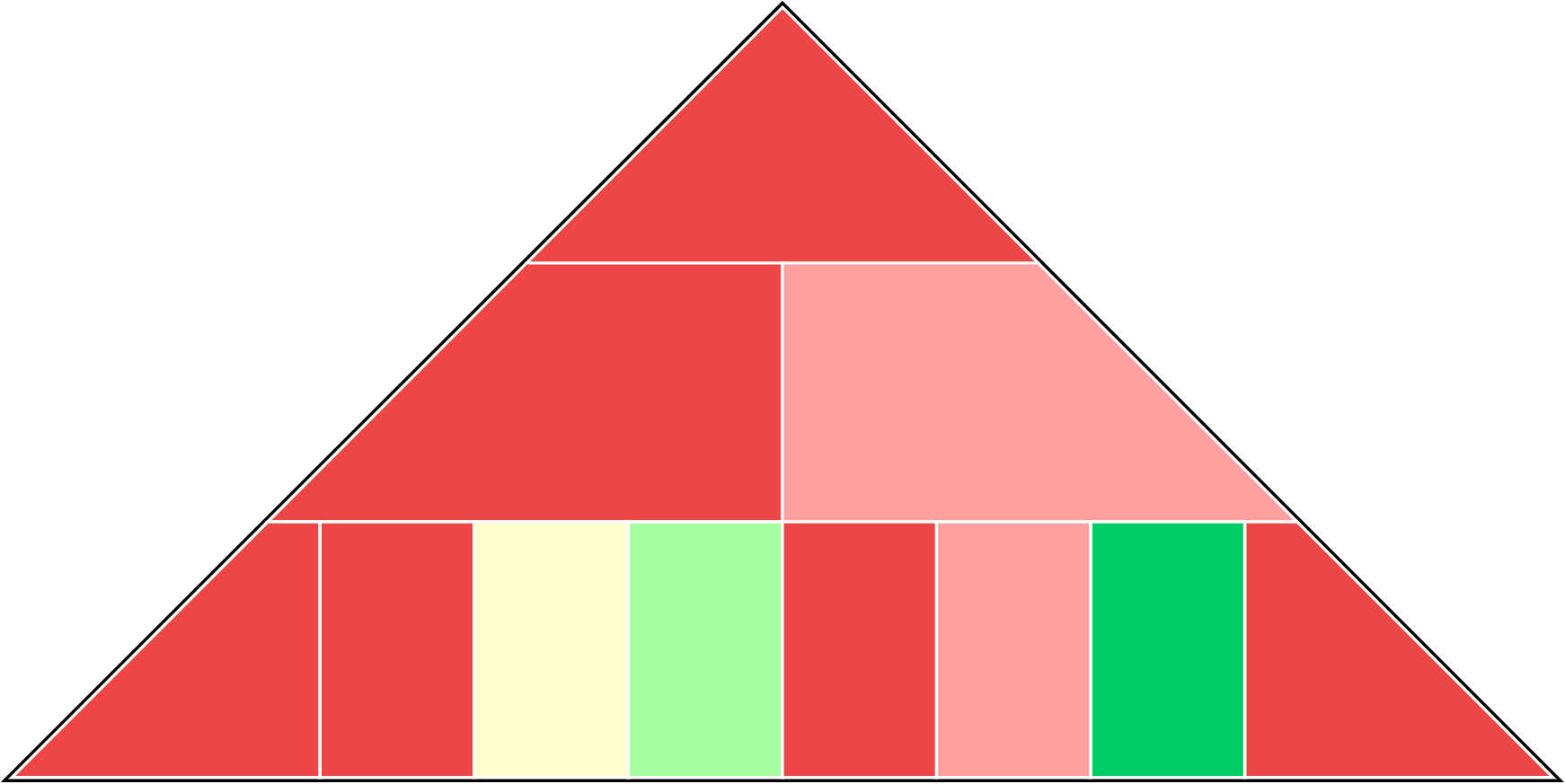
Kansas St. | 2019-20 (11-21)
8.3 (10/90)
Net Rtg
8.3 (10/90)
OER
102.5 (10/177)
DER
94.2 (7/40)
FTA
Rate
34.7%
(4/123)
FTA
Rate
38.8%
(10/299)
eFG%
47.5%
(9/270)
TO%
21.2%
(9/312)
OREB%
29.6%
(5/118)
DREB%
69.9%
(8/275)
TO%
24.3%
(1/8)
eFG%
49.6%
(9/180)

Slide 5

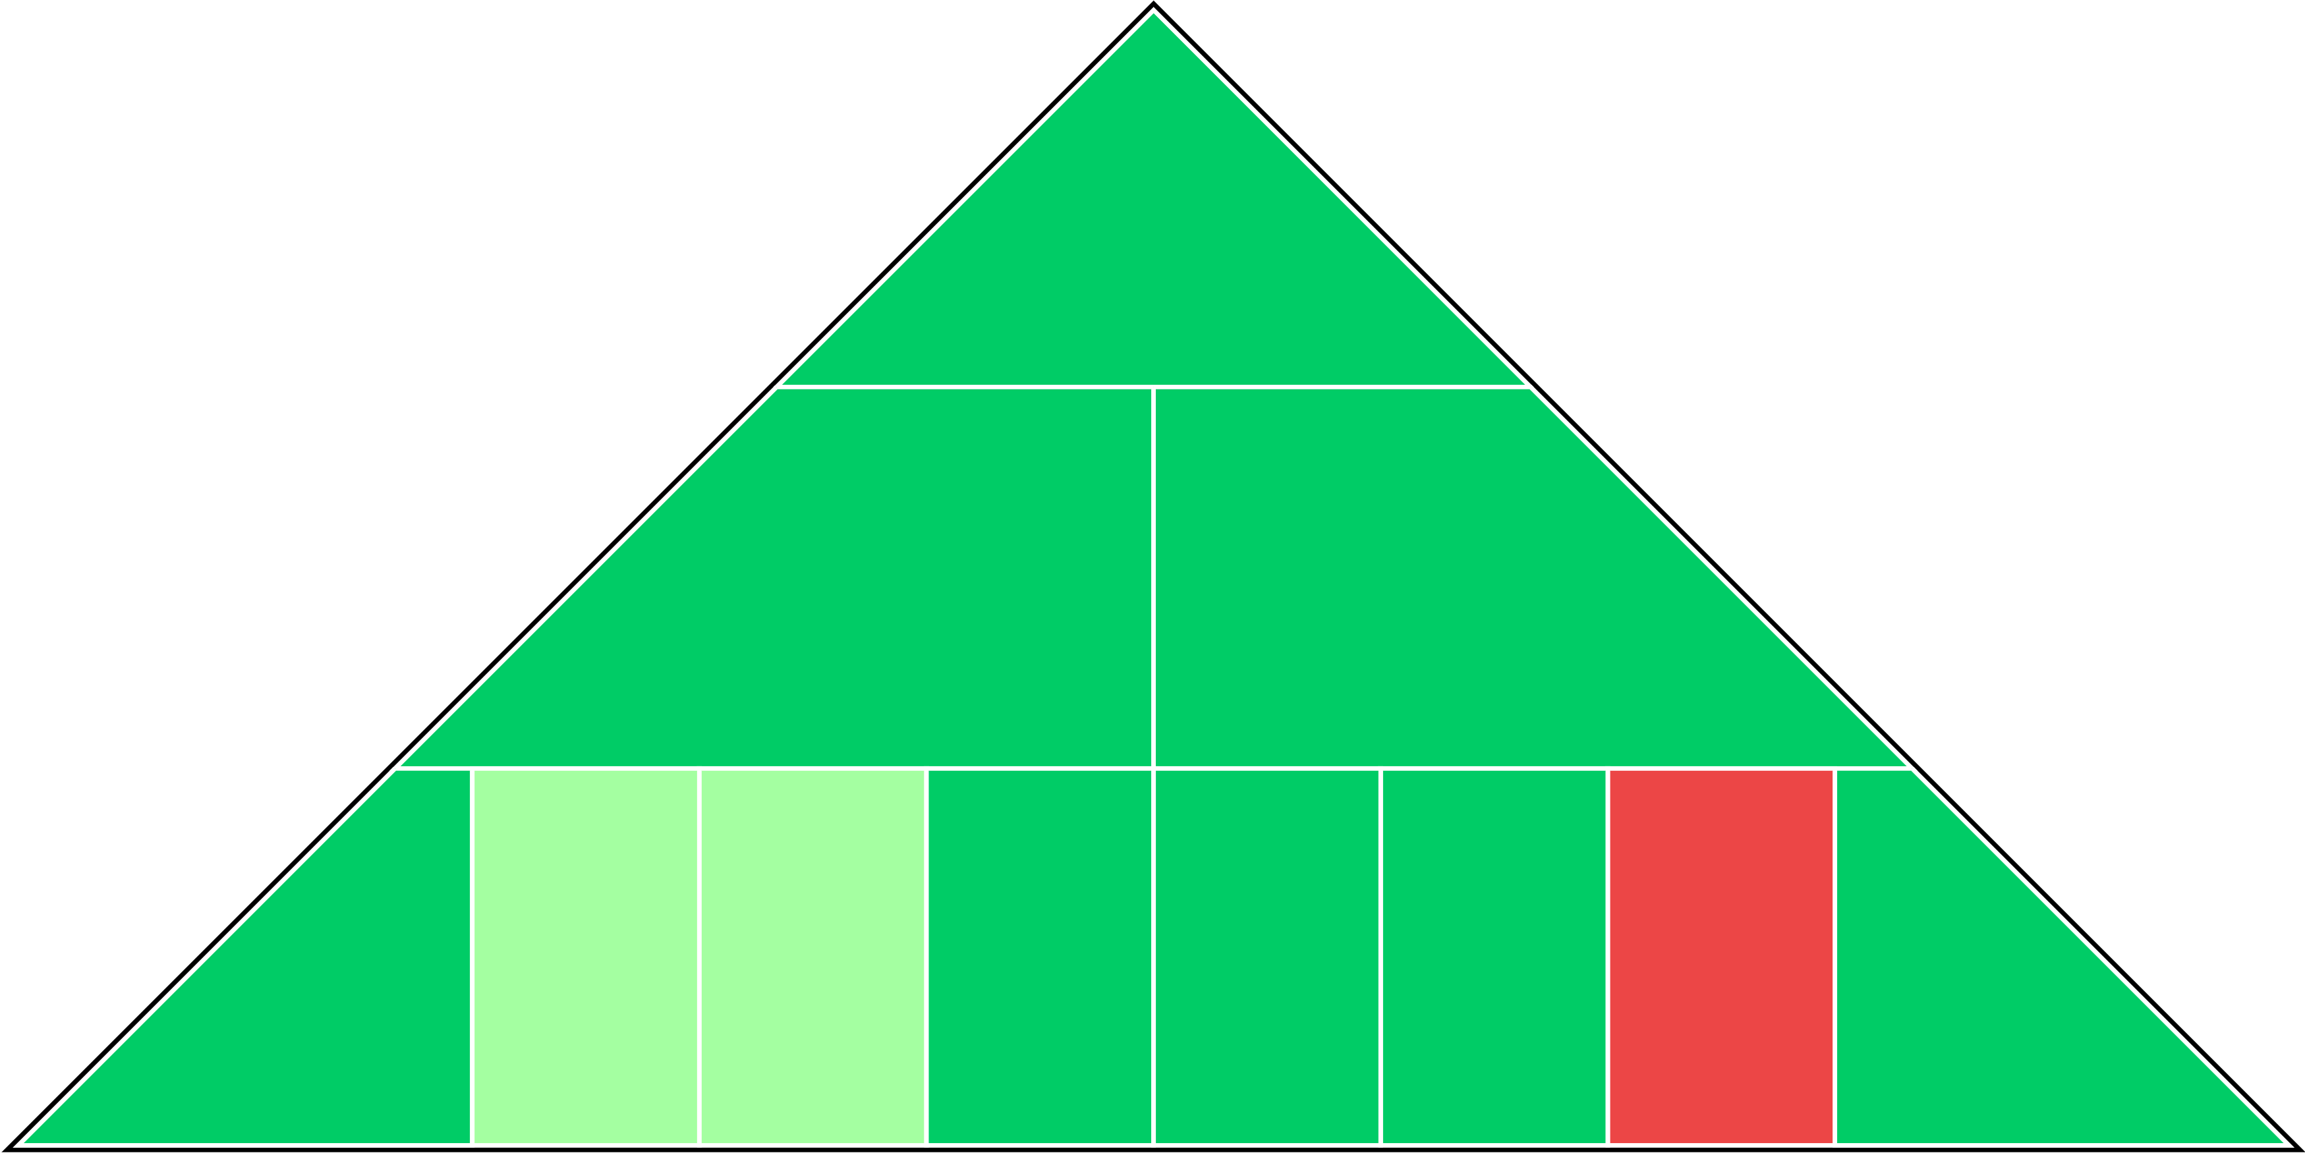
Kansas | 2019-20 (28-3)
30.3 (1/1)
Net Rtg
30.3 (1/1)
OER
115.8 (1/8)
DER
85.5 (1/2)
FTA
Rate
35.8%
(2/89)
FTA
Rate
23.2%
(2/12)
eFG%
53.7%
(1/24)
TO%
18.7%
(3/166)
OREB%
32.6%
(3/41)
DREB%
73.6%
(1/110)
TO%
18.6%
(9/178)
eFG%
43.7%
(1/4)

Slide 6

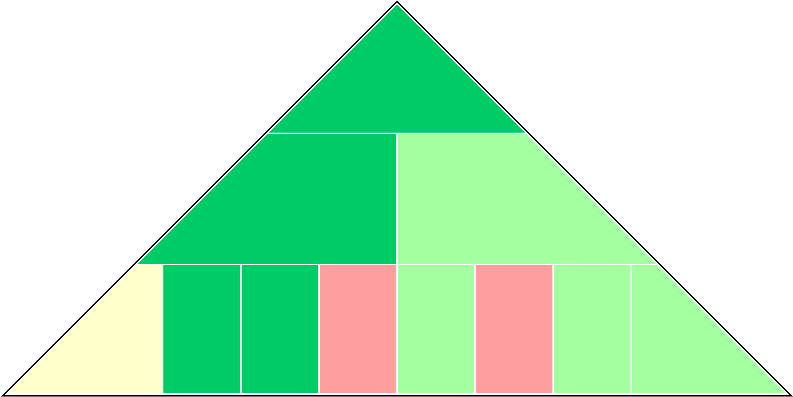
Baylor | 2019-20 (26-4)
25.4 (2/3)
Net Rtg
25.4 (2/3)
OER
113.5 (2/17)
DER
88.1 (3/4)
FTA
Rate
30.8%
(7/228)
FTA
Rate
30.8%
(4/141)
eFG%
49.4%
(6/188)
TO%
17.8%
(2/97)
OREB%
35.7%
(2/8)
DREB%
70.2%
(7/259)
TO%
22.7%
(3/22)
eFG%
45.2%
(3/15)

Slide 7

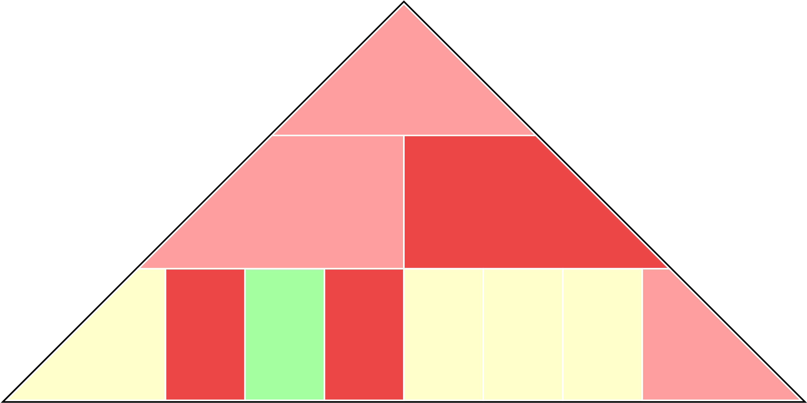
TCU | 2019-20 (16-16)
9.4 (8/84)
Net Rtg
9.4 (8/84)
OER
105.5 (8/119)
DER
96.1 (9/66)
FTA
Rate
27.1%
(9/304)
FTA
Rate
30.8%
(5/142)
eFG%
49.4%
(5/187)
TO%
21.5%
(10/320)
OREB%
32.2%
(4/48)
DREB%
70.4%
(6/256)
TO%
21.0%
(5/55)
eFG%
49.3%
(8/163)

Slide 8

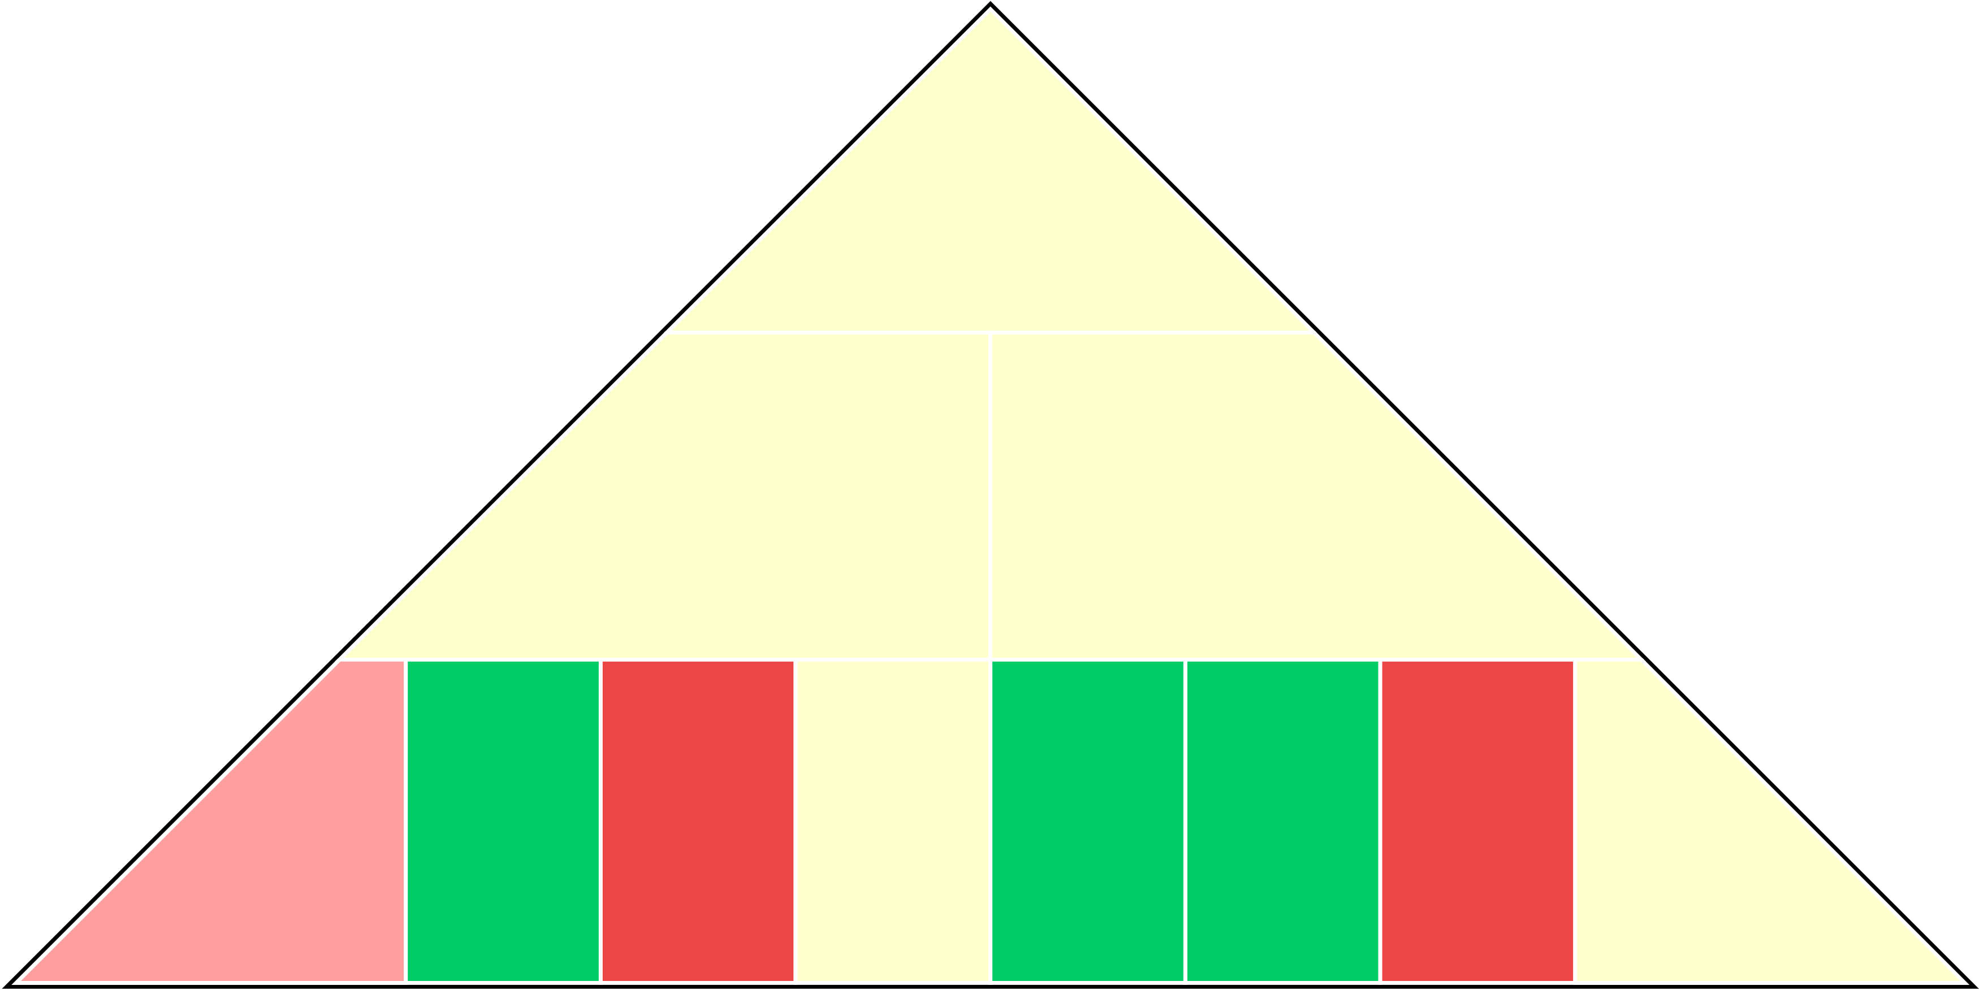
Oklahoma | 2019-20 (19-12)
15.7 (5/35)
Net Rtg
15.7 (5/35)
OER
108.8 (5/58)
DER
93.1 (6/29)
FTA
Rate
31.2%
(6/214)
FTA
Rate
19.7%
(1/1)
eFG%
48.2%
(7/237)
TO%
16.0%
(1/26)
OREB%
23.3%
(10/306)
DREB%
72.6%
(2/149)
TO%
16.7%
(10/300)
eFG%
46.7%
(5/55)

Slide 9

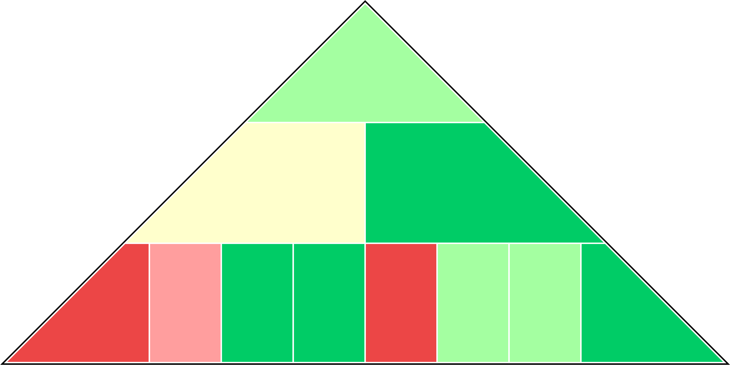
West Virginia | 2019-20 (21-10)
21.2 (3/10)
Net Rtg
21.2 (3/10)
OER
108.3 (6/67)
DER
87.1 (2/3)
FTA
Rate
40.5%
(1/23)
FTA
Rate
37.0%
(9/280)
eFG%
46.5%
(10/308)
TO%
20.7%
(8/297)
OREB%
40.1%
(1/1)
DREB%
72.3%
(3/158)
TO%
22.4%
(4/29)
eFG%
44.5%
(2/8)

Slide 10


Oklahoma St. | 2019-20 (18-14)
12.7 (6/53)
Net Rtg
12.7 (6/53)
OER
107.2 (7/84)
DER
94.5 (8/46)
FTA
Rate
35.2%
(3/108)
FTA
Rate
33.1%
(6/205)
eFG%
47.8%
(8/260)
TO%
19.5%
(5/222)
OREB%
29.5%
(6/123)
DREB%
71.0%
(4/223)
TO%
20.5%
(8/76)
eFG%
46.7%
(6/56)

