Slide 1
“Pulmonary Disease Detection using Lung Sound”
Bangladesh University of Engineering and Technology
Department of Electrical and Electronic Engineering
Project Presentation eee 312_B1
Date: 2 March, 2024
Presented by:
Name: Puspita Mobarak Student ID: 2006087
Name: Al-Amin Student ID: 2006088
Name: Muaz Rahman Student ID: 2006089
Name: Mohammed Al Hosan Student ID: 2006090
Supervisor:
Dr.Md.Kamrul Hasan
Professor,EEE,BUET
Nawshad Binte Nizam
Lecturer(PT),EEE,BUET

Slide 2
Introduction
Pulmonary diseases pose significant global health risks.
Conventional diagnostics can be costly and invasive.
Study focuses on non-invasive lung sound analysis.
Early diagnosis improves patient outcomes and reduces costs.
MFCC feature extraction, KNN classification.
Enhance accessibility to pulmonary disease diagnosis.

Slide 3
Motivation
Global lung disease impact
Current diagnostic method drawbacks
Improved outcomes with early detection
Economic relief for healthcare

Slide 4
Mentionable Program Outcomes(PO) from Project
PO(a) | Engineering knowledge | Pulmonary Disease Detection using Lung Sound using knowledge of Digital Signal Processing
PO(b) | Problem analysis | The problem involves detecting pulmonary diseases from lung sound data using MATLAB
PO(c) | Design/development Solution | Utilizes lung sound features and signal processing for disease detection in MATLAB.
PO(i) | Individual work and team work | Teamwork; Task distribution and mutual problem-solving support
PO(j) | Communication | Project report and presentation

Slide 5
Literature Review
Existing Methods:
Already existing methodology proposed by Islam MA which follows Welch Spectral Method using Machine Learning Deep Learning
Lung abnormalities also can be identified using Convolutional Neural Network and Deep Neural Network
Our Aim:
Our study presents accessible method using MATLAB which is easy to learn and understand

Slide 6
Data Resources
Dataset 1:
Dataset 2:
“Α Respiratory Sound Database for the Development of Automated Classification” Rocha BM, Filos D, Mendes L, Vogiatzis I, Perantoni E, Kaimakamis E, Natsiavas P, Oliveira A, Jácome C, Marques A, Paiva RP (2018)
Recordings: 126 patients, 5.5 hours, 6898 respiratory cycles; 1864 crackles, 886 wheezes, 506 both
Asthma, Heart failure, Bronchitis, Pneumonia
“A dataset of lung sounds recorded from the chest wall using an electronic stethoscope” Mohammad Fraiwan , Luay Fraiwan , Basheer Khassawneh , Ali Ibnian (2021)
Dataset: 112 subjects (35 healthy, 77 unhealthy); age 21-90; mean ±SD 50.5 ±19.4; 43 females, 69 males
Normal, Asthma, COPD, Bronchitis
*On field data couldn’t be collected due to technical and administrative restrictions

Slide 7
Methodology
Collecting Dataset
Audio Pre-processing
Feature Extraction
Classification of data
Comparison of Features
Identification and Result
EEE 312 Group_No: B1_

Slide 8
Working Pipeline
Audio Preprocessing:
Different lengths, sampling rates
Matching the sampling rate by resampling
Normalizing the amplitude
Matching the length using truncation
Saving the new audio files in a new location
EEE 312 Group_No: B1_

Slide 9
Working Pipeline
Feature Extraction using MFCC:
Lung sounds are broken into manageable pieces.
Works on human perceivable sounds by patterns of lung sound
Divide the lung sound into small sections and analyze
Special filters are used to focus on specific parts of lung sound
At last, the important 12 features are extracted using MFCC.
EEE 312 Group_No: B1_06

Slide 10
Working Pipeline
Classifier (K-Nearest Neighbors Algorithm, KNN):
Input: Training dataset, test dataset, value of 'k.'
Euclidean distance between test point sample point
Select the 'k' nearest neighbors.
Majority Vote
EEE 312 Group_No: B1_06

Slide 11
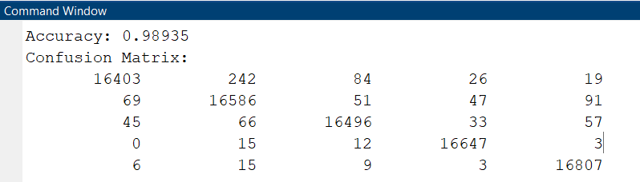
Results
Result of KNN model training
*80% of data was used in model training
EEE 312 Group_No: B1_06

Slide 12
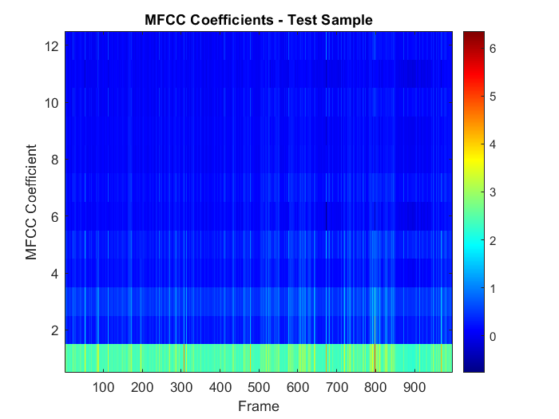

Results
Result of checking a test sample
EEE 312 Group_No: B1_06

Slide 13
Social Impact
Global healthcare accessibility enhanced.
Early diagnosis of lung disorders facilitated.
Targeting underserved communities and resource-limited settings.
Consideration of cultural beliefs and preferences in healthcare practices.
Awareness and education initiatives for non-invasive diagnostics.
EEE 312 Group_No: B1_06

Slide 14
Future Prospect
Improve feature extraction.
Use advanced classification algorithms.
Expand datasets.
Enable real-time implementation.
Integrate with clinical systems.
EEE 312 Group_No: B1_06

Slide 15
Conclusion
Extracted MFCC features from respiratory sound recordings.
Classified respiratory conditions with k-NN model.
Demonstrated potential for automated disease detection.
Promising results suggest practical application in healthcare.
Signaled advancement in respiratory healthcare technology.
EEE 312 Group_No: B1_06

Slide 16
References
D. Chamberlain, J. Mofor, R. Fletcher, R. Kodgule, ”Mobile Stethoscope and Signal Processing Algorithms for Pulmonary Screening and Diagnostics,” in 2015 IEEE Global Humanitarian Technology Conference (GHTC), 2015. [Online]. Available: https://ieeexplore. ieee.org/document/7344001
2) Y. Liu, Y. Lin, X. Zhang, Z. Wang, ”Classifying respira tory sounds using electronic stethoscope,” in 2017 IEEE SmartWorld, Ubiquitous Intelligence & Computing, Ad vanced & Trusted Computed, Scalable Computing & Communications, Cloud & Big Data Computing, Inter net of People and Smart City Innovation, 2017. [Online]. Available: https://ieeexplore.ieee.org/document/8397496
EEE 312 Group_No: B1_06

Slide 17
Thank You
Any Query?
EEE 312 Group_No: B1_06

