Slide 1
Hospital Management System (HMS) - Project Presentation

Slide 2
HMS - SRS

Slide 3
Project Overview
→ Project Title: Hospital Management System (HMS) → Institution: University Bangladesh → Team Members: → Shuvo Mozumder → Alamin Sarker → Jibon Ray → MD. Shakil → Naimur Rahman → Tarin Mustari → MD. Mahedi Ahsan

Slide 4
Introduction
The Hospital Management System (HMS) is designed to streamline hospital operations in Bangladesh, inspired by leading institutions like Ibn Sina, Labaid, and Bardem.
Objectives: → Automate administrative processes → Improve patient care through digital records → Enhance operational efficiency → Ensure data security and compliance

Slide 5
Bangladesh Healthcare Context
Bangladesh’s healthcare sector features modern facilities:
→ Ibn Sina Hospital: Multi-specialty with cardiology, oncology, emergency services → Labaid Specialized Hospital: Known for cardiac care and cancer treatment → BIRDEM: Specialized in diabetes and endocrine disorders
Our HMS aims to emulate these institutions’ digital solutions.

Slide 6
System Scope
The HMS covers:
→ Patient Management → Doctor and Staff Management → Appointment Scheduling → Medical Records & Prescriptions → Billing & Payment System → Pharmacy Management → Laboratory Management → Ward/Room Management → Reporting & Analytics

Slide 7
System Users and Roles
User Role | Description | Key Activities
Admin | System management | User management, reports
Doctor | Healthcare provider | Appointments, prescriptions
Nurse | Patient care | Vital updates, room monitoring
Receptionist | Front desk | Patient registration, scheduling
Pharmacist | Medicine management | Drug issuance, inventory
Accountant | Financial operations | Billing, payment tracking
Patient | Service recipient | Appointment booking, bill payment

Slide 8
System Architecture
→ Frontend: React.js/Next.js (Responsive web app) → Backend: Django REST Framework/Node.js (API services) → Database: PostgreSQL/MySQL (Data storage) → Hosting: Vercel (Frontend), DigitalOcean/AWS (Backend)

Slide 9
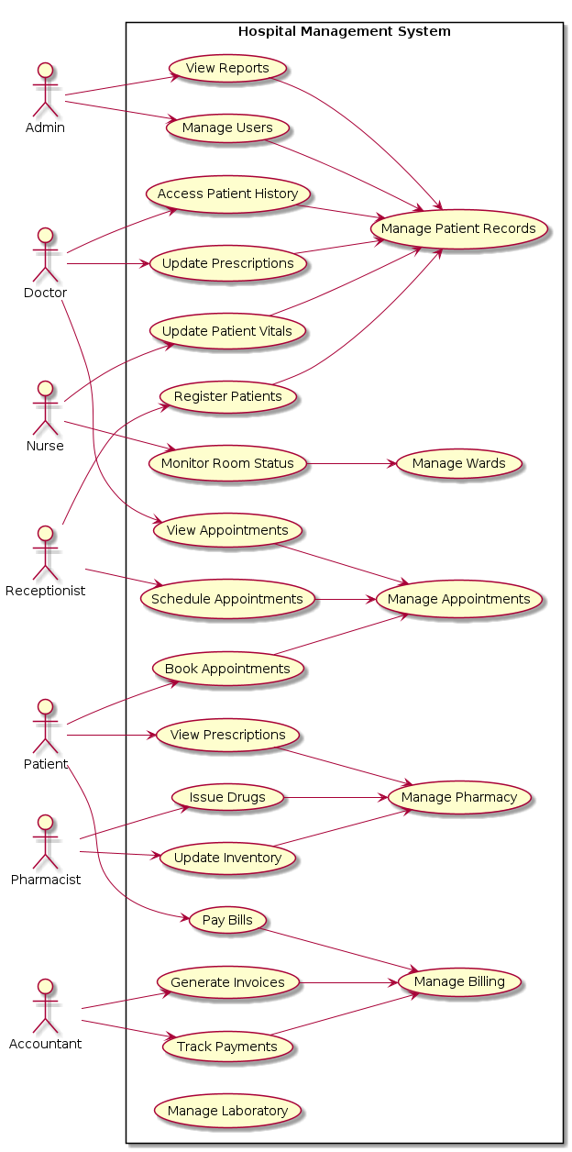
Use Case Diagram
Use Case Diagram

Slide 10
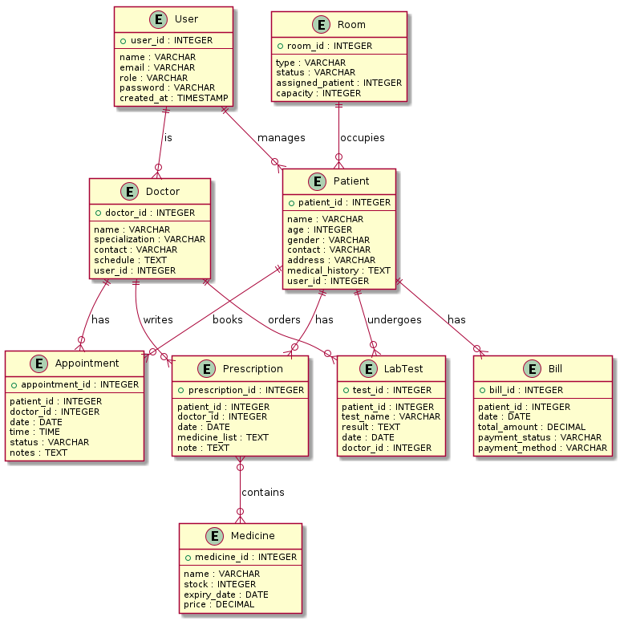
ER Diagram
ER Diagram

Slide 11
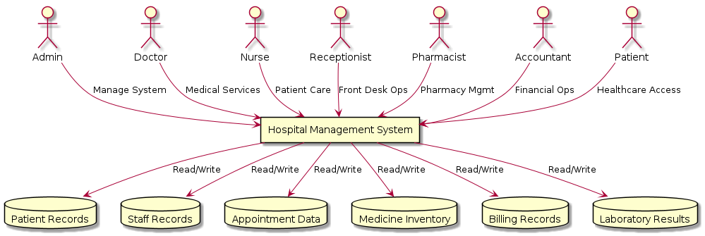
DFD Level 0
DFD Level 0

Slide 12
Functional Requirements
→ FR1: Patient Registration → FR2: Appointment Booking → FR3: Medical Record Management → FR4: Billing System → FR5: User Access Control → FR6: Reporting

Slide 13
Non-Functional Requirements
→ Performance: <2 seconds load time → Security: Encrypted passwords, JWT authentication → Scalability: Handle 100+ concurrent users → Reliability: 99.9% uptime → Usability: Intuitive dashboards → Compatibility: Cross-browser, mobile responsive

Slide 14
Implementation Plan
  Phase 1: Requirement Analysis (SRS completion)
  Phase 2: System Design (UML diagrams, database schema)
  Phase 3: Development (Frontend & Backend modules)
  Phase 4: Testing (Unit, Integration, System testing)
  Phase 5: Deployment (Production environment)
  Phase 6: Maintenance (Updates and support)

Slide 15
Tools and Technologies
→ Programming: Python (Django), JavaScript (React) → Database: PostgreSQL → Diagrams: Draw.io, PlantUML → Testing: Postman, Jest, Pytest → Version Control: Git + GitHub → Deployment: Vercel, DigitalOcean, Docker

Slide 16
Deliverables
→ Software Requirements Specification (SRS) → System Design Diagrams (Use Case, ER, DFD) → Database Schema → Source Code Repository → Test Cases and Results → User Manual → Deployment Guide

Slide 17
Conclusion
The HMS provides a comprehensive digital solution for Bangladesh’s healthcare needs, incorporating best practices from leading hospitals while ensuring compliance with international standards.
Key Benefits: → Improved patient care → Operational efficiency → Data security → Scalable architecture

Slide 18
Thank You!
Questions?
Contact: [Team Email/Contact Information]

