Slide 1
Containerized FastAPI Service
with Reverse Proxy
Docker · Docker Compose · Nginx · EC2
Yves Alain Iragena
CSC 410/510 Cloud Computing · Richard Kelley
Live at http://18.119.112.99/api/health
Notes:
Keep this on screen for ten seconds. Say: two containers, one published port, deployed to a free-tier EC2 instance.

Slide 2
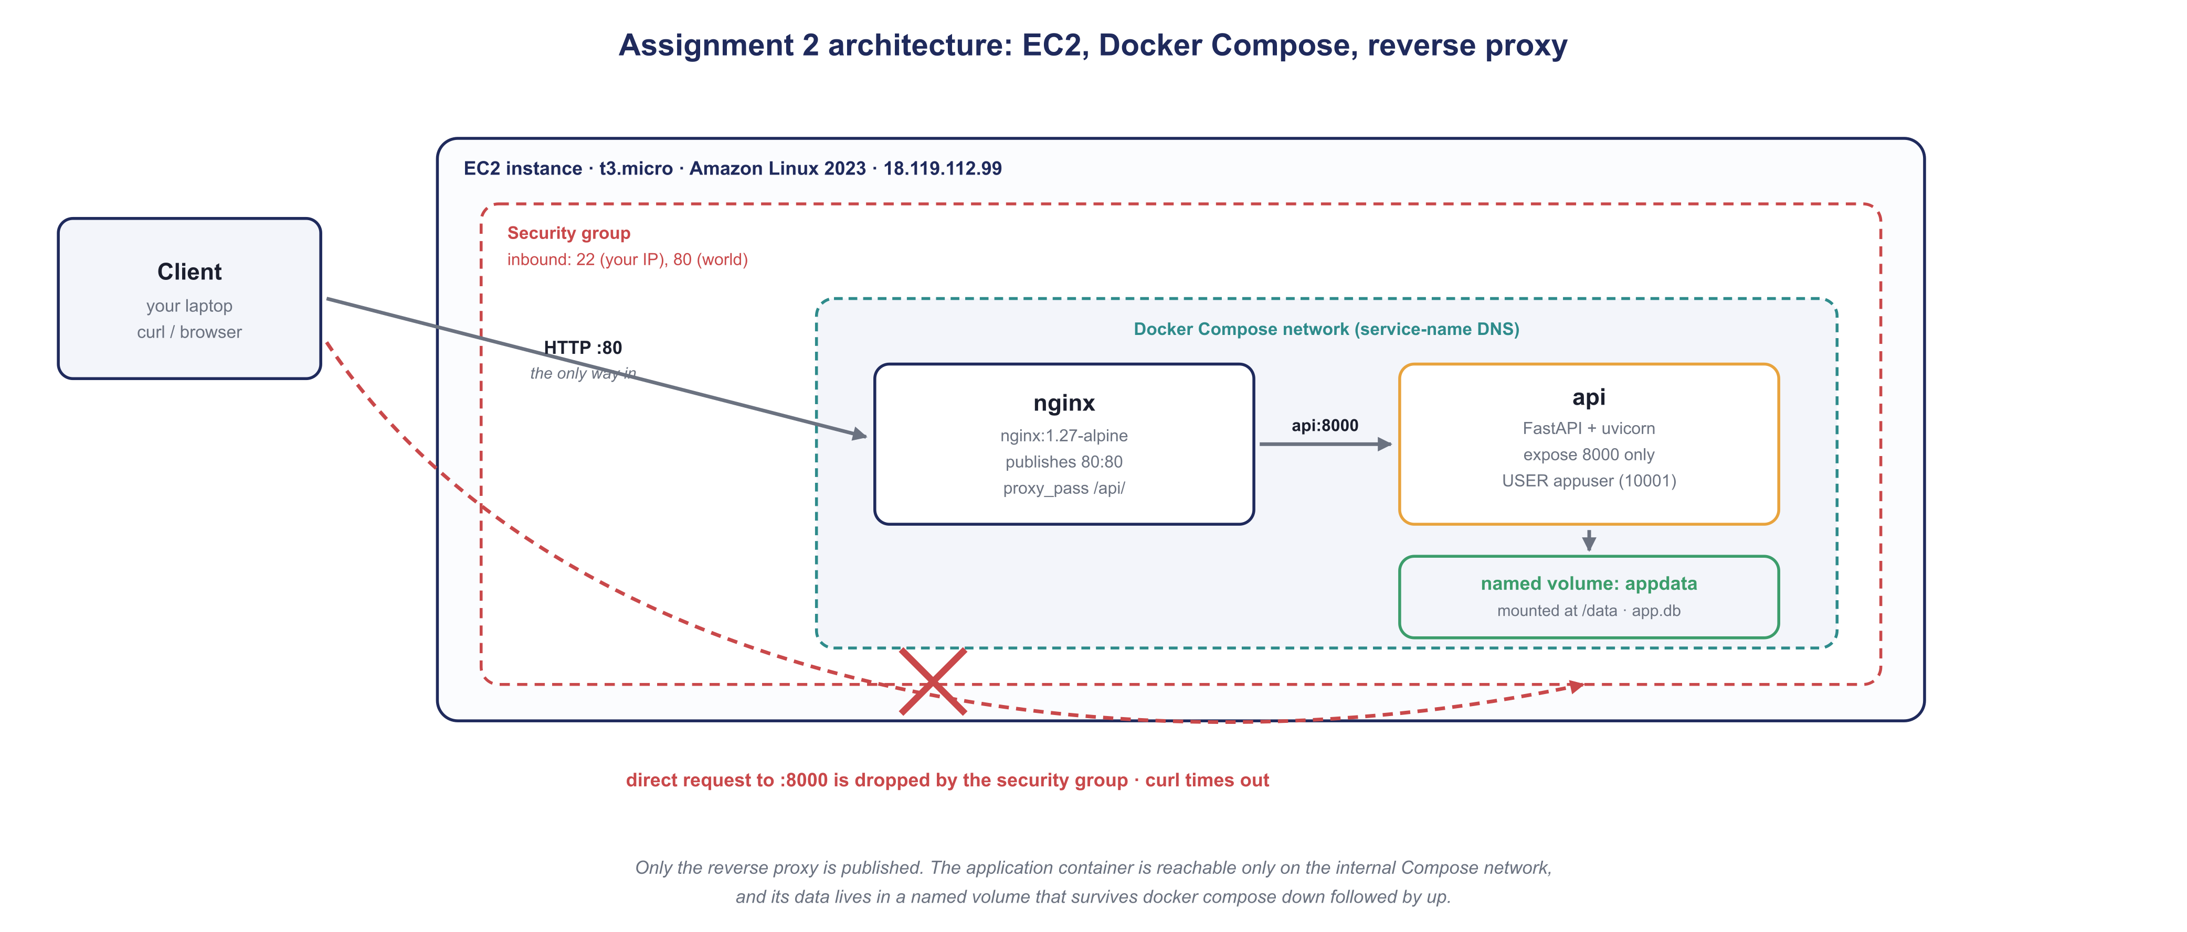
Architecture
Yves Alain Iragena · Assignment 2
2
Notes:
One way in: port 80 to nginx. Nginx reaches the api container by service name on the Compose network. The api container is never published. Data lives in a named volume at /data.

Slide 3
What the starter gave me, and what I wrote
Supplied
Written by me
app/main.py — FastAPI app, SQLite at /data
app/requirements.txt
nginx/nginx.conf — proxy_pass to api:8000
docker-compose.yml — two services, one volume
app/Dockerfile — the main deliverable
app/.dockerignore — in app/, the build context
depends_on: condition: service_healthy
scripts/ec2-setup.sh — one-command bootstrap
Yves Alain Iragena · Assignment 2
3
Notes:
The compose file was already complete. The Dockerfile was the real work.

Slide 4
The detail that makes non-root work
A named volume mounted at /data, and a process that is not root. These fight each other unless you do one thing at build time.
RUN useradd --create-home --uid 10001 --shell /usr/sbin/nologin appuser \
&& mkdir -p /data \
&& chown -R appuser:appuser /data /app
USER appuser
Why
When Docker first creates an empty named volume it copies the ownership of whatever directory sits at that path inside the image. If /data is not in the image, the volume is created owned by root, the non-root process cannot open app.db, and the container fails at startup.
Yves Alain Iragena · Assignment 2
4
Notes:
This is the part most people get wrong. Expect a question here.

Slide 5
Live demonstration
1
Both containers running
docker compose ps
2
Application runs as non-root
docker compose exec api id
3
All three endpoints, through the proxy
curl http://18.119.112.99/api/...
4
Data survives a full restart
docker compose down && up -d
5
Port 8000 is not reachable
curl -m 8 ...:8000 → times out
Notes:
Switch to the terminal now. Do not read the slide. Work through the five, saying one sentence about what each proves.

Slide 6
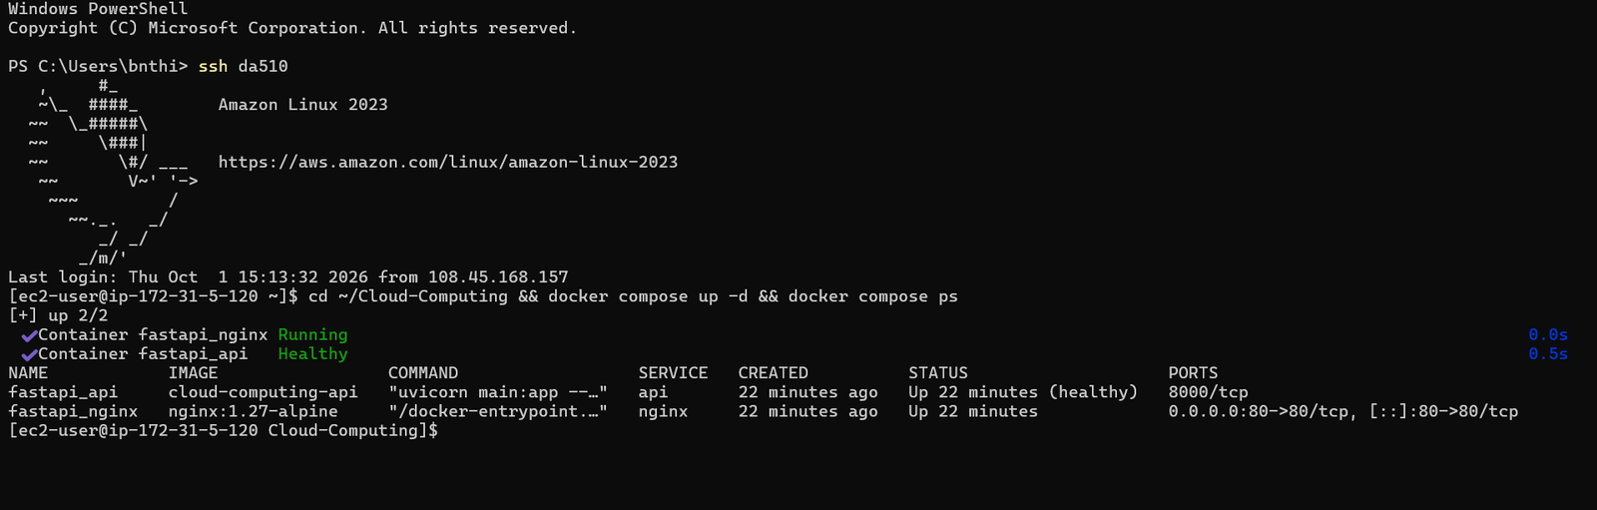
Containers running, only port 80 published
Yves Alain Iragena · Assignment 2
6
Notes:
Backup in case the live demo fails. ssh da510 connects, api shows 8000/tcp with no host binding, nginx shows 0.0.0.0:80->80/tcp.

Slide 7
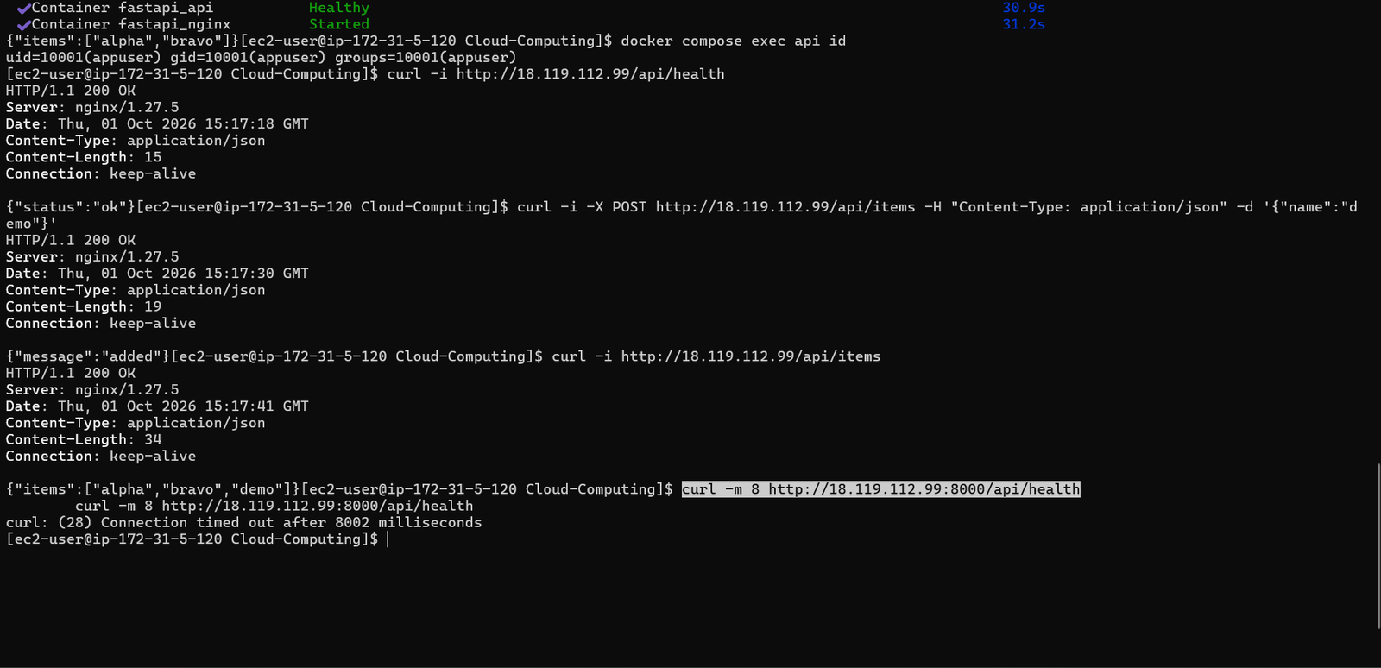
Persistence, non-root, endpoints, blocked port
Yves Alain Iragena · Assignment 2
7
Notes:
Backup slide. Items survive the restart, id returns uid 10001, three endpoints return 200 through nginx, and port 8000 times out after 8002 ms.

Slide 8
Three things that broke, and the fixes
Compose could not build
Amazon Linux ships Docker without the buildx plugin. Installed the matching release into cli-plugins; the setup script now does it automatically.
compose build requires buildx 0.17.0 or later
Container name already in use
container_name values are global to the daemon, not per project, so a second local clone cannot start while the first runs.
Conflict. The name "/fastapi_api" is already in use
SSH refused the key
OpenSSH on Windows rejects a private key readable by more than its owner. Restricted the file permissions.
Permission denied (publickey)
Yves Alain Iragena · Assignment 2
8
Notes:
Shows real debugging. The buildx one is worth mentioning because a clean instance hits it immediately.

Slide 9
Every requirement, verified
✓
Listens on 8000 internally
✓
Named volume mounted at /data
✓
GET /api/health
✓
Data survives down then up
✓
POST /api/items
✓
Nginx in its own container
✓
GET /api/items
✓
Only port 80 published
✓
Data stored in /data
✓
Proxies /api/ by service DNS
✓
Runs as a non-root user
✓
Port 8000 not public
✓
uvicorn without --reload
✓
Starts with one command
github.com/Alan-911/Cloud-Computing
Yves Alain Iragena · Assignment 2
9
Notes:
Close here. Offer to walk through any part of the Dockerfile or compose file.

