Slide 1
Introduction to Cubical Marching Squares (CMS)
By John Mecham

Slide 2
Background
CMS / Dual Contour (DC) / Marching Cubes – are all types of isosurface extraction algorithms
These algorithms are concerned with extracting surface data (triangles) from volume data
Volume data usually starts out as depth data (e.g. MRI)
Additionally surface normals are extracted
If surface normals aren’t explicitly known they can be approximated from depth data
These normals are known as “Hermite data”
Modern Isosurface extraction algorithms use depth and normal data.

Slide 3
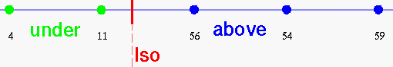
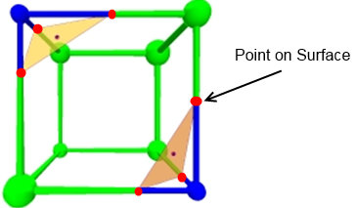
Introduction to Marching Cubes
Step 1 Cube intersection
Each corner of the cube has an associated value
Above a certain value it’s considered inside the surface and below a certain value it’s “outside” the surface
By interpolation we obtain points on the surface

Slide 4
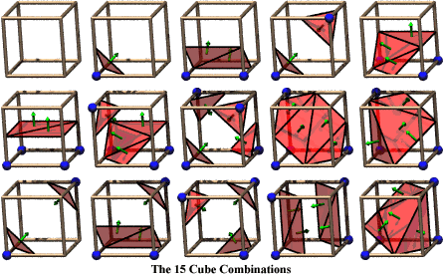
Introduction to Marching Cubes [cont.]
Using corner information
Each corner of cube is classified as inside/outside
Points on surface are calculated (red dots in previous slides)
Points on surface are convert to triangles based on cube’s classification
Pro’s:
Simple - Only need to know depth data.
Localized - Doesn’t need to know about neighboring cubes (Dual Contour)
Con’s:
Doesn’t work for sharp corners
Very inaccurate (generates incorrect surface)

Slide 5
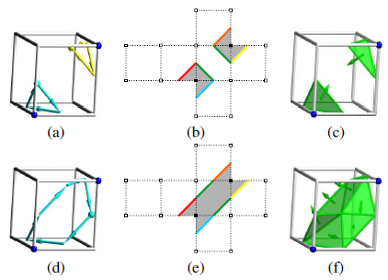
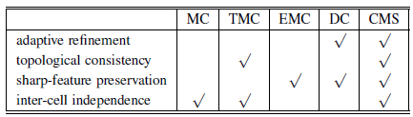
CMS Overview
Algorithm works by breaking 6 faces of the cube into 2D planes
Segments on each face are generated then wrapped together to generate the triangles of the cell.
CMS = Face Segment Algorithm + Tracing Algorithm

Slide 6
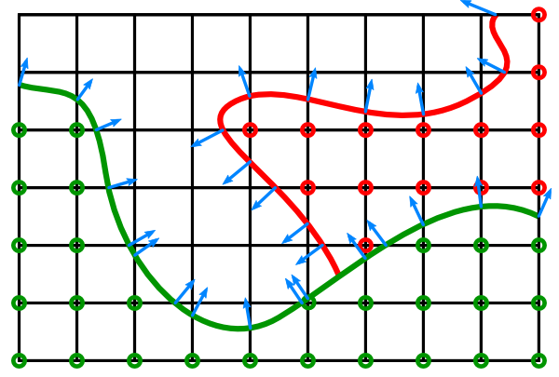
The input data (CMS)
Takes a grid or octree structure with normals and defined intersections
Blue lines are surface normals at intersection points of the cube

Slide 7
CMS Algorithm Overview
Obtain leaves of the tree
For each leaf cube
Break each cube into 6 faces
Run Segment Generation on each face
Combined face segments into “components”
For each component
Sample for feature points
Generate triangles
So breaks into 3 parts
-> Face segmentation, Component Tracing, Triangle Generation

Slide 8
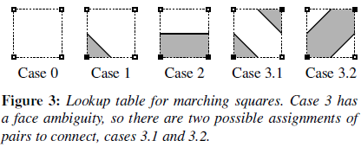
Segment Generation
Breaks cube into 6 squares. Outputs segments for each square.
Each square is classified in a similar way as marching cubes
Points on the edge are found like in marching cubes.

Slide 9
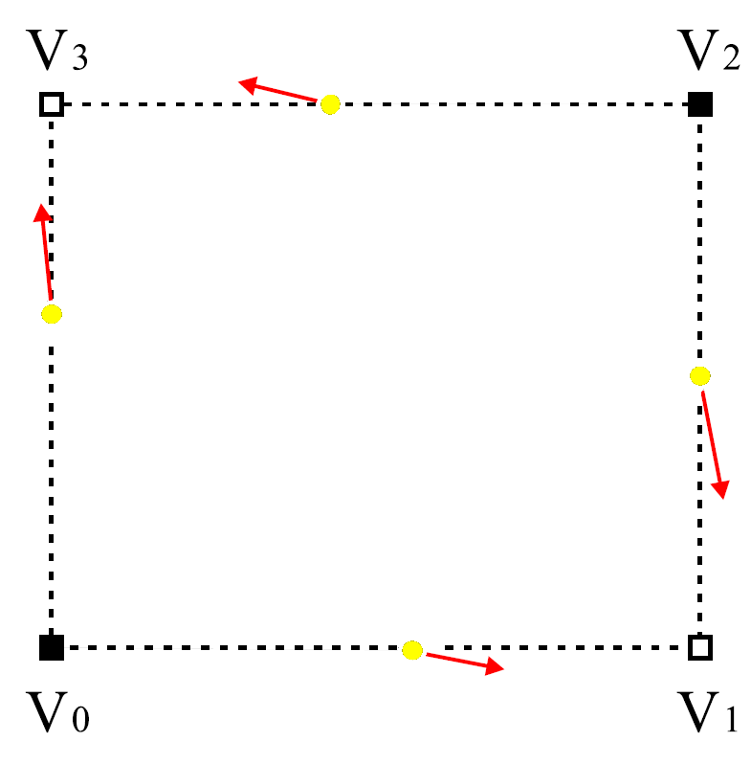
Segment Generation [Ambiguous case]
Case 3 is ambiguous so which do you choose?
We use the normal data to tell which case (3.1 or 3.2) has a smaller angle between the normals
<- Is this case 3.1 or 3.2?

Slide 10
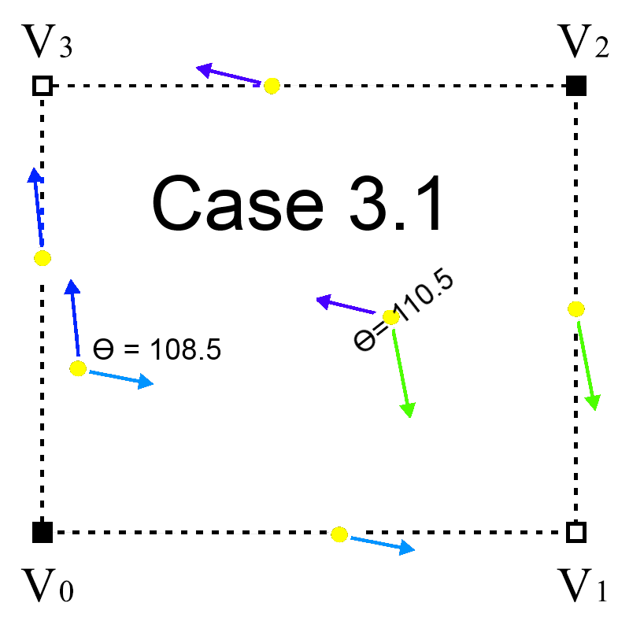
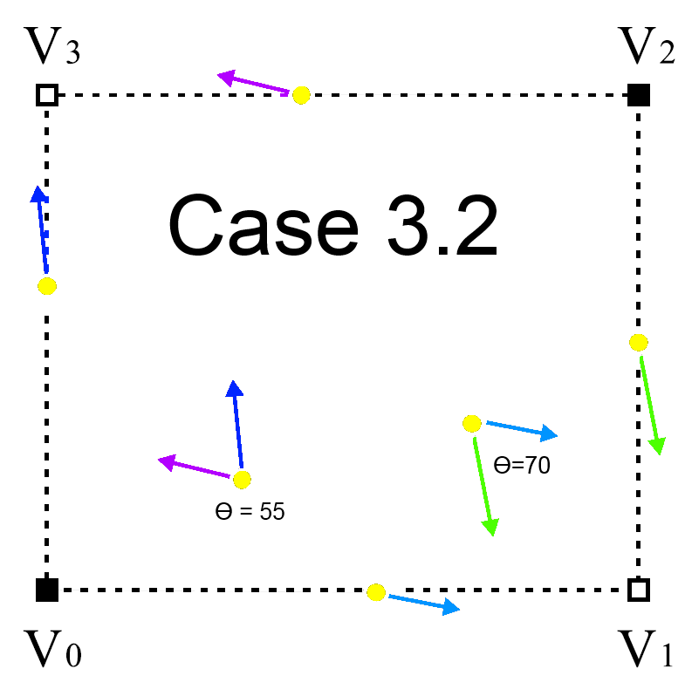
Segment Generation [Ambiguous case]
To determine if it’s case 3.1 or 3.2 we compare the angles produced in each case
Case 3.2 has lower angles so it’s correct.
Some form of a heuristic will have to be use for edge cases.

Slide 11
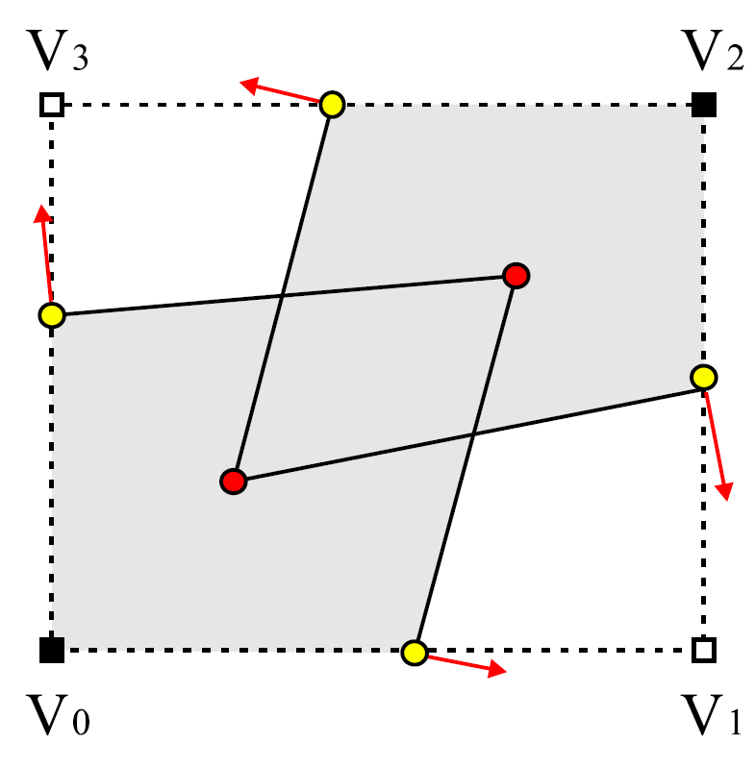
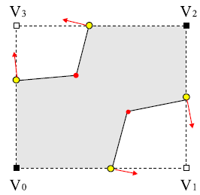
Segment Generation [Ambiguous case]
If case 3.1 were chosen generated geometry:
If case 3.2 were chosen generated geometry:
As you can see in the 3.1 case intersecting triangles are generated which shouldn’t occur!
But how do we generate these red points any way?
Also note AT MOST 4 segment can ever be generated per face.

Slide 12
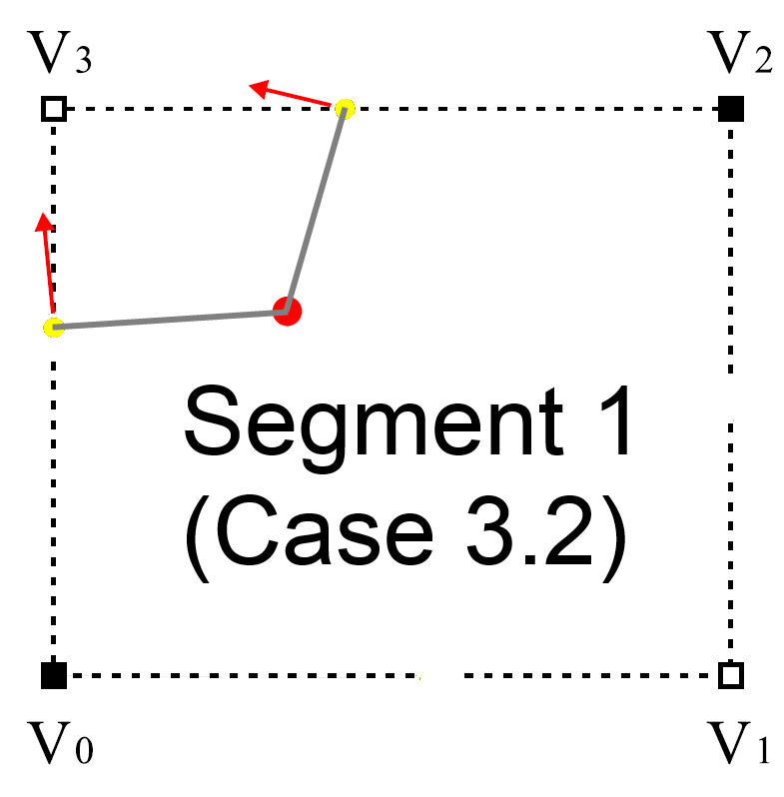
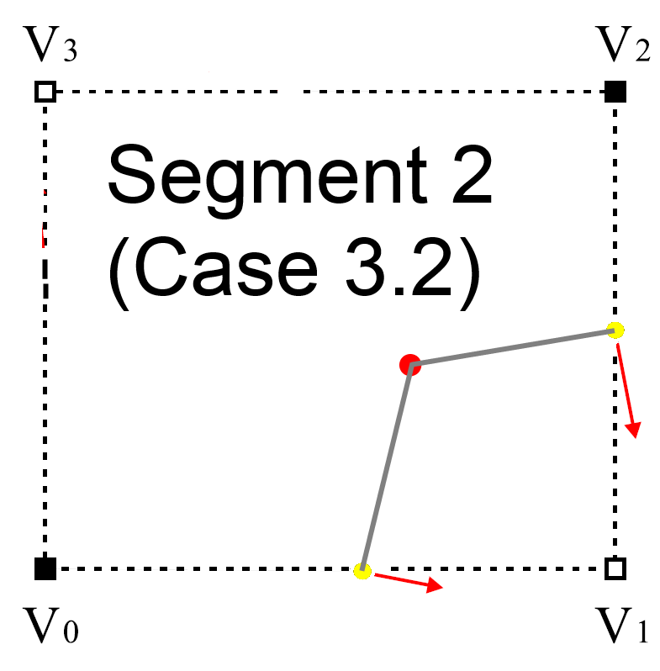
Segment Generation [additional points]
So back to how we generate those red points?
Note we only need to generate it if the angle between edge points are still “large” (heuristic).
To generate points find where the 2 tangent lines intersect
Example below is for case 3.2, The procedure be extended to all cases
Case 3.2

Slide 13
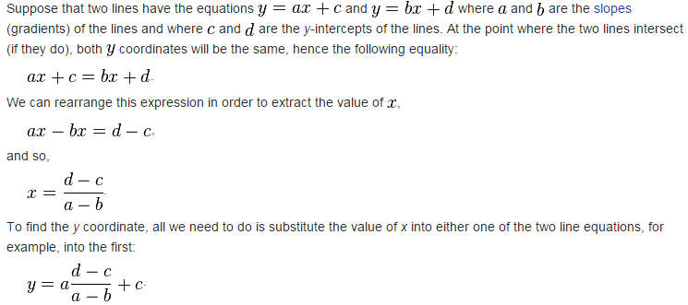
Segment Generation Feature Point (Algebra review)
We have two points and two normals.
Tangent line for 2D is defined by (-y, x) of the normal and the corresponding point
Intersection of 2 lines (Wikipedia snippet):

Slide 14
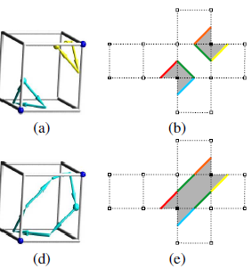
From Faces to Cells Cell Tracing Algorithm
So we have all the segments of the faces. How do we get the triangles for the cell?
Step 1: Trace segments together to form “components”
Tables can be used to make component tracing simpler. Components form loops.
After you have components each component *can* sample for one additional point.
Next slide will go more in-depth on this topic

Slide 15
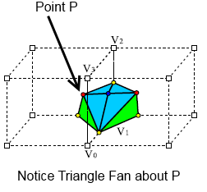
Component Feature Point Sampling
CMS paper suggests we use “Kobbelt et al” algorithm
Relies on singular value decomposition.
We may instead be able to extend the Schmitz algorithm to work for components.
Once this point has been generated a triangle fan can be created. Where the point p is the middle point.

Slide 16
Component Feature Point Sampling
We have some loop.
Edges of loop has a point and normal.
You can solve the system: by least squares.
Or you can used particle based method (next Slide)

Slide 17
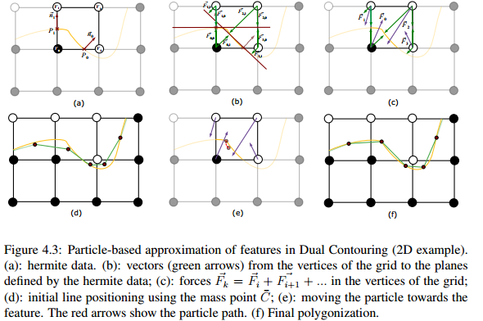
Particle-based feature approximation
Method originally based on 3D trilinear approximation
It’s trivial to reduce 2D
Originally used for DC. Can be used for CMS
It’s really just a local minimization problem.
Schaffner also provides a technique that is more accurate but relies heavily on QR decomposition of a matrix
Schaffner method was also extremely sensitive to floating point error

Slide 18
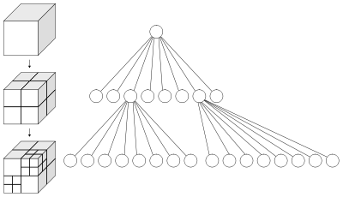
Cell Subdivision [Introduction]
So far I have told you have we have started with an octree.
However when you make this octree you must decide whether or not to subdivide a cell or node.
For each face of cell
If face has edge ambiguity
Subdivide cell

Slide 19
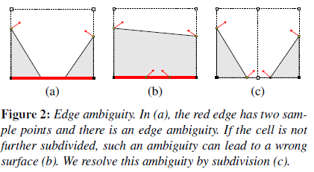
Cell Subdivision [Cont.]
What is this “edge” ambiguity?
We use the surface normals (hermite data) and a heuristic to see if the cell needs to be subdivided.
Above is face case 2. The dot products of normals tell us that the angle between the normal is too large so subdivision of cell should occur (seen in c)

Slide 20
Next time
Optimal data structures
Program organization
Multi Materials
Mystery algorithm - “Kobbelt et al” algorithm

Slide 21
Segment Generation [additional points]
So we known how to generate the correct case. But as you noticed in previous problem the surface may need more points. How do we generate these? [What follows is my guess]
We use something developed in Schaffner’s paper which finds the isopoints of the cube using the different edge values and normals.
Leonardo Augusto Schmitz came up with a simple iterative algorithm for this. [4.2.1 Particle-based feature approximation]
Next I will introduce Augusto Schmitz algorithm

