Slide 1
Terrain Generation
Tiju Thomas
CIS 565 – GPU Programming Final Project
Mid-Point Presentation
3rd December 2012

Slide 2
Outline
Introduction
Goal
Current Progress
Next Steps

Slide 3
Introduction
“The wilderness inspires many and fills you with energy and enthusiasm”
Love the outdoors
Terragen (http://planetside.co.uk)

Slide 4
Goal
Create a basic Terrain Generator
Shading
Tessellation based on distance from camera
Different terrains based on noise (and maybe height fields)

Slide 5
Basic Mesh
Flat Grid
Height using Perlin Noise
Displacement in Vertex Shader
Color assigned using Fragment Shader
Mesh created using GL_LINE instead of GL_FILL in glPolygonMode

Slide 6
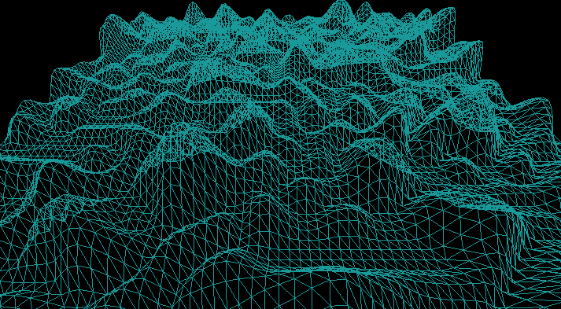
Basic Mesh

Slide 7
Shading
Geometry Shader
Contains information about the entire primitive
Generate Normals using vertex data
Diffuse shading in Fragment Shader based on directional light

Slide 8
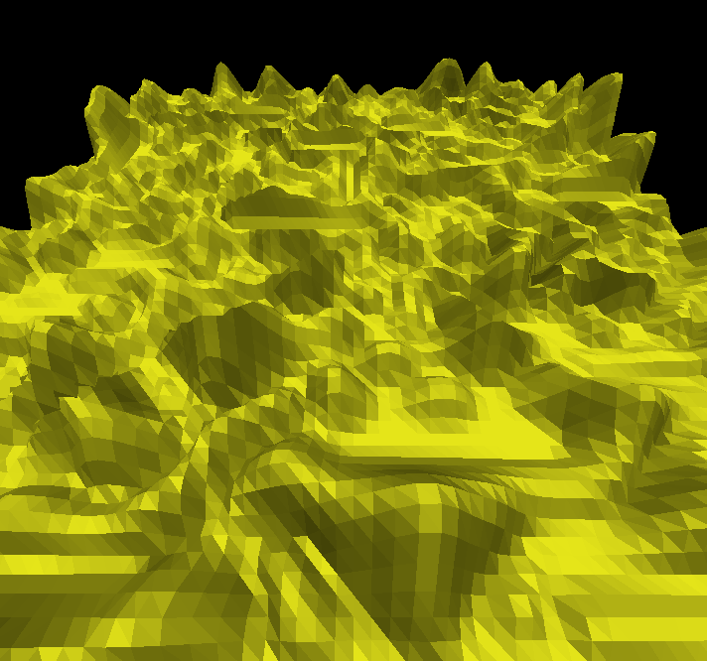
Shading
Shaded with normals data from geometry shader

Slide 9
Shading
Geometry Shader
Contains information about the entire primitive
Generate Normals using vertex data
Diffuse shading in Fragment Shader based on directional light
Issue – Flat shading for each primitive

Slide 10
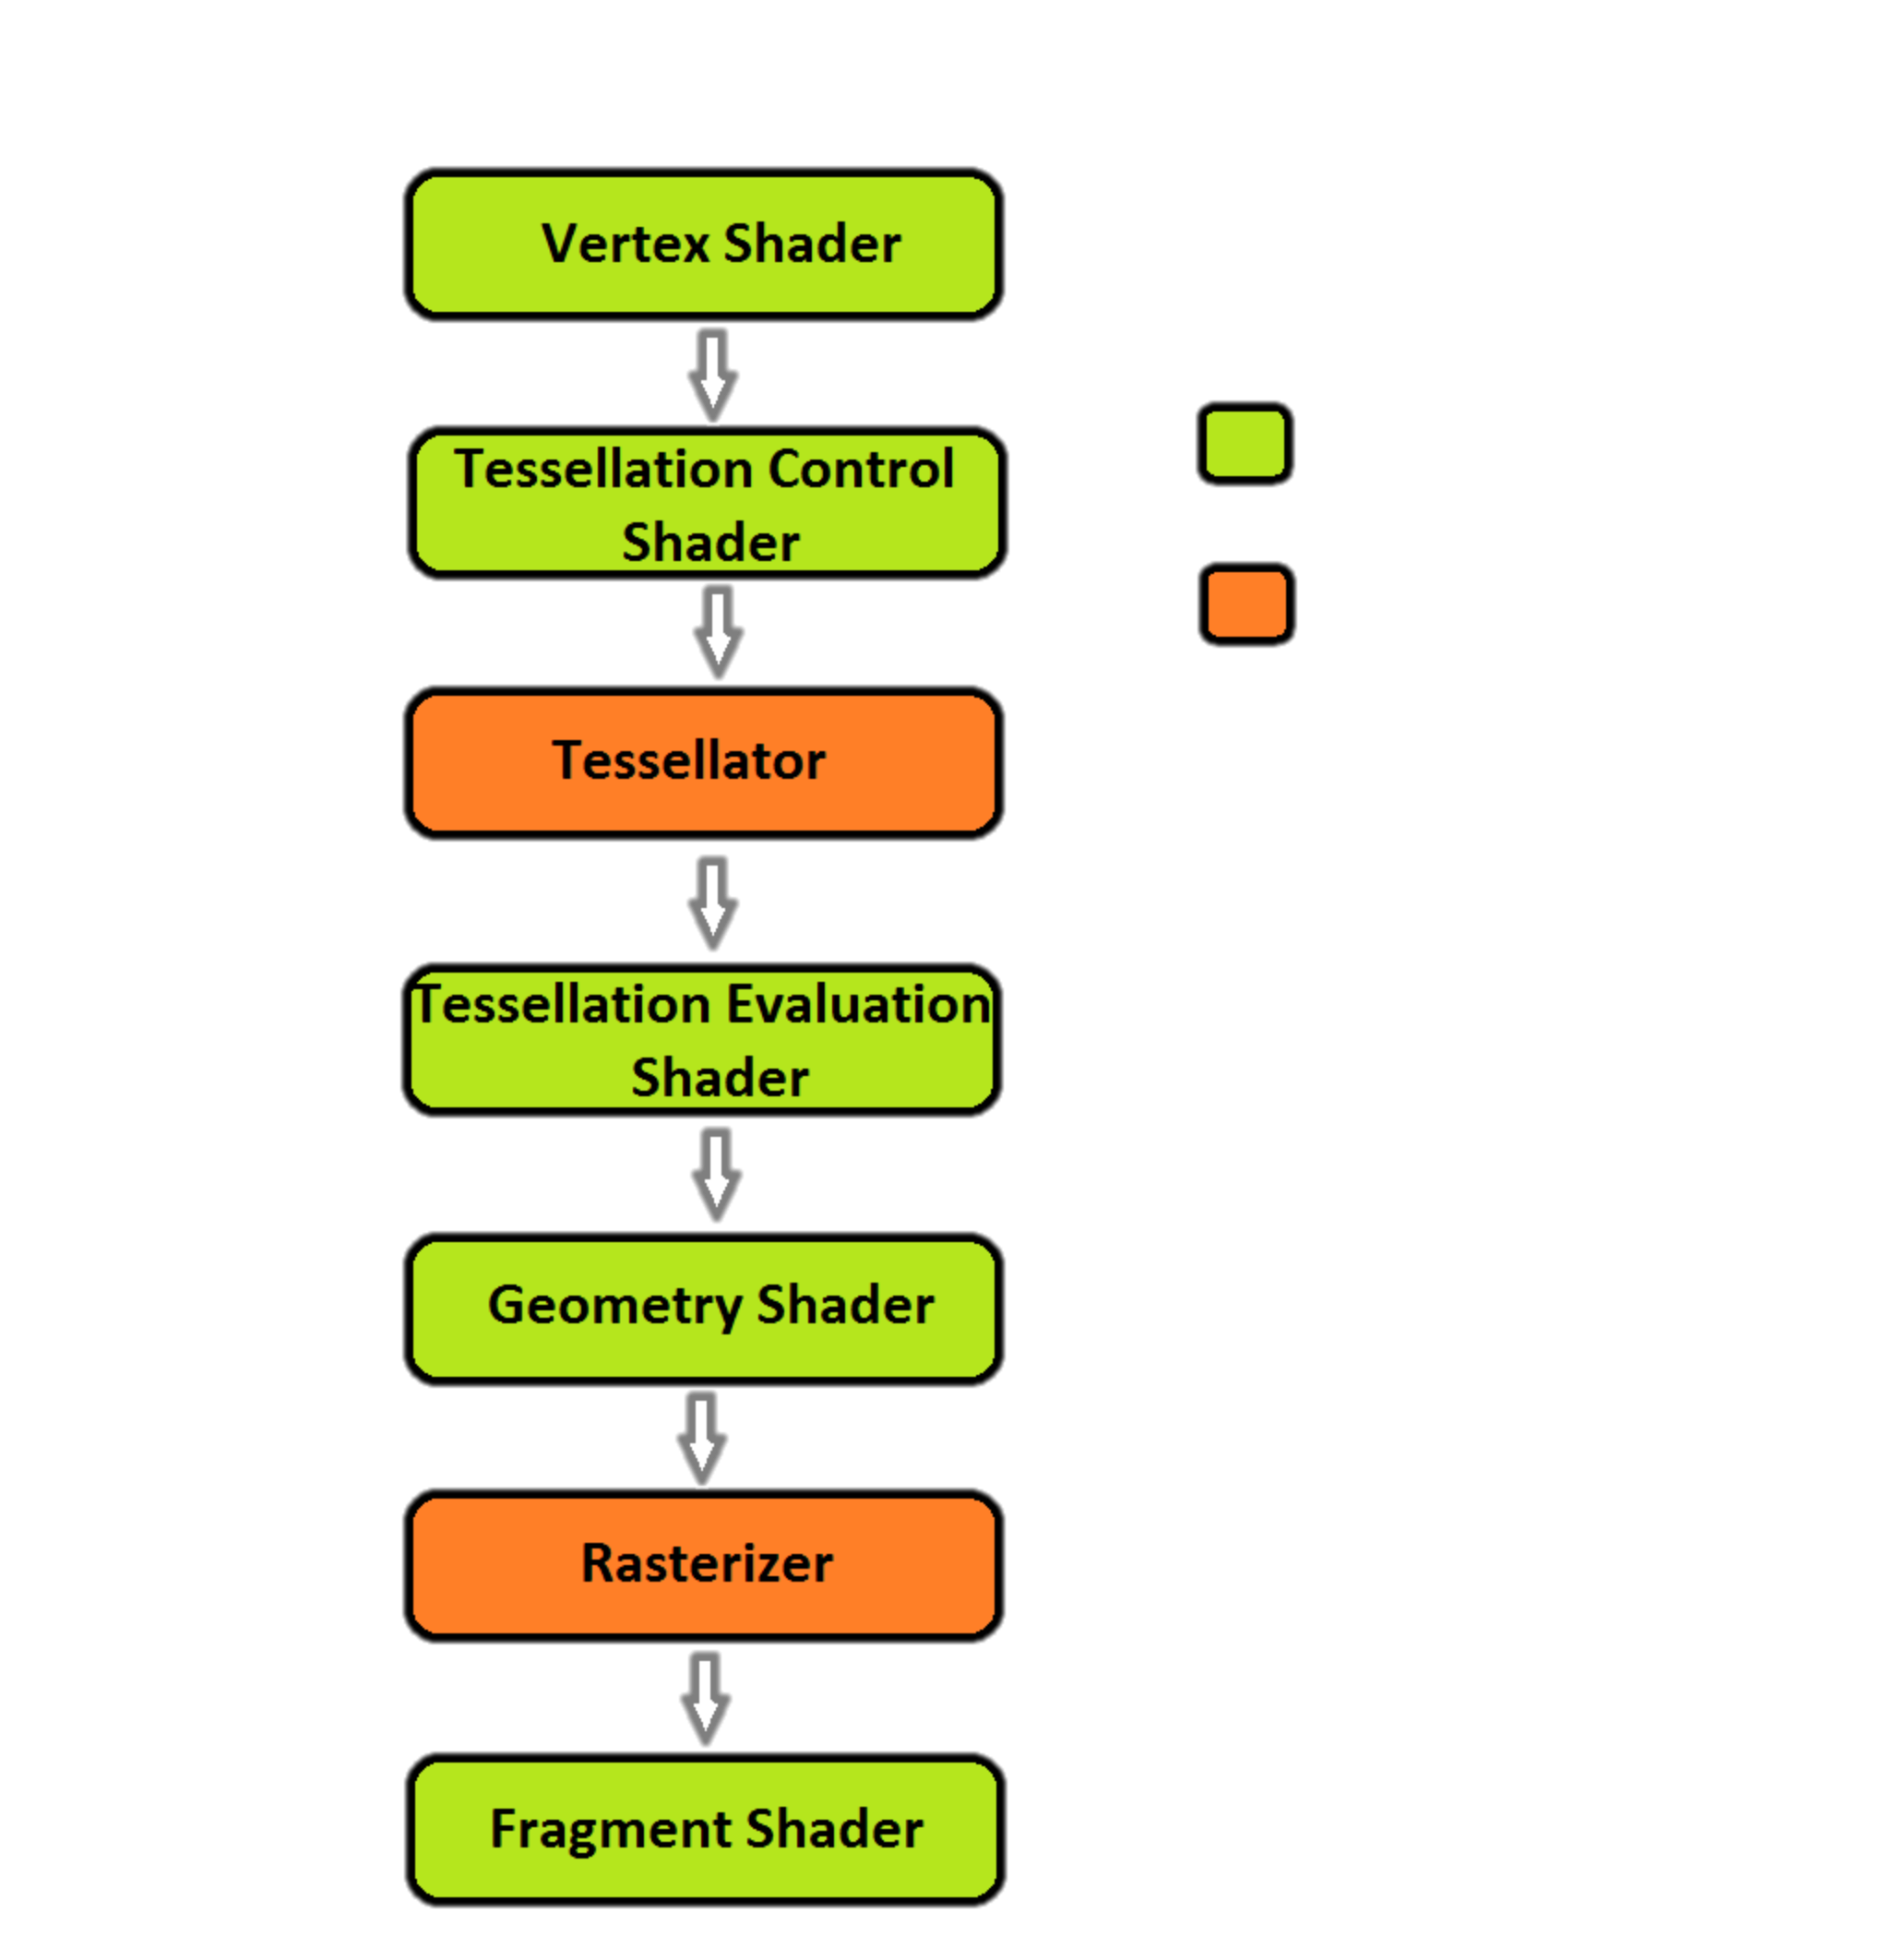
Tessellation
Tessellation Shaders
Tessellation Control
Shader (TCS)
Tessellation Evaluation
Shader(TES)
Control Parameters (Outer and Inner Tessellation Levels)
TCS sets values
Tessellator stage does actual tessellation
TES computes vertex coordinates
Programmable
Fixed

Slide 11
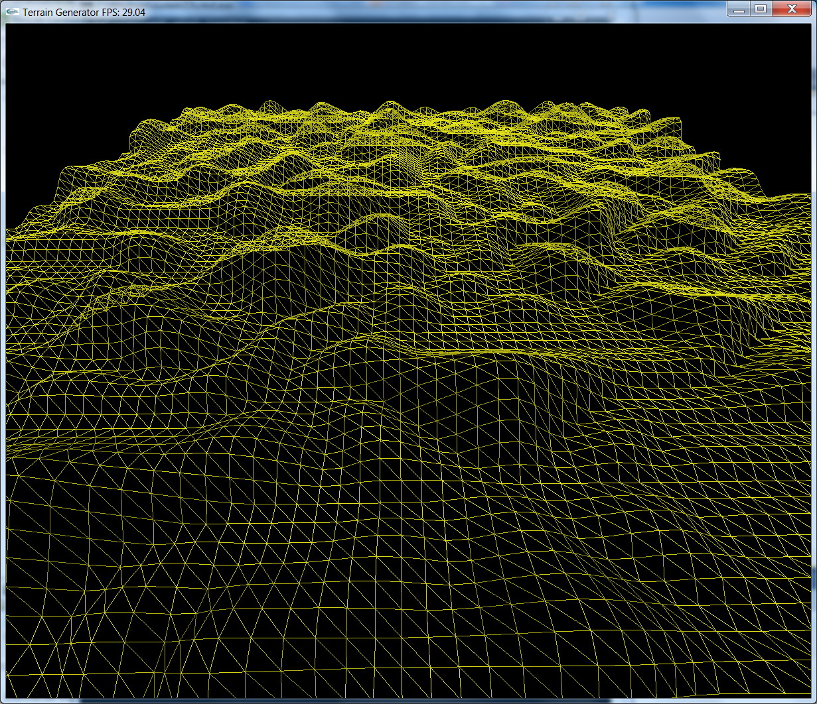
Tessellation
Non-Tessellated Mesh
Running at 30 fps

Slide 12
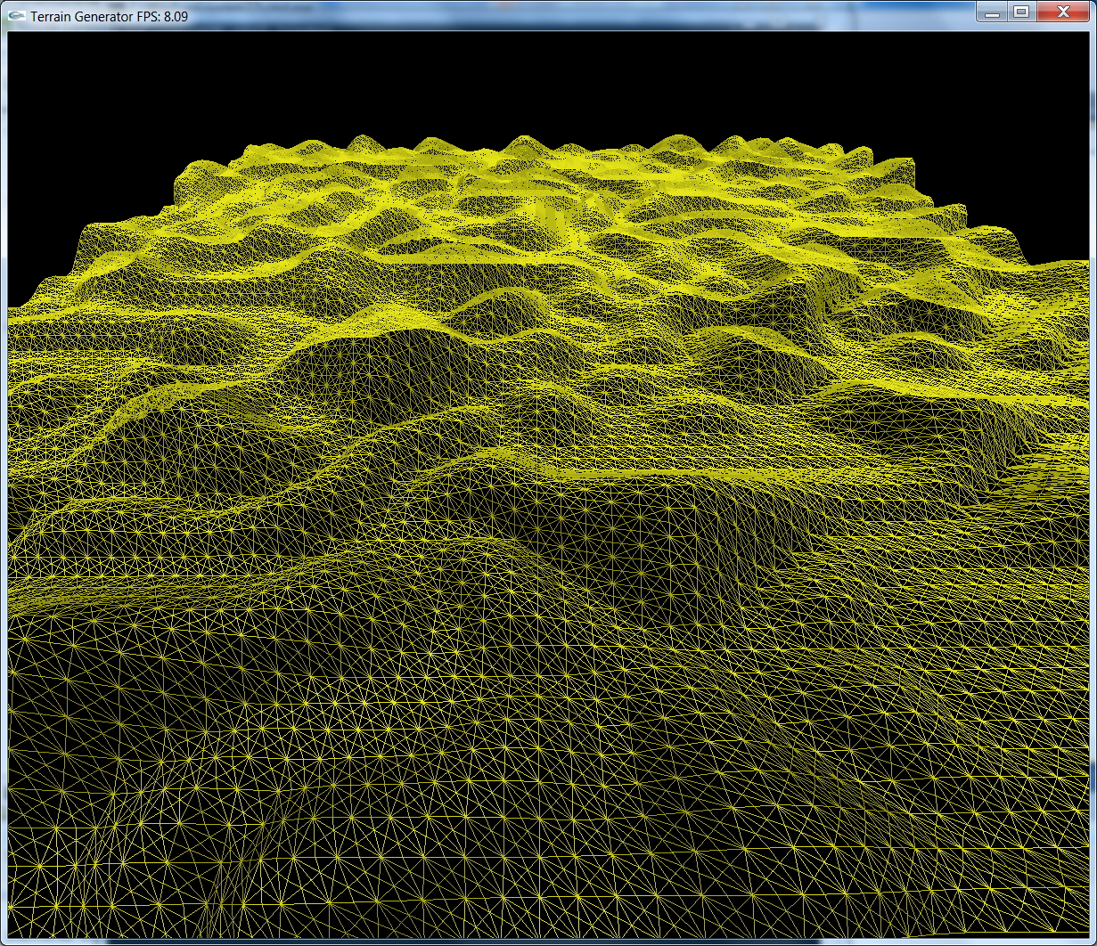
Tessellation
Outer Tessellation – 2, Inner Tessellation - 2
Running at 9 fps

Slide 13
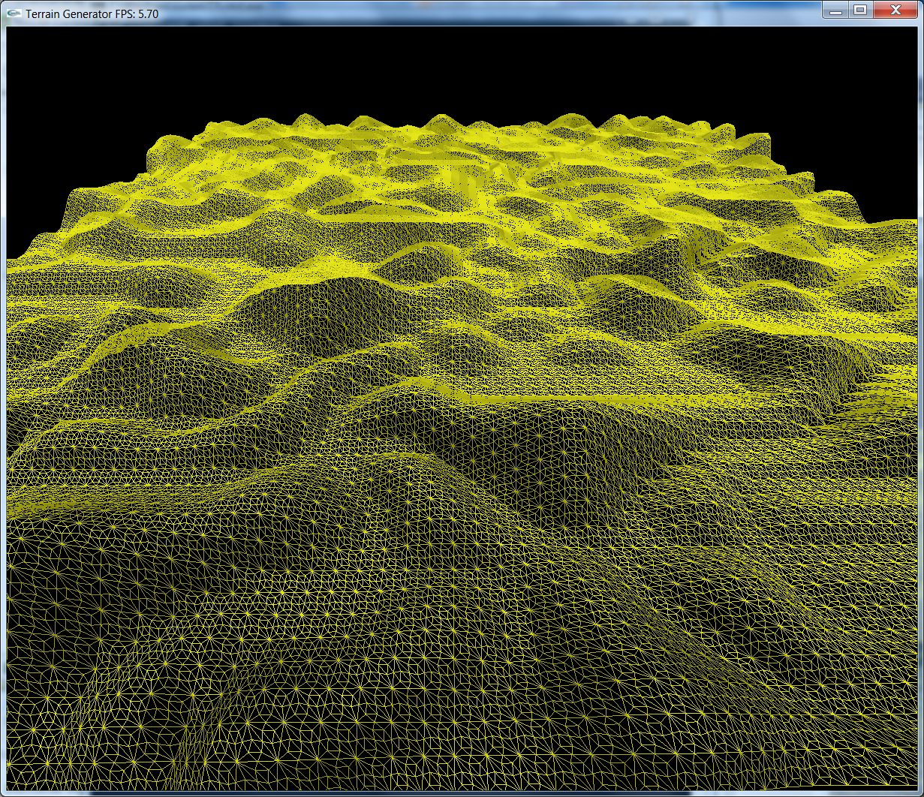
Tessellation
Outer Tessellation – 2, Inner Tessellation - 3
Running at 6 fps

Slide 14
Tessellation
Tessellation Shaders
Tessellation Control
Shader (TCS)
Tessellation Evaluation
Shader(TES)
Control Parameters (Outer and Inner Tessellation Levels)
TCS sets values
Tessellator stage does actual tessellation
TES computes vertex coordinates
Current State: No displacement of vertices after tessellation
Programmable
Fixed

Slide 15
Recap
Programmable
Fixed

Slide 16
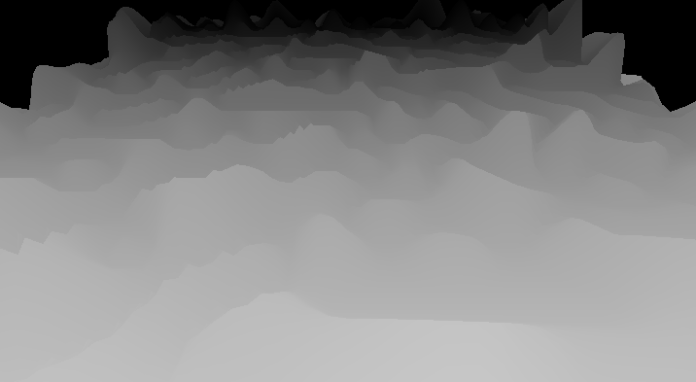
Depth
Shading based on depth from camera

Slide 17
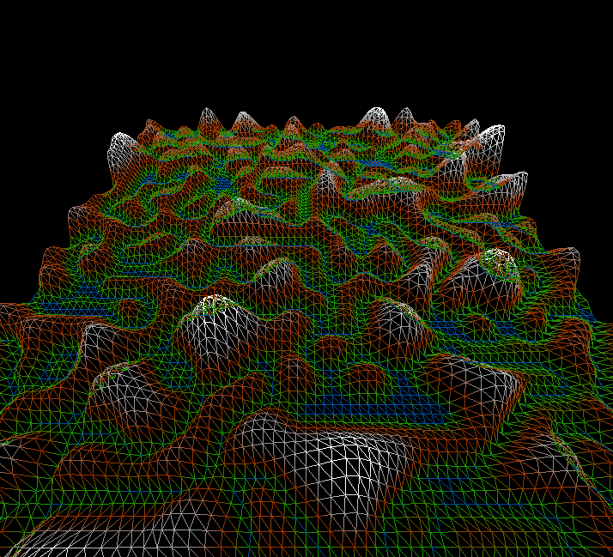
Terrain Height
Color based on height

Slide 18
Next Steps
Distance based tessellation
Displacement using tessellated vertices
Correct shading
Texturing
Different Noise functions

Slide 19
References
OpenGL Insights book
Texturing And Modeling – A Procedural Approach book
Perlin Noise (http://www.sci.utah.edu/~leenak/IndStudy_reportfall/Perlin Noise on GPU.html)
The Little Grasshopper blog (http://prideout.net/blog/?p=48)

Slide 20
Thank you

