Slide 1
OAS Graph
Core concepts

Slide 2











GraphQL receives increasingly attention & adoption
GraphQL is an emerging paradigm for data-centric web APIs
Single endpoint (instead of resource-centric endpoints in REST)
User sends type-checked data-queries
Backend resolves queries and returns only desired data
Why GraphQL?
Flexibility for (diverse) clients
Optimized payload-size
Less roundtrips
Documentation built-in
API evolution
Selected users…
Source: http://graphql.org/users
…and startups
…all “backend-as-a-service”

Slide 3

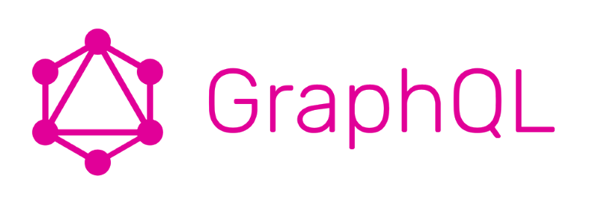
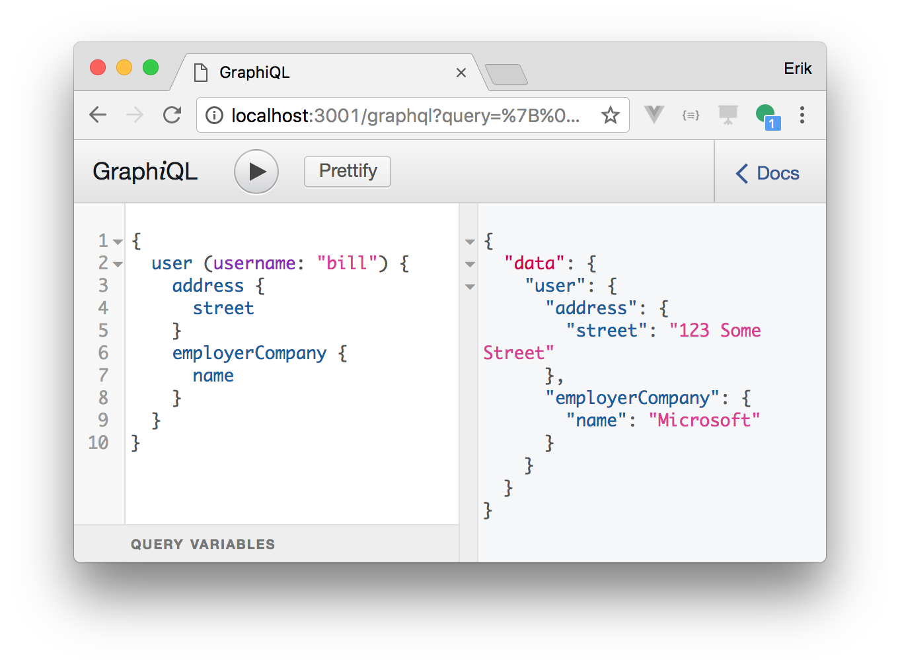
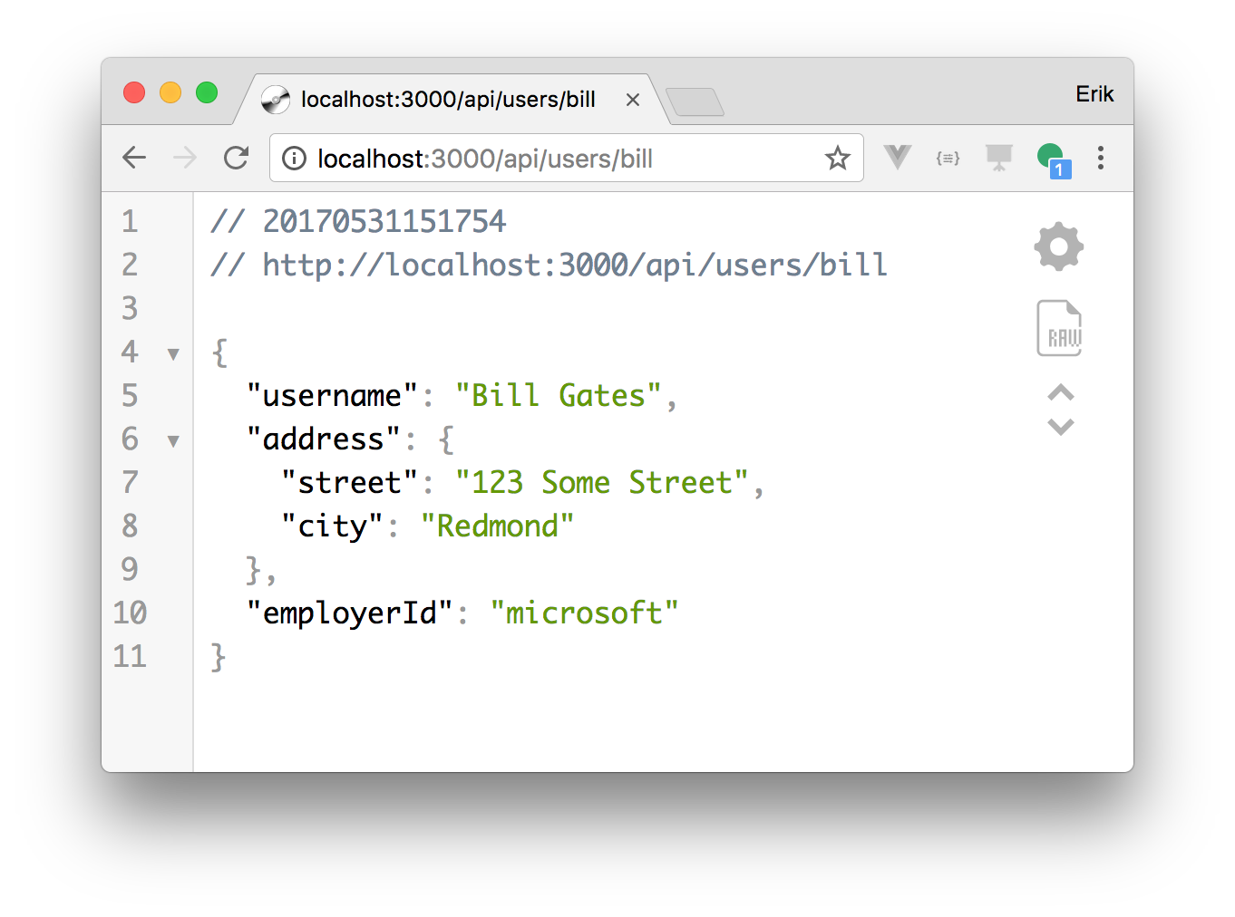
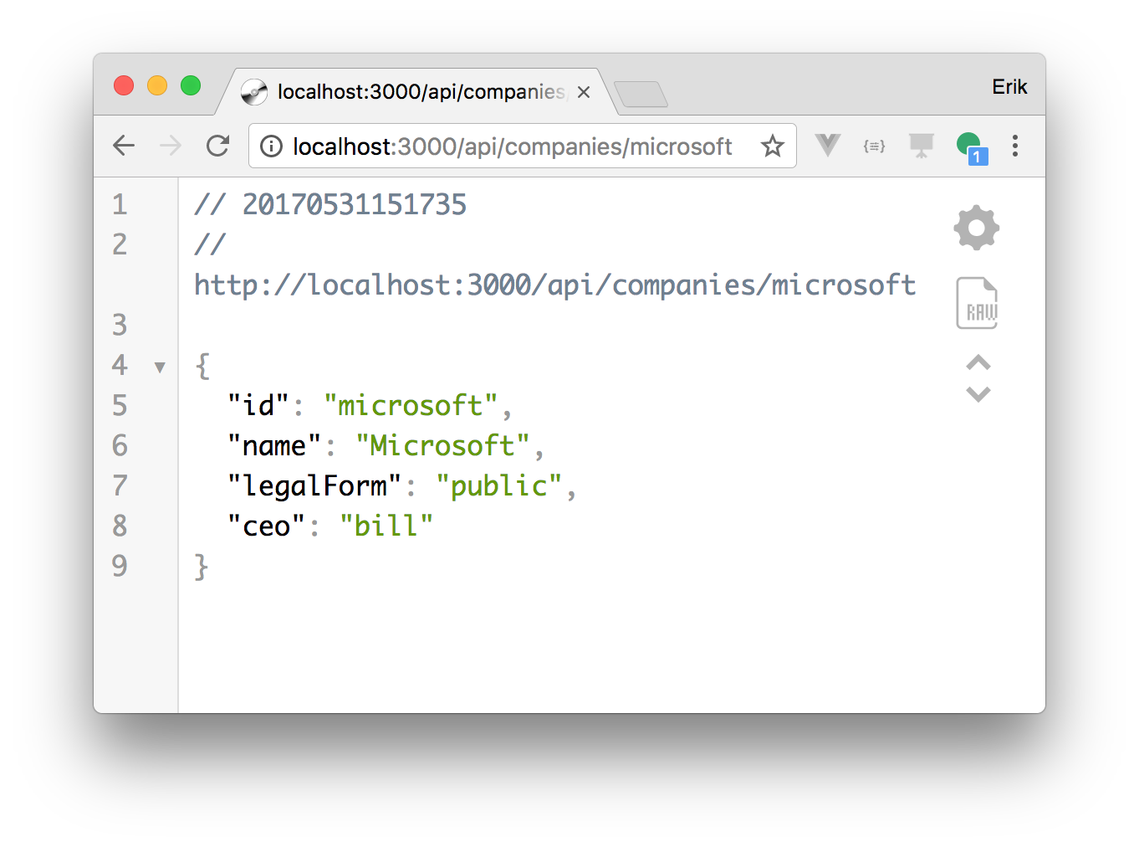
We work on automatically transitioning existing APIs to GraphQL
Automatic transition
Queries are automatically resolved as API calls
Data-centric transition
“Links” are translated to graph structure

Slide 4

Challenges and opportunities
<link>
Challenges…
Mutations (i.e., POST, PUT, DELETE…)
Authentication
Subscriptions
Defining links
…and opportunities
Automatic deployment of GraphQL interfaces to OpenWhisk
Composition of multiple APIs (using cross-API links)
<link>
<link>
Automatic transition

Slide 5
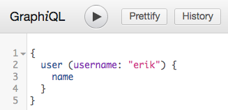
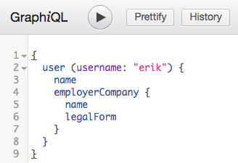
Images
...
/users/{username}:
schema:
type: object
properties:
name:
...
...
/users/{username}:
links:
employerCompany
...
/companies/{id}:
...

Slide 6
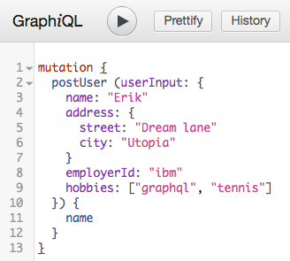
Images 2
...
/users:
post:
requestBody:
application/json
content
schema
$ref: user
...
API
1
GET /users/erik
2
GET /companies/ibm

Slide 7
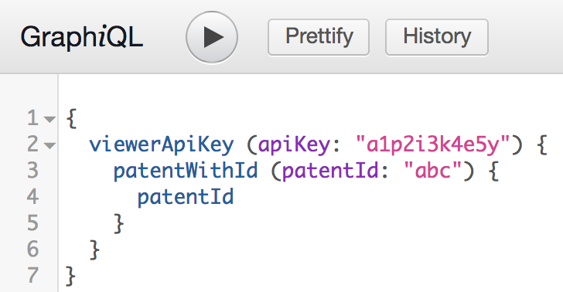
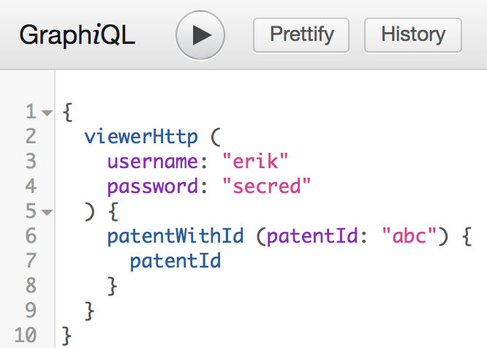
Images 3
API Key
Basic auth

