Slide 1

Odds of Unnatural Death: Historical Figures
Alan Fang

Slide 2
Research Question and Background information
Background information:
-Country (factor): categorized by 8 regions, Oceania, Caribbean, East Asia, Europe, Middle East, North America, South America, South Asia, Africa
-Occupation (factor): categorized by 5 groupings, activist, criminal, military/war, politics, and other
-Gender(factor): categorized by male or female
-Age of death(integer): age when the figure died
-Death year(integer/date); year when the figure died
-Manner of Death(Predicted value); 1 (unnatural cause of death) or 0 (natural)
Some Notes:
-Only the first 10,000 data points of 1.2 million were used
-The cleaned final dataset consists of 1457 datapoints with death years between 1900-2019

Slide 3
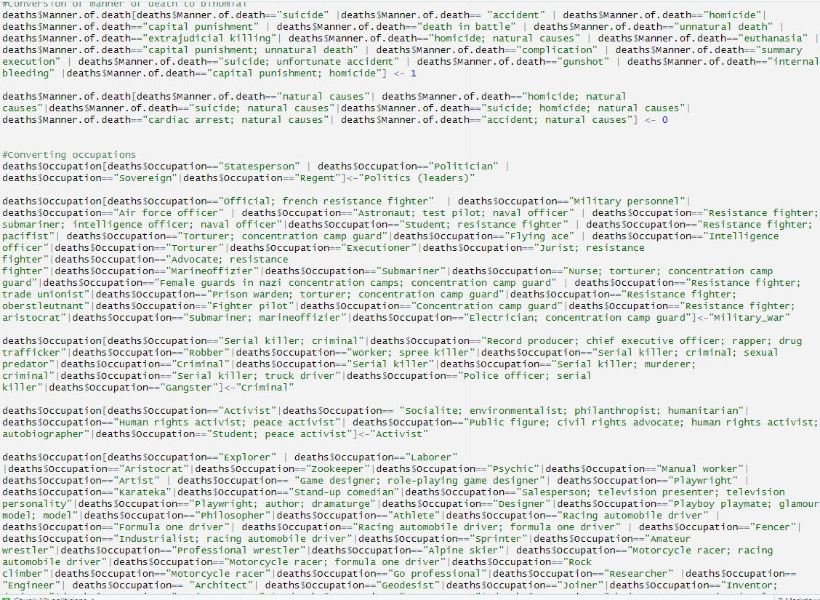
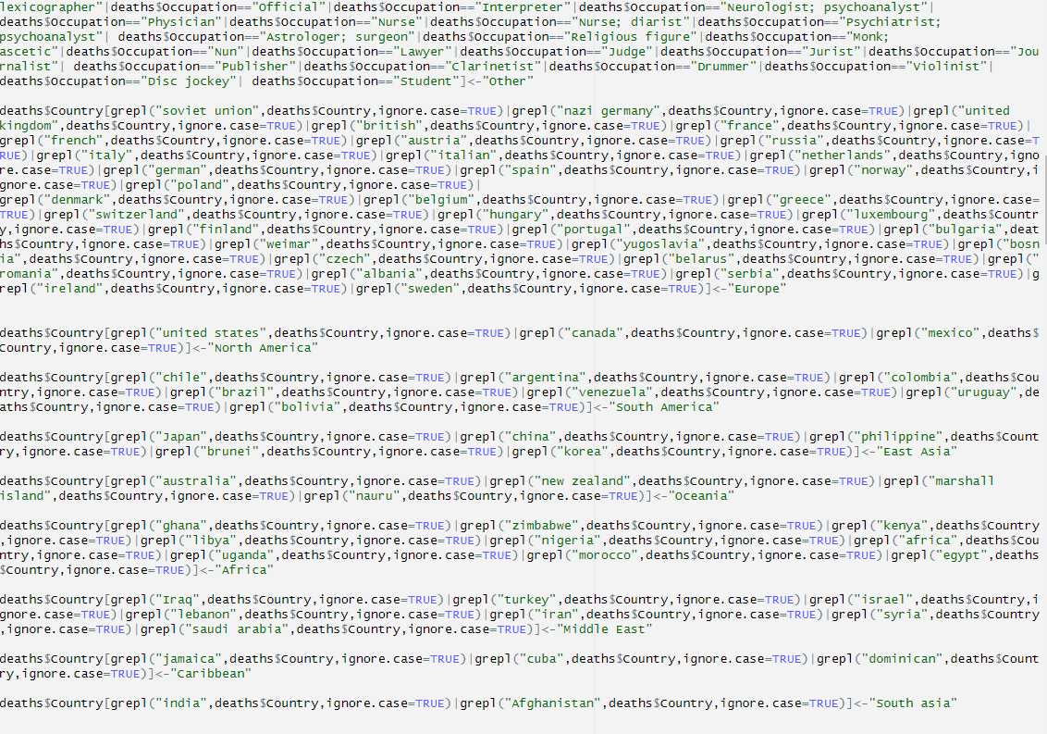
Data Cleaning

Slide 4
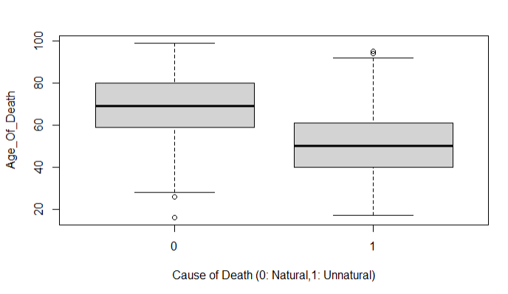
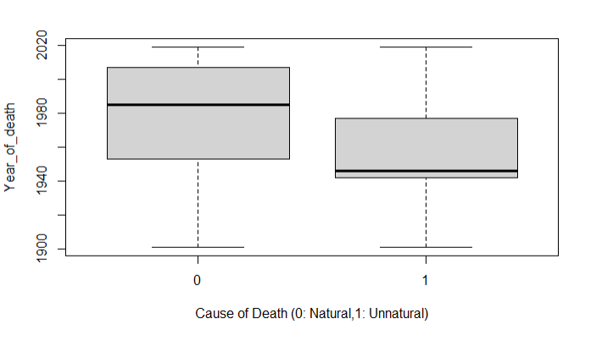
Exploratory Analysis
Plot 1. Age of Death versus Cause of Death
Plot2. Year of Death versus Cause of Death

Slide 5
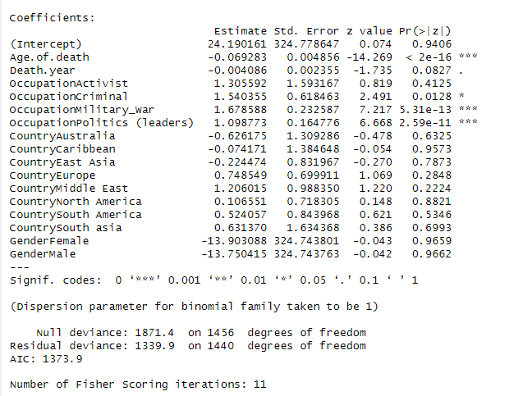
First Logistic Model

Slide 6
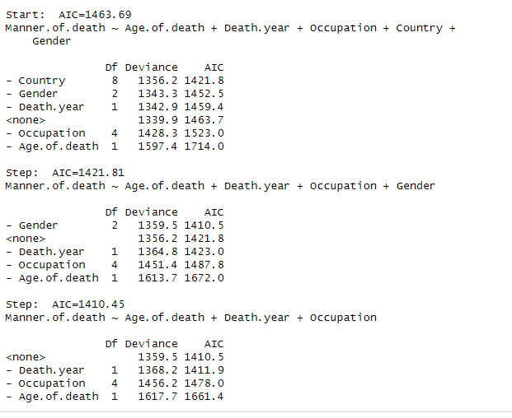
Variable Selection (backwards BIC)
Original 5 predictors:
>Country
>Gender
>Year of Death
>Occupation
>Age at Death
Final model predictors:
>Year of Death
>Occupation
>Age at Death

Slide 7
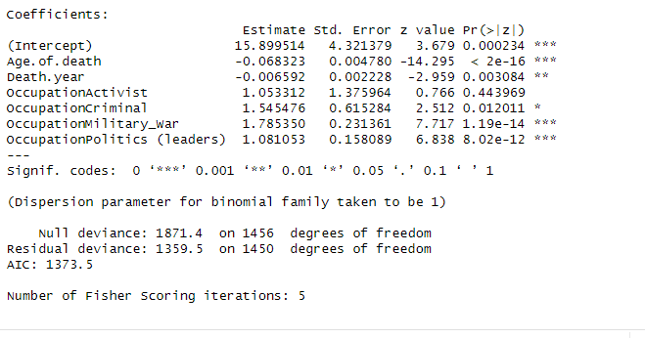
Model 2

Slide 8
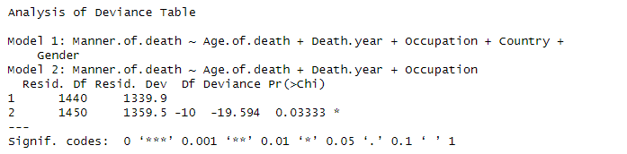
Anova comparison of models

Slide 9
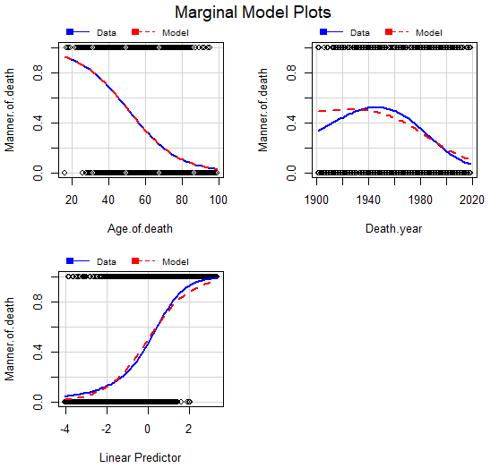
Marginal Model plots

Slide 10
Predictors and Odds (of dying unnaturally)
Per 1 unit increase in…
> age at death, odds decreases with a multiple of 0.934 times
>year of death, odds decreases with a multiple of 0.993 times
Compared to a normal occupation, if you are a…
>Activist, odds increases by 2.867 times (but not a significant predictor)
>Criminal, odds increases by 4.69 times
>Military/war (occupation), odds increases by 5.962 times
>Politician, odds increases by 2.948 times

Slide 11
Final Model and Predictions
Final model (model 2)
The median age at death: 63
The median year of death: 1972
Predicted odds of unnatural death
>Military: 0.5942
>Criminal: 0.5353
>Politician: 0.4199
>Normal: 0.1972
The average age of death (Canadians): 78
Year of average age of death: 2019
Predicted odds of unnatural death
>Military: 0.2838
>Criminal: 0.2373
>Politician: 0.1633
>Normal: 0.0607

