Slide 1
COCHIN UNIVERSITY OF SCIENCE AND TECHNOLOGY (CUSAT)
Department of Computer Applications • MCA Semester 3 Mini Project
Comparative Benchmarking of Genomic
Foundation Models for H1N1 Viral
Host Tropism Phenotyping
DNABERT-2 (117M) vs. RNA-FM (100M) — Linear Probing on Hemagglutinin Segment 4
Alan John Thomas (Lead / Track A / Benchmarking)
Viswajith K. V. (Track B / Deployment & Inference)
Meghna (Domain Virology / Metrics & Error Analysis)
Under the Guidance of:
1/16

Slide 2
OVERVIEW
Executive Summary & Research Hypothesis
Can self-supervised genomic foundation models decode zoonotic cross-species spillover risk
directly from raw, unaligned viral sequences without manual feature engineering?
OVERALL WINNER — DNABERT-2
AVIAN WINNER — RNA-FM
ENGINEERING — OFFLINE CACHING
88.46% Accuracy
96.08% F1-Score
< 2 Seconds
Macro-F1: 0.8832
+2.07% over RNA-FM
BPE codon-level encoding advantage
+1.87% over DNABERT-2
Only 4/113 misclassifications
Character-level SNP preservation
23,625 passes eliminated
Peak VRAM < 1.5 GB
RTX 3050 Laptop GPU
Speaker: Alan John Thomas
2/16

Slide 3
BIOLOGY
Biological Domain: Influenza A & Segment 4 (HA)
Hemagglutinin (HA) — Segment 4
Receptor Linkage → Host Tropism
• 8-segment ssRNA genome, error-prone RNA polymerase
• Segment 4 encodes HA (~1,700 bp glycoprotein)
• HA is the viral 'key' — binds sialic acid receptors on host cells
• 1918 Spanish Flu: 50M+ deaths from zoonotic spillover
• 2009 H1N1 pandemic: swine-origin reassortant
• Human: α-2,6-linked sialic acids (upper respiratory tract)
• Avian: α-2,3-linked sialic acids (waterfowl gut)
• Swine: BOTH α-2,3 and α-2,6 (trachea)
• Pigs = biological 'mixing vessels'
• Reassortment → novel pandemic strains
▶ Classifying Segment 4 (HA) directly predicts the virus's ability to infect humans.
Speaker: Meghna
3/16

Slide 4
MOTIVATION
Computational Paradigms: Why Foundation Models?
✗ Position Weight Matrices
✗ Multiple Sequence Alignment
✗ k-mer Frequency Counts
Assume statistical site
independence. Cannot model
epistasis (co-occurring
mutations at residues
190 + 225).
Scale O(N²) to O(N³) with
dataset size. Degrade with
insertion/deletion events.
Fragile on diverse viral
lineages.
Discard sequential position
order. Cannot capture
long-range 3D contact
folding or tertiary
structural dependencies.
✓ Self-Supervised Genomic Foundation Models
Pre-trained on millions of unaligned sequences via Masked Language Modeling (MLM).
Transformer encoders autonomously learn nucleotide grammar, thermodynamic stability,
and functional constraints — capturing non-linear epistatic dependencies across the full sequence.
Speaker: Meghna
4/16

Slide 5
FORMULATION
Mathematical Problem Formulation
Problem Definition
Multi-Class Cross-Entropy Loss
Multi-class classification:
f: s ∈ {A, C, G, T/U}* → Y = {Human, Swine, Avian}
Embedding: z ∈ ℝᵈ (d=768 DNABERT-2, d=640 RNA-FM)
Classifier: Linear(d, 3) → Softmax → Probabilities
ℒ = -(1/N) Σᵢ Σc yᵢ,c · log(p̂ᵢ,c)
N = batch size, C = 3 host classes
yᵢ,c ∈ {0,1} = one-hot label
p̂ᵢ,c = Softmax output probability
Primary Evaluation Metric: Macro-Averaged F1-Score
Macro-F1 = (1/3) × ( F1_Human + F1_Swine + F1_Avian )
• Unweighted average: treats all 3 host classes equally regardless of sample count
• Penalizes model if it fails on any single host — prevents majority-class reporting bias
• Critical for viral surveillance: avian reservoir detection is as important as human case classification
Speaker: Meghna
5/16

Slide 6
DATA ENGINEERING
NCBI Virus Data Curation Pipeline
1
Length QC
2
Ambiguity Filter
3
Host Dedup
4
Balanced Strat.
Retained full-length CDS
1,600 – 1,850 bp only
Discarded fragments
→
Rejected sequences with
> 0.5% unknown 'N' bases
Ensured clean reads
→
Eliminated cross-species
duplicates from farm
outbreak co-sampling
→
750 Human, 750 Swine,
750 Avian sequences
Exact class parity
Final Dataset Summary
Source: 65,282 raw records from NCBI Virus
After QC: 2,250 balanced, high-quality sequences
Training: 70% → 1,575 sequences (seed=42)
Validation: 15% → 337 sequences (seed=42)
Test: 15% → 338 sequences (seed=42, strictly unseen)
Speaker: Alan John Thomas
6/16

Slide 7
TRACK A
Track A: DNABERT-2 Architecture
Model Specifications
Parameters: 117 Million
Encoder Layers: 12 Transformer blocks
Hidden Dimension: 768
Pre-training Data: ~28 Billion base pairs (multi-species DNA)
Tokenization: Byte-Pair Encoding (BPE)
Vocabulary Size: 4,096 tokens
BPE Advantage:
Merges frequent nucleotide n-grams into subwords
1,700 bp → ~450 tokens (4× sequence compression)
Subwords frequently align with 3-letter amino acid codons
→ Single token = entire codon = protein-level semantics
⚠ Windows CUDA Fix (dnabert2/model.py)
Problem: DNABERT-2 hardcodes Triton GPU dependencies
→ TypeError on Windows CUDA 12.1
Solution: Bypassed Triton FlashAttention, activated
native PyTorch torch.matmul attention
→ Full GPU acceleration preserved
BPE Tokenization Example
Input: A T G G A A C T G A G T ...
BPE: [ATG] [GAA] [CTG] [AGT] ...
Met Glu Leu Ser
Each BPE token ≈ one amino acid codon
Speaker: Alan John Thomas
7/16

Slide 8
TRACK B
Track B: RNA-FM Architecture
Model Specifications
Parameters: 100 Million
Encoder Layers: 12 Transformer blocks
Hidden Dimension: 640
Pre-training Data: 23.7M non-coding ssRNA (RNAcentral)
Tokenization: Character-Level (A, C, G, U)
Position Ceiling: 1,020 characters
Position Encoding: Rotary (RoPE)
ssRNA Inductive Bias:
Models RNA secondary structure folding
Watson-Crick & G-U Wobble base-pairing
Hairpin loop detection from pre-training
Nucleotide Transcription (rnafm/dataset.py)
DNA input: A T G G A A C T G A G T
RNA output: A U G G A A C U G A G U
All Thymine (T) → Uracil (U)
Enforced 1,020-char position ceiling
Character-Level Advantage
1 nucleotide = 1 token = 1 fixed index
Zero subword boundary shifts
Point mutations retain exact positional
coordinates via RoPE embeddings
→ Critical for receptor-site SNPs (190, 225)
Speaker: Viswajith K. V.
8/16

Slide 9
SYSTEMS ENGINEERING
Systems Optimization: Offline Latent Caching
✗ The Problem: GPU Memory Bottleneck
✓ The Solution: Deterministic Caching
Self-attention complexity: O(L² · d)
Backpropagation through 12 layers × 1,700 tokens
Requires > 16 GB VRAM → OOM on laptop GPUs
Frozen backbone → deterministic embeddings
Epoch 0: Single pass with torch.no_grad()
Serialize to disk: train_emb.pt, val_emb.pt
Epoch 0
Cache
Epochs 1-15
Foundation Model
Forward Pass
(torch.no_grad)
Serialize z vectors
to train_emb.pt
& val_emb.pt
Load cached tensors
Train nn.Linear(d, 3)
only
→
→
PASSES ELIMINATED
TRAINING TIME
PEAK VRAM
GPU USED
Speaker: Alan John Thomas
9/16
23,625
< 2 seconds
< 1.5 GB
RTX 3050 Laptop

Slide 10
TRAINING PROTOCOL
Linear Probing Protocol & Hyperparameters
Why Linear Probing (Not Full Fine-Tuning)?
Hyperparameter Configuration
1. Scientific Rigor
Tests if pre-trained latent space is linearly separable
Fine-tuning 100M params on 2,250 sequences → overfitting risk
2. Isolation of Representation Quality
Conflation-free: measures foundation model, not tuning skill
Optimizer
AdamW (decoupled weight decay)
Weight Decay
0.01
Learning Rate
1e-3 → 1e-6
LR Schedule
Cosine Annealing
Epochs
15
Batch Size
16
Backbone
Frozen (all parameters)
Trainable Params
nn.Linear(d, 3) only
Training Architecture
Checkpoint Criterion
Peak Validation Macro-F1
Input Sequence
→ Frozen Foundation Model (no grad)
→ Cached Embedding z ∈ ℝᵈ
→ nn.Linear(d, 3) → Softmax
→ Cross-Entropy Loss → AdamW step
Random Seed
42 (fixed)
Speaker: Viswajith K. V.
10/16

Slide 11
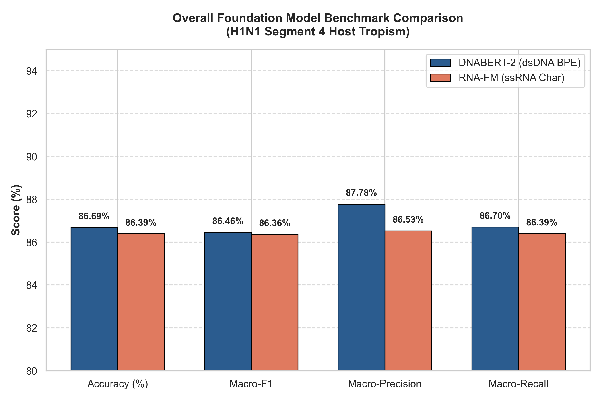
RESULTS
Empirical Benchmark Results
Evaluated on identical 338 held-out test sequences
Head-to-Head Comparison
Metric
DNABERT-2
RNA-FM
Test Accuracy
88.46%
86.39%
Macro-F1
0.8832
0.8635
Macro-Precision
0.8923
0.8664
Macro-Recall
0.8779
0.8640
DNABERT-2 wins overall (+2.07%)
BPE subwords capture codon-level
amino acid semantics in single
token embeddings.
Speaker: Alan John Thomas
11/16

Slide 12
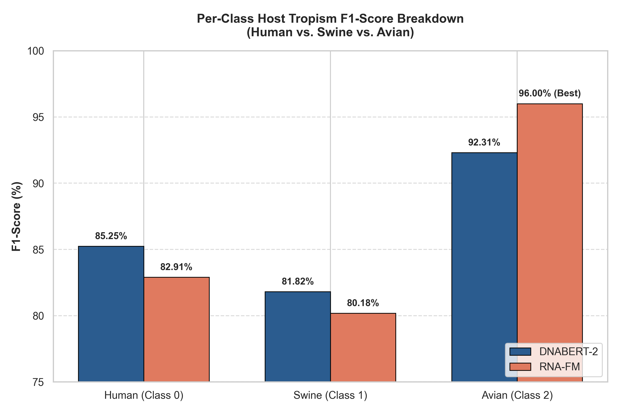
PER-CLASS ANALYSIS
Per-Class Breakdown & The Avian Discovery
The Avian Anomaly
DNABERT-2 Wins:
Human F1: 87.38%
Swine F1: 84.13%
RNA-FM Wins:
Avian F1: 96.08% (+1.87%)
Only 4/113 misclassifications
Why RNA-FM Wins on Avian:
1. Waterfowl = ancestral reservoir
Conserved ssRNA hairpin loops
match RNA-FM pre-training
2. Character-level tokens preserve
exact SNP positions (190, 225)
without BPE boundary shifts
Speaker: Meghna
12/16

Slide 13
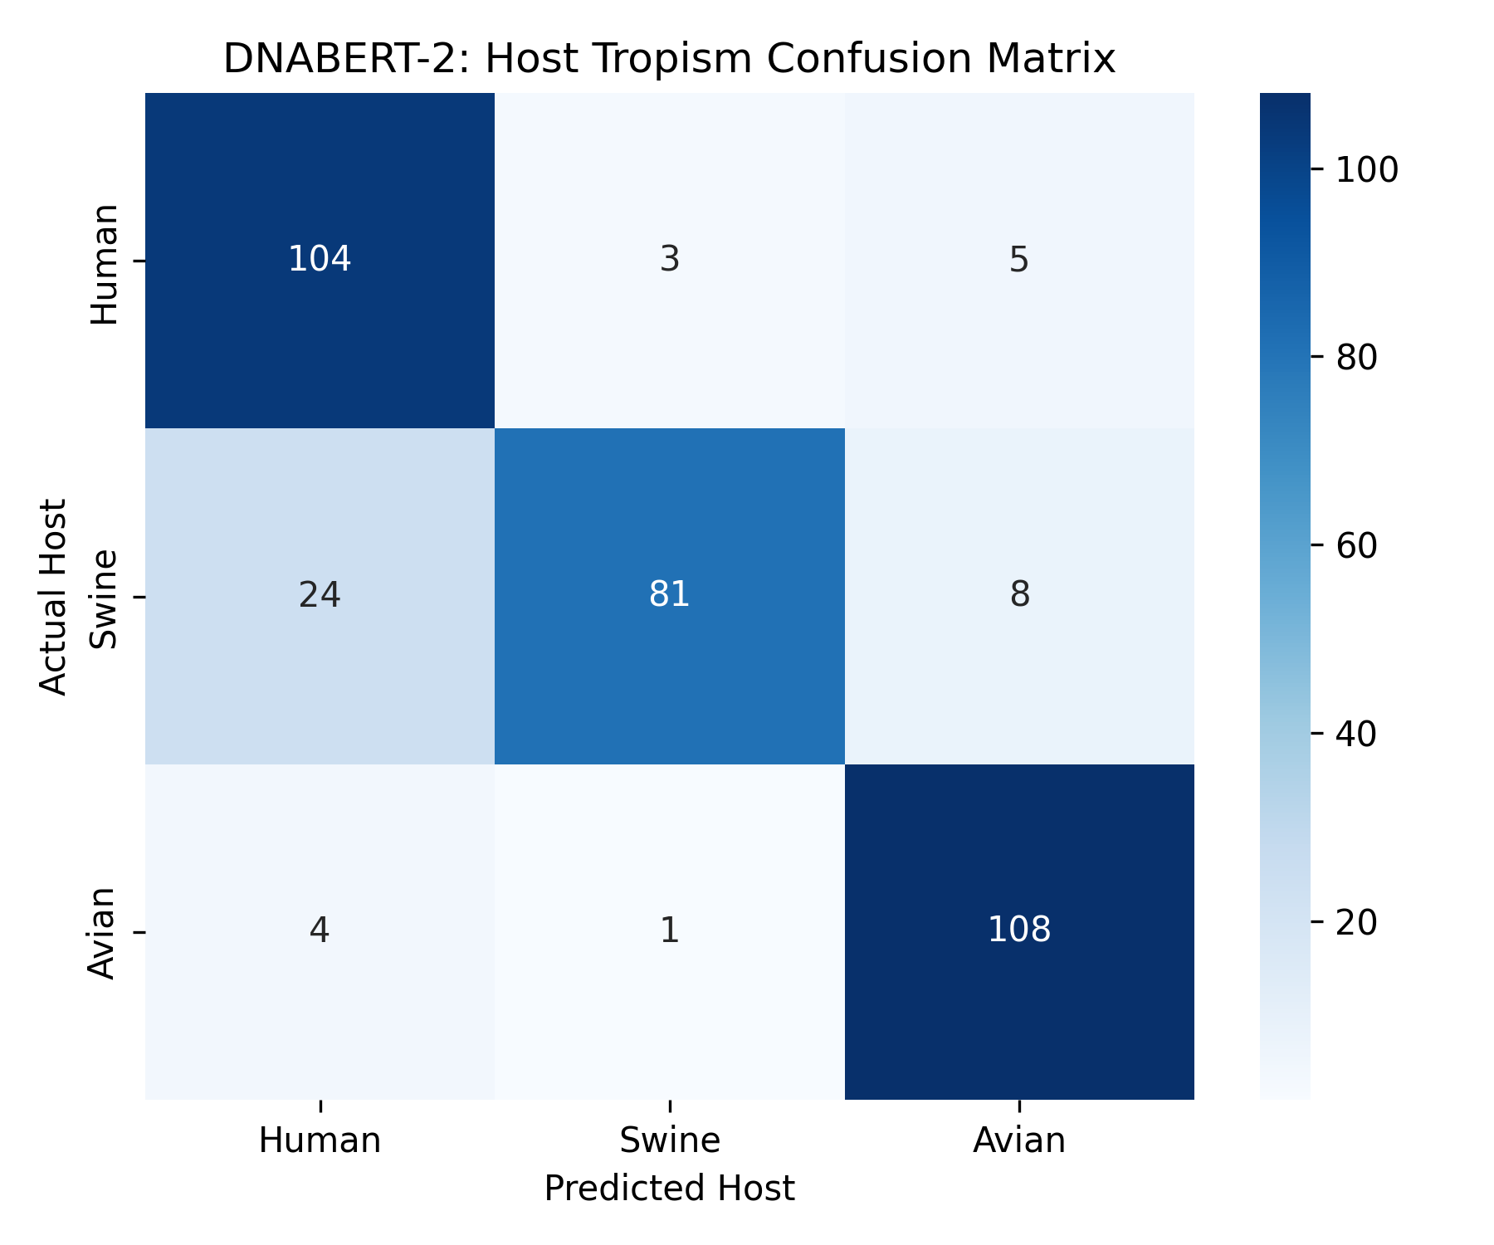
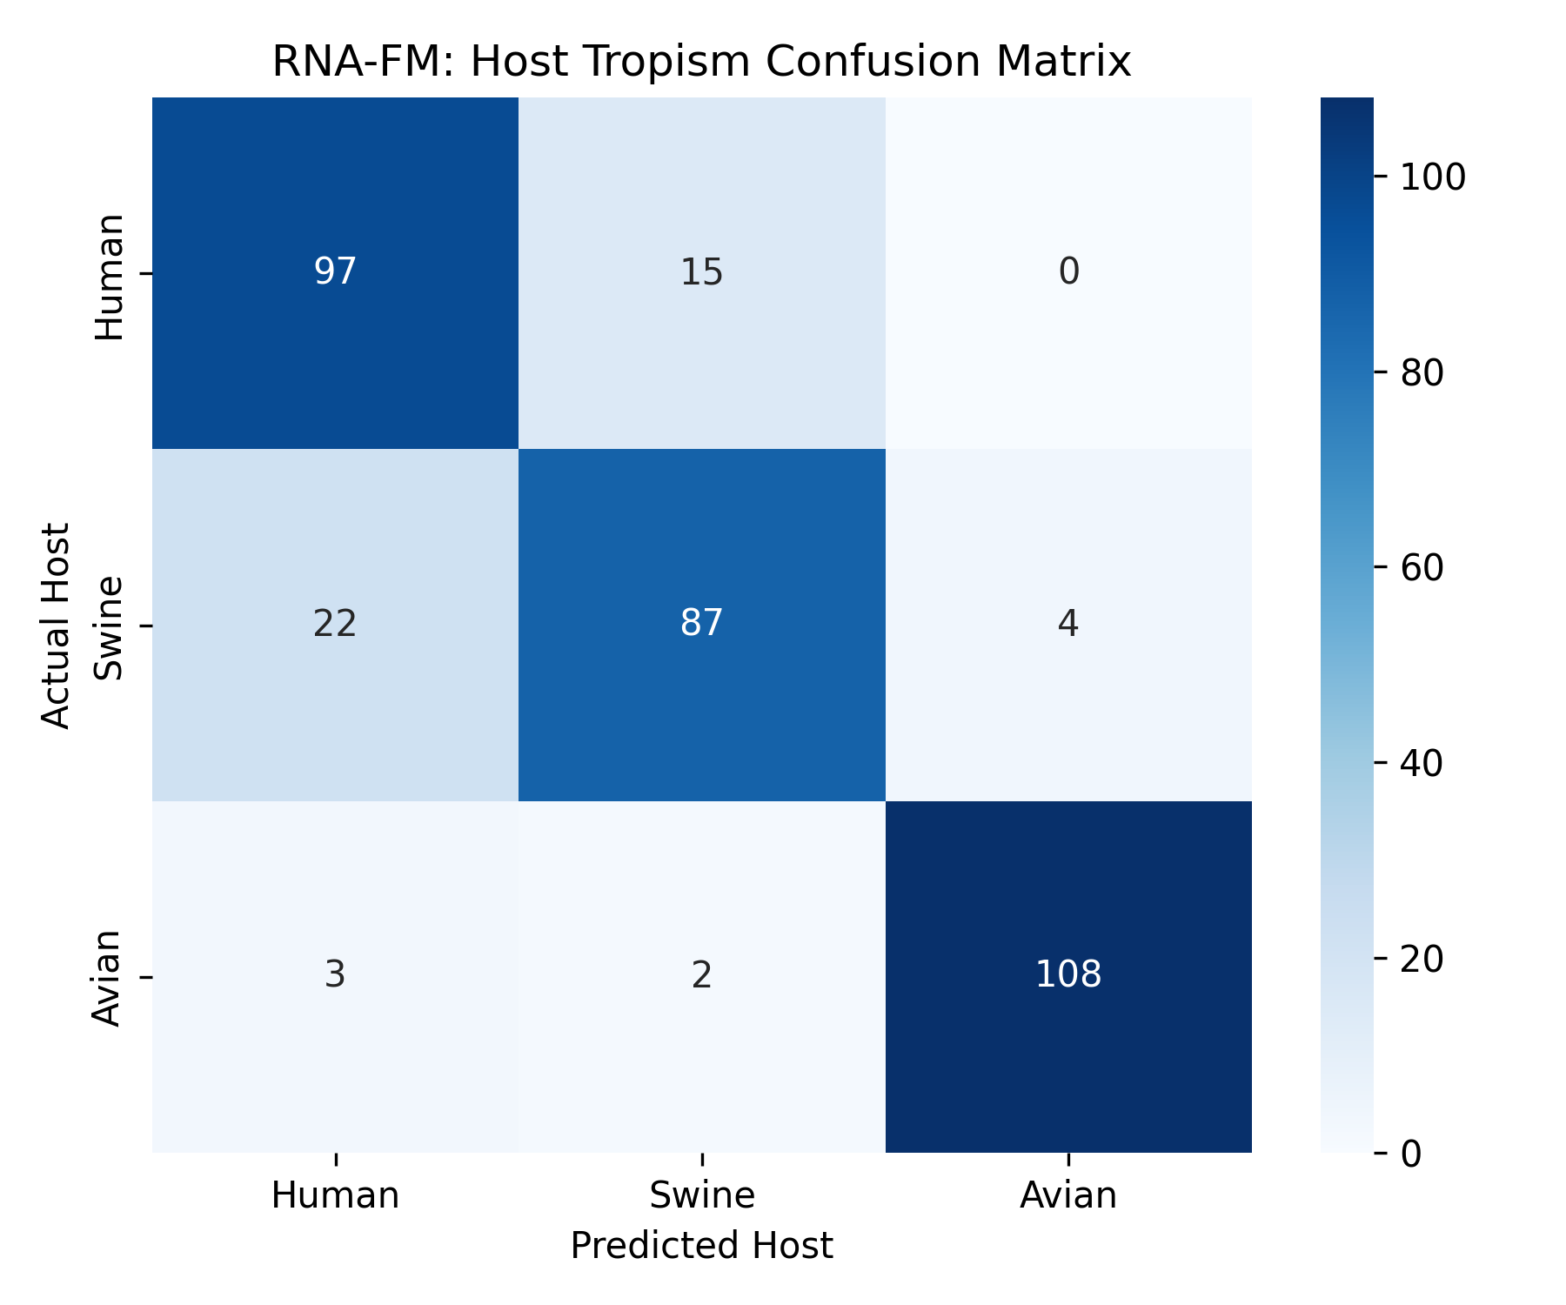
ERROR ANALYSIS
Error Analysis & Confusion Matrix Dissection
DNABERT-2 Confusion Matrix
RNA-FM Confusion Matrix
Primary Error Mode: Swine ↔ Human Confusion
Swine respiratory tissue expresses both α-2,3 and α-2,6 sialic acid receptors → continuous reassortment
with human strains. Their genetic boundary is an evolutionary spectrum, not a discrete partition.
Speaker: Meghna
13/16

Slide 14
LIVE DEMONSTRATION
Interactive Clinical Prediction Engine (predict.py)
● ● ● Terminal — predict.py
$ python predict.py --model rnafm --sample
[Sampling] Selected sample from test.csv: Accession MK844233.1
Loading pre-trained RNA-FM foundation model...
Loaded trained checkpoint: checkpoints/rnafm_best.pt
=================================================================
H1N1 VIRUS HOST TROPISM PREDICTION RESULT
=================================================================
Accession ID : MK844233.1
Sequence Length : 1701 bp
Model Used : RNA-FM (100M ssRNA Char)
Device : cuda
-----------------------------------------------------------------
PREDICTED HOST : SWINE (Confidence: 62.16%)
ACTUAL HOST : SWINE [CORRECT]
-----------------------------------------------------------------
Host Probability Breakdown:
- Human : [##########--------------------] 34.17%
- Swine : [##################------------] 62.16%
- Avian : [#-----------------------------] 3.67%
=================================================================
Speaker: Viswajith K. V.
14/16

Slide 15
SOFTWARE ENGINEERING
Repository Architecture & Engineering Practices
Project Directory Tree
Version Control & Reproducibility
h1n1-genomic-classifier/
├── src/
│ └── dataset.py # Data curation engine
├── dnabert2/
│ ├── model.py # Track A + Triton fix
│ ├── train.py # Training loop + caching
│ ├── evaluate.py # Test evaluation
│ └── dataset.py # BPE tokenization
├── rnafm/
│ ├── model.py # Track B wrapper
│ ├── train.py # Training loop + caching
│ ├── evaluate.py # Test evaluation
│ └── dataset.py # Char-level T→U
├── predict.py # Interactive CLI
├── benchmark_summary.py # Cross-model evaluation
├── requirements.txt # Pinned dependencies
└── environment.yml # Conda env spec
• GitFlow: feature branches → dev → main (release-tagged)
• Dependencies pinned: transformers==4.38.2
• Model weights & raw data isolated via .gitignore
• Fixed seed (42) for deterministic splits & training
• Open-source: all code, splits, and visualizers on GitHub
Key Dependencies
PyTorch
2.5.1+cu121
Transformers
4.38.2
RNA-FM
0.2.2
scikit-learn
Classification metrics
matplotlib
Visualization engine
CUDA
12.1 (RTX 3050 Laptop)
Speaker: Alan John Thomas
15/16

Slide 16
CONCLUSION & FUTURE WORK
Future Roadmap & Conclusion
Frozen genomic foundation models classify viral host tropism from unaligned sequences with over
88% accuracy. DNABERT-2 wins overall (+2.07%), RNA-FM wins on avian reservoir detection (96.08% F1).
Offline caching reduces 30-minute training to under 2 seconds on a consumer 6 GB GPU.
1
Multi-Segment Cross-Attention
2
3D Structural Validation
3
Edge Deployment
Fuse Hemagglutinin (Segment 4)
& Neuraminidase (Segment 6)
to jointly predict host tropism
& Tamiflu resistance.
Map transformer attention
weights onto RCSB PDB crystal
structures (1RU7, 3LZG) to
validate learned features.
INT8 post-training quantization
for Oxford Nanopore MinION
portable sequencers. Real-time
field surveillance without cloud.
Thank you. We welcome your questions.
Speaker: Alan John Thomas
16/16

