Slide 1


Stairs unlift
Alan Le Gourrierec
Ewan Pallavicini
Maxime Soulié

Slide 2

https://youtu.be/0ChvxxU6Hm8

Slide 3
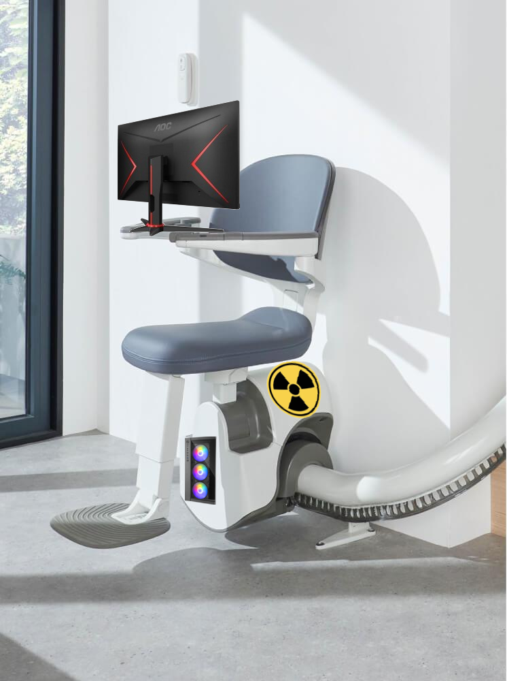
Why stairs unlift ?
Gamer computer powered by a RTX4090, 64Go RAM and Ryzen 7 7800X3D.
Fission reactor.
ROG Swift Pro PG248QP(24.1 inchs)
A chair (not important)

Slide 4

Ecological aspects
No need to call anymore the emergency service to save you
Of course, our device is nuclear powered
Old people don't fall anymore when they go down the stairs

Slide 5

Social aspects
Old people doesn't have fear anymore to take stairs lift.
Buy this to your parents and you don't have to see them anymore, their probably still alive.

Slide 6


Slide 7
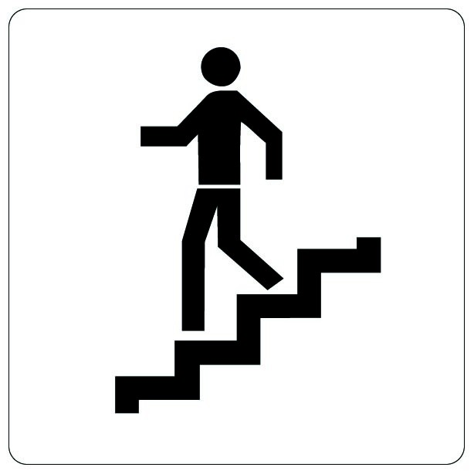
The company
created 1977
110 years after the mother company
So many old people stuck upstairs
High tech with nuclear engine
Learned from Stannah's errors
Older population → bigger market

Slide 8

The Cash
For 5% of our company, we only need 500k$ to save old people lock on top of their houses
Stannah follow us in this project (1.3M invested in R&D)
Withdrawal of reactor at client's death

Slide 9

You don't have questions.

Slide 10
Stairs unlift
Alan Le Gourrierec
Ewan Pallavicini
Maxime Soulié

