Slide 1
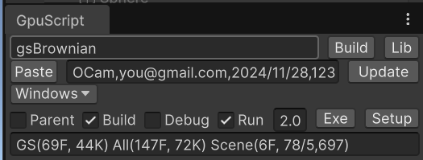
License
Compile Scene
Compile Library
Class Name
Update License
Paste License
Platform
Build Distribution Exe
Build in Parent Folder
Build Exe
Debug Build
Build Exe
Build Version
Run Exe after Build
# of files and lines of code

Slide 2
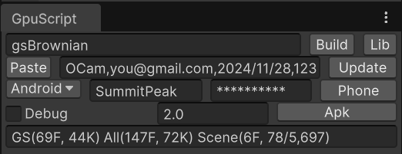
Class Name
License
Compile Scene
Compile Library
Update License
Paste License
Platform
Phone Folder
Debug Build
Build Version
Build APK
Publisher Company
Publisher Password
# of files and lines of code

Slide 3
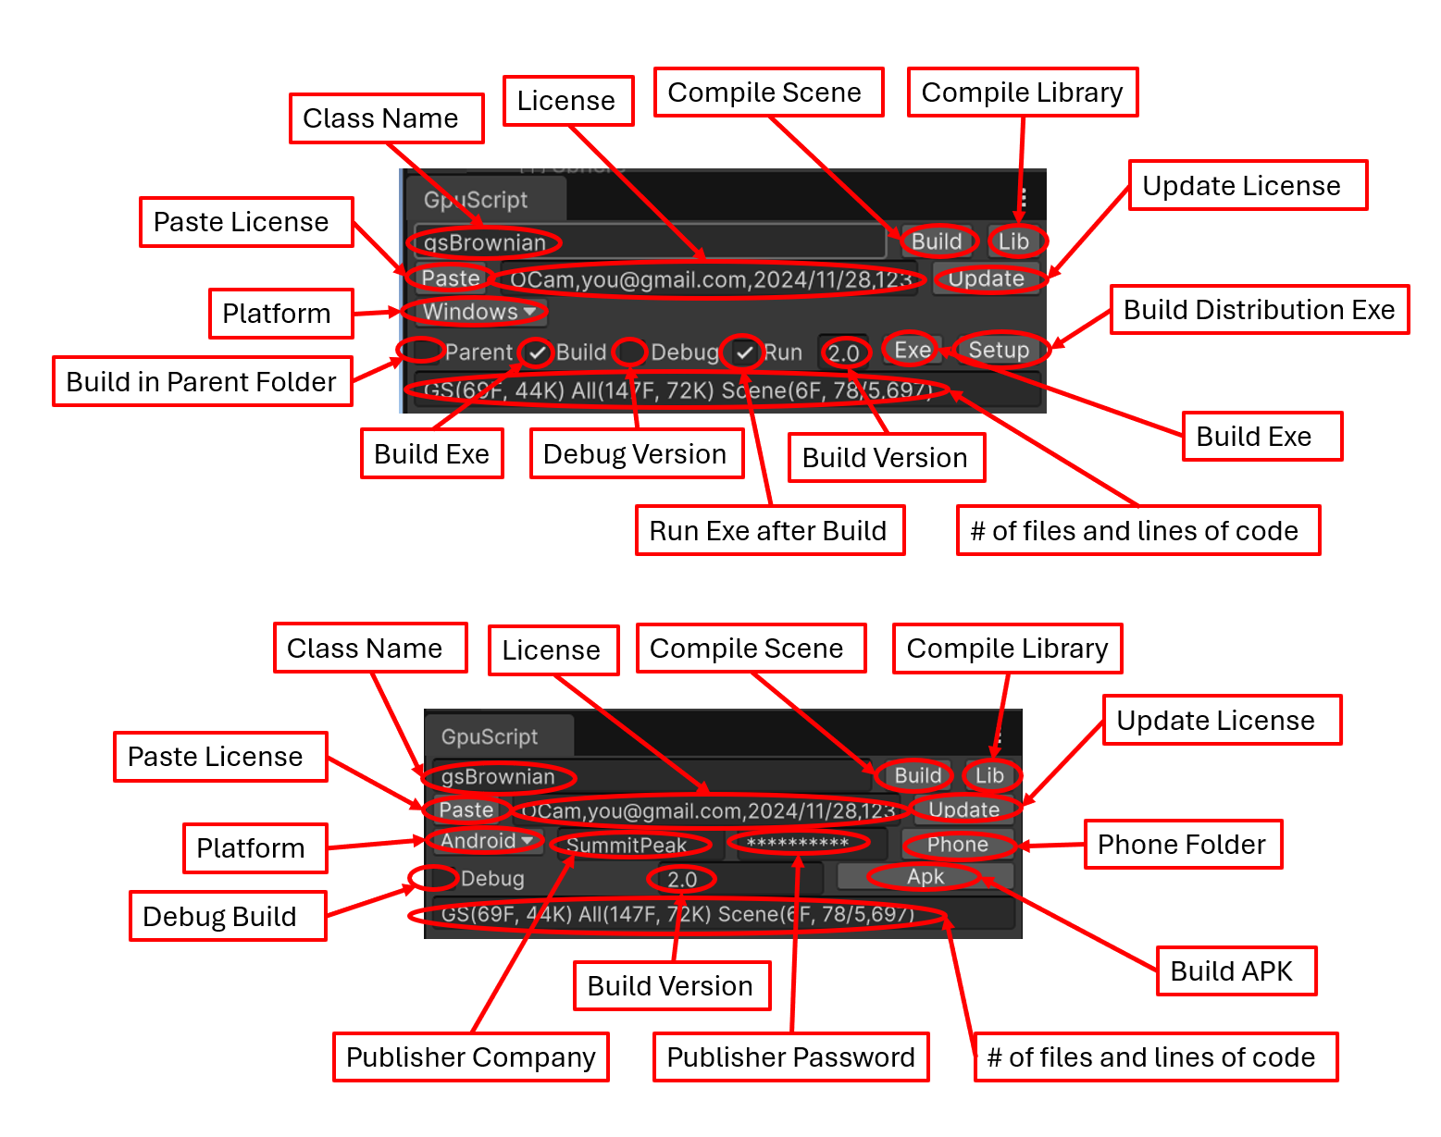
Notes:
GpuScript Unity Window at a glance: Create, copy, build, and rebuild projects instantly with a button click. Convert a project to a pre-compiled library. Update licenses for applications or libraries written with GpuScript from an email. Build and run the project executable and distribution version on Windows or connect your Android phone and build and run the same project as an APK.

Slide 4
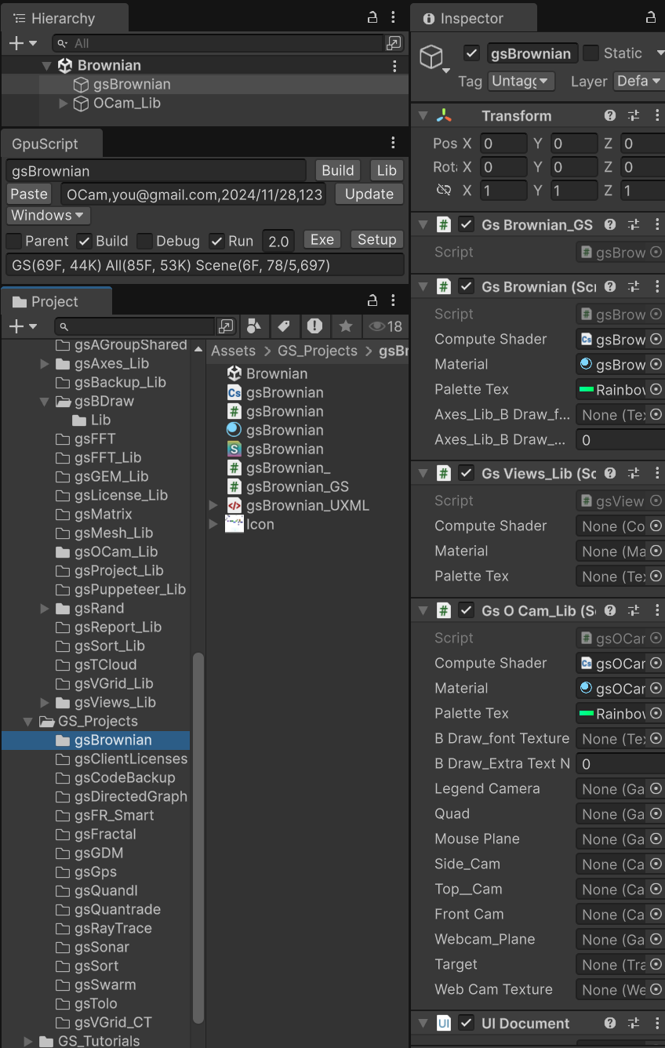
Scene automatically opened
Name automatically entered
Internal libraries
Click using the left-Alt key to only load project with library dependencies and remove all other projects.
Click empty folder to restore it, along with its library dependencies, without closing other projects
Click using the right-Alt key to restore all projects and libraries.
External libraries
Empty folders excluded, but may be restored with a click

Slide 5
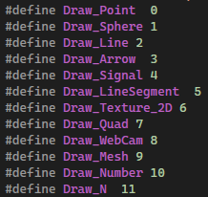
Declare an enum in the GS settings class
GpuScript generates the enum in the base class, with corresponding enum constants.
GpuScript generates the enum constants in both the compute and graphics shaders

Slide 6
Declare a vertex shader function in the GS settings class
GpuScript generates a virtual function in the cs base class
The programmer overrides the function in the cs class
GpuScript generates the graphics shader in HLSL, which doesn’t support C# statements, access modifiers, using functions before they are defined, OOP, etc.

