Slide 1
QuantumRescue
Ambulance route intelligence for Kochi
Classical routing today
Quantum optimization on the roadmap
Hackathon showcase / Research prototype
Notes:
Suggested opening: QuantumRescue explores how an ambulance route should account for road access and vehicle fit alongside travel time. Our current prototype combines OSRM routing with a transparent scoring and validation layer. QUBO and QAOA are planned experiments, not completed features.
Project sources: README.md; QuantumRescue_Implementation_Plan.md. Repository snapshot reviewed 1 November 2026.

Slide 2
The ambulance routing problem
Fast routes need
usable roads
Vehicle fit
Width, height and weight restrictions can rule out a candidate.
Changing conditions
Congestion and closures can change which alternative is preferable.
Prototype goal: compare routes and explain the choice.
02
Notes:
Frame this as the project’s design problem, not a measured claim about current emergency services. The prototype highlights known restrictions and uncertainty. Missing attributes remain unknown. It does not certify emergency suitability.
Project sources: README.md; QuantumRescue_Implementation_Plan.md. Repository snapshot reviewed 1 November 2026.

Slide 3
Our approach
01
Generate
OSRM returns road-network route candidates.
02
Enrich
Python joins OSM road attributes and simulated traffic.
03
Validate and rank
Reject known violations, then score feasible candidates.
04
Explain
Leaflet shows the selected route, alternatives and warnings.
Current stack: OpenStreetMap, OSRM, Python / FastAPI, Leaflet
03
Notes:
The routing engine proposes candidates. The Python layer adds project-specific intelligence without embedding a quantum algorithm inside OSRM. Current ranking compares the returned alternatives, so it does not prove a globally optimal path for custom costs. The existing frontend is a Leaflet application, not Angular.
Project sources: README.md; QuantumRescue_Implementation_Plan.md. Repository snapshot reviewed 1 November 2026.

Slide 4
Route scoring and constraints
Feasibility first
Then weighted cost
Known closures and access restrictions
One-way violations
Vehicle dimension limits
Estimated travel time
Optional congestion penalty
Unknown-width and surface penalties
Missing road attributes stay visible as uncertainty.
Traffic is simulated. Weights and penalties are experimental.
04
Notes:
The validator runs before ranking. Congestion affects travel time, and its separate score weight defaults to zero to avoid counting delay twice. Unknown width can be rejected with require_known_width, otherwise it carries a warning and suitability penalty. Restrictions cover a limited subset of conditions. No live traffic, clearance certification or validated operational ETA is claimed.
Project sources: README.md; QuantumRescue_Implementation_Plan.md. Repository snapshot reviewed 1 November 2026.

Slide 5
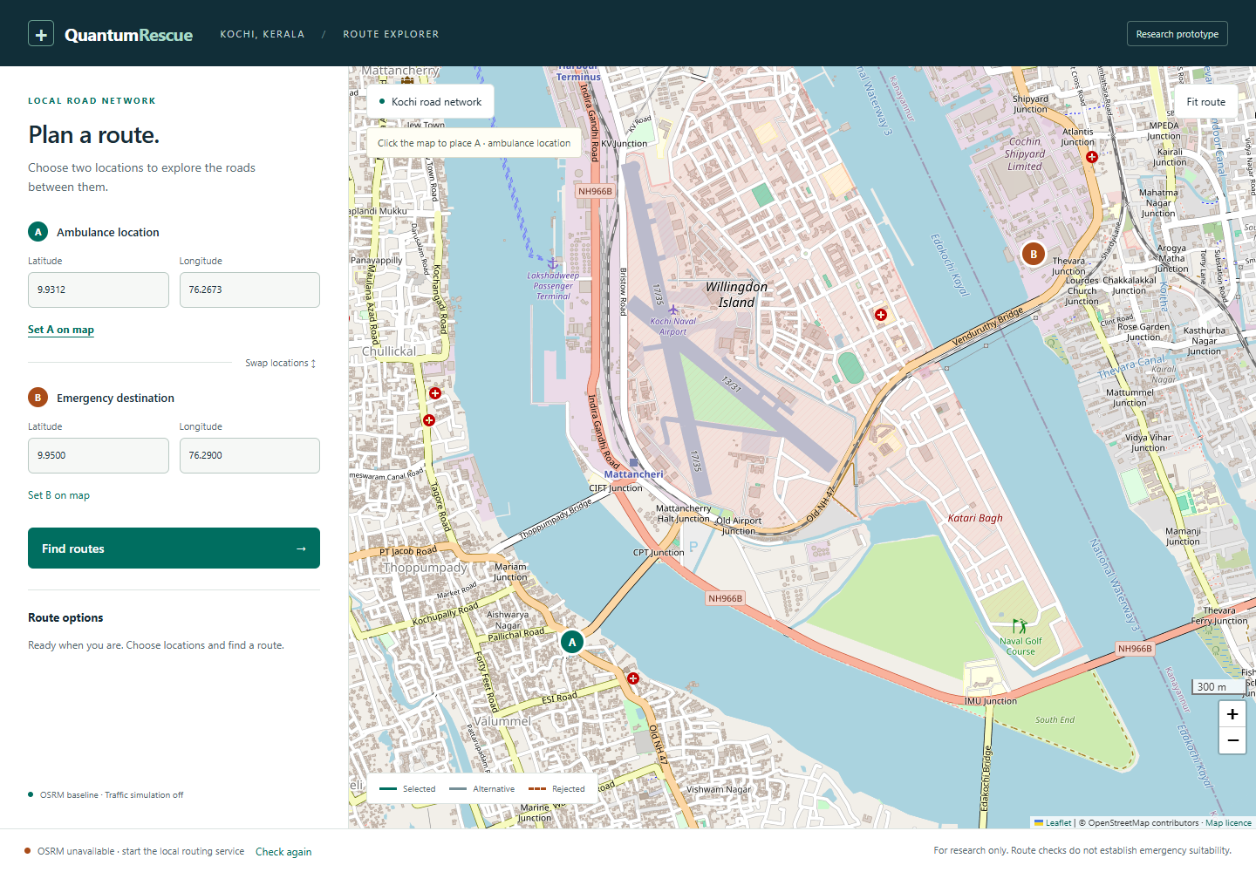
The working prototype
Built
Interactive Leaflet map
Location and coordinate inputs
Route inspection and error states
Classical scoring API
Next verification
Real Kochi routes through local OSRM after map preparation.
05
Notes:
Screenshot source: frontend/test-results/live-map.png. This is the actual interface with live OSM basemap tiles. The screenshot explicitly shows OSRM unavailable. Browser route interactions have been tested with mocked responses. Local OSRM preprocessing and live routing remain unverified in the project records. Map attribution: © OpenStreetMap contributors, https://www.openstreetmap.org/copyright, ODbL. Leaflet: https://leafletjs.com/.
Project sources: README.md; frontend/test-results/live-map.png. Repository snapshot reviewed 1 November 2026.

Slide 6
A road closure changes the selection
Synthetic offline demo
Before closure
After closure
20 sec
30 sec
Preferred route: osrm-0
Alternative route: osrm-1
The blocked baseline is excluded from fallback.
06
Notes:
Run: .\qiskit-env\Scripts\python.exe -m scripts.offline_demo. The run selected osrm-0 with estimated_time_s 20.0. Blocking directed segment 1:2 selected osrm-1 with estimated_time_s 30.0, and blocked_baseline_returned_as_fallback was false. These routes, IDs, attributes and times are synthetic. This demonstrates pipeline behavior, not Kochi travel times or a real-world benefit. Closures only filter available candidates and do not modify the OSRM graph.
Project sources: scripts/offline_demo.py; examples/osrm-demo-response.json; data/road_network/demo.json; observed offline demo output. Repository snapshot reviewed 1 November 2026.

Slide 7
The quantum experiment
Planned next
Small road graph
Binary edge choices
QUBO objective
Cost plus constraint penalties
QAOA with Qiskit Aer
Exact classical benchmark
Decode samples and reject invalid paths.
Compare feasibility, cost gap and runtime on the same graph.
QUBO and QAOA are not implemented yet. No quantum advantage claimed.
07
Notes:
Use binary edge variables with flow-conservation penalties. Start with a small graph and verify the QUBO optimum against an exact classical solution. Flow conservation can allow disconnected cycles, so explicitly detect or constrain those. Run shallow QAOA on Qiskit Aer, validate the samples and retain only feasible results. Compare identical costs, graph and constraints. Simulator experiments alone do not establish quantum advantage.
Project sources: README.md; QuantumRescue_Implementation_Plan.md. Repository snapshot reviewed 1 November 2026.

Slide 8
Roadmap and success criteria
Next
Verify local routing
Prepare Kochi map data and pass Route, Nearest and Table checks.
Then
Validate route intelligence
Check scoring and closure scenarios on real candidate routes.
After
Benchmark QUBO and QAOA
Compare feasible samples with an exact classical optimum.
Later
Explore a validated pilot
Add licensed traffic data and assess authoritative road coverage.
Target outcome: an explainable route comparison demo for Kochi
Research prototype. Operational use requires field validation and approvals.
08
Notes:
Close on the immediate milestone: two Kochi locations produce real OSRM route geometry through FastAPI. Later success means transparent cost breakdowns and a fair quantum comparison, not an assumed speedup. A pilot would require emergency-service partners, authoritative constraints, field validation and operational approval. The roadmap indicates sequence, not a committed delivery schedule.
Project sources: README.md; QuantumRescue_Implementation_Plan.md. Repository snapshot reviewed 1 November 2026.

