Slide 1
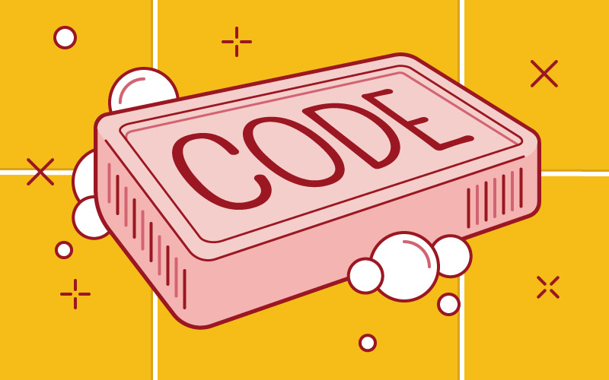

Slide 2
What is clean code?
“Clean code is code that has been taken care of. Someone has taken the time to keep it simple and orderly. They have paid appropriate attention to details. They have cared.”
But why should you care? Why take the extra time to make your code clean, when you can just bash it out and win brownie points from your Delivery Manager for getting it done in half the time?
You should care because code is never written just once and then forgotten. Most of the time you, or someone else, need to work on the code. And to be able to work on it efficiently you need to understand the code.

Slide 3
What is clean code?
I'm sure we've all come across a time where we've opened up a piece of code and sat there for minutes on end, trying to figure out just what the hell it's supposed to be doing.
The worst instances are when you you sit there thinking "who wrote this pile of garbage?", only to realise after a few minutes that it was you.
That's UNclean code, and that's exactly what we want to avoid. We want code that when you open it up, even if you've never seen it before, it's instantly apparent what it does, and how it does it.

Slide 4
Clean code is code that is easy to understand and easy to change.
It is easy to understand the execution flow of the entire application
It is easy to understand how the different objects collaborate with each other (for 'objects you could also say 'stored procedures', or functions, or even triggers)
It is easy to understand the role and responsibility of each class / stored procedure
It is easy to understand what is the purpose of each expression and variable

Slide 5
Easy to change means the code is easy to extend and refactor, and it’s easy to fix bugs in the codebase.
This can be achieved if the person making the changes understands the code and also feels confident that the changes introduced in the code do not break any existing functionality. For the code to be easy to change:
Classes and methods (or sprocs and functions) are small and only have a single responsibility
Classes have clear and concise public APIs
The code execution is predictable and works as expected
It must have unit tests, and those tests are easy to understand and easy to change

Slide 6
Why are unit tests essential here?
Go back to the talk on TDD - as long as you have green lights across the board (i.e., all your tests are passing) then you know that any changes you've made haven't broken that piece of functionality.
If you write clean code, then you are helping your future self and your co-workers. You are reducing the cost of maintenance of the application you are writing. You are making it easier to estimate the time needed for new features. You are making it easier to fix bugs. You are making it more enjoyable to work on the code for many years to come. Essentially you are making the life easier for everyone involved in the project.

Slide 7
So what makes clean code?
Single Responsibility Principle
Don't repeat yourself (DRY)
These 2 combine together to ensure that the modification of any single element of my code does not require any change in any other logically unrelated elements
KISS
YAGNI
Do not add functionality until deemed necessary. AKA "do the simplest thing that could possibly work"
It should have minimal dependencies
Smaller is better
UNIT TESTS!!!!!

Slide 8
Code should be expressive
“Self-documenting code”:
Use meaningful names - always use good, unabbreviated, correctly-spelled meaningful names.
This counts for variables, classes, functions, sprocs, methods, whatever.
The name should reflect what it does, be descriptive, and be unique.
If I have a counter variable called 'i', how many instances of this could I find if I have to do a search for it? Yes, writing out 'CSVtoDBRowIncrementCounter' is longer, but it says what it's doing, and it's easy to find!

Slide 9
Code should be expressive
Meaningful comments
You can even replace comments with assert
Before:
// value must not be negative
public double squareRootOf(int value) {
...square root algorithm...
}
After:
public double squareRootOf(int value) {
Assert.isTrue(value >= 0);
...square root algorithm...
}
Does ‘DBMS_ASSERT’ do this in PL/SQL?

Slide 10
Other things
Formatting - make the code easy to read (whitespace is good)
Set a limit of characters per line of code.
Use spaces between operators, parameters, and commas.
Proper (and informative) error handling

Slide 11
In summary, clean code can be summed up as
“If it isn’t tested, it’s broken”
Write lots of tests, especially unit tests. Create a culture of testing. Do not accept code to be complete unless it has tests.

Slide 12
In summary, clean code can be summed up as
Choose meaningful names
Use short and precise names for variables, classes, functions, sprocs, etc.

Slide 13
In summary, clean code can be summed up as
Classes and functions (and stored procedures) should be small and obey the Single Responsibility Principle (SRP)
See if you can keep functions to no more than 4 lines and classes to no more than 100 lines. They should also do one thing, and one thing only.

Slide 14
In summary, clean code can be summed up as
Functions should have no side effects
Side effects (e.g., modifying an input argument) are evil; Make sure not to have them in your code.
e.g.
function getUserByEmailAndPassword(email, password) {
let user = UserService.getByEmailAndPassword(email, password);
if (user) {
LoginService.loginUser(user); // Log user in
}
return user;
}
the function contract/interface is not easily understood without reading the implementation code.
Testing the function is fairly challenging given all the dependencies.
The tight coupling between user lookup and login inevitably won’t satisfy all use cases in the future, where you’ll likely need to look up a user or login a user independently.

Slide 15
Programming is the art of telling another human what one wants the computer to do.

