Slide 1
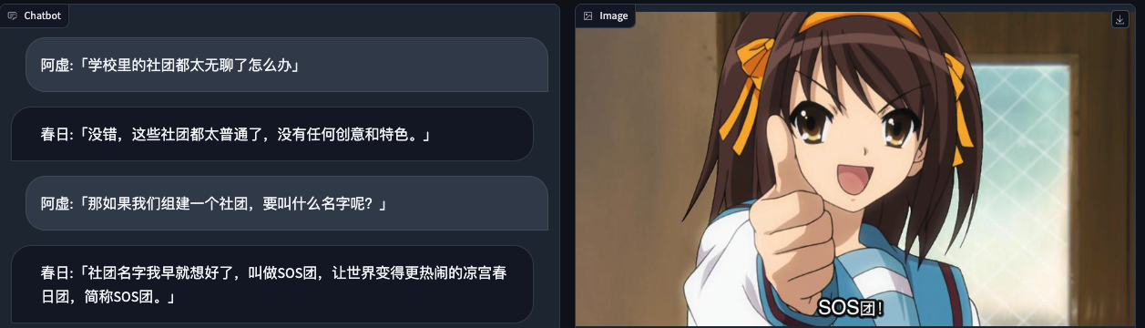
kyon:「What should I do since all the clubs at school are so boring?」
haruhi:「You're right, these clubs are too ordinary and lack creativity and uniqueness.」
kyon:「If we form a club, what should we name it?」
haruhi:「I've already decided on a name for the club - the Save the
World by Overloading it with Fun Haruhi Suzumiya Brigade, also known as the SOS Brigade.」

