Slide 1

DISSERTATION DEFENSE
ProofEstate:
Blockchain-Based Real Estate Lending Platform
with ZK Compliance and Property Verification
Binding a private LTV relation to an auditable lending decision
Zhang Tianyi
Supervisor: Nicholas Mac Gregor GARCIA
37
399.53 ms
310,411 gas
contract tests
median local proof
compliance operation
Current revision · Node 22.22.1
Archived 30-run session
Archived whole-call average
Source: ProofEstate thesis, Chs. 5–6; local prototype evaluation.
01 / 15
Notes:
Good morning, everyone. My name is Zhang Tianyi. Today I will present my project, ProofEstate: Blockchain-Based Real Estate Lending Platform with ZK Compliance and Property Verification.
The question behind this project is simple: can a public smart contract enforce a lending rule without publishing the property's valuation or the requested loan amount? To investigate this, I built an end-to-end prototype that combines a property registry, an oracle service, a zero-knowledge circuit, smart contracts, and a web application.
I will explain how the proof is connected to the lending decision, show the implementation and evaluation results, and then discuss the boundaries that the tests reveal. The main contribution is a concrete and reproducible integration, with clearly stated assumptions and limitations.

Slide 2
RESEARCH QUESTION
Private proofs connect financial rules to public decisions
Can a public contract approve a loan without publishing valuation or principal?
Design
Chain enforcement
Financial plaintext
Plaintext on chain
Contract checks the inequality
Published in calldata / storage
Off-chain decision
Backend decision only
Depends on backend access controls
ProofEstate
Proof + state binding at approval
Omitted from chain; API still exposes it
Contribution: a working proof-to-state integration with executable boundary tests.
Source: ProofEstate thesis, §§1.1–1.3, 2.8, 7.2.
02 / 15
Notes:
The central challenge is connecting a private compliance calculation to a public decision.
A plaintext on-chain design can check the loan-to-value ratio directly, but it publishes the financial inputs. An off-chain service can keep those inputs outside the blockchain, but its decision depends on the backend operator and does not provide an independently verified on-chain proof.
ProofEstate takes a third approach. It commits to the valuation and principal, proves that they satisfy the lending rule, and checks that the proof matches the current contract state before approval.
This does not automatically make the entire application confidential. The current prototype API still exposes these values. The demonstrated result is more specific: the blockchain can enforce the relation without directly publishing the valuation or principal.

Slide 3
SYSTEM ARCHITECTURE
Trusted data and bound proofs drive lending decisions
Public contract state
Registry / client
Trusted oracle / prover
PropertyVerification
Mock property registry
Oracle API
Owner, Cv and compliance record
Owner, valuation and eligibility
/verify and /compliance
Current API exposes witness values and salts.
ComplianceVerifier
Witness inputs
Bindings → generated verifier
React DApp / wallets
Groth16 prover
Oracle requests and loan actions
Witness → proof + public signals
Lending
Reads current verification and Cp
Source: ProofEstate thesis, §§3.2–3.4, 4.2–4.3.
03 / 15
Notes:
This diagram shows how that approach is implemented.
On the left are the mock property registry and the React application. The registry supplies ownership, valuation, and eligibility data. The application lets borrowers and loan officers interact with the system.
In the middle, the trusted oracle validates the registry record and prepares the proving inputs. The Groth16 prover then generates a proof and its public signals.
On the right, PropertyVerification stores the verified property record. ComplianceVerifier checks the proof's bindings, calls the generated verifier, and records compliance. Lending uses that record when deciding whether to approve a request.
The oracle remains trusted for the correctness of external facts. The contracts enforce the proof and state checks, but they cannot establish whether a real-world appraisal or land-title record is authentic.

Slide 4
PROOF STATEMENT
The circuit proves LTV and commitment openings
10000p ≤ tv
PUBLIC STATEMENT
k Property identifier
Cv Valuation commitment
t = 8000 in the contract wrapper
Cp Principal commitment
t Policy threshold
Cv = MiMCSponge(k, v, sv)
Cp = MiMCSponge(k, p, sp)
CIRCUIT-PRIVATE WITNESS
v, p, sv, sp
64-bit v, p · 14-bit t · 80-bit comparison
Valuation, principal and salts
4,196 constraints · BN254 / bn-128
Private to the circuit, visible to the oracle.
Source: ProofEstate thesis, §§4.4, 5.6, 6.1; circuit implementation.
04 / 15
Notes:
The circuit proves two things together: the loan-to-value rule and the openings of the public commitments.
Here, v represents the property valuation, p the requested principal, and t the policy threshold in basis points. The inequality is: ten thousand times the principal must be no greater than the threshold times the valuation. The contract fixes the threshold at eight thousand, which means an eighty percent limit.
The public statement contains the property identifier, two commitments, and the threshold. The witness contains the valuation, principal, and salts. The circuit recomputes both MiMC commitments and checks the inequality.
Range constraints keep this calculation in integer arithmetic rather than allowing field wraparound. The circuit has four thousand, one hundred and ninety-six constraints. These inputs are private to the circuit, but the trusted oracle still handles them.

Slide 5
APPLICATION BINDING
Four signal checks bind each proof to contract state
Public signal
Required match
Prevents
k · propertyKeyField
propertyIdToField(propertyId)
Wrong-property substitution
Cv · valuationCommitment
Current stored valuation commitment
Different valuation context
Cp · principalCommitment
Principal submitted to the wrapper
Different principal context
t · maxLtvBps
Fixed contract constant: 8000
Weaker-threshold substitution
All bindings match → Groth16 verifies → compliance is written.
Lending later matches Cp to the requested loan at approval.
Source: ProofEstate thesis, §§4.2, 6.1, 6.7; verifier implementation.
05 / 15
Notes:
A valid mathematical proof is not sufficient by itself. It must refer to the correct application state.
ProofEstate checks four public signals before calling the Groth16 verifier. The property field must match the selected property identifier. The valuation commitment must match the current stored record. The principal commitment must match the one submitted to the wrapper. Finally, the threshold must equal the fixed policy value of eight thousand.
Only after those bindings match and the proof verifies does the contract write compliance state. Lending then performs a separate check at approval: the accepted principal commitment must match the loan request.
This prevents substitution across these contexts. However, it does not provide single-use freshness or bind the proof to a particular borrower, loan identifier, expiry, or deployment domain.

Slide 6
LENDING LIFECYCLE
Compliance gates approval; locks govern the loan lifecycle
Normal flow: verify property → prove → record compliance → request → approve → repay
Request: recorded owner + valid Cp + no active loan
Approval: officer role + Requested state + verified property + matching compliance
Requested
Approve
Approved
Repay
Repaid
Lock held
Lock held
Lock released
Reject / checks fail
Borrower cancels
Rejected
Cancelled
Repayment records state;
Lock released
Lock released
no ETH / ERC20 settlement.
Source: ProofEstate thesis, §§3.4, 4.2; Lending contract.
06 / 15
Notes:
The normal demonstration follows this sequence: verify the property, generate the proof, verify it on chain, submit the loan request, obtain approval, and then repay.
The contract distinguishes the checks at each stage. A request checks the recorded owner, a valid principal commitment, and the absence of an active loan for that property. Approval checks the loan officer's role, the requested state, current property verification, and matching compliance.
If verification or compliance fails during approval, the request becomes rejected and the property lock is released. The requested and approved states hold the lock; rejected, cancelled, and repaid states release it.
This prevents concurrent active borrowing against the same property within the prototype. Repayment records a state change only. It does not transfer Ether or tokens, and ownership is not checked again at approval.

Slide 7
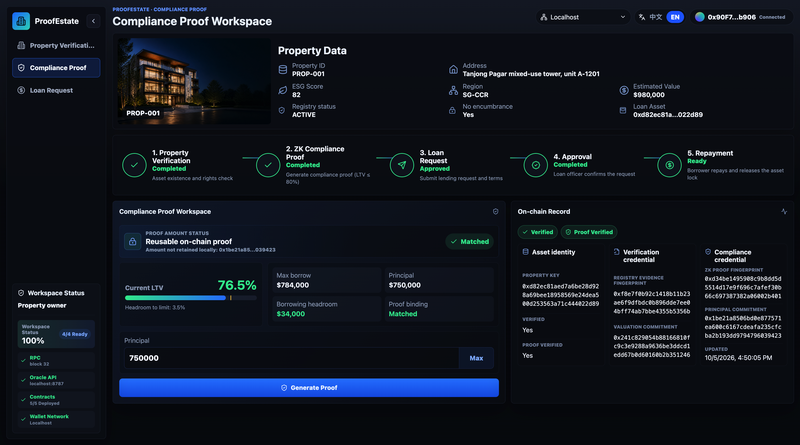
PRODUCT EVIDENCE
The DApp makes proof status and binding inspectable
76.5%
displayed LTV
Mock valuation: 980,000; principal: 750,000
Matched
proof binding
Public signals match the local contract context
Local mock-workflow capture
Source: ProofEstate thesis, §4.5 and Appendix C; local DApp capture.
07 / 15
Notes:
This is the original local compliance workspace captured in the repository.
The selected property is PROP-001. Its mock valuation is nine hundred and eighty thousand, and the requested principal is seven hundred and fifty thousand. That gives a displayed loan-to-value ratio of approximately seventy-six point five percent, below the eighty percent cap.
The screen shows successful proof generation and matched binding information. The application therefore makes the proof workflow inspectable instead of requiring the user to assemble calldata manually.
These are local mock values. Their visibility here does not mean that they are published as financial plaintext in the contracts. It also reminds us that the current application interface itself is not confidential. The screenshot supports the product demonstration; contract tests provide separate evidence for enforcement.

Slide 8
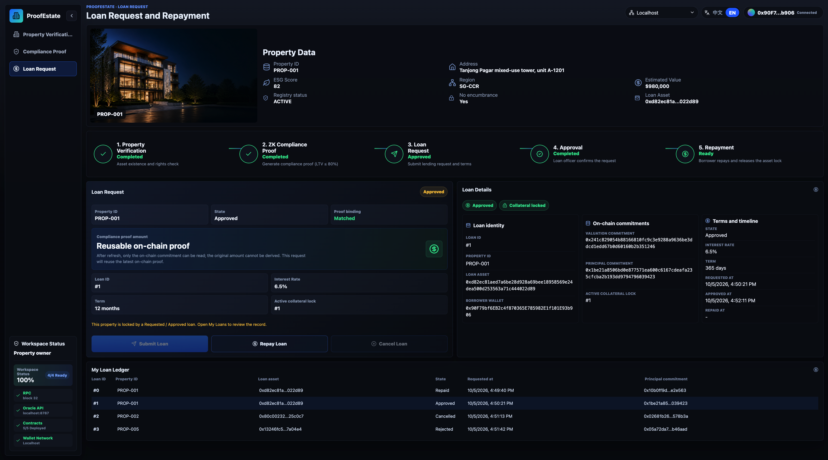
PRODUCT EVIDENCE
The loan ledger exposes context and lifecycle decisions
Loan context
Property + principal commitment remain inspectable.
Lifecycle visibility
The ledger contains multiple local outcomes.
State transition only;
no asset transfer.
Source: ProofEstate thesis, §§4.5, 5.7 and Appendix C; local loan ledger.
08 / 15
Notes:
The loan workspace exposes the lending lifecycle and its recorded outcomes.
The selected loan remains connected to a property and a principal commitment, while the ledger shows several local requests and terminal states. This makes approval, rejection, cancellation, and repayment visible to the user.
It is important to read this screenshot correctly. The ledger contains multiple loans; it is not a single image proving one uninterrupted sequence across every row. The separate archived local command-line workflow is the end-to-end observation that finishes in the repaid state.
The application helps users inspect and operate the workflow, while the contracts enforce roles and state transitions. In the current prototype, repayment releases the active lock and records the result, without transferring financial assets.

Slide 9
EXPERIMENT DESIGN
Four cases test the 80% limit and registry rejection
PROP-001 valuation: 980,000 → maximum principal: 784,000
Case
Principal / property
Recorded proving behavior
Compliant
750,000 / PROP-001
Proof generated
Exact 80% boundary
784,000 / PROP-001
Proof generated
One unit over
784,001 / PROP-001
Rejected; proving skipped
Registry failure
100,000 / PROP-004
Encumbered; proving skipped
37
contract tests
5 warmups + 30 measured iterations per case
Current Node 22 revision
Archived Node 20 timing; no exceptions ≠ exhaustive correctness
Source: ProofEstate thesis, §§5.1–5.3; contract tests and archived timing runs.
09 / 15
Notes:
The evaluation separates behavioral correctness from performance measurement.
For PROP-001, the valuation of nine hundred and eighty thousand gives an exact eighty percent boundary of seven hundred and eighty-four thousand. The experiment includes a compliant principal of seven hundred and fifty thousand, the exact boundary, one unit above the boundary, and an encumbered property that fails registry validation.
Each timing case uses five warm-up iterations and thirty measured iterations. Passing cases generate proofs; rejected cases skip proving. Zero recorded timing exceptions are not the same as independently verifying every proof or asserting every decision.
The current contract suite has thirty-seven passing tests, including six security regressions and three arithmetic regressions. Those results use Node twenty-two. The archived timing and gas measurements retain their original Node twenty baseline.

Slide 10
LOCAL LATENCY
Proving dominates the measured read-only compliance path
Read-only /compliance
P95
409.16 ms
Proof: 469.53 ms
Direct Groth16 proof
API: 480.30 ms
399.53 ms
n = 30 · local sequential runs
Read-only /verify
5.98 ms
Independent proof calls;
median difference does not measure API overhead.
0
250
500 ms
API timings exclude blockchain submission and confirmation.
Source: ProofEstate thesis, §5.4, Table 12; archived 30-run session, 25 Sep 2026.
10 / 15
Notes:
Proof generation dominates the measured local compliance path.
The median direct proving time is three hundred and ninety-nine point five three milliseconds. The read-only compliance endpoint has a median response time of four hundred and nine point one six milliseconds. Ordinary verification is much lighter, with a median of five point nine eight milliseconds.
The ninety-fifth percentile is approximately four hundred and seventy milliseconds for direct proving and four hundred and eighty milliseconds for the compliance endpoint.
Warm-up iterations are excluded. The median and ninety-fifth percentile use nearest-rank statistics; for thirty observations, the reported median is the lower central value.
These timings exclude blockchain submission and confirmation. Also, direct proving and API compliance generate separate proofs in separate invocations. Therefore, the difference between their medians is not a measurement of API overhead.
The results describe a small, sequential local workload. They support a bounded feasibility observation, rather than a claim about production throughput or public-chain latency.

Slide 11
ON-CHAIN COST
Full compliance processing averages 310,411 gas
verifyProofAndSetCompliance
Whole compliance operation
310,411
requestLoan
Signal checks
233,609
Generated verifier
approveLoan
State writes + events
81,464
repay
Archived Node 20 workload
57,219
Mixed storage states and approval outcomes.
These are gas units, not isolated verifier cost or transaction fees.
Source: ProofEstate thesis, §5.5, Table 15; archived Node 20 gas baseline.
11 / 15
Notes:
This slide shows the on-chain cost of the archived workload.
The complete compliance operation averages three hundred and ten thousand, four hundred and eleven gas. That includes the public-signal checks, the generated verifier call, state writes, and events. It is not the cost of the cryptographic verifier alone.
Requesting a loan averages about two hundred and thirty-four thousand gas. Approval averages about eighty-one thousand, and repayment about fifty-seven thousand.
These figures come from the historical Node twenty gas-reporter baseline. The reporter aggregates calls with different storage states and outcomes, including approval attempts that reject a request. The new thirty-seven-test suite does not replace that historical baseline.
The figures help characterize where the prototype spends gas. They do not establish transaction fees, public-network confirmation time, or economic feasibility.

Slide 12
PRIVACY BOUNDARY
Financial plaintext stays off chain; the API exposes inputs
Boundary
What is visible
Supported conclusion
Public blockchain
Identifiers, owner, commitments, proofs and lifecycle state
Valuation / principal plaintext omitted
Oracle + current API
Valuation, principal, witness inputs and salts
Application confidentiality is not established
Mock registry / blinding
Public property values; deterministic valuation salt
Candidate valuation testing remains possible
Zero knowledge does not protect values already exposed by another interface.
Source: ProofEstate thesis, §§3.5, 6.6, 6.8; oracle API and registry implementation.
12 / 15
Notes:
The privacy conclusion needs to distinguish the blockchain from the rest of the application.
On the public blockchain, ProofEstate records identifiers, owner addresses, commitments, proof material, and lifecycle state. It omits the valuation and principal as financial plaintext.
However, the current oracle API exposes financial values, witness inputs, and salts without caller authentication. The mock registry is also available in the artifact. In addition, the valuation salt is deterministic, so an observer with the relevant public context can test candidate valuations against the commitment.
As a result, application-wide confidentiality is not established. Groth16 zero knowledge cannot protect information that another interface has already revealed.
The supported result is selective omission of financial plaintext from the blockchain, under a trusted proving service. This is an important boundary for interpreting the prototype.

Slide 13
REGRESSION FINDINGS
Regression tests expose four proof-lifecycle boundaries
Tested change
Observed behavior
Limit of the claim
Refresh; same valuation
Identical proof restores cleared compliance
Reset does not imply freshness
Owner changes after request
Original request can still be approved
Owner is not rechecked at approval
Another principal replaces Cp
Old pending request rejected; lock released
One mutable compliance slot per property
Refresh after approval
Approved state and active lock remain
Approval is a snapshot decision
Approval integrity also assumes an honest oracle, valid setup, commitment binding and maintained roles.
Source: ProofEstate thesis, §6.5, Table 23; security regression tests.
13 / 15
Notes:
The regression tests reveal four lifecycle boundaries that successful proof verification does not resolve.
First, if a property refresh retains the same valuation commitment, the identical proof can restore cleared compliance. Resetting state therefore does not guarantee proof freshness.
Second, if the authorized oracle changes the owner after a request, while retaining the valuation commitment, the original request can still be approved once compliance is restored. Ownership is not rechecked at approval.
Third, a valid proof for another principal can replace the property's single compliance record. The old pending request is then rejected and its lock released.
Finally, a refresh after approval does not change the approved loan or its active lock. Approval is a snapshot decision.
These are tested boundaries, not claims of production security. The approval argument also depends on the oracle, proof system, commitment construction, and maintained roles.

Slide 14
RESEARCH PRIORITIES
Next steps: protect witnesses and strengthen proof context
01
Protect witness delivery
Authenticate callers; restrict API responses; use secret valuation blinding.
02
Define proof lifecycle
Bind loan context and freshness; revalidate ownership; specify revocation.
03
Strengthen source and evaluation
Signed attestations and setup assurance; matched baselines; concurrent / chain measurements.
Broader extensions: identity policies, real settlement, liquidation and operational governance.
Source: ProofEstate thesis, §§8.1–8.3.
14 / 15
Notes:
The next research steps should address those boundaries directly.
The first priority is protecting witness delivery. That means authenticating callers, restricting API responses, and using suitable secret randomness for valuation blinding.
The second priority is an explicit proof lifecycle. A stronger design would bind proofs to their loan context and freshness, revalidate ownership where required, and define how compliance records can be replaced or revoked.
The third priority is stronger source assurance and evaluation. That includes signed registry attestations, a documented setup model, matched performance baselines, and experiments with concurrency and public-chain conditions.
Broader features, such as identity policies, real settlement, and liquidation, are further extensions. This is a research priority sequence, not a delivery timetable or a claim that these features already exist.

Slide 15
CONCLUSION
Bound proofs support auditable loan approval
An implemented binding pattern with tested security boundaries.
Under explicit oracle, proof-system, commitment and role assumptions.
Thank you.
Questions & discussion
SOURCE CODE
WEB DEMO
https://github.com/Alan42x/proofestate
https://proofestate.vercel.app/
Source: ProofEstate thesis, §§6.1, 9; implementation and evaluation.
15 / 15
Notes:
To conclude, ProofEstate connects a committed loan-to-value proof to an auditable loan approval decision. Its main contribution is an implemented binding pattern with tested security boundaries.
This result depends on the oracle, trusted setup, proof system, commitments, and role assumptions discussed earlier. Real-world property authenticity and financial settlement remain outside the scope of this prototype.
Before I close, I will play a recorded demonstration of the prototype in operation.
That concludes the demonstration.
The GitHub link on this slide provides the source code, and the Vercel link opens the web demonstration.
Thank you for your attention. I welcome your questions about the design, evaluation, and limitations.

